Slide 1

Python BootCamp
Learn Faster & Easier than You Think
Day 9/10

Slide 2
Announcement
Attendance Link will be available around 4:30 PM

Slide 3
Creating GUI

Slide 4
Designer to Python Program
python -m PyQt5.uic.pyuic -x [FILENAME].ui -o [FILENAME].py

Slide 5
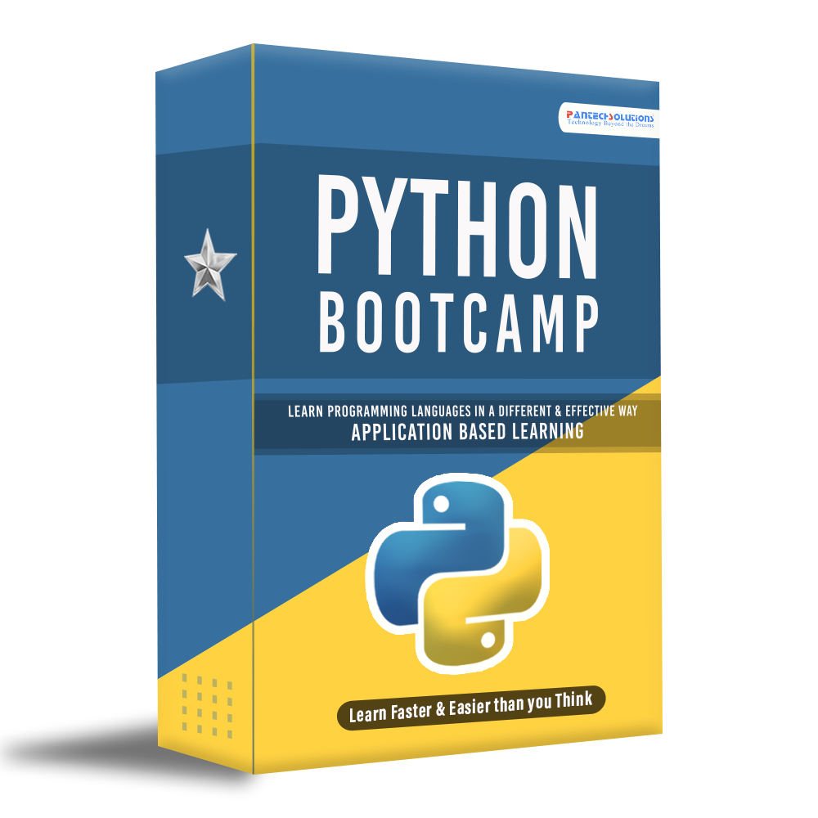
—Total Value: ₹1500
Python - Internship
Recorded Video Lectures (Value:₹400)
Source Code based on Application (Value:₹400)
Material PPT & Mindmap (Value:₹100)
Assignment & Support (Value:₹100)
5+ Python Based Projects (Value:₹500)
Internship E-Certificate
Offer Value: ₹750

Slide 6

Bonus 1 – Python CV DUO
+

Slide 7
Total Value – Ends This Sunday
Recorded Video Lectures (Value:₹900)
Source Code based on Application (Value:₹1000)
Material PPT & Mindmap (Value:₹200)
Assignment & Support (Value:₹200)
15+ Python & CV Projects (Value:₹2000)
2 Internship E-Certificate
+
—Total Value: ₹4,300
Offer Value: ₹1,499
Todays Launch OFFER Price: ₹499

Slide 8
Q & A Session

Slide 9
Thanks!
Follow Me on LinkedIn : Link in Description
+91 7305845758
Pantechsolutions.net

