Slide 1
Checking Integrity and Maintain Privacy of Cloud Data
By : Rohit Patidar (B19CS029)
Viraj Vaishnav (B19CS016)
Supervisor : Dr. Surmila Thokchom

Slide 2
Problem Statement :
To develop a scheme to verify the integrity of cloud data and maintain privacy.

Slide 3
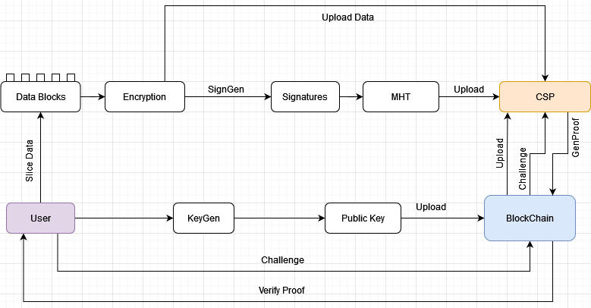
Following figure shows the working of Integrity Verification Scheme :

Slide 4
Working of proposed scheme :
KeyGen() : This phase is performed by the user to generate the user’s public key and private key.
Encryption() : In this, The data is sliced into data blocks and then encrypted.
SignGen(): It is performed by the user to construct signature set of files to be uploaded.
Upload(): It is performed by the user and the CSP. The user slice the data and generate the signature and upload data to the cloud.

Slide 5
Challenge(): To check the integrity of data the user sends the challenge request to the CSP through the smart contract.
ProofGen(): After the CSP receives the user’s audit request. it constructs the proof and sends to the user through smart contract.
Verify(): After the user receives the proof returned by the CSP, Then the lookup operation of cuckoo filter is performed. If all signatures exist in the cuckoo filter, the data integrity verification is passed; otherwise, the data are compromised.

Slide 6
Work Done so far :
We have completed the RSA key pair generation for encrypting the data blocks.
Data slicing or File Splitting part has been completed. We are slicing data into chunks of 2 MB.
We are also done with merging of data blocks.
We have done the data chunks encryption using RSA Key Pair that we have generated.
We have implemented the cuckoo filter to store Tags (i.e. signatures) of each data chunk.

Slide 7
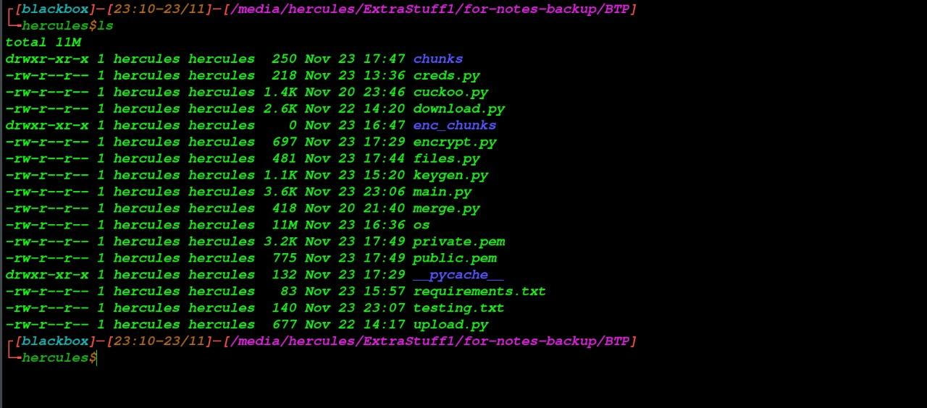
Following are the scripts and files we have created so far..

Slide 8
Ongoing work :
We are currently working on uploading data chunks to cloud (AWS S3). And calculating encryption time to check weather the RSA is efficient for this project or we will use any other encryption algorithm.

Slide 9
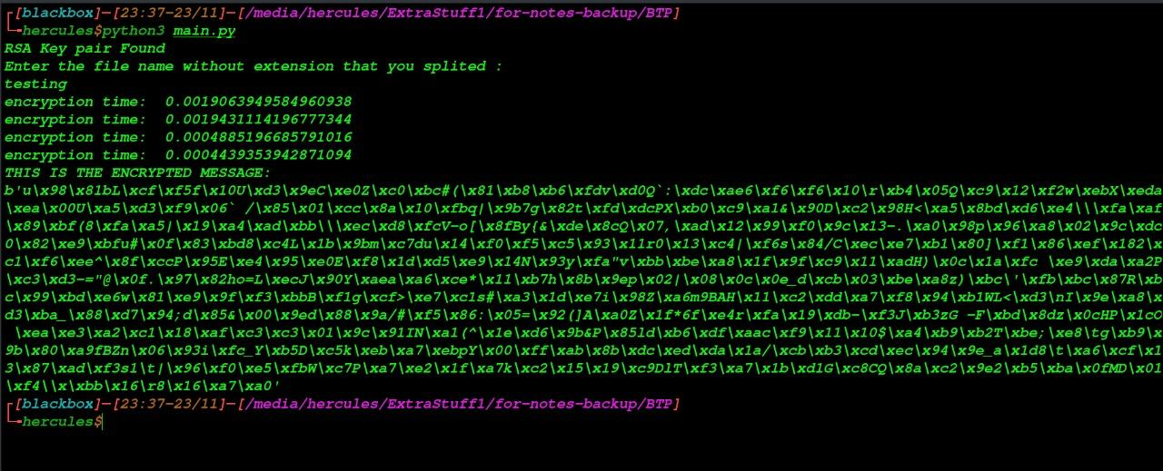
Encryption time :

Slide 10
Issues we are currently facing :
We are not able encrypt the whole 2 MB data chunk because we are using RSA to encrypt data but the keysize is only 4096 bits. RSA can only encrypt data smaller than (or equal to) the key length.
So to encrypt large data with RSA you need to do it indirectly - i.e. we will use a symmetric key algorithm(Most probably AES) to encrypt the large data and encrypt this key using the RSA public key.

Slide 11
Thank You…

