Slide 1

STUDENT CREDENTIALS
Veer Gupta
CISCO NETWORKING ACADEMY – VIRTUAL INTERNSHIP PROGRAM
Enrollment / Roll No.
Program & Degree
25SCS1003003599
B.Tech (CSE)
NetSage AI: Network Troubleshooting & Diagnostics
A 9-Week AI-Assisted Networking Internship Report
INTERNSHIP DURATION
May 15 – July 15, 2026 (9 Weeks)
HOST PROGRAM
Cisco Networking Academy
In partnership with IILM University

Slide 2

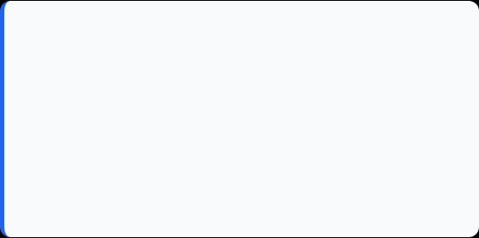
Candidate & Program Overview
Candidate Details
Internship Profile
Student Name: VEER GUPTA
Program Name: Cisco Networking Academy (VIP)
Roll Number: 25SCS1003003599
Specialization Domain: AI Network Troubleshooting
Degree: B.Tech (Computer Science & Engineering)
Duration: 9 Weeks (May 15 – July 15, 2026)
Academic Batch: 2025-2029
Certificate ID: c2681fa6…c9de9 (see Slide 11)
University: IILM University, Greater Noida, U.P.
Instructor: Swati Vashisht, Cisco Networking Academy

Slide 3


Organization Profile: Cisco Networking Academy
Cisco Networking Academy is a global IT skills program delivered through IILM University, operating under the vision of "Bridging Classrooms and Careers in Technology".
Cisco Collaboration: Delivered through IILM University in partnership with Cisco Networking Academy to empower engineering talent across India.
Industry Alignment: Partners with Cisco's global academy network to bridge the gap between classroom learning and industry-ready networking and AI skills.
Core Focus Domains: Networking Fundamentals, Data Analytics, Applied Artificial Intelligence, and Cybersecurity.

Slide 4

Problem Statement & Industry Context
The Industry Challenge
The Solution Scope
Students and junior network engineers can often run the right networking commands but struggle to connect a symptom to its true underlying cause among many possible faults.
This internship builds NetSage AI, a decision-support system that analyzes troubleshooting evidence and proposes a probable root cause and next diagnostic step.
Combining a deterministic Python rule engine with Gemini-powered NLP diagnosis, while always keeping a human reviewer in the loop before any fix is accepted.
A connectivity issue could stem from a VLAN misconfiguration, gateway mismatch, DHCP failure, routing problem, DNS issue, ACL rule, or NAT misconfiguration.

Slide 5








Core Project Objectives
Rule-Based Diagnosis
NLP / AI Diagnosis
Hybrid Decision & Review
Responsible AI Analytics
Build a deterministic Python rule engine that detects known network faults such as VLAN, DHCP, and gateway issues from evidence patterns.
Use Gemini-powered similarity matching to rank Top-3 candidate diagnoses when no deterministic rule matches the evidence.
Combine rule-based and AI outputs into a High-Confidence or Human-Review verdict, with Accept, Edit, or Reject controls.
Track agreement rate, category/severity breakdowns, and a full AI-vs-human corrections audit log on a Streamlit dashboard.

Slide 6





Technologies & Tech Stack
Dashboard & UI
Diagnosis Engine
Data & Config
Analytics & Logging
Language: Python (core application logic)
AI Engine: Google Generative AI (Gemini API)
Data Handling: pandas for case datasets & logs
Dashboard: Responsible AI analytics & agreement rate
Configuration: python-dotenv for environment secrets
Audit Log: Review History & Corrections Log
UI Framework: Streamlit dashboard and review panel
Rule Engine: Deterministic Python rule-based checks

Slide 7
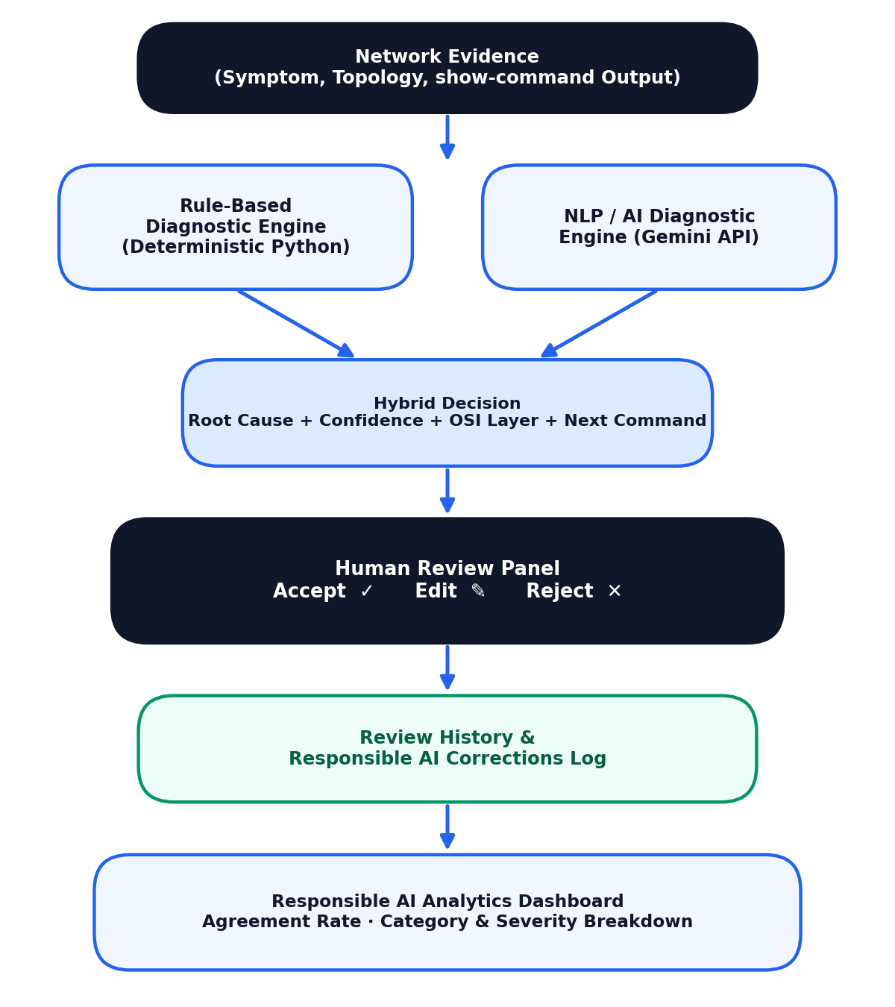
System Architecture & Workflow
Evidence Layer: Symptom, topology, and Cisco show-command output submitted via the dashboard.
Rule Engine: Deterministic Python engine matches evidence against known network fault patterns.
AI / NLP Engine: Gemini-powered similarity matching ranks Top-3 candidate diagnoses.
Hybrid Decision: Combines both engines into a High-Confidence or Human-Review verdict.
Human Review & Logging: Reviewer accepts, edits, or rejects; every decision is logged for audit.

Slide 8
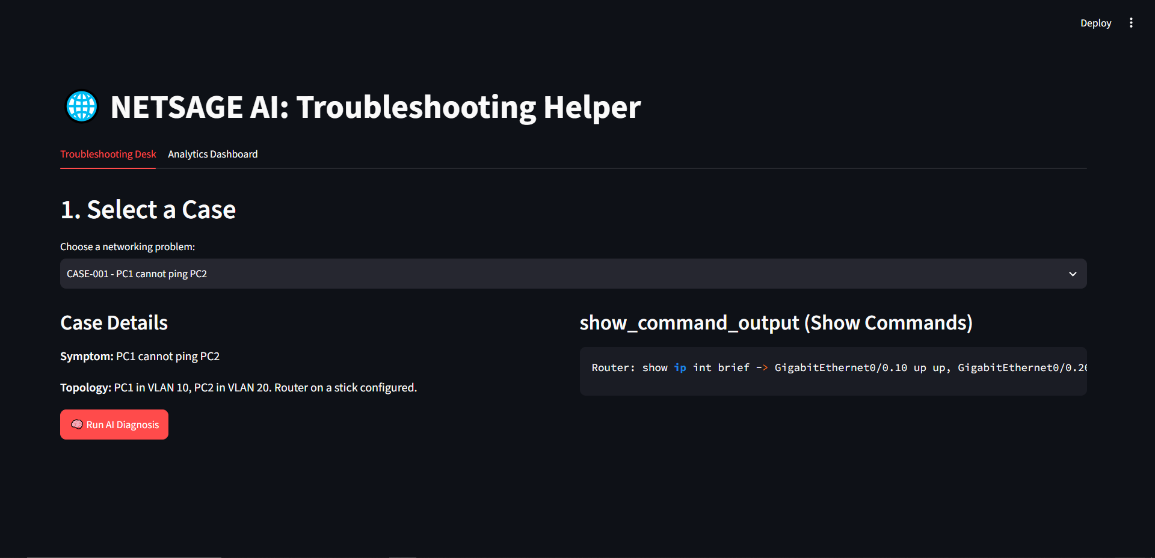
Application Walkthrough
Troubleshooting Desk – Case Selection & Evidence

Slide 9
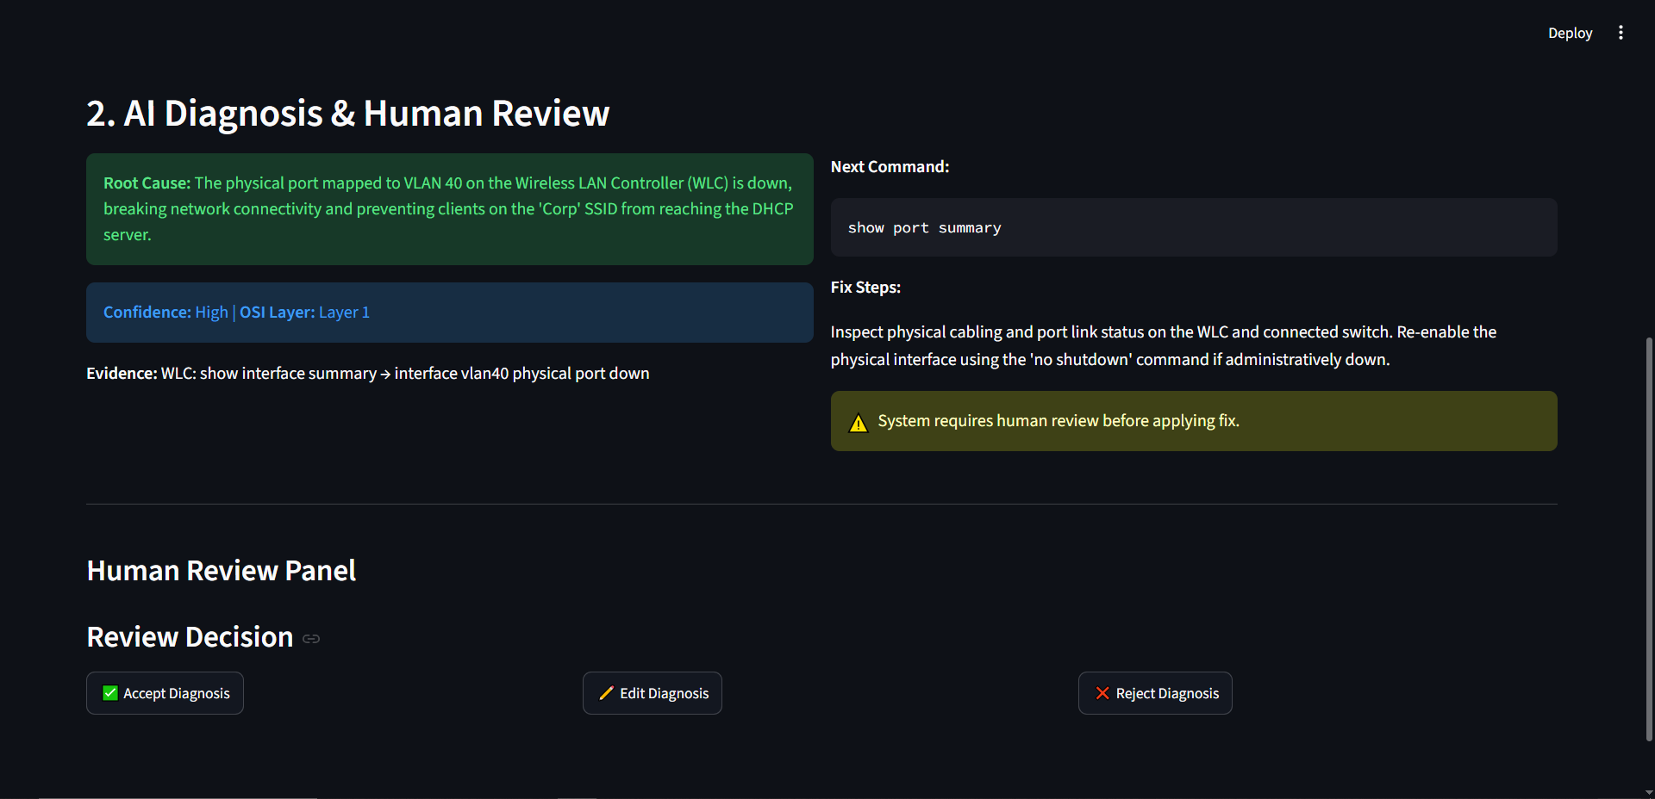
Application Walkthrough
AI Diagnosis & Human-in-the-Loop Review

Slide 10
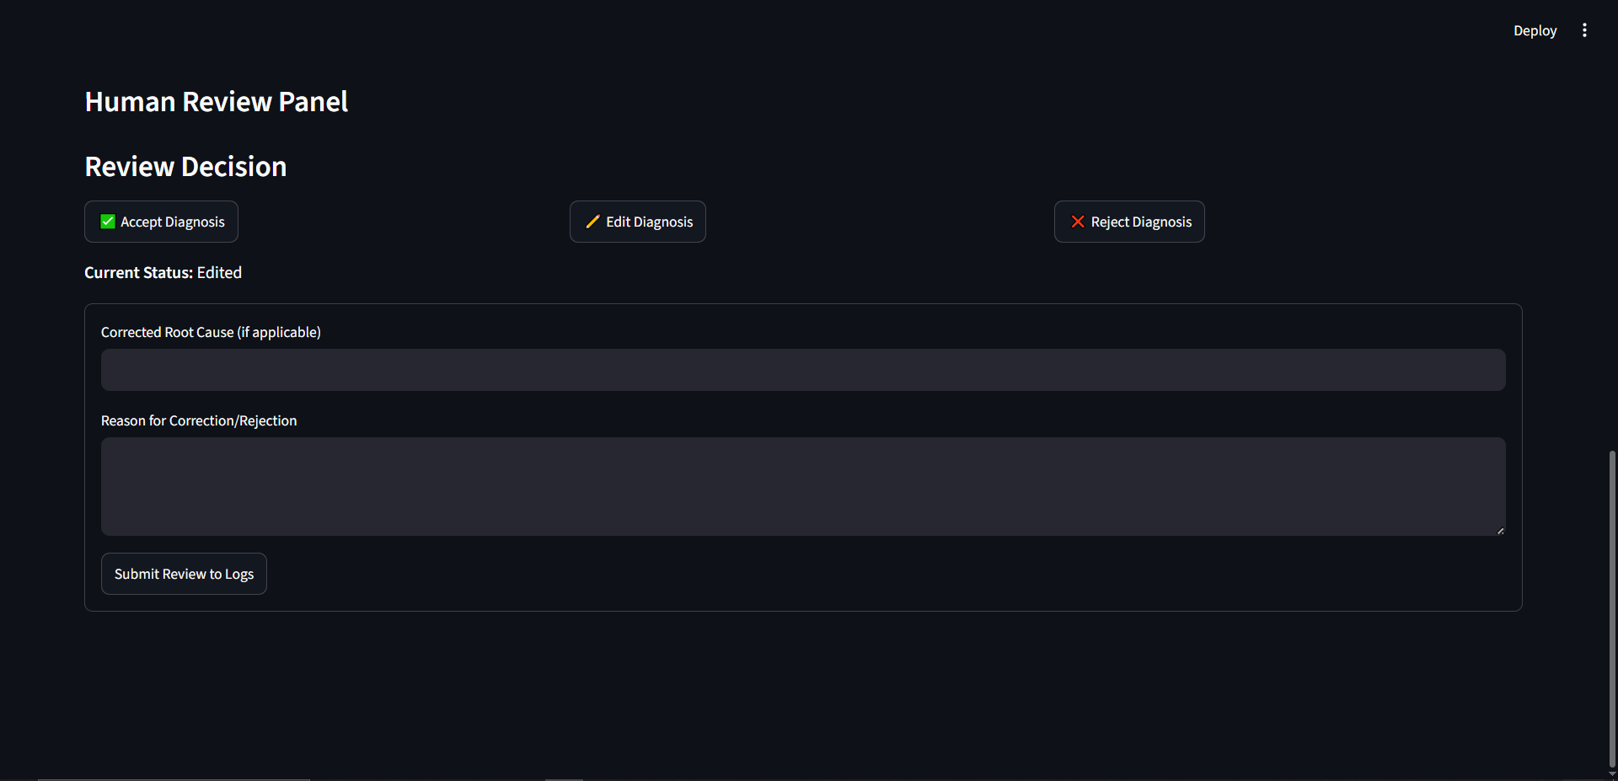
Application Walkthrough
Review Submission: Edit, Correct & Log Decisions

Slide 11
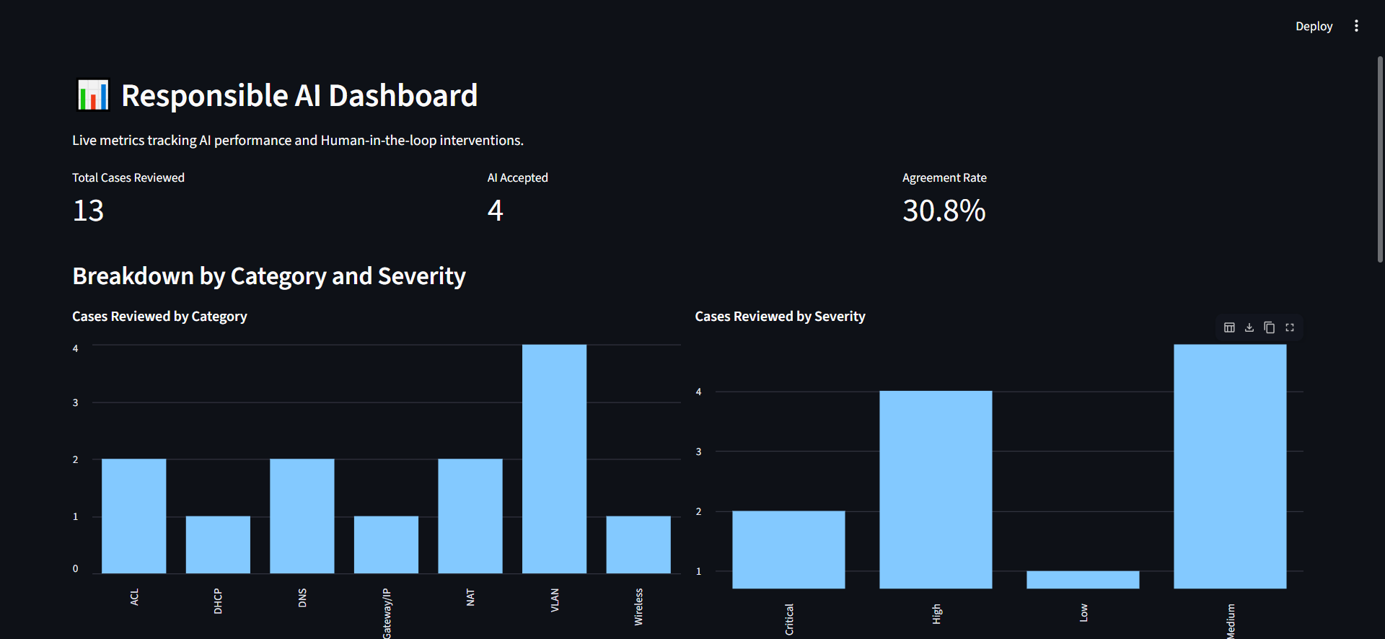
Application Walkthrough
Responsible AI Analytics Dashboard

Slide 12
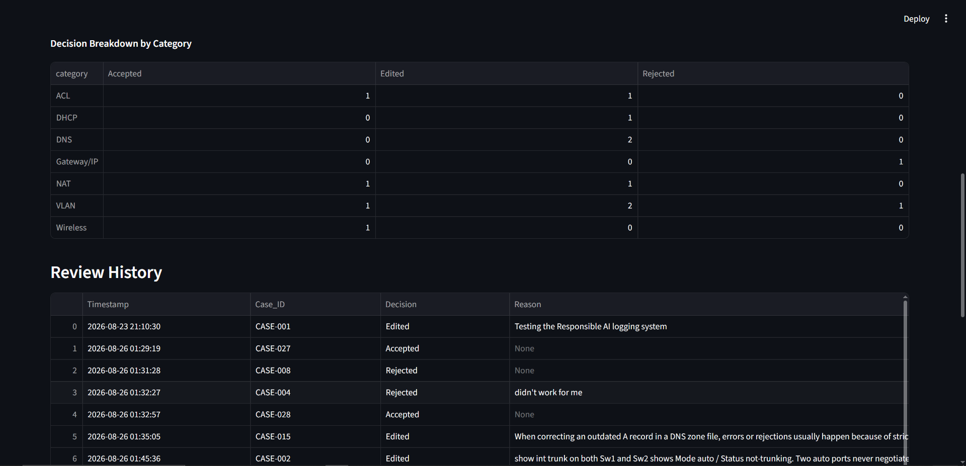
Application Walkthrough
Decision Breakdown by Category

Slide 13
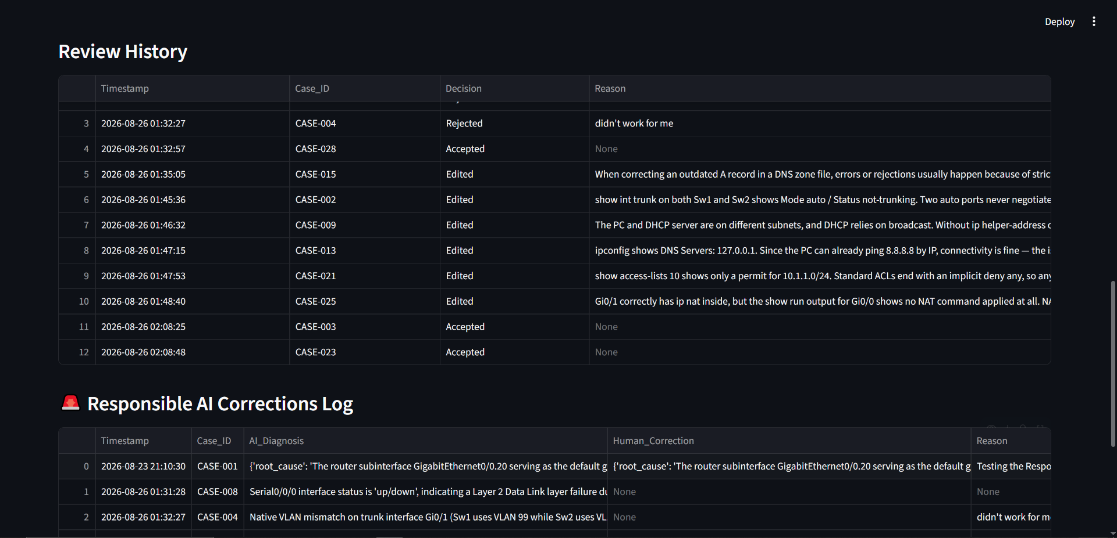
Application Walkthrough
Review History & Responsible AI Corrections Log

Slide 14
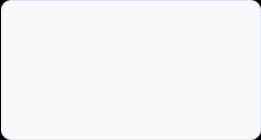
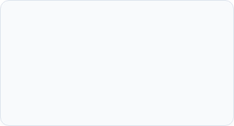
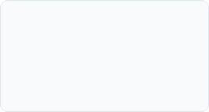
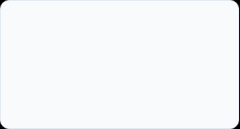
Curriculum Timeline (Weeks 1 to 4)
Week 2
Week 4
Data Analytics Essentials Data formats, acquisition, statistical analysis, and hands-on labs with Excel, SQL, and Tableau.
Case Dataset Design Built the 30-case network troubleshooting dataset with symptom, evidence, and severity fields.
Week 1
Week 3
Networking & AI Foundations Cisco Networking Academy orientation, OSI model refresher, and Introduction to Modern AI concepts.
Applying AI to Real Data Apply AI: Analyze Customer Reviews coursework covering NLP and similarity-based analysis.

Slide 15
Curriculum Timeline (Weeks 5 to 9)
Week 6
Week 8-9
NLP / AI Diagnostic Engine Gemini API integration with similarity-based Top-3 candidate diagnosis ranking.
Dashboard & Capstone Demo Responsible AI Analytics dashboard, final evaluation, and capstone demonstration.
Week 5
Week 7
Rule-Based Diagnostic Engine Deterministic Python rules for VLAN, DHCP, gateway, and ACL faults, validated to 100% accuracy.
Hybrid Decision & Review Combined both engines and built the Accept / Edit / Reject human review panel.

Slide 16
Key Projects & Demonstrated Skills
Rule-Based Diagnostic Engine: Built a deterministic Python rule engine validated to 100% accuracy across all 30 troubleshooting cases.
NLP/AI Diagnostic Engine: Implemented Gemini-powered similarity matching, achieving 83.33% Top-1 and 90.00% Top-3 accuracy on unseen evidence.
Full-Stack Streamlit Dashboard: Built an end-to-end Troubleshooting Desk and Analytics Dashboard using Streamlit and pandas.
Human-in-the-Loop Review System: Designed an Accept / Edit / Reject review workflow that logs every reviewer decision and correction reason.
Responsible AI Analytics: Built category/severity breakdown charts and a Responsible AI Corrections Log to track AI-human agreement over time.

Slide 17

Certification & Official Verification
Verification Metric | Official Record / Credential Details
Internship Title | AI-Assisted Network Troubleshooting Virtual Internship
Issuing Organization | Cisco Networking Academy (delivered via IILM University)
Academic Patronage | IILM University – School of Computer Science & Engineering
Certificate 1 – Intro to Modern AI | d08b1949-9730-46c9-b3f5-81e6244cb417 (Issued: Jun 3, 2026)
Certificate 2 – Apply AI: Reviews | c2681fa6-2d20-4047-901d-ba7afc1c9de9 (Issued: Jun 5, 2026)
Certificate 3 – Data Analytics | Data Analytics Essentials, verified by QR (Issued: Jun 12, 2026)

Slide 18
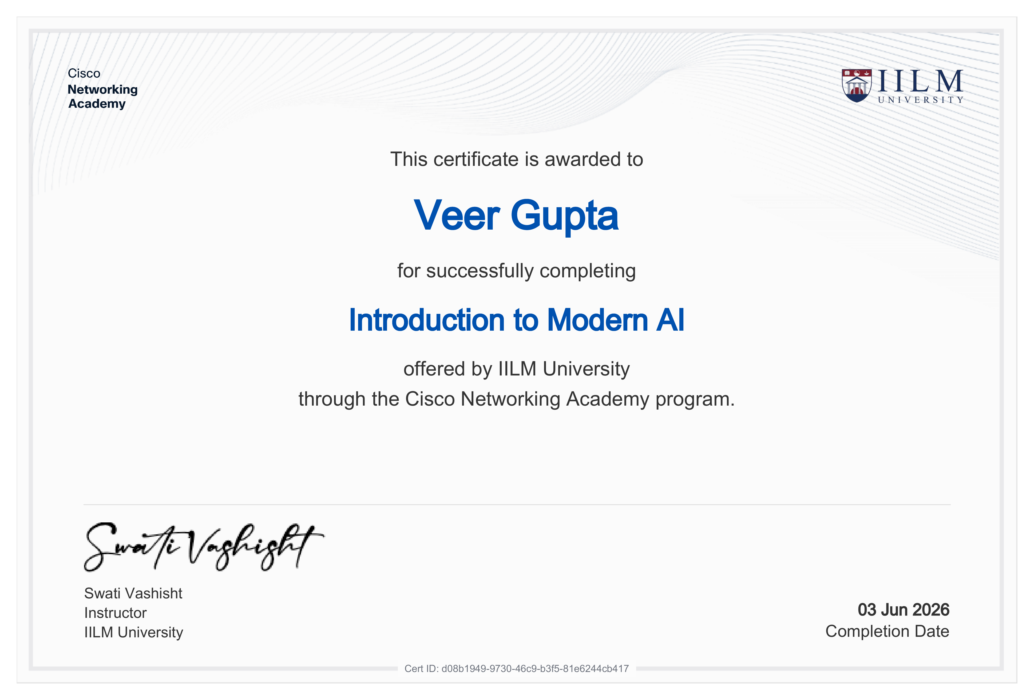
Certification & Official Verification
Certificate 1 of 3 – Introduction to Modern AI

Slide 19
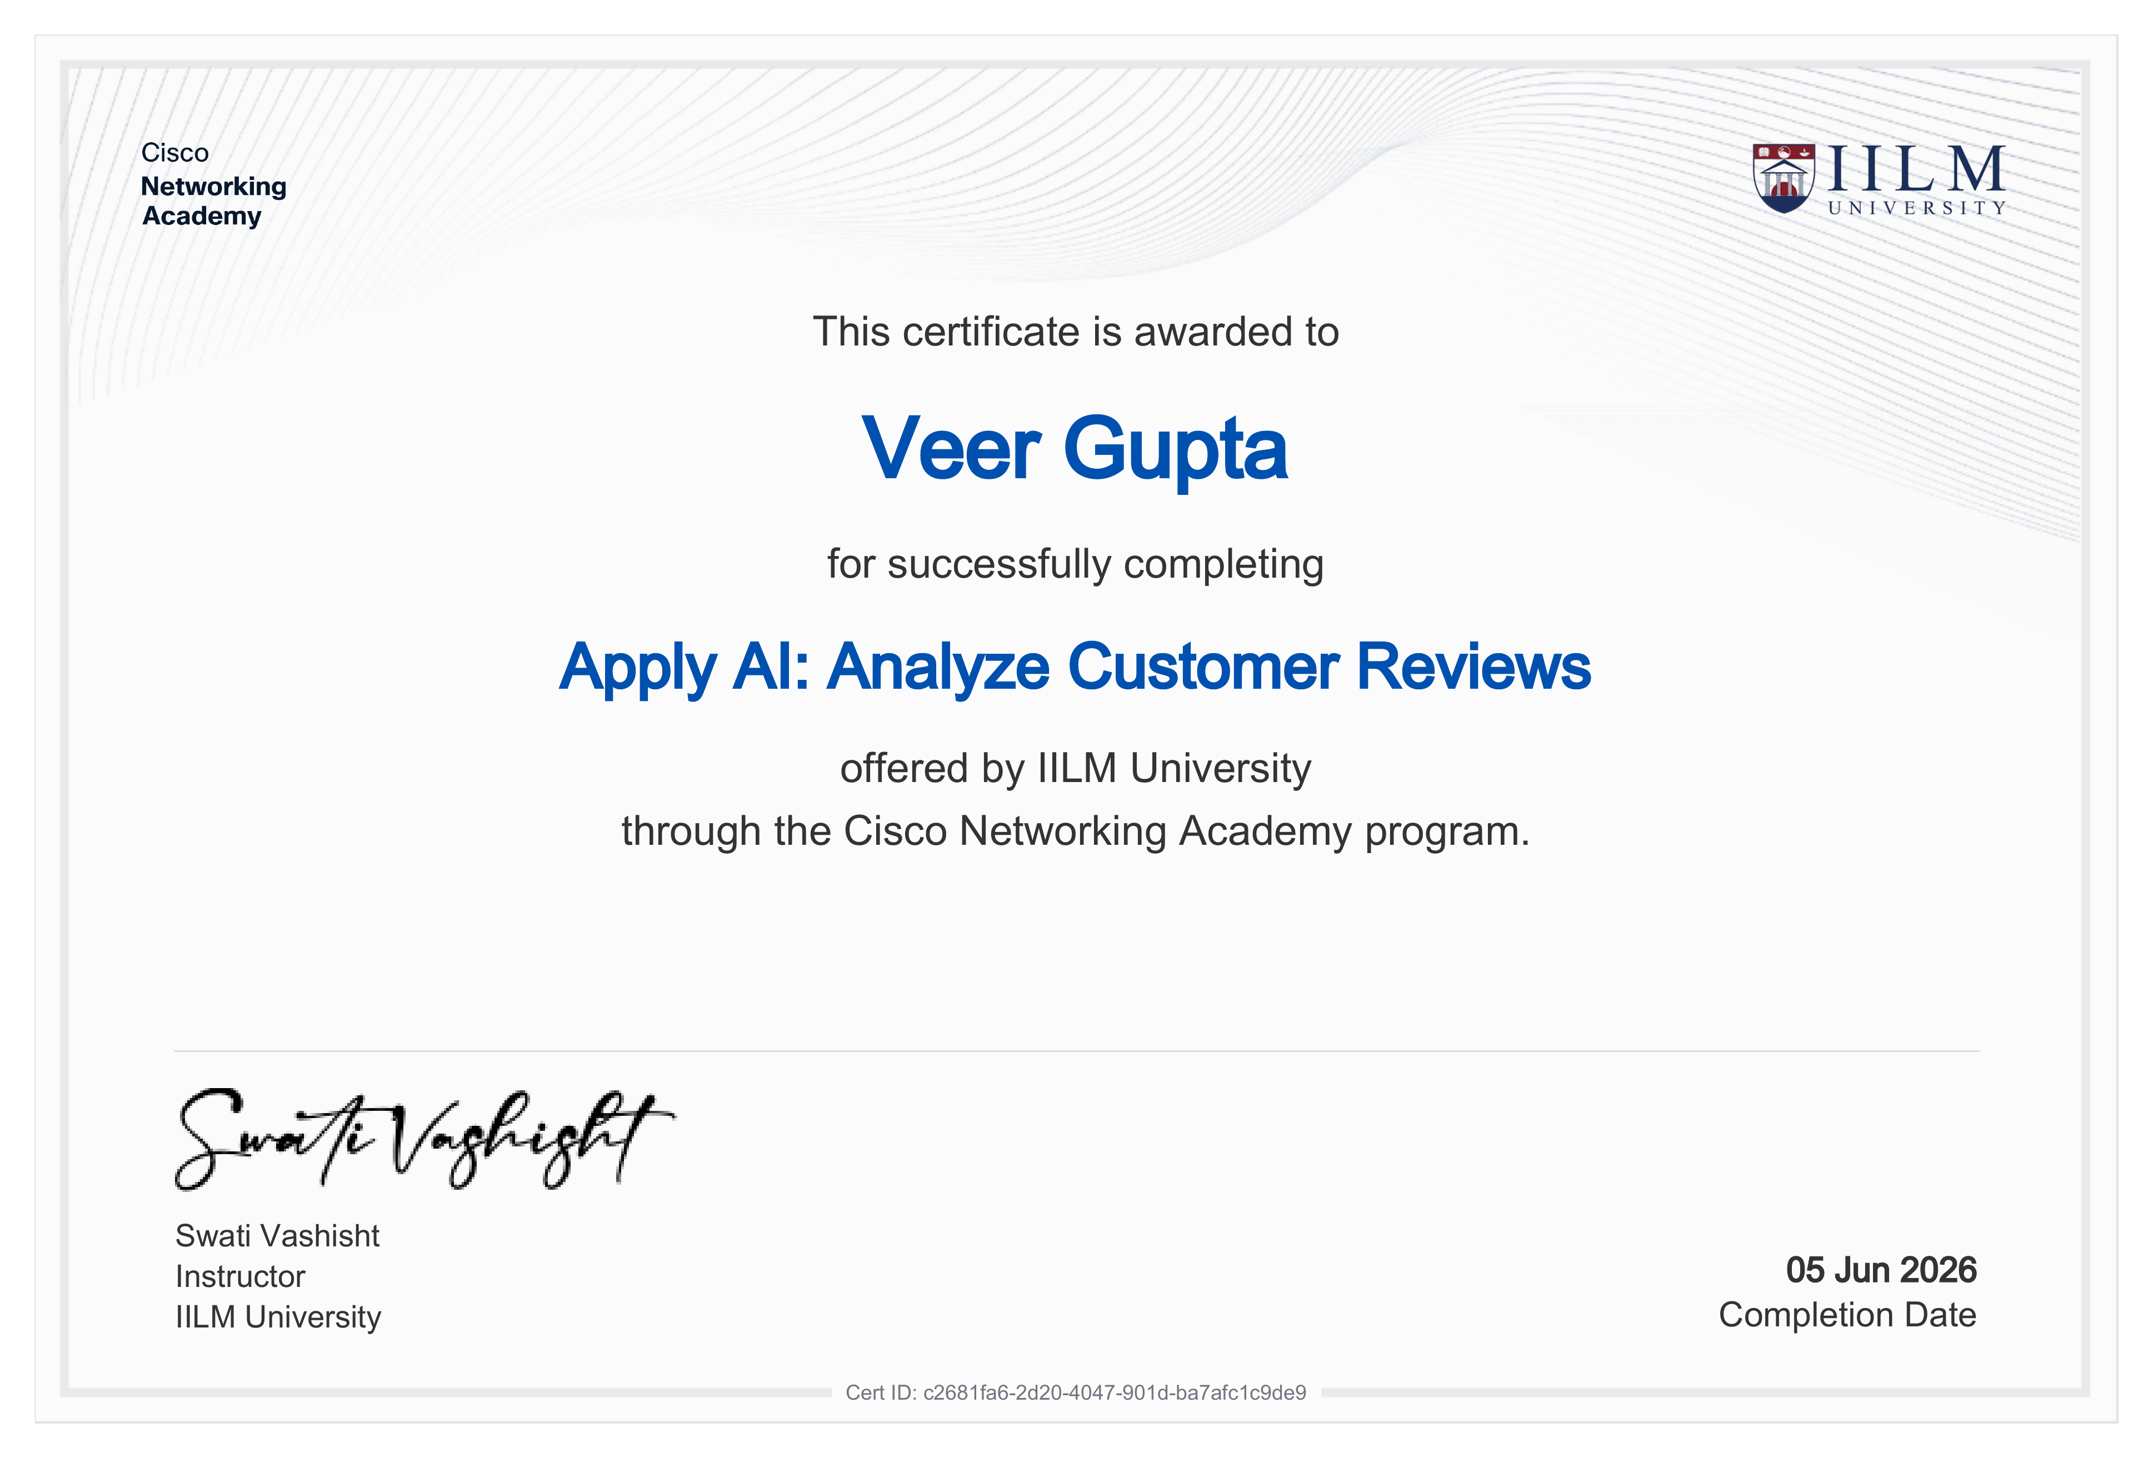
Certification & Official Verification
Certificate 2 of 3 – Apply AI: Analyze Customer Reviews

Slide 20
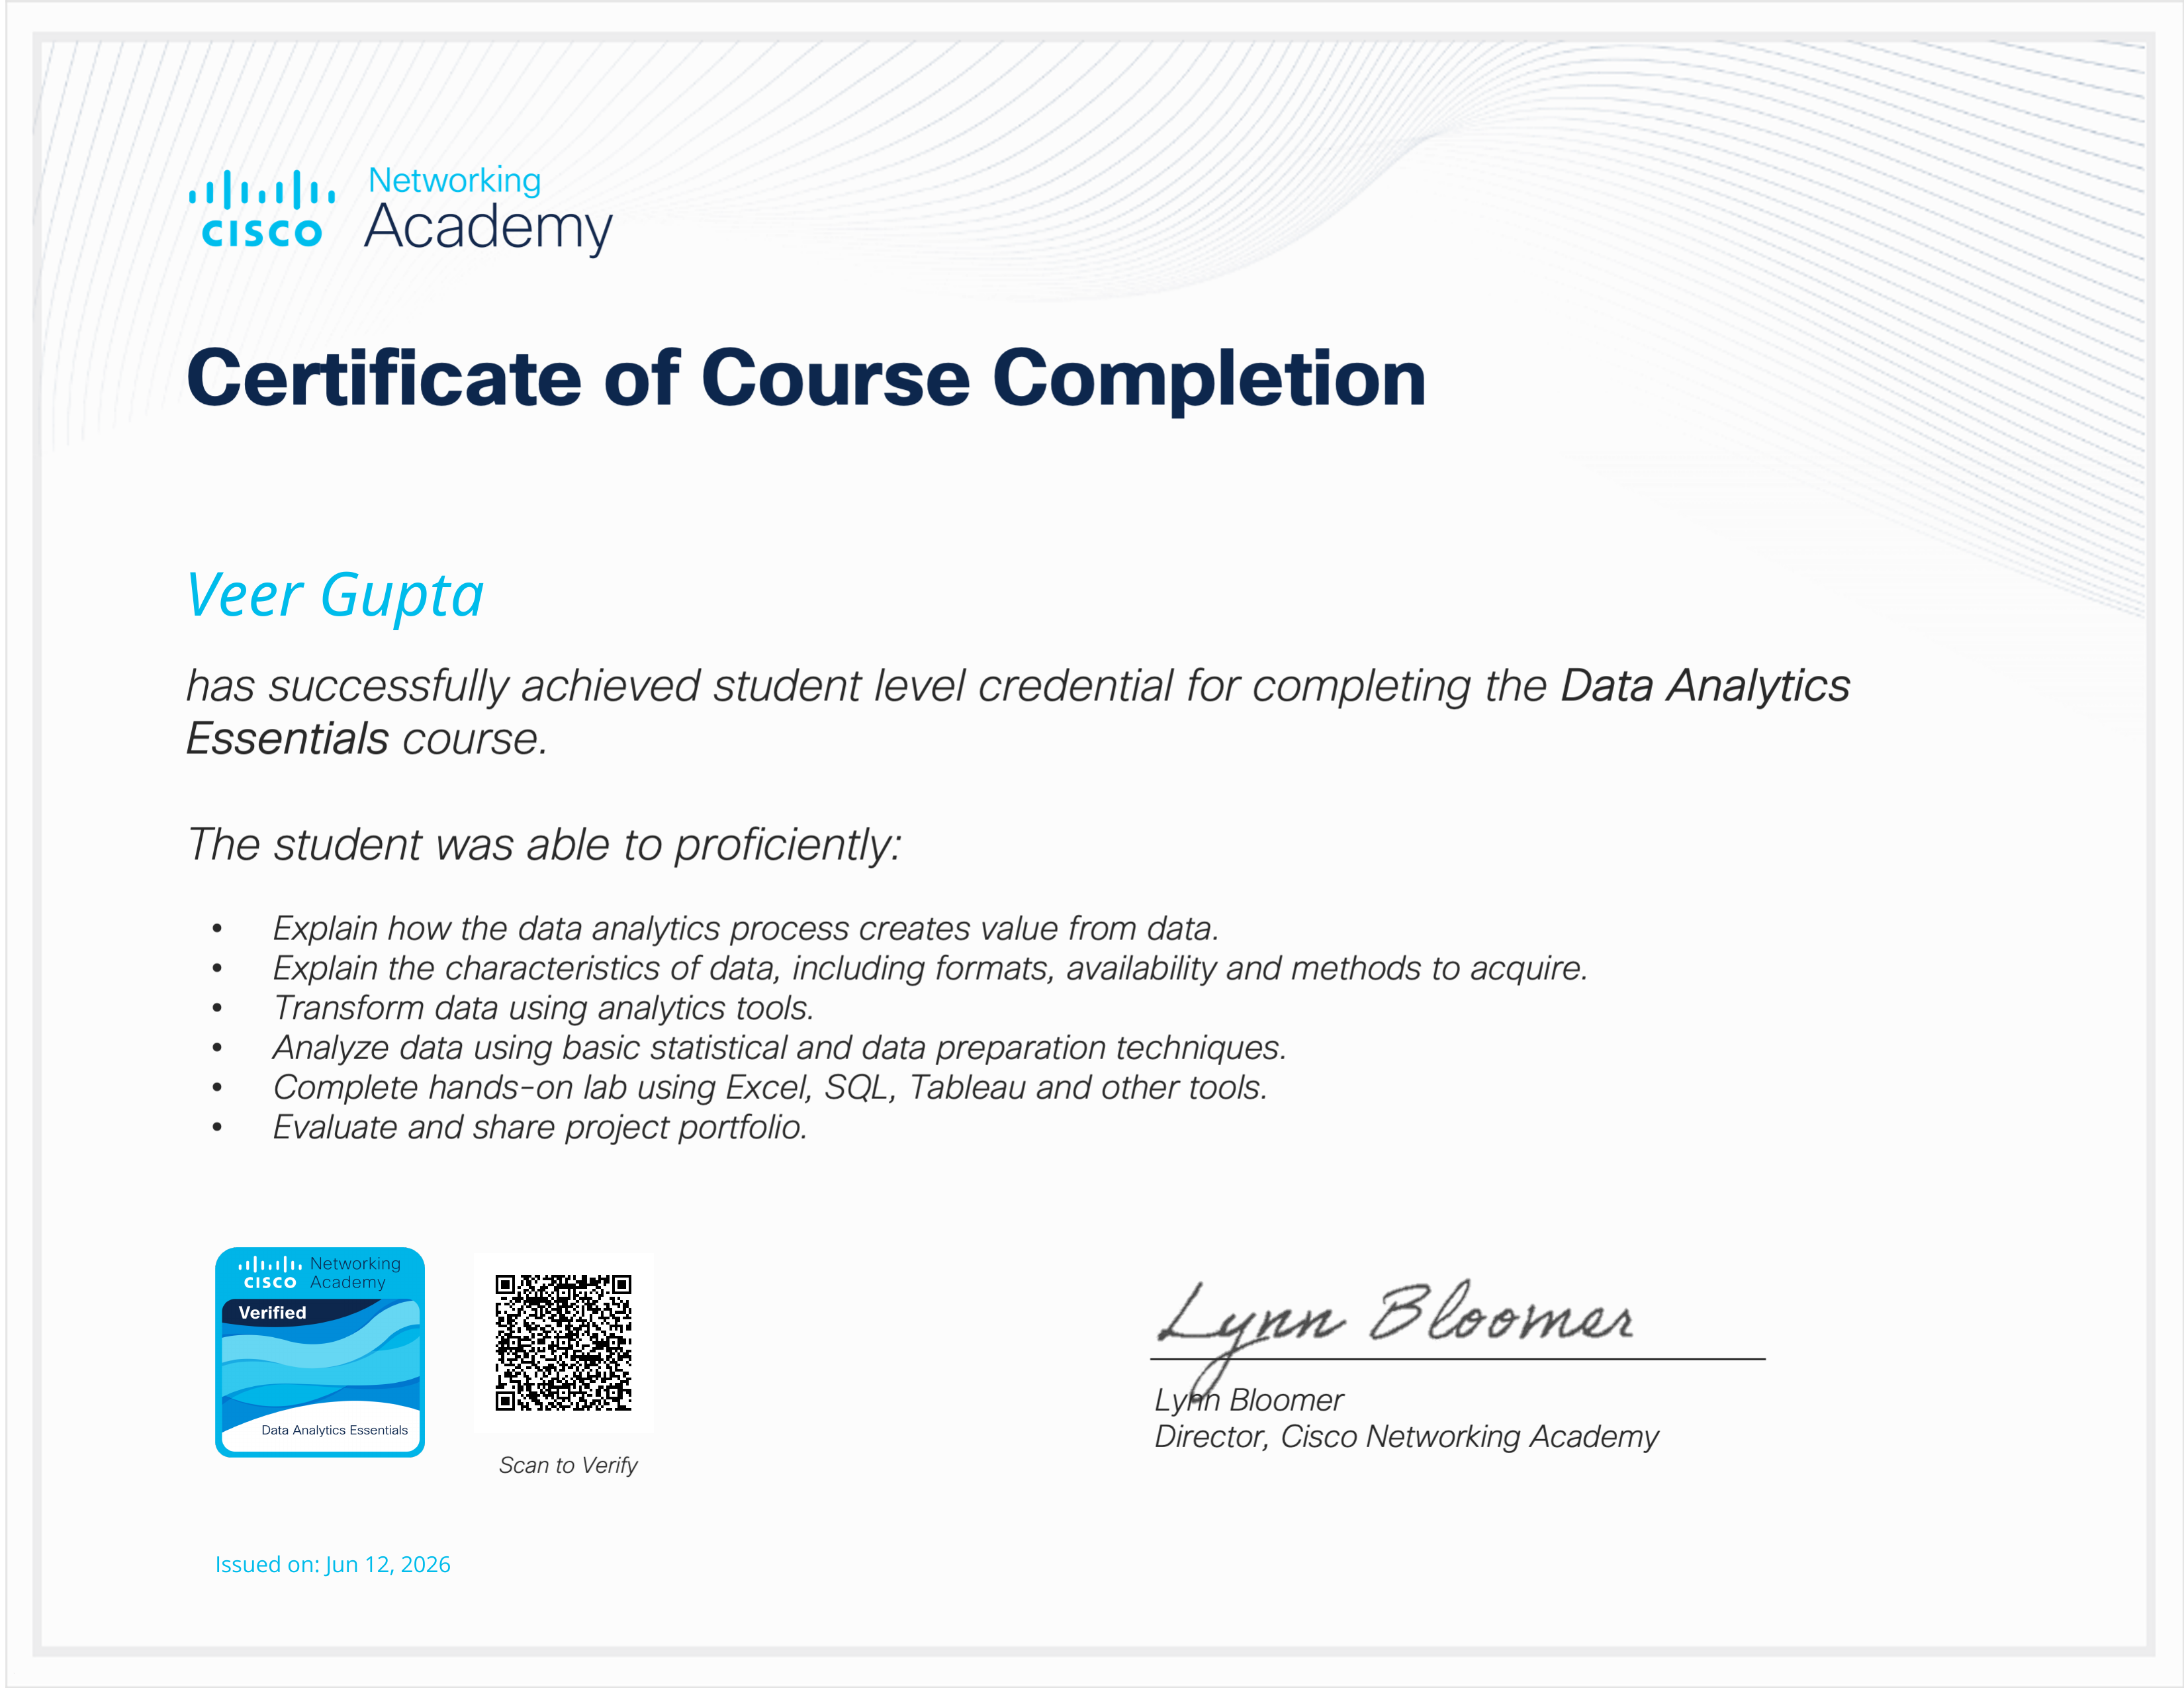
Certification & Official Verification
Certificate 3 of 3 – Data Analytics Essentials

Slide 21
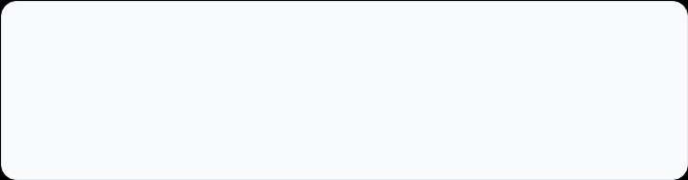
Thank You!
Veer Gupta
School of Computer Science & Engineering
Roll No: 25SCS1003003599
IILM University, Greater Noida, U.P.

