Slide 1

OOPS
TRAINING & RECRUITMENT
OFFSHORE DEVELOPMENT
IDENTITY MANAGEMENT
PORTAL DEVELOPMENT
APPLICATION DEVELOPMENT
5th Floor , V.V.Vintage-Boulevard, Somajiguda
Hyderabad – 500082 INDIA
Tel: 040-30605533

Slide 2
Topics
1. Class
2. Object
3. Encapsulation
4. Abstraction
5. Interface
6. Inheritance
7. Polymorphism
8. This (keyword)
9. Super (Keyword)
10. constructors

Slide 3
Class
A class is a user defined blueprint.
Class has set of properties and common methods that are common to all object of one type.
Class are created by using a keyword class.
When we create a class it will not allocate memory to the class.
Classes are blue print for creating objects.

Slide 4
Syntax:
class Demo {
// Method Body(variables and methods.)
}
keyword class Name
Note:
In class key word ‘c’ must be in lowercase because keywords in java start with lowercase only otherwise it shows compile time error.
We cannot create more than one class with same name.

Slide 5
Objects
Objects are real world entities like car, bike…
Object is a physical entity.
Objects are created in runtime.
We have use a new keyword in java to create a object for class.
When we create a object for particular class then jvm allocate memory for that class.
we can create a multiple object for one class based on the requirement.

Slide 6
Example:
class Demo {
// variables and methods.
public void show() {
System.out.println(“Hello World…”);
}
}
Demo d1=new Demo();
Object reference keyword for creating object.

Slide 7
Encapsulation
Encapsulation in java is wrapping code and data in a single unit.
We can create a fully encapsulated class by making all data members as private modifier.
By providing getters and setters we can get data and we can update data.
It’s also know as data hiding because the variables with private we cannot access in other classes.

Slide 8
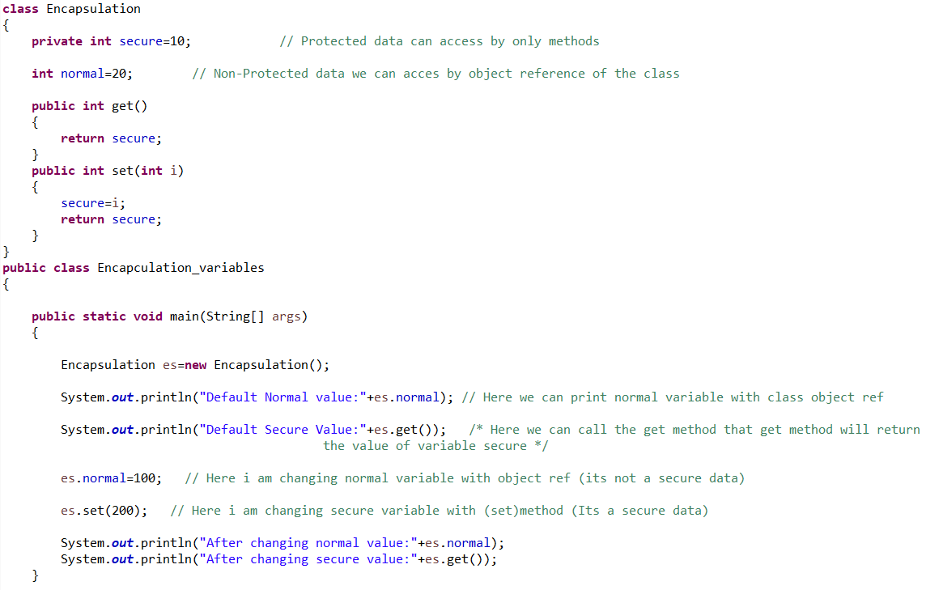
Example:

Slide 9
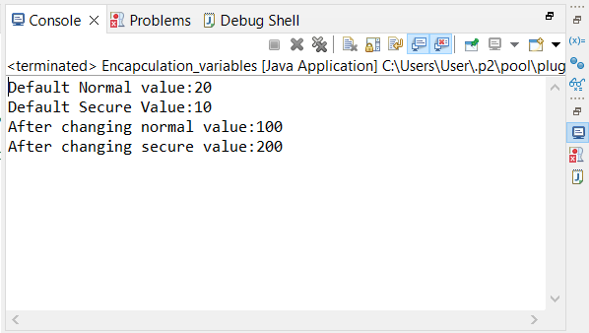
Output:

Slide 10
Abstraction
A class which is declared with the abstract keyword is known as an abstract class in java. It can have abstract and non-abstract methods (method with the body).
Abstraction is a process of hiding the implementation details and showing only functionality to the user.
Ways to achieve Abstraction:
1.Abstract class (0 to 100%)
2.Interface (100%)

Slide 11
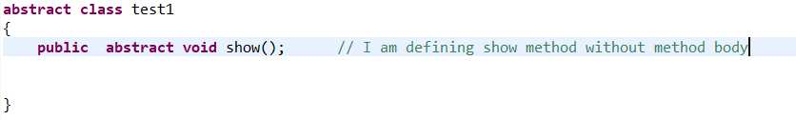
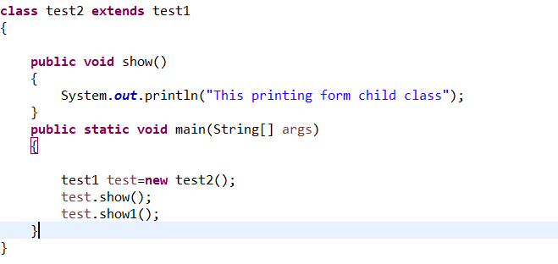
Example:
Syntax:
extends class:

Slide 12
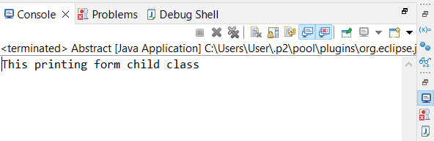
Output:
Note:
An abstract class must be declared with an abstract keyword.
It can have abstract and non-abstract methods.
It cannot be instantiated.
In abstract class we can take final methods also.

Slide 13
Interface
The interface in Java is a mechanism to achieve abstraction.
There can be only abstract methods in the Java interface, not method body.
It is used to achieve abstraction and multiple inheritance in java.

Slide 14
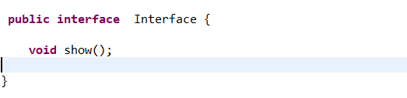
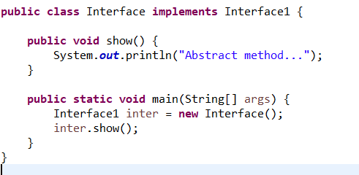
Example:
Syntax:
implements class:

Slide 15
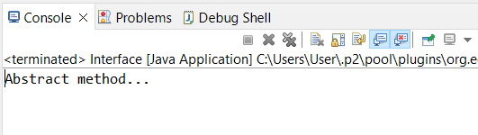
output:
Note:
If it is a abstract class we are using extends to extend the super class with subclass but here we use implements to extend with super class with subclass.

Slide 16
Inheritance
In java Inheritance is the one of the main concept in oops. in this concepts we can inherit the variables and methods from super class(parent class) to sub class(child class) is know as inheritance. When you inherit from an existing class, you can reuse methods and fields of the parent class. Moreover, you can add new methods and fields in your current class also. We use extend key word to inherit the classes.
subclass (child) is the class that inherits from another class superclass (parent) is the class being inherited from.

Slide 17
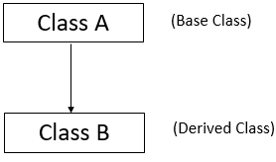
There are three types of inheritance:
1. Single.
2. Hierarchy.
3.Multilevel.
Single inheritance:
When a class inherits another class, it is known as a single inheritance.

Slide 18
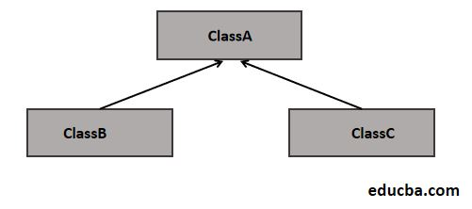
Hierarchical inheritance:
When two or more classes inherits a single class, it is known as hierarchical inheritance.

Slide 19
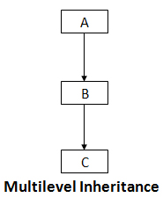
Multilevel inheritance:
When there is a chain of inheritance, it is known as multilevel inheritance.

Slide 20
Polymorphism
Polymorphism in Java is a concept by which we can perform a single action in different ways.
we have two ways to achieve polymorphism:
Method Overriding (Run time-polymorphism)
Method Overloading (Compile time polymorphism)

Slide 21
Method Overriding
During inheritance in Java, if the same method is present in both the superclass and the subclass. Then, the method in the subclass overrides the same method in the superclass. This is called method overriding.
Runtime polymorphism or Dynamic Method Dispatch is a process in which a call to an overridden method is resolved at runtime rather than compile-time.
Object reference from super class
Object created for subclass

Slide 22
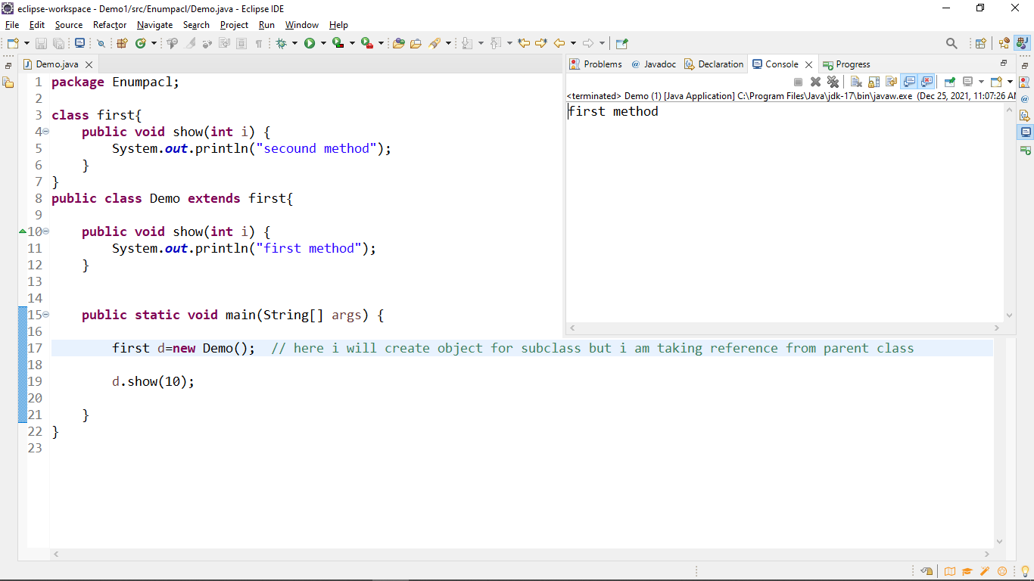
Example:

Slide 23
Method Overloading:
In Java, two or more methods may have the same name if they differ in parameters (different number of parameters, different types of parameters, or both). These methods are called overloaded methods and this feature is called method overloading.
Note: The method that is called is determined by the compiler. Hence, it is also known as compile-time polymorphism.

Slide 24
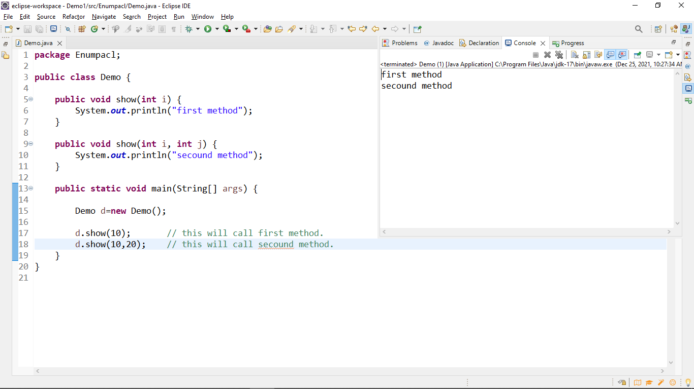
Example:

Slide 25
this
The this keyword refers to the current object in a method or constructor.
this keyword is used to call another constructor from within a constructor in the same class.
Invoke current class constructor
Invoke current class method
Return the current class object
Pass an argument in the method call
Pass an argument in the constructor call

Slide 26
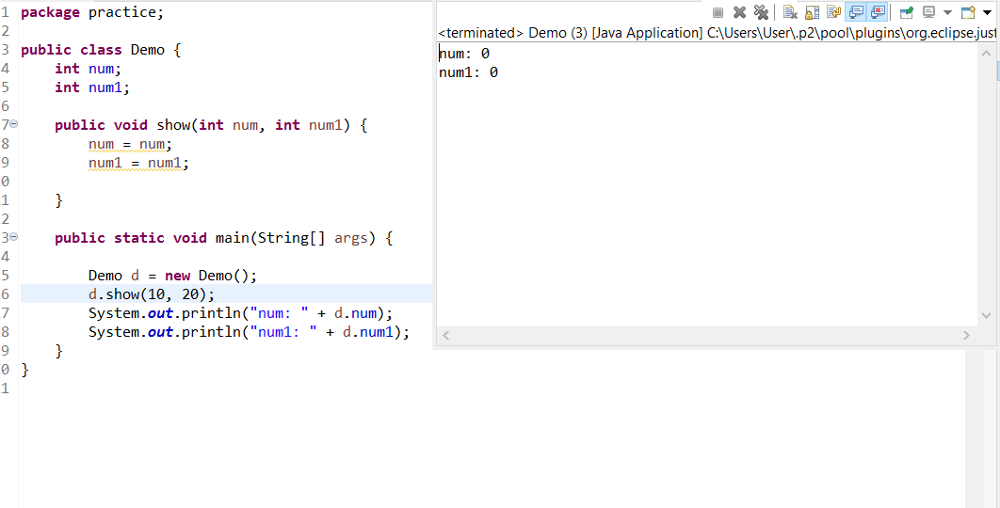
Example:
without this :

Slide 27
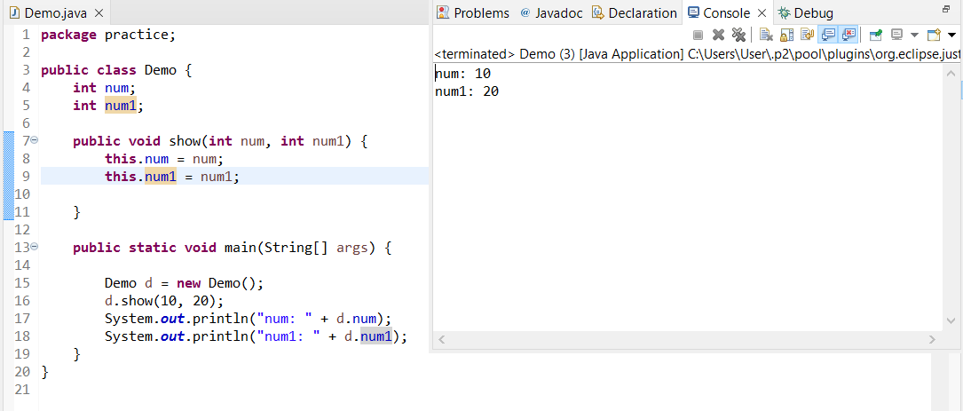
with this :

Slide 28
Super
The super keyword refers to superclass (parent) objects.
It is used to call superclass methods, and to access the superclass constructor.
super keyword is used to call the super class’s constructor from within a constructor of the subclass.
By default JVM automatically put the super () keyword at first line inside the constructor. As below.

Slide 29
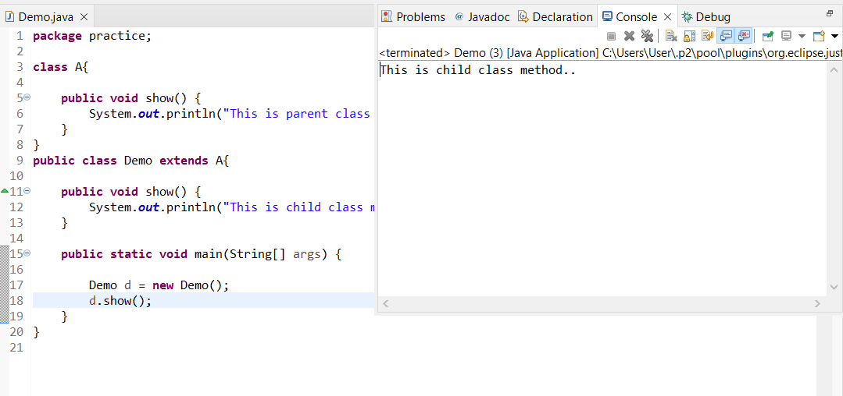
Example:
without super :

Slide 30
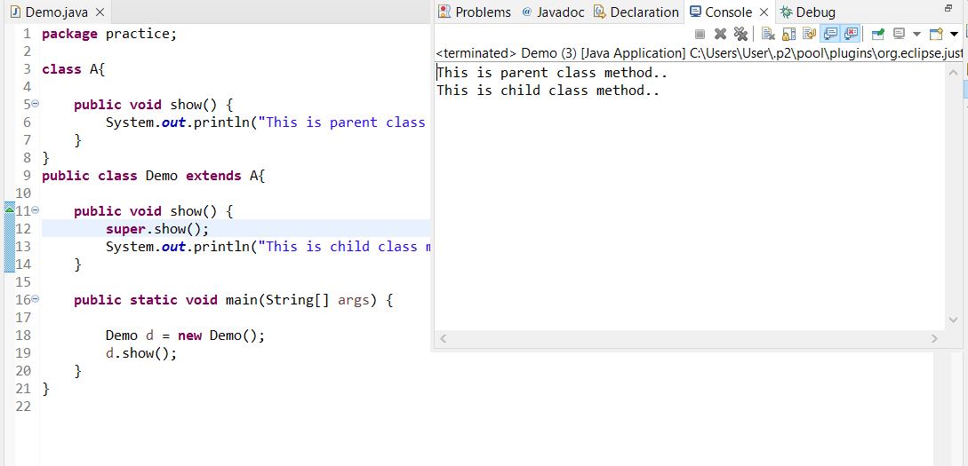
with super :

Slide 31
Constructors:
It is also one type of method and it would be executed when the object is constructed (created).
It is defined with class name only.
We have two types of constructors.
No parameter.
Parameter.

Slide 32
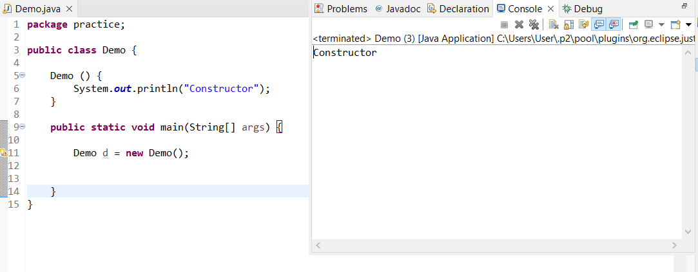
Syntax (default):

Slide 33
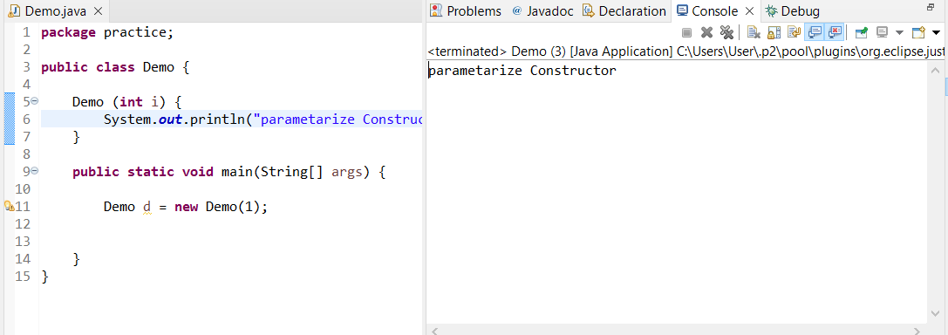
Syntax (Parameterize constructor) :

Slide 34
For further info please visit www.techstratinc.com
Thank You

