Slide 1
OPERATORS
1. Arithmetic operators.
2.Bitwise Operators.
3.Increment and Decrement.
4. Up casting.
5. Down casting.
presented By
K.Veera Narayana.

Slide 2
Arithmetic Operators:
Topics in Arithmetic operators:
There are Five Arithmetic operators in java
Addition(+).
Subtraction(-).
Multiplication(*).
Division(/).
Modulus(%).

Slide 3
Addition: Symbol: +
As we know addition means Adds values on either side of the operator.
In mathematics we can add two numbers the same way we can add in programming also.
Example:
2+4=6. In mathematics.
Int num1=2;
Int num2=4;
Int num3=num1+num2; In programming.
num3=6;

Slide 4
Subtraction: Symbol: -
As we know subtraction means Subtracts right hand operand from left hand operand .
In mathematics we can Subtracts two numbers the same way we can Subtracts in programming also.
Example:
4-2=2. In mathematics.
Int num1=4;
Int num2=2;
Int num3=num1-num2; In programming.
num3=2;

Slide 5
Multiplication: Symbol: *
As we know Multiplication means Multiplies values on either side of the operator.
In mathematics we can Multiply two numbers the same way we can Multiply in programming also.
Example:
4*2=8. In mathematics.
Int num1=4;
Int num2=2;
Int num3=num1*num2; In programming.
num3=8;

Slide 6
Division: Symbol: /
As we know Division means Divides left hand operand by right hand operand.
In mathematics we can Divide two numbers the same way we can Divide in programming also division will give the Quotient value.
Example:
4/2=2. In mathematics.
Int num1=4;
Int num2=2;
Int num3=num1/num2; In programming.
num3=2;

Slide 7
Modulus: Symbol:%
As we know Modulus means Divides left hand operand by right hand operand and returns remainder.
In mathematics we can Divide two numbers the same way we can Divide in programming also modulus will give the Reminder value.
Example:
4%2=0. In mathematics.
Int num1=4;
Int num2=2;
Int num3=num1/num2; In programming.
num3=0;

Slide 8
Bitwise Operators.
Topics in Bitwise operators:
Bitwise operators are used to perform the manipulation of individual bits of a number. They can be used with any integral type (char, short, int, etc.).
Bit-Shift Operators (Shift Operators).
Right shift operator (>>).
2. Left shift operator(<<).
bitwise operators.
1. Bitwise OR (|) .
2. Bitwise AND (&).
3. Bitwise XOR (^).
4. Bitwise Complement (~).

Slide 9
Bit-Shift Operators (Shift Operators).
In shift operators totally we have four shifting operators.
Right shift operator (>>)
Unsigned Right shift operator (>>>)
Left shift operator (<<)
Unsigned Left shift operator (<<<)
* Most of the time we use right and left Shift operator only that’s why I mention only this two In topics.

Slide 10
Decimal to Binary Format:
Computer can understand only 0’s and 1’s. that means it will not understand Decimal numbers like 12,30,100…etc.
For computer understanding first given number can converted into a binary format.
Example:
Decimal Binary Format
10 1010
16 10000
20 10100

Slide 11
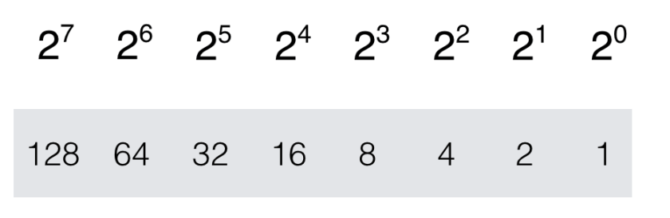
If we want to convert decimal to binary first we have to understand Binary number system can be derived by base 2 to the power of whole numbers.
Conversion of binary will start with right to left.
Example :
diagram 1:
10=1010 observe above example from left to right it will start with 1
if we add 2³ = 8 and 2¹ = 2 when we add 8+2=10. so binary format of 10 is 1010.

Slide 12
Right shift operator (>>).
This operator is represented by a symbol >>, read as double less than.
It will shift the bits to right side.
Example:
10 >> 1
Value Operator Step
output:
10 >> 1=5.

Slide 13
Explanation:
10 1010.
it will shift avery bit to right side based on step here step is 1 so it will shift avery bit to right side one time.
Before Shift: 1010 10
After shift: 0101 5 (If u have any dought please refer diagram 1 in page no 11).

Slide 14
Left shift operator(<<).
This operator is represented by a symbol <<, read as double less than.
It will shift the bits to left side.
Example:
10 << 1
Value Operator Step
output:
10 << 1=20.

Slide 15
Explanation:
10 1010.
it will shift avery bit to left side based on step here step is 1 so it will shift avery bit to left side on time.
Before Shift: 1010 10
After shift: 10100 20 (If u have any dought please refer diagram 1 in page no 11).

Slide 16
Truth Table: Table no:1
A | B | A&B | A|B | A^B
0 | 0 | 0 | 0 | 0
0 | 1 | 0 | 1 | 1
1 | 0 | 0 | 1 | 1
1 | 1 | 1 | 1 | 0

Slide 17
Bitwise OR (|)
This operator is a binary operator, denoted by ‘|’. It returns bit by bit OR of input values, i.e., if either of the bits is 1, it gives 1, else it shows 0.
Example:
num1=4 0100 (Binary Format)
num2=2 0010 (Binary Format)
When We apply bitwise Or(|)
0 1 0 0
| 0 0 1 0
0 1 1 0 Out Put = 6.

Slide 18
Bitwise AND (&)
This operator is a binary operator, denoted by ‘&.’ It returns bit by bit AND of input values, i.e., if both bits are 1, it gives 1, else it shows 0.
Example:
num1=4 0100 (Binary Format)
num2=2 0010 (Binary Format)
When We apply bitwise And(%)
0 1 0 0
& 0 0 1 0
0 0 0 0 Out Put = 0.

Slide 19
Bitwise XOR (^)
This operator is a binary operator, denoted by ‘^.’ It returns bit by bit XOR of input values, i.e., if corresponding bits are different, it gives 1, else it shows 0.
Example:
num1=4 0100 (Binary Format)
num2=2 0010 (Binary Format)
When We apply bitwise And(%)
0 1 0 0
^ 0 0 1 0
0 1 1 0 Out Put = 6.

Slide 20
Bitwise Complement (~)
This operator is a unary operator, denoted by ‘~.’ It returns the one’s complement representation of the input value, i.e., with all bits inverted, which means it makes every 0 to 1, and every 1 to 0.
Example:
~14 =-15.
* When we use compliment for 14 that is ~14.
* It will give the output as -15.
Let’s check why -15.
Before going to check we have to understand what is 1’s compliment and 2’s compliment.

Slide 21
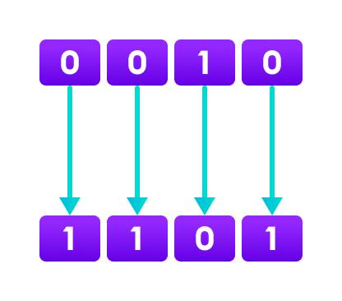
1’s Compliment:
* It converts binary digits 1 to 0 and 0 to 1
0 0 0 0 1 1 1 0 Binary format (14).
1 1 1 1 0 0 0 1 1’s compliment (14)

Slide 22
2’s compliment:
2’s complement of a binary number is 1 added to the 1’s complement of the binary number.
Steps to convert 2’s compliment:
1.We have convert number into a binary format.
2.Then we have convert into a 1’s compliment.
3.Then we have to add with +1 in the first.
Example:
0 0 0 0 1 1 1 1 Binary format (15)
1 1 1 1 0 0 0 0 1’s compliment
+1
1 1 1 1 0 0 0 1 2’s compliment (15)

Slide 23
Now we can check why 14 will output as -15:
* Now clearly observe (Above) that 1’s compliment of 14 is equal to the 2’s compliment of 15.
* That’s why we use compliment that is negative it is giving output as -15.
Note:
* When we give input as ~14 it will give output as -15.
* When we give input as ~-14 it will give output as 15.
* When u give input as negative numbers, we are using compliment (Not) what’s it will give output as positive number. The same way for positive numbers also if we give positive numbers it will give output as negative numbers.

Slide 24
Increment and Decrement:
Increment:
Increment is nothing but increasing the value. There are two types…
1. Pre-increment.
2. Post-increment.
Pre-increment:
Here first it incrementing the value and then we are assign to the other variable.
Example: Output:
int I=10; I=11
int J=++I; j=11

Slide 25
Post-increment:
Here first it assign to the variable and then we are incrementing value.
Example:
int I=10;
int J=I++;
Output:
J=10
I=11

Slide 26
Decrement:
Decrement is nothing but decreasing the value. There are two types…
1.Pre-decrement.
2.Post-decrement.
Pre-decrement:
Here first it decreasing the value and then we are assign to the other variable.
Example: output:
int I=10; J=9
int J= --I; I=9

Slide 27
Post-decrement:
Here first it assign to the variable and then we are decrease value.
Example:
int I=10;
int J=I--;
Output:
J=10
I=9

Slide 28
Widening(Up casting)
Typecasting: The process of converting one type of object and variable into another type is referred to as Typecasting.
In implicit typecasting, the conversion involves a smaller data type to the larger type size.
The process of converting the lower data type to that of a higher data type is referred to as Widening.
Widening diagram no:2
byte
short
int
long
float
double
char

Slide 29
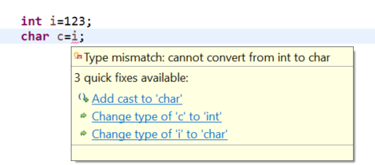
As per diagram no:2 .
Double: can store all data type values.
Float: we can store long, int, char, short, byte values.
Long : we can store int, char, short, byte values.
Int : we can store char, short, byte values.
Char : in char implicitly we cannot store any values.
Ex: int i=123;
char c=I; compile time.

Slide 30
But we can store like this
char c=123;
* short: we can store only byte values.
Byte : we can not any data type values except byte values.
Boolean : in Boolean we can store only Boolean type values true, false.

Slide 31

Down casting(Narrowing).
Narrowing refers to passing a higher size data type like int to a lower size data type like short. It may lead to data loss. Casting is required for narrowing conversion. Following program output will be 44.

Slide 32
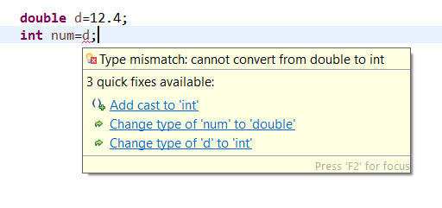
We cannot store higher data type values in lower data types.
Example:
double d=12.3;
int num=d;
We can store higher values into lower data type using down casting.
Int num=(int )d; down casting

Slide 33


