Slide 1
Stay Connected!
PSG College of Technology, Coimbatore

Slide 2
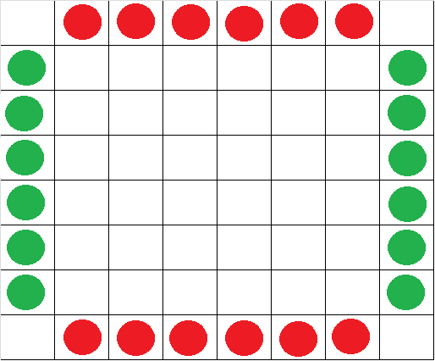
Rules
Each player has two sets of 6 pegs placed on the opposite edges of a chess board as follows

Slide 3
Rules contd.
You can move a peg in any of the 8 possible directions
The number of steps you can move a peg is determined total number of pegs (both yours and the opponent pegs) available on that line of motion.
You can jump over your own pegs while moving from your source to the destination.
You cannot jump over your opponent’s peg.
If the opponent peg is at the destination, you can land on your opponent’s peg as long as you don’t jump over any other opponent pegs, eliminating that peg from the board,
The winner of the game is the player who can first get all his pegs connected to each other in any possible way.

Slide 4
What is the GameState?
The GameState consists of the board and positions of the pegs of the user and computer at a particular point in the game.

Slide 5
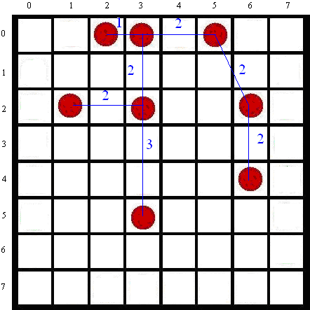
The MST
In a particular game state, the user’s or the computer’s pegs are considered as a graph and the Minimum Spanning Tree is generated and the minimum total distance is computed from this tree.
The distance between any two pegs is computed as max(|x₂-x₁|, |y₂-y₁|).

Slide 6
Comparing MSTs
From here, we calculate the minimum total distance for the computer as well as the user.
The difference between these values gives the computer’s advantage over the user.

Slide 7
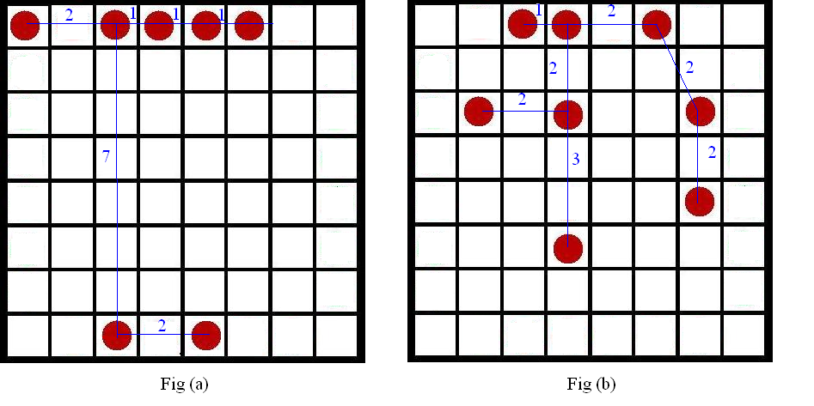
Problem with this method
Both these GameStates have the same minimum total distance of 14.
But GameState in Fig(b) is in a better position to reach a win state than Fig (a).

Slide 8
Solution: Proximity Factor
Proximity Factor = Minimum total distance × Length of edge with maximum distance
The Proximity Factor for Fig (a) = 14 × 7 = 98.
The Proximity Factor for Fig (b) = 14 × 3 = 42.

Slide 9
WinFactor
The Proximity Factor is then normalized to a range between -1 and +1. This value is defined as WinFactor.
WinFactor = (x – y) / max(x, y)
x →Proximity Factor of User
y →Proximity Factor of Computer
WinFactor = -1 → User has won
WinFactor = +1 → Computer has won
WinFactor = 0 → Both have equal chances of winning

Slide 10
The Game Tree
The Current State
of the Game
LEVEL-1
All possible moves by the computer
LEVEL-2
All possible moves by the user at this level
LEVEL-3
All possible moves by the computer at this level

Slide 11
Game Tree & WinFactor
We start by calculating the WinFactor for all the leaf nodes of the Game Tree.
The non-leaf nodes acquire the WinFactor of their children by aggregation.
WinFactor of parent = (Sum of WinFactors of
children) / (No. of children)
This is done from level ‘h’ to Level 1
At Level-1, the node with the highest WinFactor is selected as the computer’s next move.

Slide 12
Improving Intelligence
The height of the game tree controls the number of steps the computer can think ahead.
Increasing the height of the tree would indicate that the computer would think ‘h/2’ moves ahead where h is the height of the tree.

