Slide 1

Safeguarding Banking's Future with Responsible GenAI Deployment
Unlocking the power of Generative AI while prioritizing data security, regulatory compliance, and ethical principles in the banking industry.
Barclays' approach to GenAI deployment in the banking industry emphasizes the critical role of data as the foundation for financial services, coupled with a comprehensive control framework to ensure responsible implementation. By addressing the unique data considerations and implementing robust security, risk management, governance, and operational controls, Barclays is positioning itself to safely harness the benefits of GenAI while mitigating potential risks and maintaining regulatory compliance. This holistic approach underscores Barclays' commitment to innovation while prioritizing customer trust and the long-term stability of the banking industry.

Slide 2
The Critical Role of Data in Banking's GenAI Evolution
Data as the Foundation of Financial Services
Customer financial records, transaction histories, and behavioral patterns form the bedrock of banking operations, while market data and economic indicators create complex interdependencies.
Banking Data Ecosystem
Traditional systems and modern platforms must interface seamlessly to maintain data integrity in Barclays' evolving infrastructure.
Strategic Value of High-Quality Data
High-quality data drives operational efficiency, enhances decision-making, and strengthens competitive positioning.
Key Data Quality Dimensions in Banking
Accuracy, completeness, consistency, timeliness, and lineage are critical for reliable financial decisions and regulatory compliance.
Regulatory Implications of Banking Data
Meticulous governance of critical data elements and authoritative data sources is required to meet regulatory requirements.
GenAI's Unique Data Considerations
Model performance, bias mitigation, privacy concerns, synthetic data alternatives, and security challenges must be addressed for responsible GenAI implementation.

Slide 3
The Imperative of Controls in Banking's GenAI Landscape
Regulatory Control Environment
Banking faces uniquely stringent regulatory requirements from multiple authorities like FCA, PRA, FED, and FINRA. GenAI applications introduce complex regulatory interpretation questions, requiring proactive engagement with regulators to build trust and reduce implementation friction.
Security Control Architecture
Enforced by the Chief Security Office, security controls include data protection measures like encryption and access controls, model security defenses against attacks, infrastructure resilience with defense-in-depth, and specialized incident response protocols for AI-specific security incidents.
Risk Management Control Mechanisms
Frameworks adapted for generative capabilities, enhanced validation processes, defined risk thresholds for GenAI failure modes, continuous monitoring with early warning indicators, and risk transfer strategies including specialized insurance coverage.
Governance and Oversight Controls
Rigorous application approval process with sign-offs from specialized departments, board-level accountability, cross-functional governance forums, independent ethical AI committees, and tailored documentation standards to address the complexities of generative models.
Operational Excellence Controls
Human-in-the-loop intervention points, specialized quality assurance methodologies, transparency mechanisms for explainability, performance frameworks with GenAI-specific metrics, and feedback systems to capture emergent risks and opportunities for continuous improvement.

Slide 4
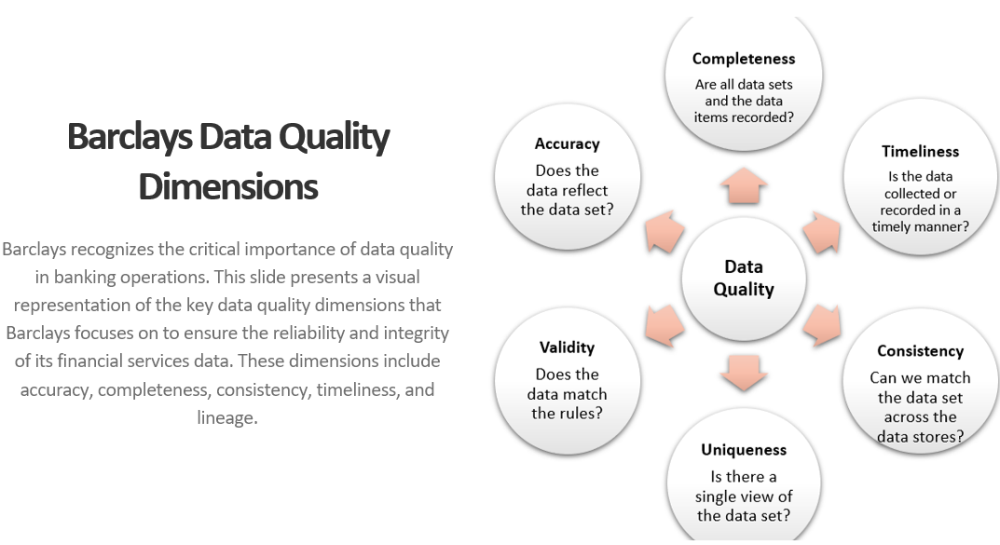
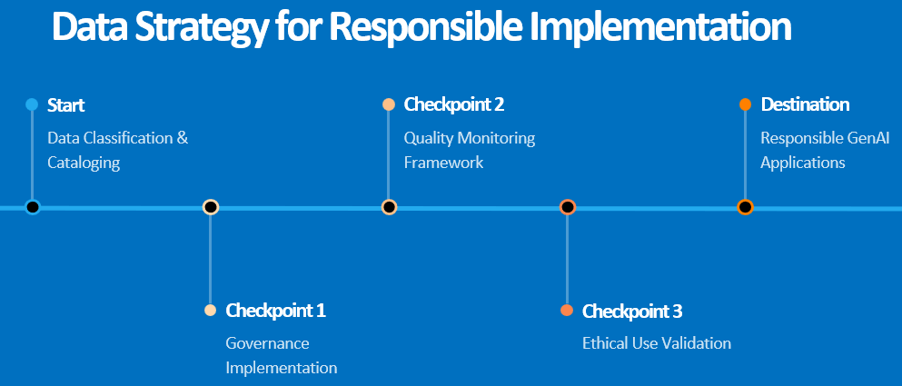
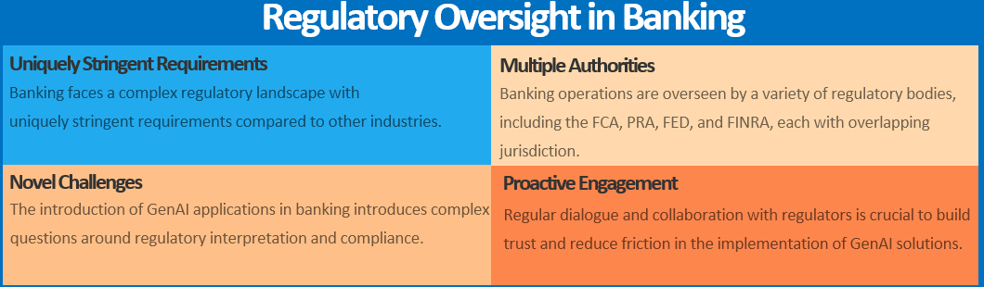

Slide 5
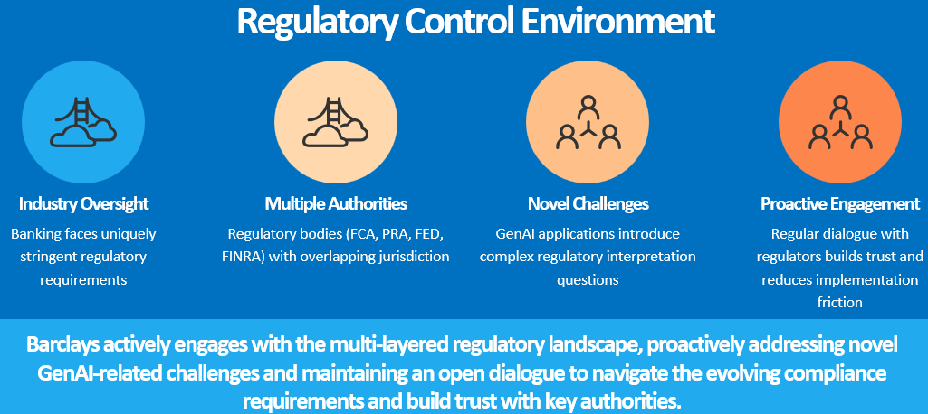
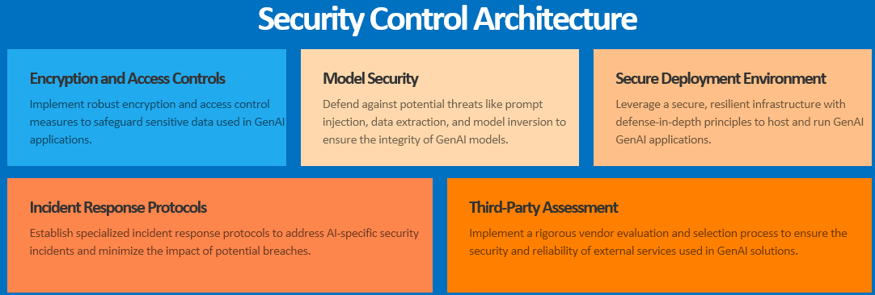

Slide 6
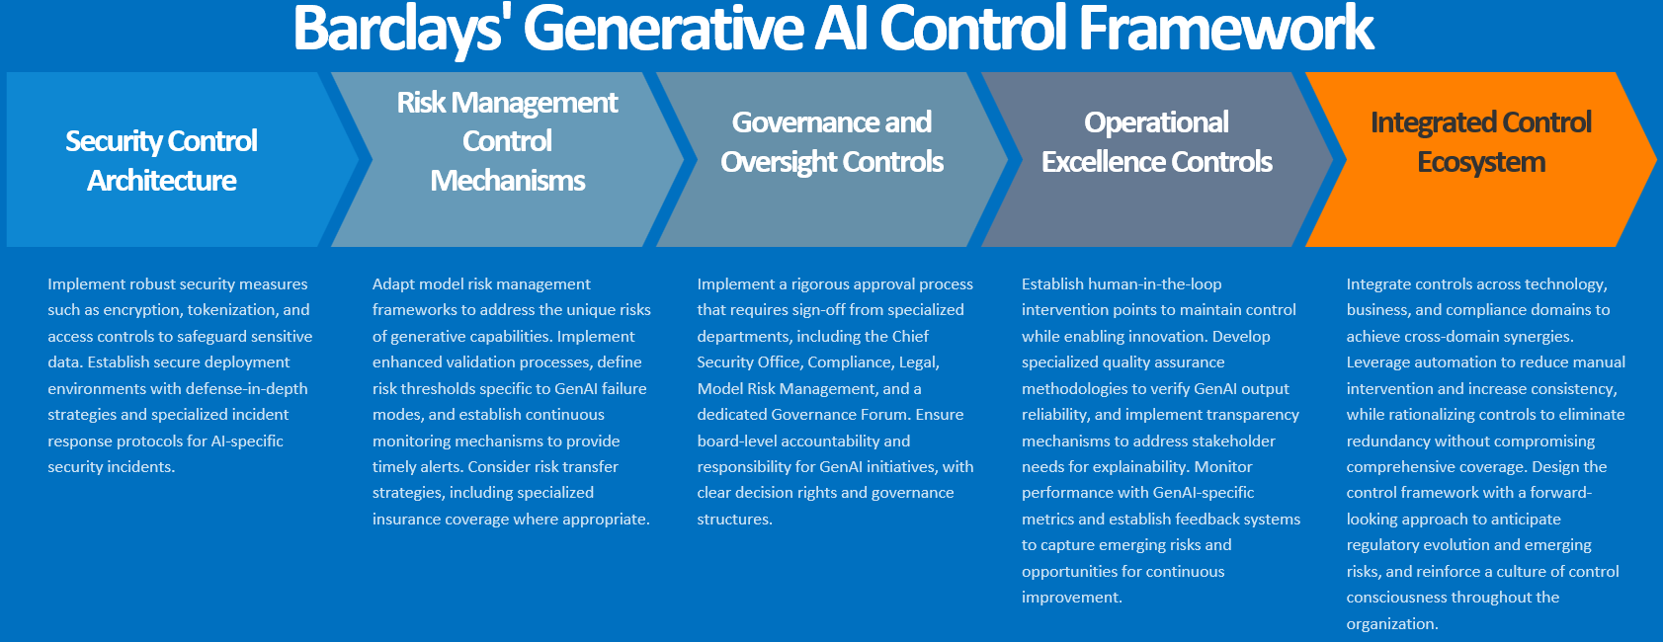
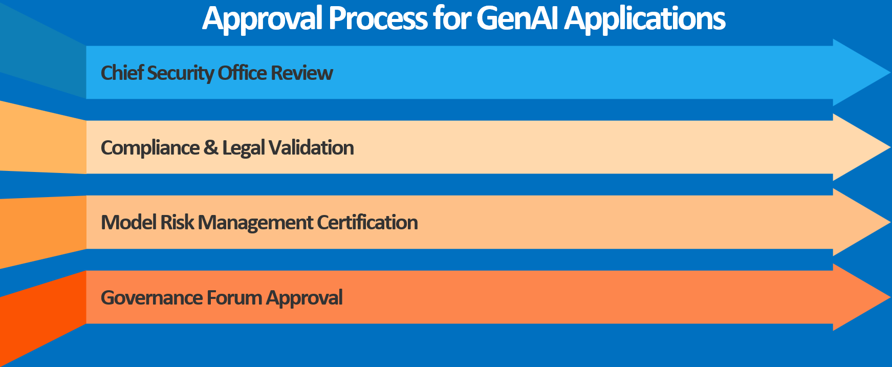

Slide 7
Appendix

Slide 8





Barclays' Generative AI Control Framework
Risk Management Control Mechanisms
Governance and Oversight Controls
Operational Excellence Controls
Integrated Control Ecosystem
Security Control Architecture
Implement robust security measures such as encryption, tokenization, and access controls to safeguard sensitive data. Establish secure deployment environments with defense-in-depth strategies and specialized incident response protocols for AI-specific security incidents.
Adapt model risk management frameworks to address the unique risks of generative capabilities. Implement enhanced validation processes, define risk thresholds specific to GenAI failure modes, and establish continuous monitoring mechanisms to provide timely alerts. Consider risk transfer strategies, including specialized insurance coverage where appropriate.
Implement a rigorous approval process that requires sign-off from specialized departments, including the Chief Security Office, Compliance, Legal, Model Risk Management, and a dedicated Governance Forum. Ensure board-level accountability and responsibility for GenAI initiatives, with clear decision rights and governance structures.
Establish human-in-the-loop intervention points to maintain control while enabling innovation. Develop specialized quality assurance methodologies to verify GenAI output reliability, and implement transparency mechanisms to address stakeholder needs for explainability. Monitor performance with GenAI-specific metrics and establish feedback systems to capture emerging risks and opportunities for continuous improvement.
Integrate controls across technology, business, and compliance domains to achieve cross-domain synergies. Leverage automation to reduce manual intervention and increase consistency, while rationalizing controls to eliminate redundancy without compromising comprehensive coverage. Design the control framework with a forward-looking approach to anticipate regulatory evolution and emerging risks, and reinforce a culture of control consciousness throughout the organization.

Slide 9




Approval Process for GenAI Applications
Chief Security Office Review
Compliance & Legal Validation
Model Risk Management Certification
Governance Forum Approval

Slide 10

Operational Excellence Controls
Human-in-the-Loop
Quality Assurance
Explainability
Performance Frameworks
Feedback Systems
Barclays employs strategic intervention points that maintain human control and oversight while enabling innovation with GenAI applications.
Barclays has developed specialized quality assurance methodologies to thoroughly verify the reliability and accuracy of GenAI-generated output.
Barclays ensures transparency mechanisms are in place, tailored to the needs of various stakeholders, to provide appropriate levels of explainability for GenAI-based decisions.
Barclays has implemented monitoring and evaluation frameworks with GenAI-specific metrics to assess the performance, reliability, and ongoing suitability of the deployed models.
Barclays has established feedback systems to capture emerging risks and opportunities, enabling continuous improvement of their GenAI implementation.

Slide 11





Data Strategy for Responsible Implementation
Start
Checkpoint 2
Destination
Data Classification & Cataloging
Quality Monitoring Framework
Responsible GenAI Applications
Checkpoint 1
Checkpoint 3
Governance Implementation
Ethical Use Validation

Slide 12


Regulatory Control Environment
Industry Oversight
Multiple Authorities
Novel Challenges
Proactive Engagement
Banking faces uniquely stringent regulatory requirements
Regulatory bodies (FCA, PRA, FED, FINRA) with overlapping jurisdiction
GenAI applications introduce complex regulatory interpretation questions
Regular dialogue with regulators builds trust and reduces implementation friction
Barclays actively engages with the multi-layered regulatory landscape, proactively addressing novel GenAI-related challenges and maintaining an open dialogue to navigate the evolving compliance requirements and build trust with key authorities.

Slide 13
Security Control Architecture
Encryption and Access Controls
Model Security
Secure Deployment Environment
Implement robust encryption and access control measures to safeguard sensitive data used in GenAI applications.
Defend against potential threats like prompt injection, data extraction, and model inversion to ensure the integrity of GenAI models.
Leverage a secure, resilient infrastructure with defense-in-depth principles to host and run GenAI applications.
Incident Response Protocols
Third-Party Assessment
Establish specialized incident response protocols to address AI-specific security incidents and minimize the impact of potential breaches.
Implement a rigorous vendor evaluation and selection process to ensure the security and reliability of external services used in GenAI solutions.

Slide 14
Regulatory Control Environment
Industry Oversight
Novel Challenges
Banking faces uniquely stringent regulatory requirements from multiple authorities, including the FCA, PRA, FED, and FINRA, with overlapping jurisdiction.
GenAI applications introduce complex regulatory interpretation questions that require proactive engagement with regulators.
Proactive Engagement
Regulatory Alignment
Regular dialogue with regulators builds trust and reduces implementation friction as Barclays rolls out its GenAI initiatives.
Barclays aligns its GenAI applications with the guidelines and requirements set forth by the various regulatory bodies overseeing the banking industry.

Slide 15
Governance and Oversight Controls
Approval Process
Board-Level Accountability
Cross-functional Forums
Applications require sign-off from Chief Security Office, Compliance, Legal, Model Risk Management, and Governance Forum
Executive awareness and responsibility for GenAI initiatives
Clear decision rights and governance structures
Ethical AI Committees
Documentation Standards
Independent expertise ensures fairness and transparency
Tailored to address the unique complexities of generative models

Slide 16

Safeguarding Banking's Future with Responsible GenAI Deployment
Barclays' approach to GenAI deployment in the banking industry emphasizes the critical role of data as the foundation for financial services, coupled with a comprehensive control framework to ensure responsible implementation. By addressing the unique data considerations and implementing robust security, risk management, governance, and operational controls, Barclays is positioning itself to safely harness the benefits of GenAI while mitigating potential risks and maintaining regulatory compliance. This holistic approach underscores Barclays' commitment to innovation while prioritizing customer trust and the long-term stability of the banking industry.

Slide 17
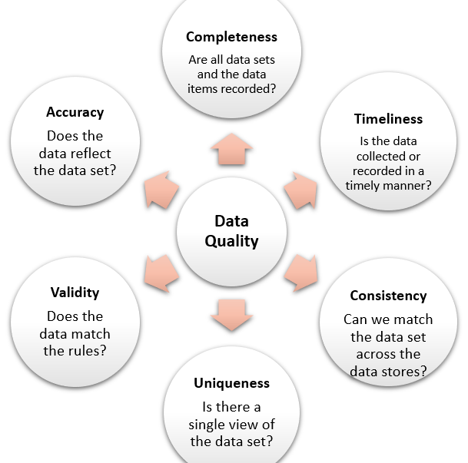
Barclays Data Quality Dimensions
Barclays recognizes the critical importance of data quality in banking operations. This slide presents a visual representation of the key data quality dimensions that Barclays focuses on to ensure the reliability and integrity of its financial services data. These dimensions include accuracy, completeness, consistency, timeliness, and lineage.

Slide 18
Regulatory Oversight in Banking
Uniquely Stringent Requirements
Multiple Authorities
Banking faces a complex regulatory landscape with uniquely stringent requirements compared to other industries.
Banking operations are overseen by a variety of regulatory bodies, including the FCA, PRA, FED, and FINRA, each with overlapping jurisdiction.
Novel Challenges
Proactive Engagement
The introduction of GenAI applications in banking introduces complex questions around regulatory interpretation and compliance.
Regular dialogue and collaboration with regulators is crucial to build trust and reduce friction in the implementation of GenAI solutions.

