Slide 1
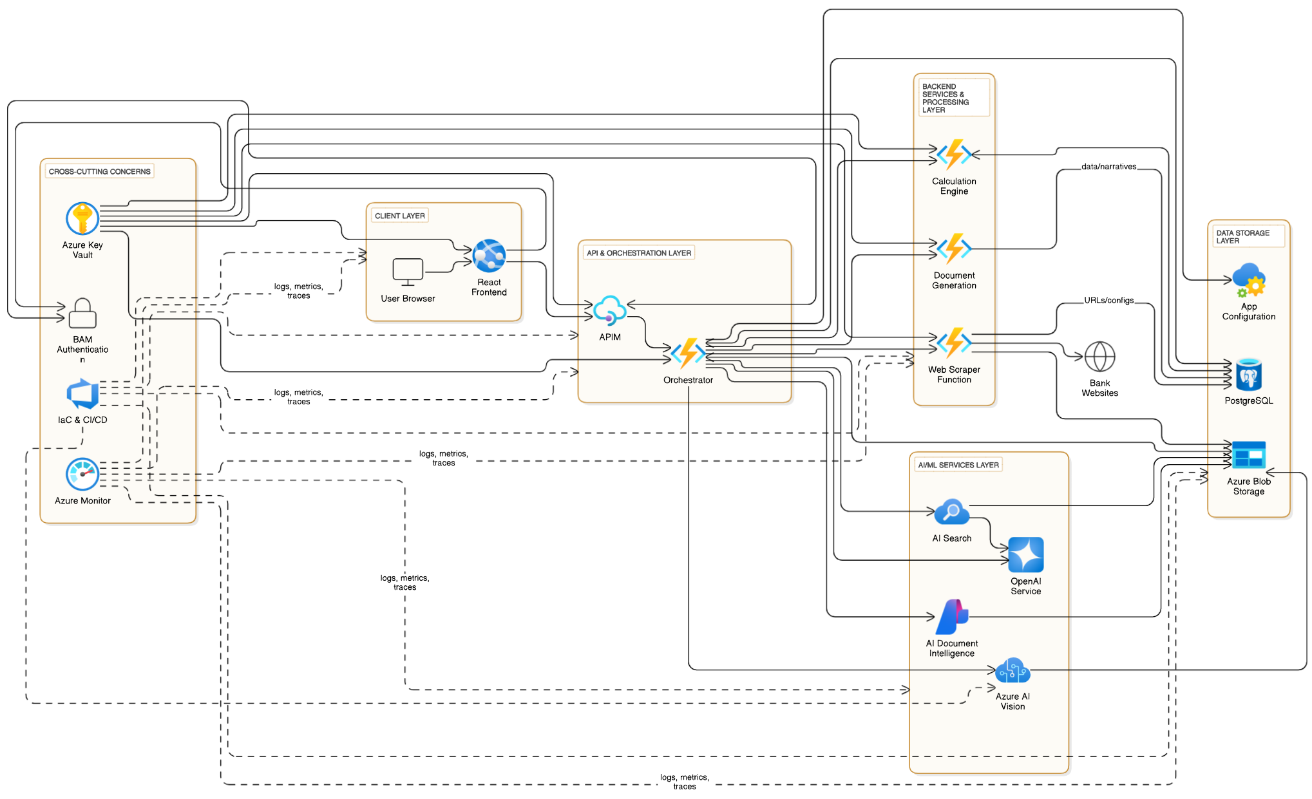
Technical Architecture
Client Layer:
User Browser: Standard web browser (Chrome, Edge, etc.) used by the end-user to access and interact with the React application.
React Frontend (on Azure App Service): JavaScript library for building the interactive user interface, hosted on Azure's platform-as-a-service for web applications.
Node.js/npm: JavaScript runtime and package manager used for developing and building the React application.
JavaScript Charting Libraries (e.g., Chart.js, D3.js): Libraries used within React to render interactive charts and graphs directly in the browser.
API & Orchestration Layer:
Azure API Management (APIM): Secure gateway to manage, publish, and protect backend APIs, routing client requests to the orchestrator.
Orchestrator (Azure Functions - Python): Serverless Python function that acts as the central coordinator, managing the overall workflow of data collection, processing, and analysis.
Backend Services & Processing Layer:
Web Scraper Service (Azure Functions - Python): Serverless Python function responsible for automatically navigating bank investor websites and downloading financial documents.
Playwright/BeautifulSoup: Python libraries used within the scraper function for web crawling and parsing HTML content.
Calculation Engine (Azure Functions - Python): Serverless Python function that performs financial calculations and derives new metrics from the extracted data.
Pandas/NumPy: Python libraries potentially used for efficient data manipulation and numerical computation within the calculation engine.
Document Generation (Azure Functions - Python): Serverless Python function that creates downloadable reports in PPTX, PDF, or DOCX formats using processed data and narratives.
python-pptx / reportlab / python-docx: Python libraries used to programmatically create PowerPoint, PDF, and Word documents respectively.
External Bank Websites: Third-party investor relations websites from which financial documents are sourced (an external data source).
AI/ML Services Layer (Azure AI):
Azure AI Document Intelligence & AI Vision: AI service that extracts text, tables, and layout structure from PDF documents, images and charts.
Azure AI Search: AI-powered cloud search service used to index document content and enable semantic search for the RAG pattern.
Azure OpenAI Service: Provides access to powerful large language models (like GPT) for natural language understanding, data extraction, summarization, and narrative generation.
Data Storage Layer:
Azure Blob Storage: Scalable object storage service used for storing raw downloaded financial documents (PDFs, text files, etc.).
Azure Database for PostgreSQL: Managed relational database service used to store structured extracted financial data, calculated metrics, narratives, and dynamic application configurations (like peer lists and metric definitions).
Azure App Configuration: Service for centrally managing application settings and feature flags for global configurations.
Cross-Cutting Concerns:
Microsoft Entra ID (IAM Authenticator): Cloud-based identity and access management service for authenticating users and securing application access.
Azure Key Vault: Service for securely storing and managing application secrets like API keys, passwords, and connection strings.
Azure Monitor: Comprehensive monitoring service for collecting, analyzing, and acting on telemetry data (logs, metrics) from all Azure resources.
IaC & CI/CD (Azure DevOps/GitHub Actions, Azure CLI, Bicep/ARM): Tools and practices for automating infrastructure provisioning (Infrastructure as Code) and continuous integration/continuous deployment of the application.

