Slide 1

Navigating the Future of Banking Data and Controls in the GenAI Era
The transformative impact of Generative AI on banking data and the imperative for enhanced controls in the evolving industry landscape.

Slide 2
Data in Banking: The Traditional Landscape
Historically central for customer relationships, risk, and compliance
Data has been the foundation of traditional banking operations, driving business activities and product development.
Drove business operations (transactions, accounts, profiles) and product development
Banking relied heavily on data to manage day-to-day operations, customer information, and product offerings.
Supported structured regulatory reporting
Data was essential for meeting regulatory requirements and generating standardized reports.
Siloed data hindering a unified customer view
Fragmented data systems and lack of integration made it challenging to obtain a comprehensive understanding of customers.
Manual processes causing delays and errors
Traditional banking data management often involved manual processes, leading to delays and increased risk of errors.
Limited, retrospective analytical insights
The data-driven decision-making in traditional banking was primarily based on historical information, limiting real-time insights.
Significant manual effort for compliance
Ensuring regulatory compliance was a labor-intensive process, requiring extensive manual data management and reporting.

Slide 3
GenAI's Transformative Impact on Banking Data
Heightened Data Quality Requirements
Training Data Quality
Accuracy, Completeness, Consistency, and Timeliness are critical for GenAI models to function reliably. Data lineage is also crucial for explainability.
The quality of training data dictates the reliability of GenAI models. Ensuring data representativeness is key to mitigating bias risks.
Enhanced Privacy Safeguards
Protection Against Adversarial Attacks
New inference risks with GenAI require robust privacy controls, including the use of synthetic data for sensitive information handling.
Safeguarding against data poisoning and other adversarial attacks targeting GenAI systems

Slide 4







Traditional Banking Controls: A Mature Framework
Regulatory Oversight
Credit, Market, and Operational Risk Management
Manual Process Controls with Human Judgment
Manual process controls with human judgment
The controls are largely manual, relying on human expertise and decision-making rather than automated or AI-driven processes.
Standard PII handling (classification, access)
The controls around handling personally identifiable information (PII) are based on standard classification and access management practices.
Standard PII Handling (Classification, Access)
Long-established, stringent control requirements
The traditional banking control environment has been in place for a long time, with well-defined and rigorous control requirements.
Focus on credit, market, operational, and compliance risks
The controls are primarily aimed at managing the key risk areas in traditional banking, such as credit, market, operational, and compliance risks.
Well-defined regulatory oversight
The control environment is subject to well-established and clearly defined regulatory oversight and requirements.

Slide 5








The Imperative of Enhanced Controls in the GenAI Era
Implementing specialized AI security expertise, enhanced data protection measures, and robust model security controls (e.g., against prompt injection attacks).
Developing and implementing tailored controls, such as input filtering, output moderation, topic boundaries, behavioral constraints, and content classifiers, to govern the use of GenAI in banking.
Adapting control frameworks to address AI-specific regulatory requirements, such as guidelines from agencies like PRA, FED, and FINRA.
Leveraging AI-powered pattern and entity recognition to enable real-time, context-aware redaction of personally identifiable information (PII) in GenAI outputs.
Regulatory Controls
Security and Data Protection
AI-Specific Guardrails
Automated PII Protection
Risk Management
Governance and Oversight
Operational Excellence
Integrated Ecosystem
Establishing new frameworks for evaluating and managing risks associated with GenAI models, including probabilistic validation, redefined risk thresholds, and early warning systems.
Implementing AI ethics review processes, board-level education, cross-functional integration, and formalization of ethical AI principles and guidelines.
Enhancing human-AI collaboration, implementing AI-specific quality verification, and ensuring transparency and explainability in GenAI-powered banking operations.
Adopting a holistic, cross-domain control approach, automating control processes, strategically rationalizing the control framework, and anticipating future control requirements.

Slide 6
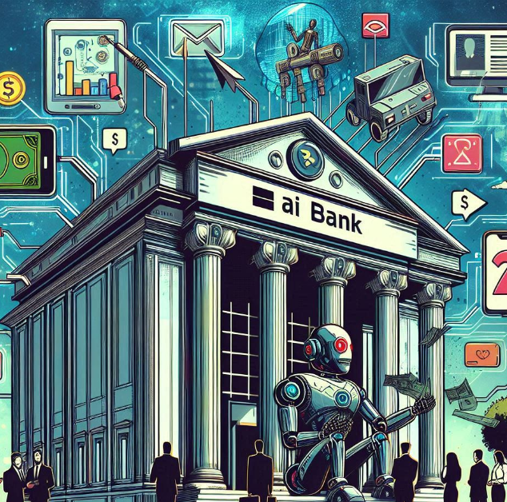
Navigating the Future of Banking Data and Controls in the GenAI Era
As the banking industry embraces the transformative potential of Generative AI, it must navigate a new era of heightened data requirements and enhanced controls. By addressing these challenges, banks can unlock the full benefits of GenAI while ensuring regulatory compliance, data integrity, and ethical AI governance. This journey will require a comprehensive, cross-functional approach that aligns people, processes, and technology to build a resilient and future-ready banking ecosystem.

