Slide 1
Approach Comparison: ML vs. GenAI for Central Bank Communication Analysis

Slide 2
GenAI Approach
ML Approach
Hybrid Approach
Data Collection
Automated scraping of central bank communications
Real-time monitoring of press releases, minutes, speeches
Storage in document database with temporal metadata
RAG System Implementation
Vector embedding of all historical communications
Chunking strategy optimized for financial context preservation
Retrieval mechanism prioritizing recency and relevance
LLM Processing Layer
Fine-tuned financial domain LLM (Claude 3 Opus or equivalent)
Specialized prompt engineering for central bank analysis
Chain-of-thought reasoning for transparent signal generation
Signal Generation System
Structured output format for trading signals (-1 to +1 scale)
Multi-horizon analysis (short/medium/long-term impacts)
Currency and yield curve point-specific signals
Trader Interface
Conversational system for portfolio managers
Document comparison and exploration tools
Reasoning visualization for signal explanation
Data Preparation
Historical communications paired with subsequent market movements
Labeling based on yield changes across key curve points
Feature extraction including linguistic markers, economic references, and structural elements
Model Development
Ensemble of specialized classifiers for hawkish/dovish assessment
Regression models for signal strength prediction
Time series models for temporal pattern recognition
Signal Generation Pipeline
Multi-model voting system for robust predictions
Confidence scoring based on historical accuracy
Calibration to standardized signal scale (-1 to +1)
Validation Framework
Backtesting against historical market movements
Performance metrics (Sharpe ratio, hit rate, drawdowns)
Continuous retraining with new communication-market pairs
Deployment Architecture Low-latency inference pipeline for real-time processing
Scheduled retraining for model adaptation
API-based integration with trading systems
Integrated Data Pipeline
Real-time ingestion of all central bank communications
Structured metadata extraction and document versioning
Parallel processing through both ML and GenAI pipelines
ML Component Implementation
Feature extraction optimized for financial text
Specialized models for hawkish/dovish classification, yield curve impact prediction
Statistical pattern recognition across historical communications
Consistent numerical signal generation with confidence intervals
GenAI Component Implementation
RAG system with economic context integration
Nuanced interpretation of policy implications
Chain-of-thought reasoning for signal justification
Natural language explanations of policy stance
Signal Integration Engine
Dynamic weighting between ML and GenAI signals based on:
Communication type (formal statements vs. speeches)
Market conditions (normal vs. volatile)
Historical accuracy of each component
Cross-validation between components with discrepancy resolution
Comprehensive Trading Interface
Numerical signals with confidence metrics for automated systems
Natural language explanations for trader understanding
Interactive exploration of central bank communication archives
Scenario analysis for potential policy paths
Key Limitations and Impact:
Inconsistency in Signal Generation: Same communications analyzed multiple times may produce slightly different signals, leading to unpredictable trading decisions
Hallucination Risk: Model may generate convincing but incorrect correlations between communication patterns and market movements, potentially causing significant trading losses
Latency Issues: Processing lengthy documents through LLMs creates delays in signal generation during critical market-moving events
Calibration Challenges: Difficulty in consistently mapping linguistic analysis to precise numerical signals, leading to suboptimal position sizing
Historical Pattern Blindness: May miss subtle statistical correlations between specific phrases and market movements that have proven reliable over time
Key Limitations and Impact: Context Blindness: Fails to understand the broader economic context of communications, potentially misinterpreting policy signals during regime transitions Rigidity: Unable to adapt quickly to new communication styles or unprecedented economic conditions, leading to significant model drift during policy pivots Reasoning Opacity: Provides signals without clear explanations, reducing trader confidence and adoption, particularly for large position recommendations Feature Engineering Dependencies: Requires continuous expert intervention to update features as communication strategies evolve Missing Nuance: Struggles with deliberate ambiguity or subtle phrasing changes in forward guidance, potentially missing early signals of policy shifts
Both pure approaches have critical weaknesses that would significantly impact trading performance. The hybrid approach compensates for these limitations by leveraging the complementary strengths of both technologies.
Key Benefits for Barclays Trading: Enhanced Signal Accuracy: Combined approach captures both statistical patterns and contextual nuances, significantly improving prediction quality Faster Adaptation: System responds effectively to both gradual communication evolution and sudden policy shifts Trader Confidence: Transparent reasoning builds trust in signals, increasing adoption and position sizing Reduced False Signals: Cross-validation between components minimizes costly trading errors Multi-horizon Coverage: Effective for both immediate tactical trades and longer-term strategic positioning

Slide 3
Central Bank Communication Analysis System: Final Summary
Strategic Value Proposition The proposed hybrid ML/GenAI system transforms Barclays' approach to trading based on central bank communications. By combining the statistical pattern recognition of machine learning with the nuanced understanding of generative AI, the system provides portfolio managers with superior trading signals directly tied to interest rate movements.
Key Architecture Components Data Ingestion: Real-time monitoring of all central bank communications Dual Processing: Parallel ML and GenAI analysis pipelines Signal Integration: Dynamic weighting system balancing components Trading Interface: Combined numerical signals with natural language explanations
Approach Comparison Summary
Approach | Key Strengths | Critical Weaknesses
Pure ML | Statistical consistency, Computational efficiency, Backtesting frameworks | Context blindness, Reasoning opacity, Adaptation challenges
Pure GenAI | Nuanced understanding, Contextual awareness, Reasoning transparency | Signal inconsistency, Hallucination risk, Computational latency
Hybrid (Recommended) | Combines strengths of both approaches, Cross-validation reduces errors, Adapts to various market conditions | Higher implementation complexity, Additional computational cost
Business Impact:
Enhanced Trading Decision Quality: More accurate interpretation of central bank communications leads to better position timing and sizing
Risk Reduction: Transparent reasoning and cross-validated signals minimize costly trading errors
Competitive Advantage: System's ability to quickly adapt to changing policy frameworks provides edge over competitors
Scalable Returns: As described in requirements, the profits are "tangible, quantifiable, attributable" and "(de-facto) infinitely scalable"
Implementation Pathway:
The system can be deployed in phases, starting with a core RAG system for immediate value, then integrating ML components and finally the signal integration engine. This approach allows for validation at each stage and continual refinement based on trading performance.
This hybrid solution directly addresses Barclays' stated challenge of making large trading wagers based on central bank communications, providing both the quantitative precision and qualitative understanding needed for high-confidence interest rate trading decisions.

Slide 4
Machine Learning Approach
Generative AI Approach
Architecture
Text Classification Models: Train specialized models to classify central bank communications as hawkish/dovish
NER & Entity Extraction: Identify key economic indicators, policy references, and sentiment signals
Time Series Forecasting: Correlate extracted signals with historical rate movements
Implementation Steps
Data Collection & Preprocessing
Gather historical central bank communications with corresponding market reactions
Clean and normalize text data
Label communications based on subsequent market movements
Feature Engineering
Extract numerical features from text (keyword frequencies, sentiment scores)
Create specialized dictionaries of hawkish/dovish terminology
Develop structural features (document length, sentence complexity)
Model Development
Train multiple specialized models (SVMs, Random Forests, GBDTs)
Optimize for accuracy in classifying communications
Create ensemble models for robust predictions
Signal Generation
Convert model outputs into actionable trading signals (-1 to +1)
Apply weighting based on confidence scores
Integrate with existing trading systems
Backtesting & Deployment
Validate against historical data
Implement A/B testing framework
Deploy with monitoring for signal drift
Architecture
Large Language Model Core: Fine-tuned LLM specialized in financial/economic domain
RAG System: Retrieval-augmented generation with central bank communication archive
Signal Extraction Layer: Structured output generation for trading signals
Implementation Steps
Data Preparation
Create knowledge base of central bank communications
Develop vector embeddings for efficient retrieval
Build structured schema for financial insights extraction
Model Selection & Customization
Select foundation model (e.g., Claude 3 Opus, GPT-4, Gemini, Llama 3)
Fine-tune on financial domain data
Develop prompt engineering strategies for consistent output
RAG Integration
Implement vector database (Pinecone, Weaviate)
Create retrieval pipeline for relevant communications
Develop context window optimization
Signal Generation System
Design structured output format for trading signals
Develop reasoning chains for signal justification
Create confidence scoring mechanism
User Interface & Integration
Build conversational interface for portfolio managers
Develop API endpoints for system integration
Create visualization components for signal strength

Slide 5
Hybrid Approach (Recommended)
Comparison and Recommendation
Recommended solution combines both approaches:
Data Ingestion Layer
Real-time scraping of central bank websites, press releases, speeches
Automatic document categorization and metadata extraction
Versioning system for tracking communication evolution
Processing Pipeline
LLM Component: For deep semantic understanding and nuanced context
ML Component: For consistent pattern recognition and historical correlation
Knowledge Management System
Vector database of all communications with temporal indexing
Contextual relationships between documents mapped
Historical market response data linked to communications
Signal Generation Engine
Rule-based signal formulation tied to confidence scores
Backtesting module for historical validation
Calibration system for signal strength (-1 to +1)
User Interface
Conversational interface for trader interaction
Visualization dashboard for signal strength and reasoning
Document exploration and comparison tools
Aspect | Machine Learning | Generative AI | Hybrid (Recommended)
Pattern Recognition | ★★★★☆ | ★★★☆☆ | ★★★★★
Nuanced Understanding | ★★☆☆☆ | ★★★★★ | ★★★★★
Reasoning Transparency | ★★☆☆☆ | ★★★★☆ | ★★★★☆
Consistency | ★★★★★ | ★★★☆☆ | ★★★★☆
Adaptability | ★★☆☆☆ | ★★★★★ | ★★★★★
Implementation Complexity | ★★★☆☆ | ★★★★☆ | ★★★★★

Slide 6
Recommendation: Hybrid Approach
The recommend a hybrid approach that leverages the strengths of both ML and GenAI for the following reasons:
Complementary Strengths:
GenAI excels at understanding nuanced language and context in central bank communications
ML provides consistency and historically-validated pattern recognition
Risk Mitigation:
ML models provide stable baseline predictions
GenAI adds adaptive reasoning for novel situations
System can fall back to either approach when confidence is low in the other
Progressive Implementation:
Start with GenAI-based RAG system for immediate value
Develop ML models in parallel using feedback from GenAI system
Integrate gradually for continuous improvement
Trader Experience:
Conversational interface powered by GenAI
Signal consistency assured by ML validation
Reasoning chains provided for trader confidence
The hybrid approach would generate the most robust signals across varying market conditions while providing transparent reasoning that portfolio managers can understand and trust - critical for the high-stakes trading environment described in your requirements.

Slide 7
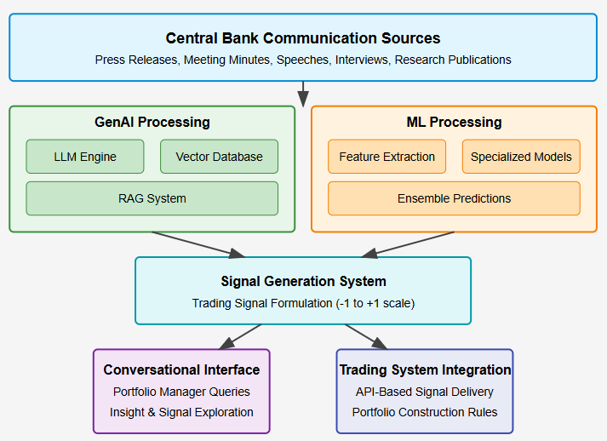
Central Bank Communication Analysis System Architecture

Slide 8
Detailed Comparison and Recommendation
Machine Learning Approach: Strengths and Limitations
Strengths:
Pattern Recognition Consistency: ML models excel at identifying statistical patterns in historical data, providing reliable detection of known sentiment indicators.
Quantitative Precision: Can assign precise numerical scores to communications based on historical correlations with market movements.
Computational Efficiency: Once trained, ML models can process new communications quickly with minimal computational resources.
Proven Track Record: Traditional ML has a longer history in algorithmic trading with established performance metrics.
Limitations:
Context Blindness: Struggles with understanding the broader economic context and policy implications.
Rigidity: Models trained on historical patterns may fail when central banks change communication styles or face unprecedented economic conditions.
Feature Engineering Overhead: Requires extensive manual work to create relevant features that capture communication nuances.
Reasoning Opacity: Difficult for traders to understand why a specific signal was generated, reducing trust and adoption.
Generative AI Approach: Strengths and Limitations
Strengths:
Nuanced Understanding: Can interpret subtle shifts in tone and rhetoric that might signify policy direction changes.
Contextual Awareness: Capable of considering broader economic contexts when analyzing communications.
Reasoning Transparency: Can articulate its rationale for signal generation in natural language that traders understand.
Adaptability: Can more readily adapt to novel communication styles or unprecedented economic conditions.
Limitations:
Consistency Challenges: May generate slightly different interpretations of similar texts across queries.
Hallucination Risk: Potential to fabricate correlations or reasoning not supported by the data.
Computational Intensity: Processing communications through LLMs requires more computational resources.
Historical Pattern Recognition: May not identify subtle statistical patterns as effectively as specialized ML models.
Hybrid Approach: The Optimal Solution
The recommended hybrid approach combines these technologies in a complementary architecture:
Key Advantages:
Multi-dimensional Analysis:
Quantitative ML analysis identifies statistical patterns
Qualitative GenAI analysis provides semantic and contextual understanding
Combined, they provide a more complete picture than either approach alone
Error Correction and Validation:
ML components can flag when GenAI interpretations deviate significantly from historical patterns
GenAI components can provide contextual explanations for unexpected ML signals
This cross-validation increases overall system reliability
Adaptive Signal Weighting:
System can learn to adjust weights between ML and GenAI signals based on:
Market conditions (high volatility vs. stable periods)
Communication types (formal statements vs. interviews)
Historical performance of each approach for specific central banks
Scalable Implementation Path:
Start with core RAG system for immediate value
Develop specialized ML models in parallel
Integrate and balance signals progressively
This approach allows for validation at each stage rather than a risky all-at-once deployment

Slide 9
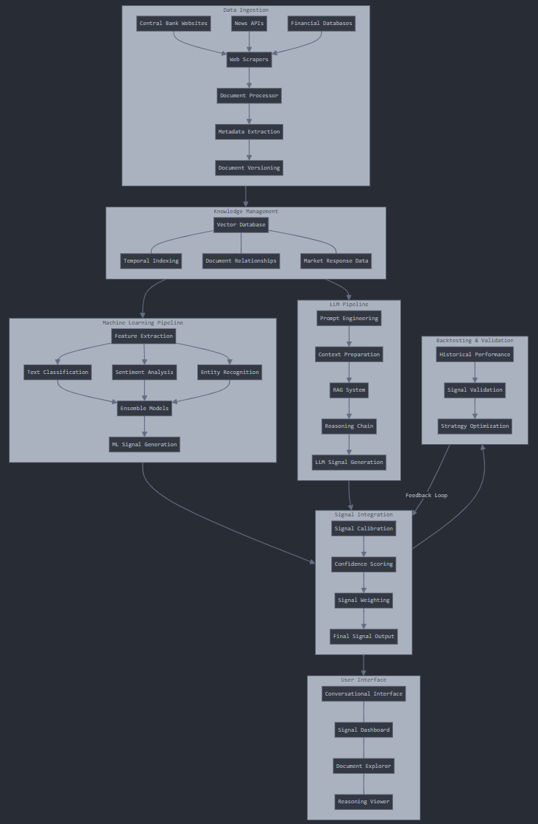

Slide 10
System Components Explained
Data Ingestion
Automated Scrapers: Regular collection of all communications from central bank websites, financial news sources, and specialized databases
Document Processing Pipeline:
Converts various formats (PDF, HTML, transcripts) to standardized text
Extracts metadata (date, author, event type, publication context)
Maintains document versioning to track revisions of policy statements
Real-time Monitoring: Alerts system of new publications within minutes of release
Knowledge Management System
Vector Database: Stores document embeddings for semantic retrieval
Technologies: Pinecone, Weaviate, or Qdrant optimized for financial text
Indexing Strategy: Multi-dimensional indexing by content, time, source, and impact
Document Relationships: Maps connections between related communications
Tracks evolution of policy language over time
Links preliminary statements with formal announcements
Market Response Data: Pairs communications with subsequent market movements
Short-term price actions (1hr, 1day)
Medium-term yield curve changes (1wk, 1mo)
Machine Learning Pipeline
Feature Extraction:
Statistical text features (document structure, complexity metrics)
Economic indicator mentions and context
Policy terminology frequency and positioning
Specialized Models:
Hawkish/Dovish Classification: Multi-class models for policy stance detection
Term Structure Impact: Predicts yield curve sector responses
Cross-Currency Effects: Anticipates spillover effects across GBP/USD/EUR
Ensemble Integration:
Weighted voting mechanism based on historical accuracy
Bayesian model averaging for confidence estimation
Temporal decay factors for recency bia
LLM Processing Pipeline
Prompt Engineering:
Specialized prompts for different communication types
Chain-of-thought reasoning prompts for transparent analysis
Multi-step analysis templates for complex documents
RAG Implementation:
Semantic search for relevant historical communications
Economic context inclusion from market data
Policy continuity analysis against previous statements
Signal Extraction:
Structured output generation with confidence levels
Multi-horizon impact assessment (short/medium/long term)
Currency-specific implications extraction
Signal Integration System
Calibration Engine:
Maps raw outputs to standardized signal scale (-1 to +1)
Adjusts for model-specific biases and tendencies
Normalizes confidence levels across approaches
Weighting Mechanism:
Dynamic weights based on historical performance
Regime-specific adjustments (high volatility periods vs. stable)
Communication-type optimizations (formal statements vs. interviews)
Final Signal Generation:
Produces asset-specific signals across yield curve points
Includes confidence intervals and supporting evidence
Generates trade size recommendations based on conviction
Backtesting & Validation
Historical Performance Analysis:
Simulates trading strategy performance using historical signals
Measures key metrics (Sharpe ratio, drawdowns, hit rate)
Performs attribution analysis between ML and GenAI components
Validation Framework:
Out-of-sample testing across different market regimes
Stress testing against historical policy surprises
Sensitivity analysis to system parameters
Feedback Loop:
Continuous retraining and optimization based on performance
Signal drift detection for model recalibration
A/B testing framework for system improvements
User Interface
Conversational Interface:
Natural language queries about central bank communications
Comparative analysis requests across time periods or banks
Customized alerts and monitoring setups
Signal Dashboard:
Visual representation of current signals across currencies/maturities
Signal evolution charts showing change over time
Confidence visualization with supporting evidence
Document Explorer:
Side-by-side comparison of communications
Highlighted key passages with impact assessment
Language evolution tracking across policy cycles
Reasoning Viewer:
Transparent explanation of signal generation logic
Contributing factors with relative importance
Alternative interpretations with probability estimates

