Slide 1

Cloth Store Online Booking Batch – 86
Suresh
Veera
Shiva

Slide 2
AGENDA
PROBLEM sTATEMENT
DESIGN
TECHNOLOGIES
SCREEN SHOTS(rESULT)
cONCLUSION

Slide 3
Problem Statement
E-commerce provides an easy way to sell products to a large customer base. However, there is a lot of competition among multiple e-commerce sites. When users land on an e-commerce site, they expect to find what they are looking for quickly and easily. Also, users are not sure about the brands or the actual products they want to purchase. They have a very broad idea about what they want to buy. The purpose of any e-commerce website is to help customers narrow down their broad ideas and enable them to finalize the products.

Slide 4
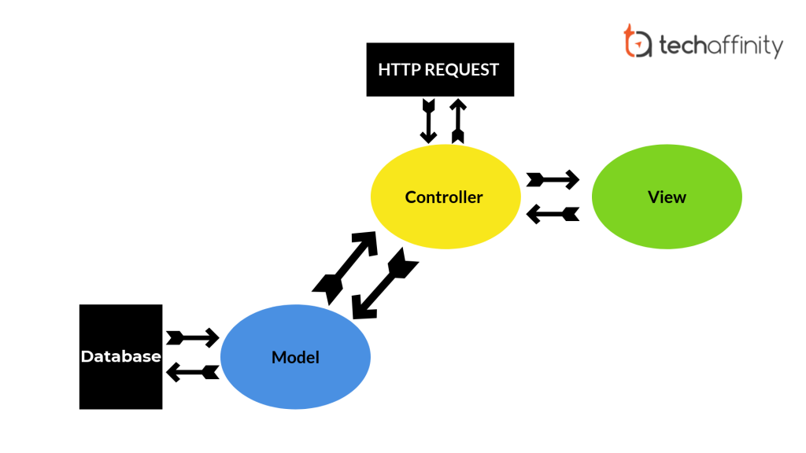

Design

Slide 5
Technologies
MySql database for backend.
Html, CSS and Java Script for Front end.
Spring boot, Spring web services and Rest API's.

Slide 6
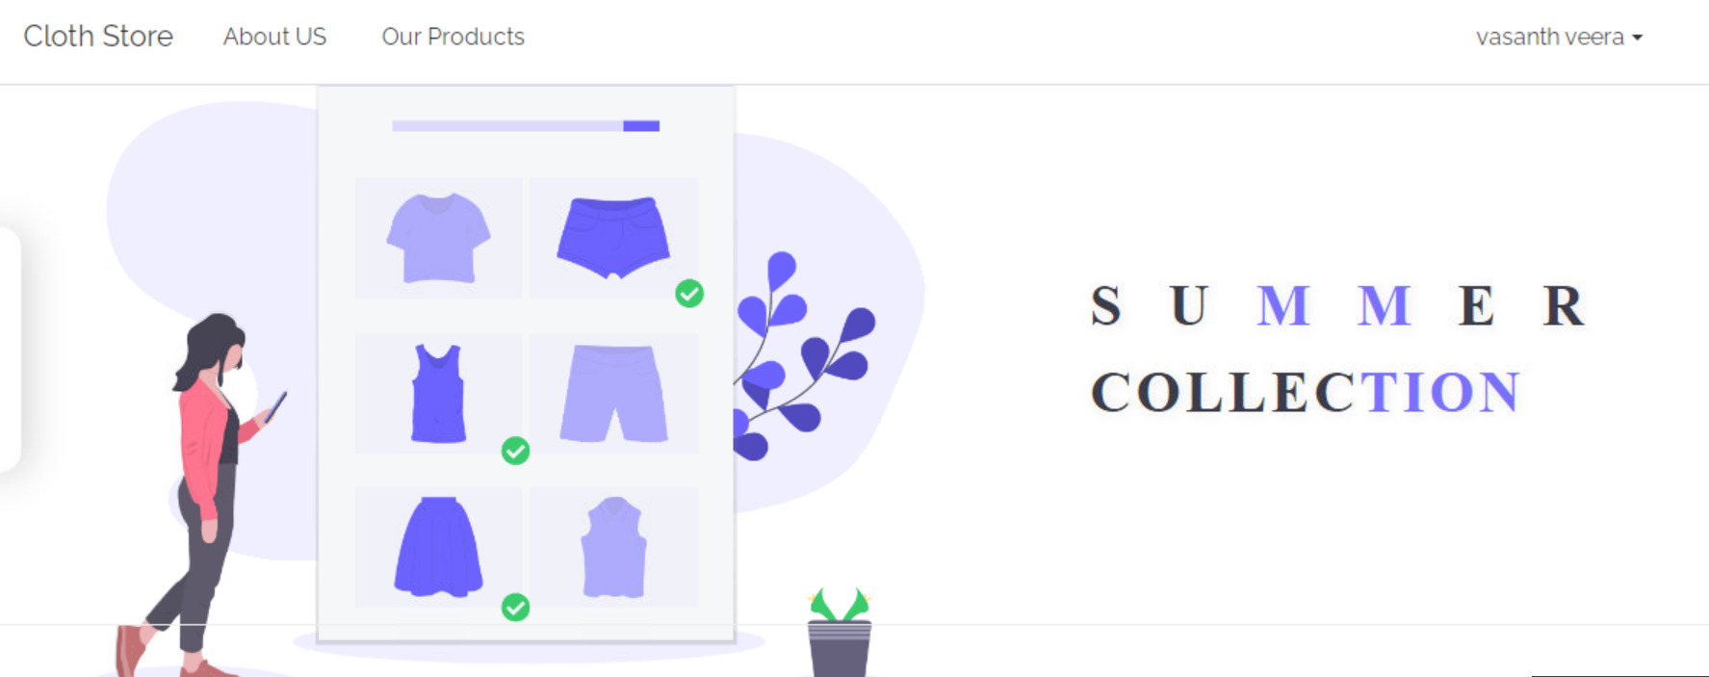
SCREEN SHOT

Slide 7
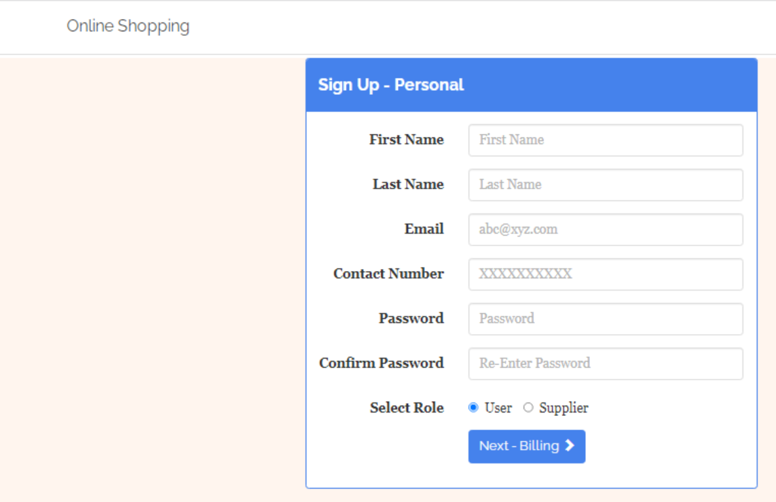
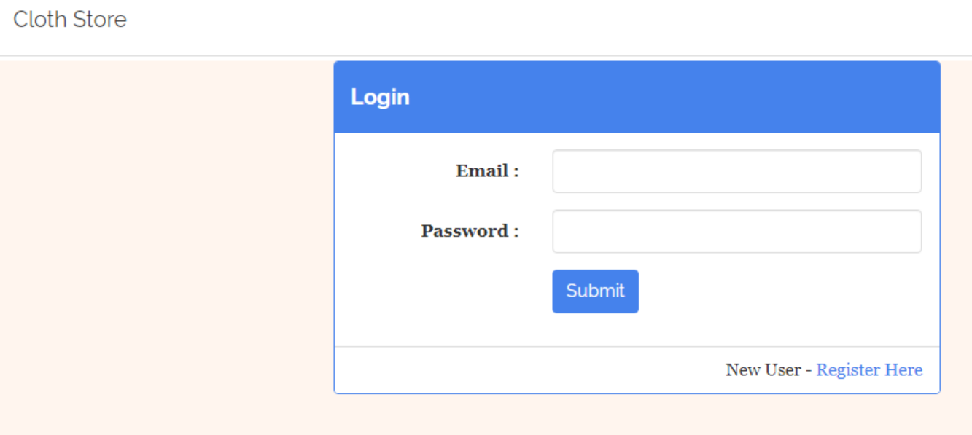
SCREEN SHOT

Slide 8
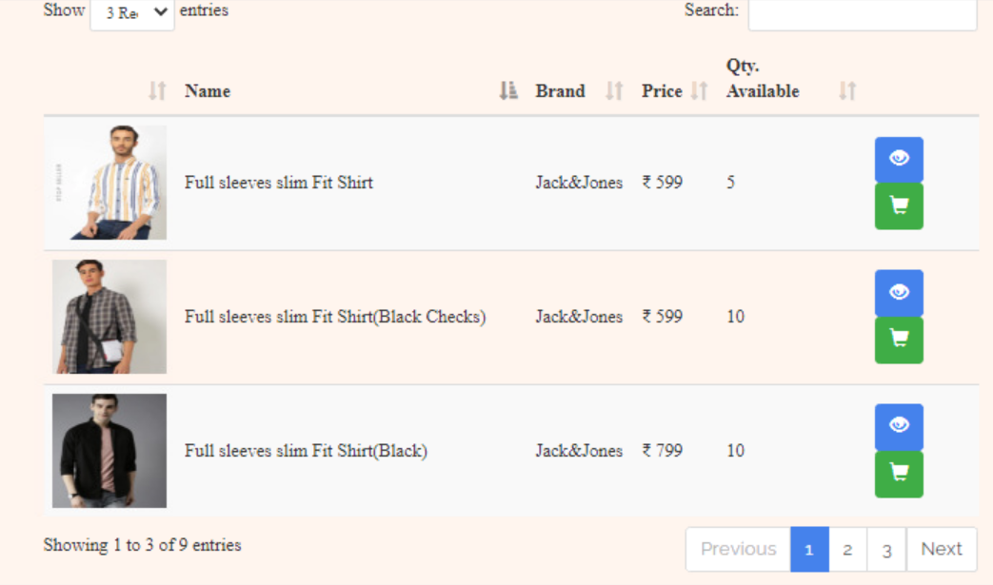
SCREEN SHOT

Slide 9
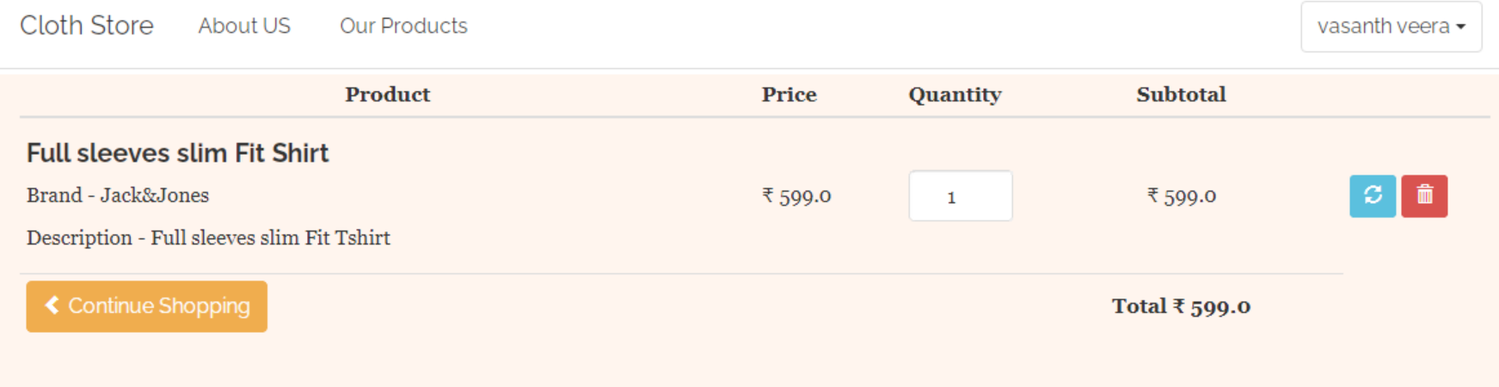
SCREEN SHOT

Slide 10
CONCLUSION
The online clothing shopping portal gives user an experience to shop at one place and exposure to the wide range of products at one website.
The future enhancement is to make the website more secure, interactive and dynamic

Slide 11
THANK YOU

