Slide 1



PAAVAI ENGINEERING COLLEGE
Autonomous Institution | Approved By AICTE
Affiliated To Anna University, Chennai | Accredited by NBA & NAAC(UGC) with 'A' Grade
Department of CSE(IoT)
Automatic heating and cooling IoT based smart sipper
Guided by :
Ms .M. Mangaiyarkarasi
(Assistant Professor)
Department of CSE (Internet of Things)
By :
S .Brindha
N .Veeradesika
IV -CSE(IoT)

Slide 2
PAAVAI ENGINEERING COLLEGE
Autonomous Institution | Approved By AICTE
Affiliated To Anna University, Chennai | Accredited By NBA & NAAC(UGC) With 'A' Grade
|
Department of CSE(IoT)
Introduction
The Internet of Things (IoT) has brought intelligence and connectivity to everyday objects, improving convenience and efficiency. A smart sipper integrates IoT technology to automatically maintain the temperature of water using a Peltier module. The bottle can both cool and heat the water as needed and allows the user to monitor and control it via a mobile application using Wi-Fi and Bluetooth. This innovation ensures proper hydration with the desired temperature anytime, making it ideal for daily use and travel.

Slide 3

PAAVAI ENGINEERING COLLEGE
Autonomous Institution | Approved By AICTE
Affiliated To Anna University, Chennai | Accredited By NBA & NAAC(UGC) With 'A' Grade
|
Department of CSE(IoT)
Abstract
Real-time temperature data is uploaded to mobile app, allowing remote monitoring and control.
The project aims to improve hydration convenience.
This project proposes an IoT-enabled Smart Sipper capable of automatically cooling or heating water based on user requirements.

Slide 4
PAAVAI ENGINEERING COLLEGE
Autonomous Institution | Approved By AICTE
Affiliated To Anna University, Chennai | Accredited By NBA & NAAC(UGC) With 'A' Grade
|
Department of CSE(IoT)
Problem Statement
People often struggle to maintain drinking water at their desired temperature.
Conventional water bottles cannot automatically heat or cool water.
There is a no real-time monitoring or remote control in normal sippers.
Users cannot track temperature or control the sipper using a mobile device.

Slide 5


PAAVAI ENGINEERING COLLEGE
Autonomous Institution | Approved By AICTE
Affiliated To Anna University, Chennai | Accredited By NBA & NAAC(UGC) With 'A' Grade
|
Department of CSE(IoT)
Objectives
To develop a smart sipper that can automatically heat or cool water .
To monitor real-time temperature using an IoT cloud platform.
To allow remote control via mobile app.
To ensure user safety with multilayer insulation.
To design a portable, and user-friendly system.

Slide 6
PAAVAI ENGINEERING COLLEGE
Autonomous Institution | Approved By AICTE
Affiliated To Anna University, Chennai | Accredited By NBA & NAAC(UGC) With 'A' Grade
|
Department of CSE(IoT)
Existing System vs Proposed System
Existing System | Proposed System
Cannot adjust water temperature based on user performance. | Smart sipper with Peltier module for heating and cooling.
No real-time temperature display. | Temperature sensor for continuous monitoring.
Manual effort is required to change water temperature. | Real-time data upload to Adafruit IO.
No smart features such as alerts or remote access. | Remote ON/OFF control through IoT dashboard.
Self cleaning smart water bottle | ESP32 microcontroller for control and communication.

Slide 7
PAAVAI ENGINEERING COLLEGE
Autonomous Institution | Approved By AICTE
Affiliated To Anna University, Chennai | Accredited By NBA & NAAC(UGC) With 'A' Grade
|
Department of CSE(IoT)
Module Description
Sensor Module: Measures water temperature.
Control Module: Uses microcontroller logic to activate heating or cooling.
Peltier Module: Performs cooling operation.
Ceramic cartage: Performs hot operation.
Communication Module: Enables Wi-Fi/Bluetooth connectivity to send/receive data .
Power Module: Supplies power to all components.

Slide 8
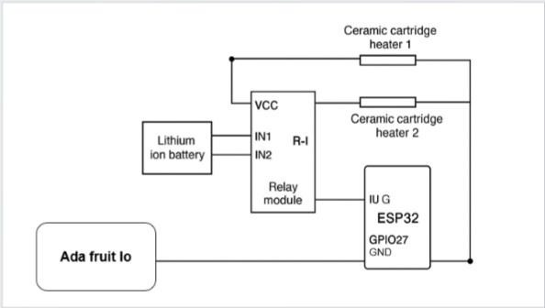
PAAVAI ENGINEERING COLLEGE
Autonomous Institution | Approved By AICTE
Affiliated To Anna University, Chennai | Accredited By NBA & NAAC(UGC) With 'A' Grade
|
Department of CSE(IoT)
Circuit Diagram

Slide 9
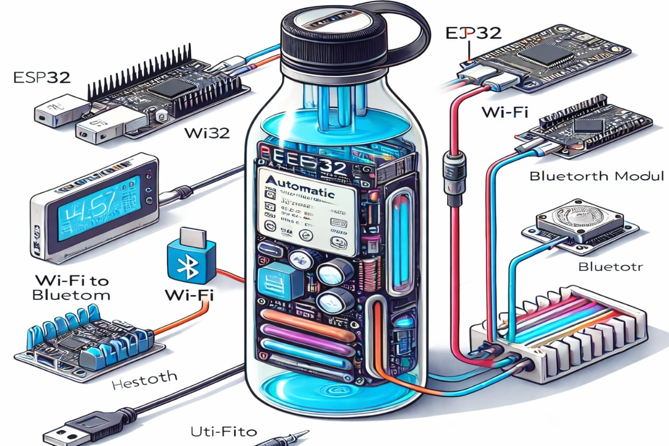
PAAVAI ENGINEERING COLLEGE
Autonomous Institution | Approved By AICTE
Affiliated To Anna University, Chennai | Accredited By NBA & NAAC(UGC) With 'A' Grade
|
Department of CSE(IoT)
System Architecture

Slide 10
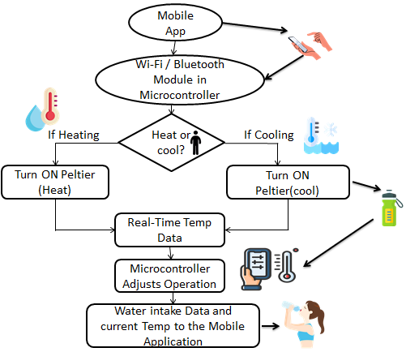
PAAVAI ENGINEERING COLLEGE
Autonomous Institution | Approved By AICTE
Affiliated To Anna University, Chennai | Accredited By NBA & NAAC(UGC) With 'A' Grade
|
Department of CSE(IoT)
Methodology

Slide 11
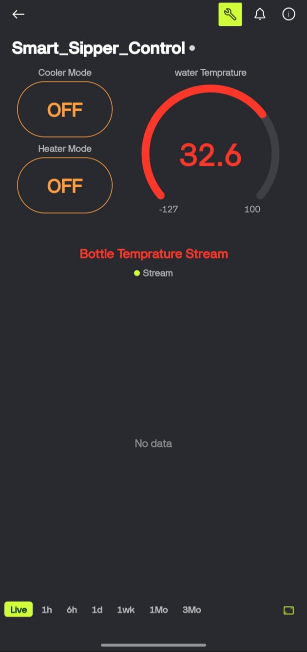
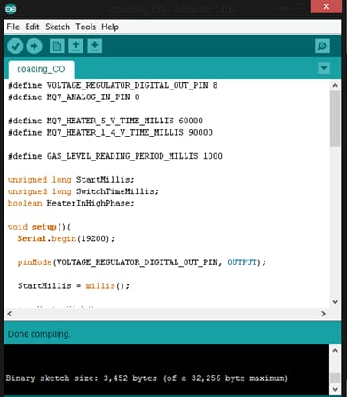
PAAVAI ENGINEERING COLLEGE
Autonomous Institution | Approved By AICTE
Affiliated To Anna University, Chennai | Accredited By NBA & NAAC(UGC) With 'A' Grade
|
Department of CSE(IoT)
Output Screenshot

Slide 12
PAAVAI ENGINEERING COLLEGE
Autonomous Institution | Approved By AICTE
Affiliated To Anna University, Chennai | Accredited By NBA & NAAC(UGC) With 'A' Grade
|
Department of CSE(IoT)
Performance Analysis
Condition | Initial Temperature | Final Temperature | Time Taken
Cooling | 30°C | 20°C | 10 min
Heating | 25°C | 40°C | 3 min

Slide 13
PAAVAI ENGINEERING COLLEGE
Autonomous Institution | Approved By AICTE
Affiliated To Anna University, Chennai | Accredited By NBA & NAAC(UGC) With 'A' Grade
|
Department of CSE(IoT)
Test case Scenarios
Power ON Test
Temperature Monitoring Test
Cooling/Heating Function Test
Mobile App Connectivity Test

Slide 14
PAAVAI ENGINEERING COLLEGE
Autonomous Institution | Approved By AICTE
Affiliated To Anna University, Chennai | Accredited By NBA & NAAC(UGC) With 'A' Grade
|
Department of CSE(IoT)
Remaining Work with Timeline
100 percent work completed

Slide 15
PAAVAI ENGINEERING COLLEGE
Autonomous Institution | Approved By AICTE
Affiliated To Anna University, Chennai | Accredited By NBA & NAAC(UGC) With 'A' Grade
|
Department of CSE(IoT)
Advantages & Applications
Tracks daily water intake to maintain hydration.
Sends alerts to remind users to drink water.
Helps fitness users monitor hydration levels.
Assists elderly people in remembering to drink water.
Improves focus and productivity by maintaining hydration.
Keeps water hot or cold as required.
Easy to control using a mobile app.
Works automatically, no manual effort needed.
Saves energy by operating only when necessary.
Portable and user-friendly for daily use.

Slide 16

PAAVAI ENGINEERING COLLEGE
Autonomous Institution | Approved By AICTE
Affiliated To Anna University, Chennai | Accredited By NBA & NAAC(UGC) With 'A' Grade
|
Department of CSE(IoT)
Conclusion
Smart Sipper maintains desired temperature automatically.
Provides real-time monitoring and control.
Demonstrates IoT and embedded integration for smart lifestyle devices.

Slide 17
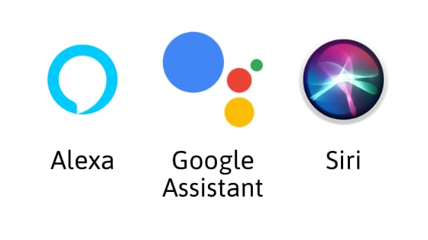
PAAVAI ENGINEERING COLLEGE
Autonomous Institution | Approved By AICTE
Affiliated To Anna University, Chennai | Accredited By NBA & NAAC(UGC) With 'A' Grade
|
Department of CSE(IoT)
Future Enhancement
Integration of hydration tracking and water intake reminders.
Voice assistant control using Alexa or Google Assistant.
Solar-based power system for energy efficiency.
Lightweight and compact design with rechargeable battery.

Slide 18
PAAVAI ENGINEERING COLLEGE
Autonomous Institution | Approved By AICTE
Affiliated To Anna University, Chennai | Accredited By NBA & NAAC(UGC) With 'A' Grade
|
Department of CSE(IoT)
Thank You

