Slide 1
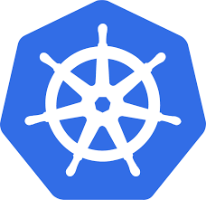
KUBERNETES
Kubernetes is an open-source system for automating deployment, scaling, and management of containerized applications or platforms.
Benefit of using Kubernetes:
Load balancing and simplify container management on multiple hosts.
Better business productivity.
Multi-cloud capability.
Cheaper than its alternatives

Slide 2
KUBERNETES ARCHITECTURE

Slide 3
Kubernetes Cluster Architecture
Master node
Worker node
ETCD cluster
Kube-API server
Control Manager
Kube Scheduler
Kubelet
Kubelet Proxy

Slide 4
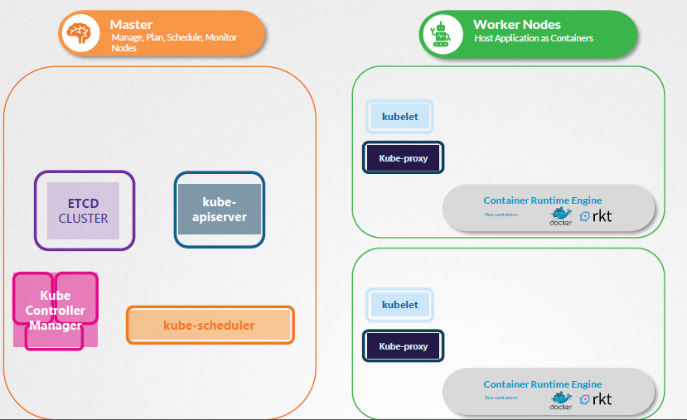

Slide 5
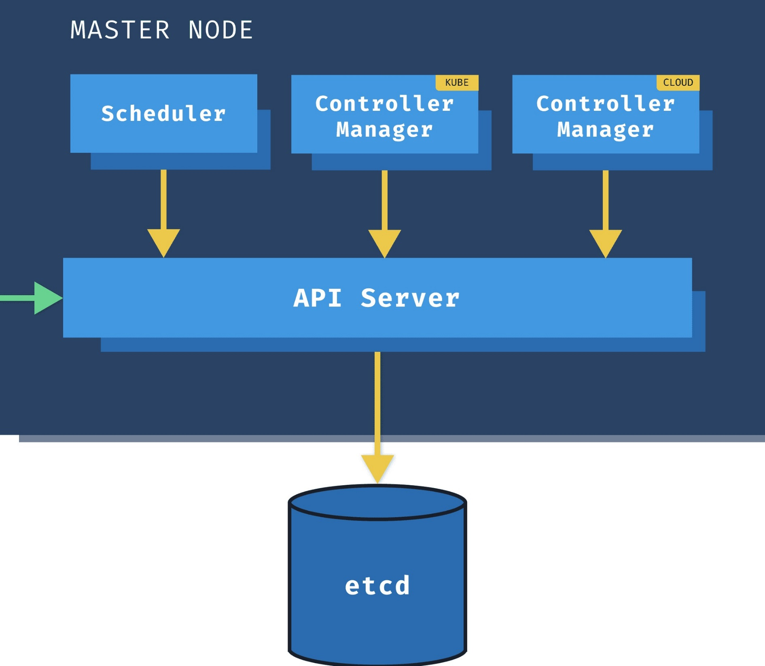
Master node is responsible for managing, storing information, planning and monitoring the nodes.

Slide 6
1. ETCD Cluster:
Highly available key value store.
Holds the information of cluster configuration and state data such as the number of pods, their state, namespace, etc.
Stores information in key value format.
2. Kube-API server:
The primary management component of k8s and responsible for all the operations in the cluster.
Authenticates user, validate requests, retrieve data etc.

Slide 7
3. Control manager:
Regulates the state of cluster and performs tasks.
Takes care of different areas like node controller takes care of nodes.
Responsible for on boarding of new nodes and handling the situations where as replication controller ensures that the desired number of containers are running or not.
4. Kube Scheduler:
Allocates right pods to nodes based on the requirement.
Responsible for distributing of workloads.

Slide 8
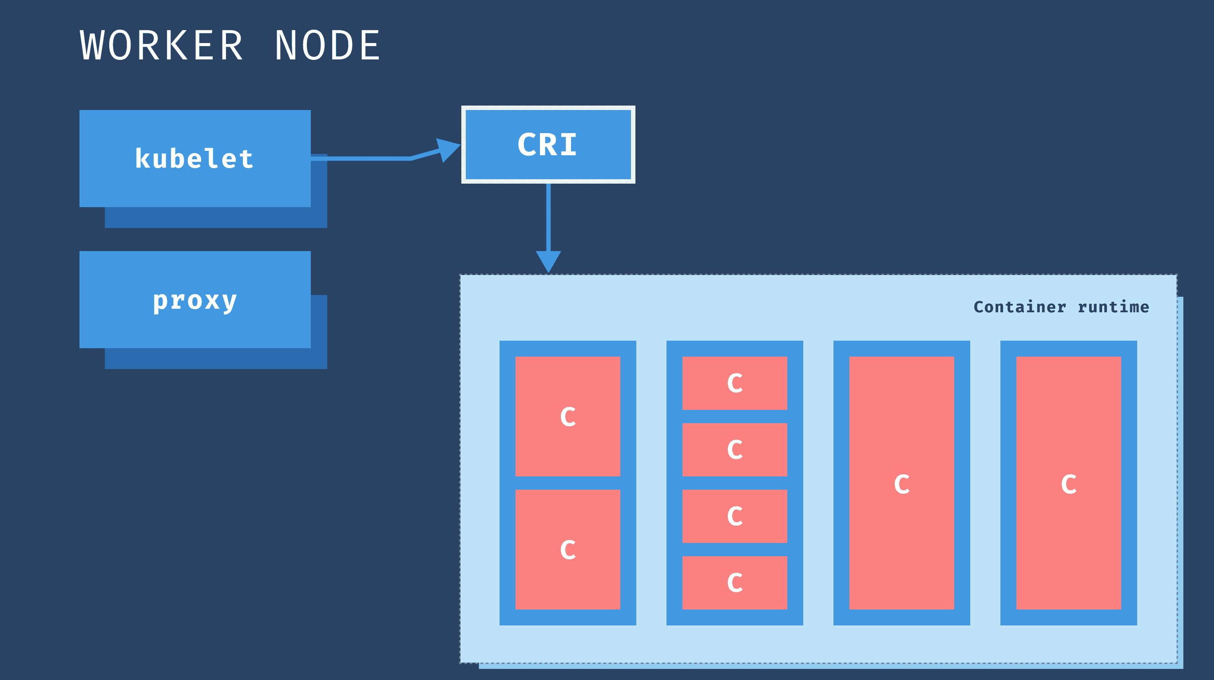
Worker nodes are responsible for hosting Docker containers and handles networking to ensure the traffic between applications across the cluster.

Slide 9
Kubelet:
Kubelet is a agent that runs on each node in a cluster.
Listens for instructions from Kube-API server and instructs the container runtime to start or stop containers as needed.
Periodically fetches status report, monitor the status of nodes and containers on them.
Responsible for managing the deployment of pods to Kubernetes nodes.
Kubelet Proxy:
Kube-proxy is a network proxy that runs on each node in your cluster.
Maintains network rules on nodes. These network rules allow network communication to your Pods from inside or outside of your cluster.

Slide 10
THANK YOU

