Slide 1
DIGITAL PORTFOLIO
STUDENT NAME: KAVIYA.V
REGISTER NO AND NMID:24131130500122009
/asanm11324131130500122009
DEPARTMANT: BCA – II year
COLLEGE NAME AND UNIVERSITY: 113-VALLALAR ARTS AND SCIENCE COLLEGE,ANNAMALAI UNIVERSITY

Slide 2
PROJECT TITLE:
CUSTOMER SERVICE REPRESENTATIVE
PORTFOLIO

Slide 3
AGENDA:
1.Problem Statement
2.Project Overview
3.End Users
4.Tools and Technologies
5.Portfolio design and Layout
6.Features and Functionality
7.Results and Screenshots
8.Conclusion
9.Github Link

Slide 4
PROBLEM STATEMENT:
Customer service skills and achievements are often hard to showcase through a traditional resume. Professionals need an interactive portfolio to highlight communication abilities, support metrics, and tools used. This project solves that by creating a digital portfolio using HTML, CSS, and JavaScript.

Slide 5
PROJECT OVERVIEW:
Designed a professional portfolio website for a Customer Service Representative.
Showcases key skills, achievements, and customer support metrics.
Built using HTML, CSS, and JavaScript for interactive design.
Includes sections like About, Skills, Projects, Testimonials, and Contact.
Provides a modern way to present customer service expertise online.

Slide 6
END USERS:
Hiring managers looking to evaluate customer service skills.
Recruiters searching for candidates with proven support experience.
Customers or clients wanting to see professionalism and communication style.
Trainers or mentors reviewing portfolio projects for career development.

Slide 7
TOOLS AND TECHNIQUES:
HTML5 – for structuring portfolio content.
CSS3 – for styling and responsive design.
JavaScript – for interactivity and form validation.
CRM Tools (Zendesk, Freshdesk, HubSpot) – highlighted as part of domain expertise.

Slide 8
PORTFOLIO DESIGN AND LAYOUT:
Modern and professional UI with dark theme and brand colors.
Responsive grid layout for About, Skills, Projects, and Contact sections.
Hero section with portrait and key highlights in cards.
Card-based design for testimonials, FAQs, and skills.
Sticky navigation bar with call-to-action for easy access.

Slide 9
FEATURES AND FUNCTIONALITY:
Interactive navigation with smooth scrolling across sections.
Hero section showcasing key metrics like CSAT, FCR, and response time.
Skills and projects displayed with filtering and highlights.
Testimonials and FAQs for credibility and clarity.
Contact form with validation and email copy functionality.

Slide 10
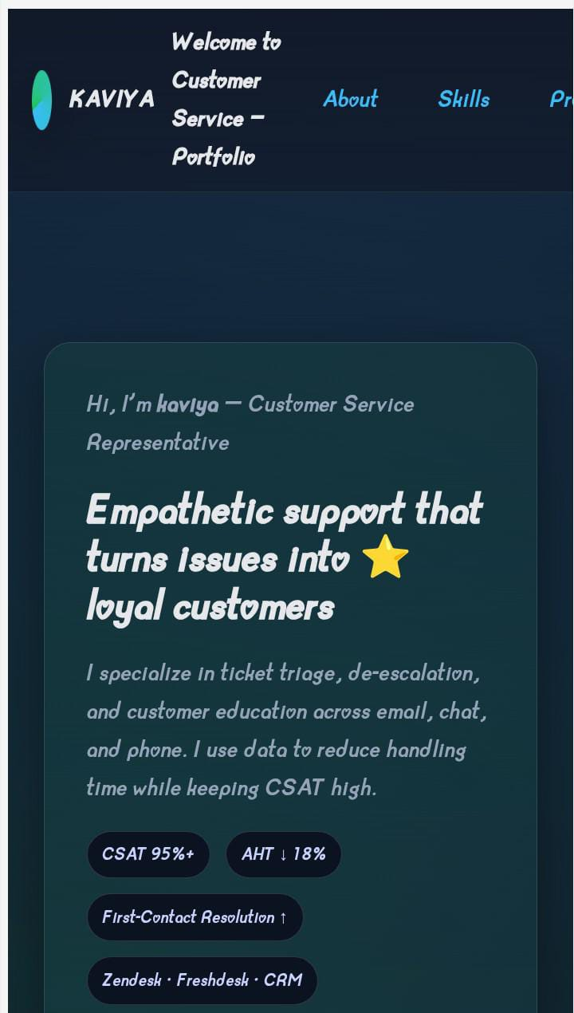
RESULTS AND SCREENSHORT:
Successfully developed a responsive and interactive portfolio showcasing customer service skills and achievements.
Screenshots highlight the Hero, Skills, Projects, and Contact sections with clean UI and smooth navigation.

Slide 11
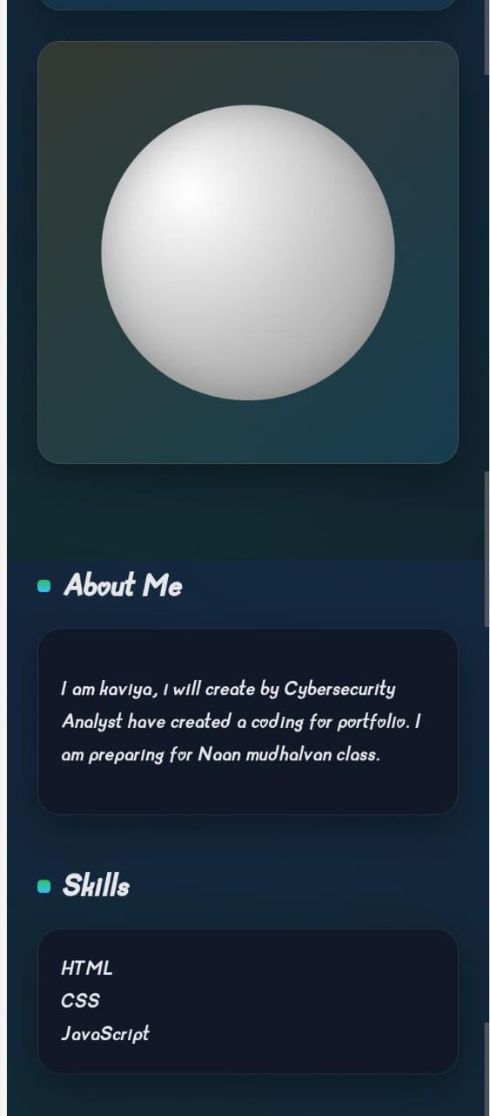
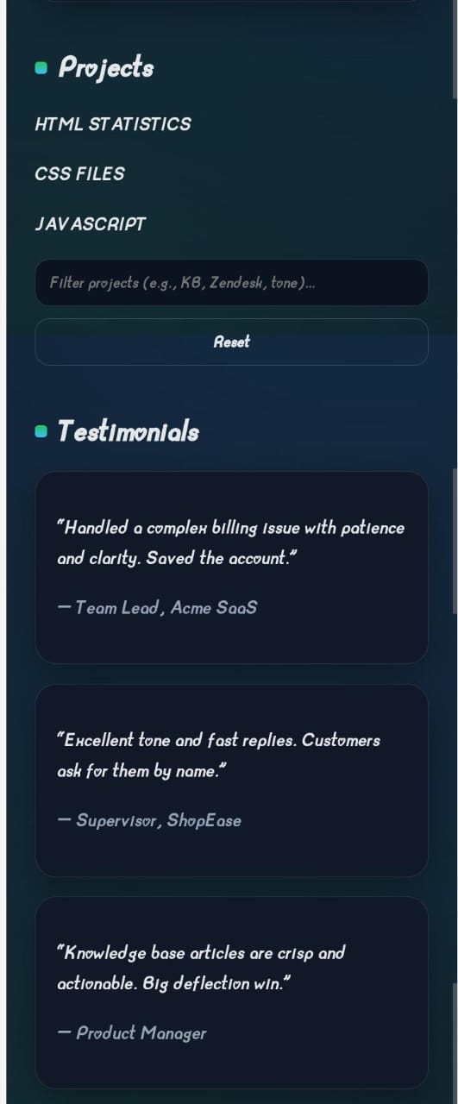
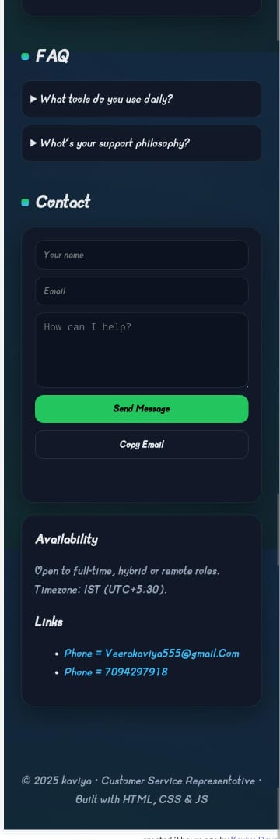

Slide 12
CONCLUSION:
This portfolio demonstrates how customer service expertise can be presented in a modern and engaging way.
It highlights key skills, metrics, and achievements with interactive features.
Built using HTML, CSS, and JavaScript, it ensures responsiveness and accessibility.
The project serves as a professional tool for career growth and opportunities.

