Slide 1

Is it Possible to Predict Heart Disease with Machine Learning?

Slide 2
Research Question
“Is it possible to predict heart disease with machine learning? With the help of the dataset’s attributes and machine learning techniques used to predict the presence of heart disease in a patient. Typically doctors and healthcare companies use similar attributes and factors to predict this type of disease with patients that have similar lifestyles and family history. The focus of this project is developing a model that can be used to make early prediction of people who are a high risk of developing heart disease.”

Slide 3
My Approach
I see this being a classification problem in predicting heart disease in men and women of different age groups and lifestyles
I am planning on using classification algorithms like random forests, ADA boost and logistic regression.
Using different approaches will give an insightful image of which one works and the differences of the results. This will lead me to have a better understanding of the results and how to handle them.

Slide 4
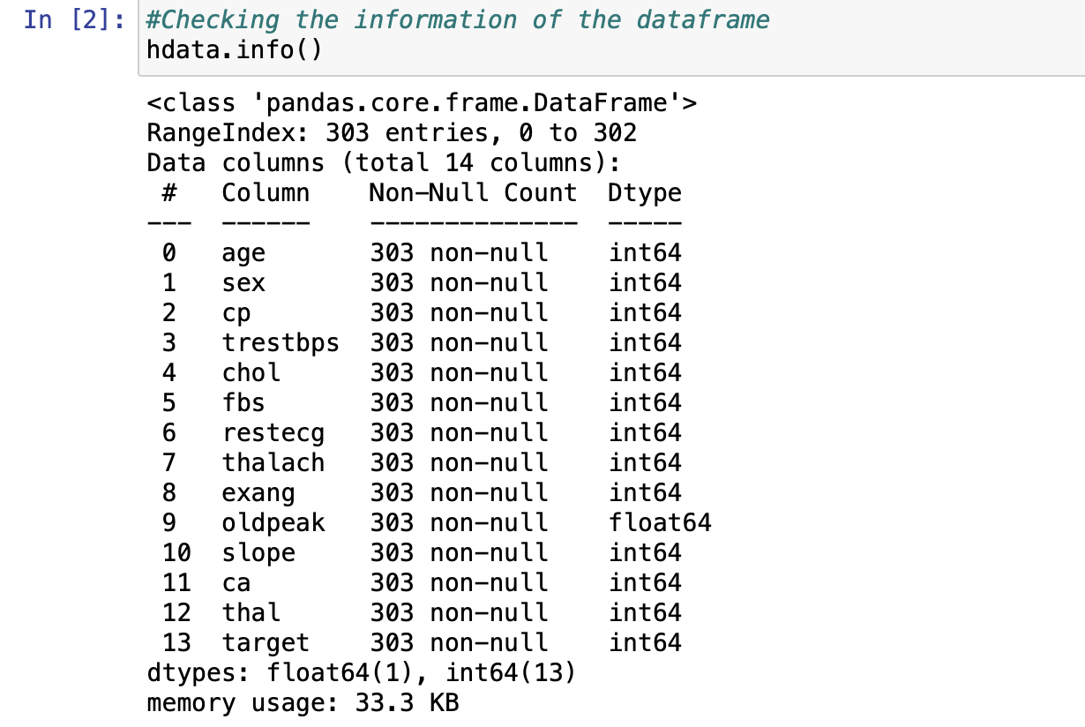
Dataset Overview

Slide 5
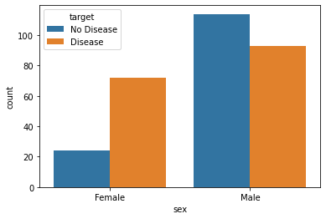
Sex is a major Predictor?
From this histogram, men are more likely to have the presence of heart disease compared to women.

Slide 6
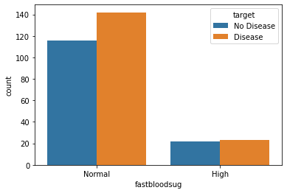
Fasting Blood Sugar is an indicator?
This histogram displays people who have high fasting blood sugar levels and normal levels with the presence of heart disease or not.

Slide 7
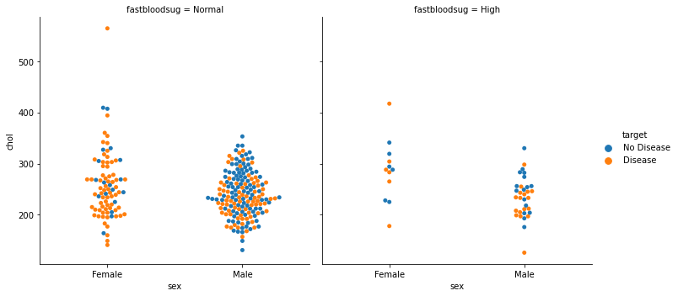
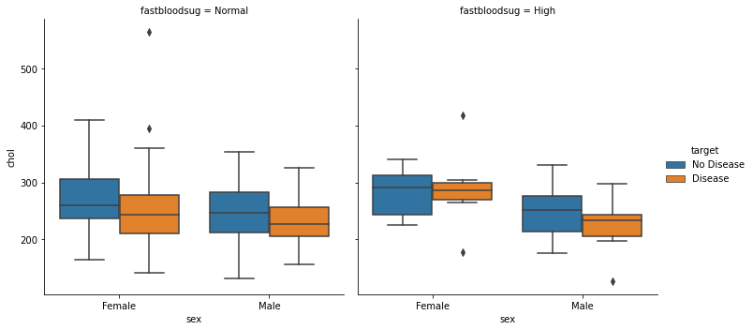
Fasting Blood Sugar by Sex
These plot(s) shows the distribution of fasting blood sugar levels between men and women. These plots compares people with high and normal fasting blood sugar levels.

Slide 8
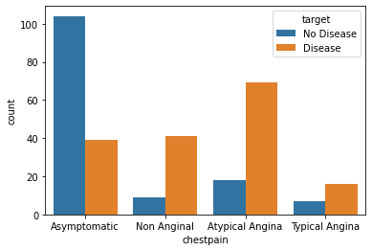
Which Type of Chest pain Predicts?
This bar chart displays people who might have the presence of heart disease or not with chest pains symptoms.

Slide 9
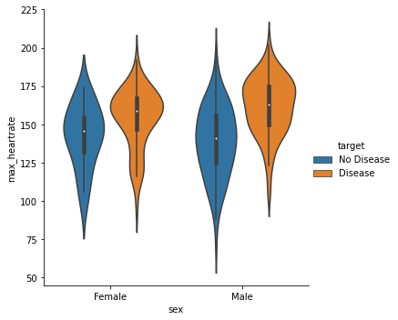
How about Heart Rate?
This violin plot displays men and women who might have the presence of heart disease or not based on sex and max heart rate.

Slide 10
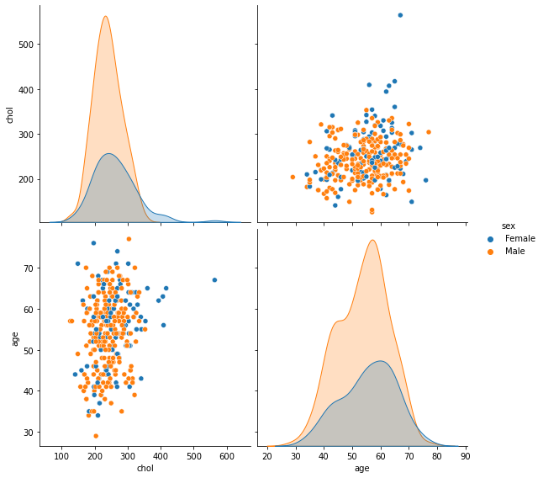
Cholesterol with age

Slide 11
How did the Models fare?
ADA Boost Classifier’s model accuracy is 80%.
Logistics Regression with cross validation accuracy is 82%.
Logistics Regression with Grid search hyperparameters with an L2 penalty accuracy is 87%
Random Forest Classifier with Grid Search accuracy is 88%

Slide 12
Conclusions
The focus of project one was to accurately predict the presence of heart disease based on a person’s data.
I experimented with three different models to see which one was the best at making accurate predictions.
The three different models had an accuracy rate range from 80% to 88%, which makes any of these models a good choice.
Even though the size of the dataset is small. The three models were able to accurately predict the presence of heart disease in people.

