Slide 1
New Store Location for Fashion Retailer
Locations for New Fashion Stores in High Traffic Areas for PARIS

Slide 2
TASK ON HAND
Data-driven decisions on the new locations that are most suitable for their new stores
The ground qualitative analysis of districts once the data and report are reviewed and studied.
They do not seek stores in the premium upmarket strips, but rather, in high traffic areas where consumers go for shopping, restaurants and entertainment.
Foursquare data will be very helpful in making data-driven decisions about the best of those areas.

Slide 3
CRITERIA
Qualitative data from another retailer suggests that the best locations to open new fashion retail stores may not only be where other clothing is located, rather the best places are in fact areas that are near French Restaurants, Cafés and Wine Bars.
The analysis and recommendations for new store locations will focus on general districts with these establishments, not on specific store addresses.
Narrowing down the best district options derived from analysis allows for either further research to be conducted, advising agents of the chosen district, or on the ground searching for specific sites.

Slide 4
OUTCOME
The goal is to identify the best districts to open new stores as part of the company's plan.
The results will be translated to management in a simple form that will convey the data-driven analysis for the best locations to open stores.

Slide 5
Data Research and Preparation
Import the Paris District Data
Paris is divided into 20 administrative districts. They and normally referenced by the arrondissement number rather than a name.
Data for the districts is necessary to select the most suitable of these areas for new stores.
After much research, this data is available on the web and can be manipulated and cleansed to provide a meaningful dataset to use
Data from Open|DATA: https://opendata.paris.fr/explore/dataset/arrondissements/table/?dataChart
Data From Opendatasoft: https://data.opendatasoft.com/explore/dataset/arrondissements%40parisdata/export/

Slide 6
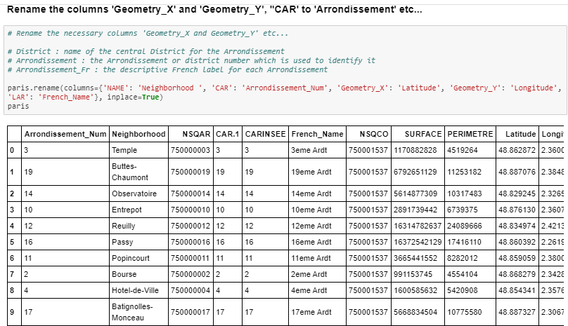
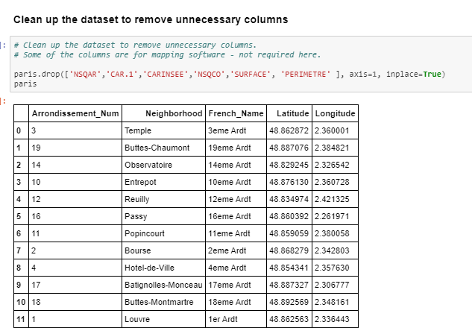
Exploring, Wrangling and Cleaning the Data

Slide 7
Methodology and Exploratory Data Analysis
Data Analysis and Location Data
Foursquare location data will be leveraged to explore or compare districts around Paris.
Data manipulation and analysis to derive subsets of the initial data.
Identifying the high traffic areas using data visualisation and tatistical nalysis.
Visualization:
Analysis and plotting visualizations.
Data visualization using various mapping libraries.
Discussion and Conclusions:
Recomendations and results based on the data analysis.
Discussion of any limitations and how the results can be used, and any conclusions that can be drawn.

Slide 8
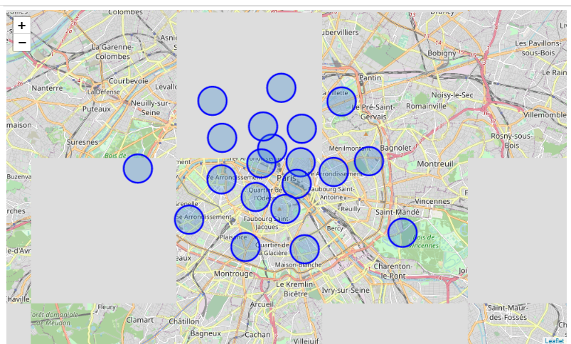
Create a map with districts superimposed

Slide 9
Data Analysis
Use the Foursquare API to explore the Districts (Neighborhoods)
Define Foursquare Credentials and Version
Exploratory data analysis
Explore the first district in our dataframe to become familiar with the data.
The first district is identified as 3eme Ardt
Get the top 100 venues that are in the neighborhood 3eme Ardt within a radius of 500 meters
Define the function that extracts the category of the venue
Structure the json file into a pandas dataframe
Create a nearby venues function for all the neighborhoods in Paris
Create a new dataframe called for the venues of Paris called paris-venues

Slide 10
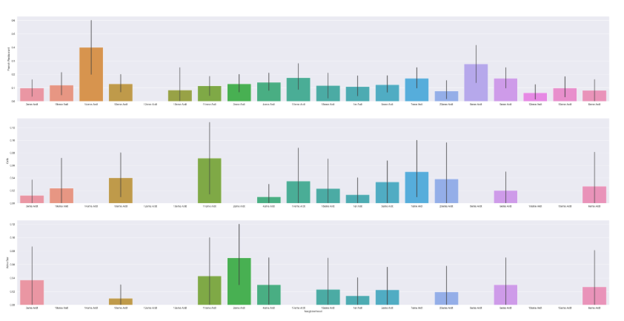
The business types criteria specified by the client! 'Restaurants', 'Cafés’ & 'Wine Bars’
Frequency distribution for top 3 venue categories for each neighborhood

Slide 11
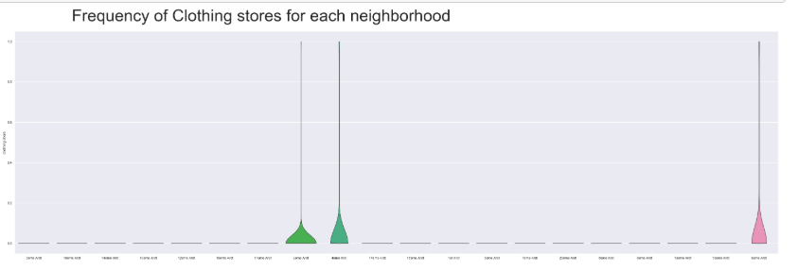
FREQUENCY OF CLOTHING STORE

Slide 12
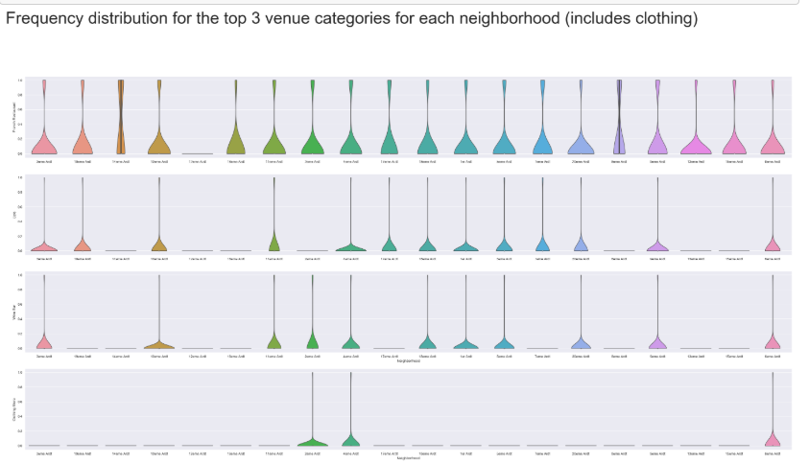
Frequency distribution for top 3 categories including clothing

Slide 13
Chosen Neighborhoods - Results
Inferential analysis using the data, as well as domain knowledge of retail and marketing, allow the list to be focused to just 3 neighborhoods.
The reasoning being that if the 3 criteria have been met - identifying neighbourhoods that are lively with Restaurants, Cafés and Wine Bars - adding Clothing Stores into the mix of stores in the area is a significant bonus. Having some of the same category of stores in the same area - especially in fashion retail - is very desirable as a retailer.
So we can increase the criteria to include Restaurants, Cafés, Wine Bars and Clothing Stores - which narrows down and focuses the suggested districts for new stores to be located, and at the same time provides better locations for the brand.
So the final 3 prospective neighborhoods for new store locations are where 4 criteria are met
3eme Ardt : Arrondissement 3, Temple
- 4eme Ardt : Arrondissement 4, Hotel-de-Ville
- 6eme Ardt : Arrondissement 6, Luxembourg

Slide 14
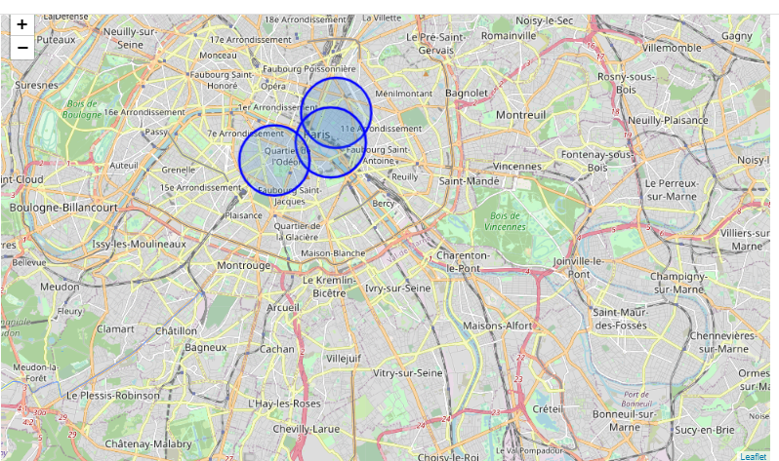
Let's look at the 3 districts on a Paris map

Slide 15
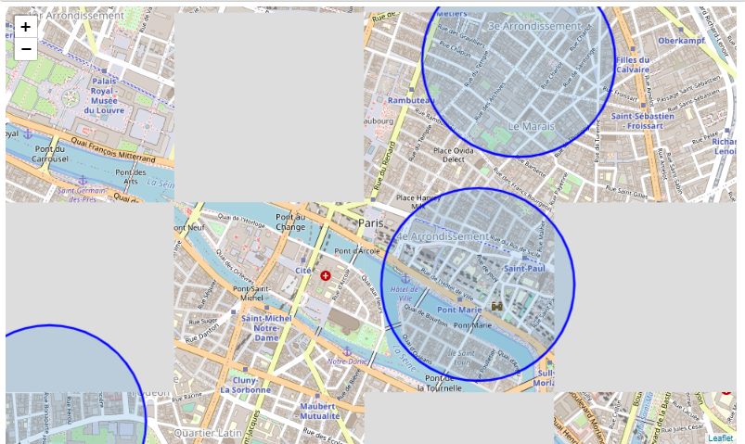
for a closer view of Central Paris

Slide 16
CONSLUSIONS
There are many ways this analysis could have been performed based on different methodology and perhaps different data sources.
I selected the above as it was a straight forward way to narrow down the options, not complicating what is actually simple in many ways – meeting the criteria for the surrounding venues.
The analysis and results are not an end point, but rather a starting point that will guide the next part of the process to find specific store locations.
The next part will involve domain knowledge of the industry, and perhaps, of the city itself. But the data analysis and resulting recommendations have greatly narrowed down the best district options based on data and what we can infer from it.
Without leveraging data to make focused decisions, the process could have been drawn out and resulted in new stores opening in sub-standard areas for this retailer.
Data has helped to provide a better strategy and way forward, these data-driven decisions will lead to a better solution in the end.

