Slide 1

veera

Slide 2
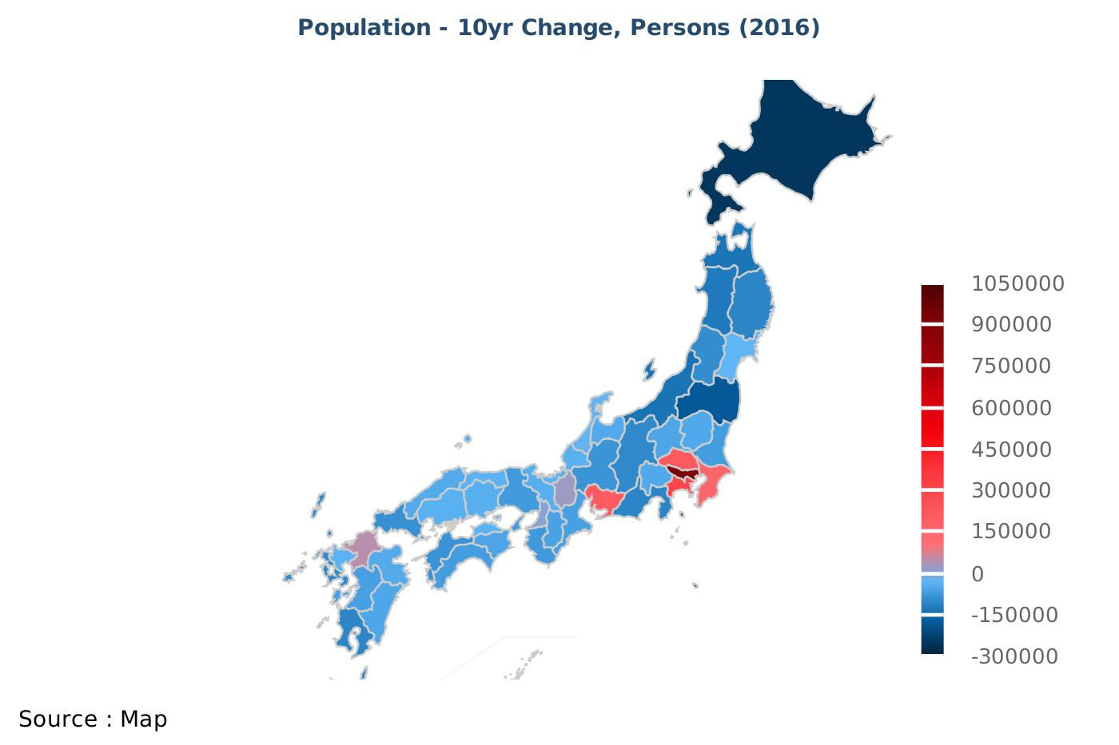
1.Population - 10yr Change, Persons

Slide 3
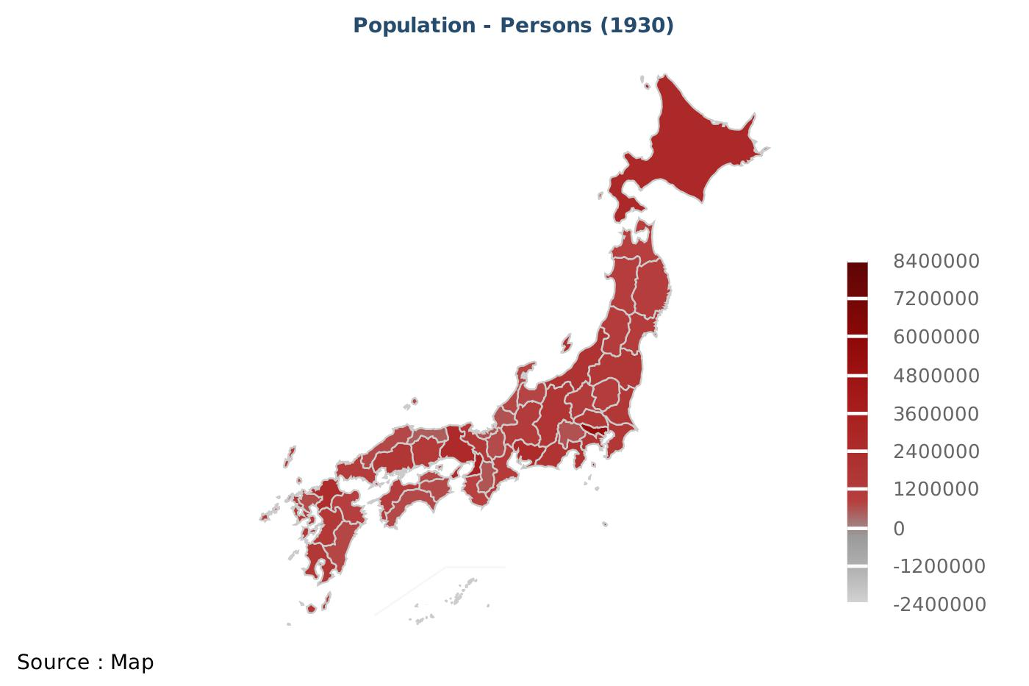
2.Population - Persons

Slide 4
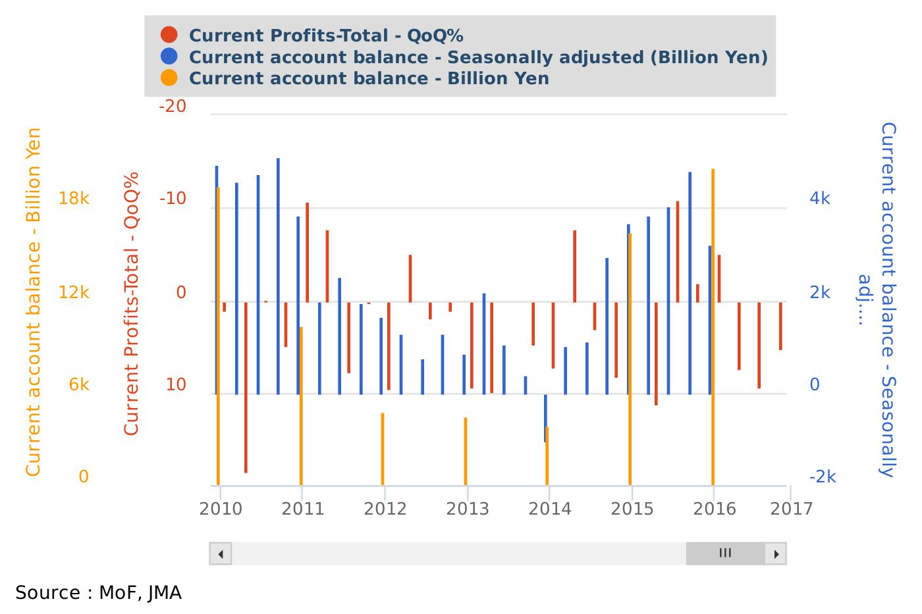
3.Current Profits-Total - QoQ%

Slide 5
IMPORTANT DISCLAIMER
IMPORTANT DISCLAIMER: The information herein is not intended to be an offer to buy or sell, or a solicitation of an offer to buy or sell, any securities and including any expression of opinion, has been obtained from or is based upon sources believed to be reliable but is not guaranteed as to accuracy or completeness although Japan Macro Advisors (JMA) believe it to be clear, fair and not misleading. Each author of this report is not permitted to trade in or hold any of the investments or related investments which are the subject of this document. The views of JMA reflected in this document may change without notice. To the maximum extent possible at law, JMA does not accept any liability whatsoever arising from the use of the material or information contained herein. This research document is not intended for use by or targeted at retail customers. Should a retail customer obtain a copy of this report they should not base their investment decisions solely on the basis of this document but must seek independent financial advice.

