Slide 1
A web application

Slide 2
Browser
Webserver
App server
DB
Serves html
Processes data
Serves data

Slide 3
Our example structure

Slide 4





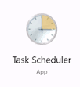
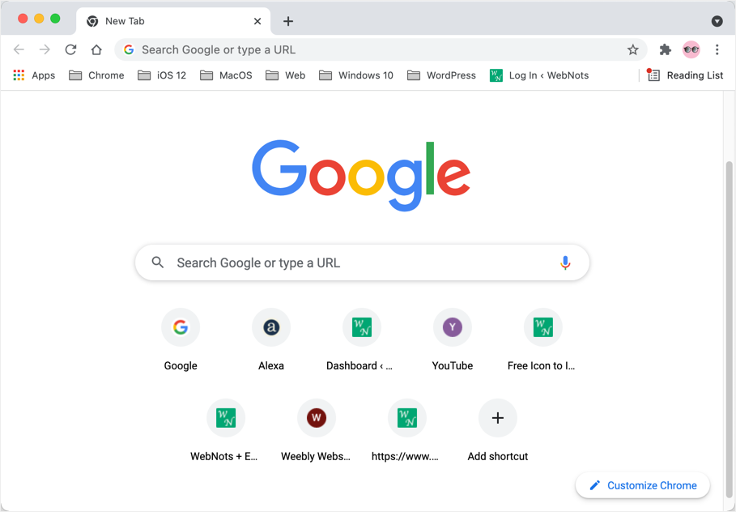

Data Processor PY
Processes files to csvs
Dash
Report Folder
dashboard PY

