Slide 1
Contents / Index (1 of 4)
Page No | Slide title | Body content
5 | A First Simple Java Program | class Example code and modifier notes
6 | Explanation of System.out.println(…) | Term-by-term explanation (System, dot, out, println, parentheses, string literal, semicolon)
7 | Complie and Run | Four compile-and-run steps and the program output
8 | A Second Short Program | Example2.java code
9 | Example showing byte, short, and int… | Integer data type code and output
10 | Example for byte | Byte overflow code
11 | Example : Long | Description plus code image
12 | Example: Double | Description plus code image
13 | CharDemo.java | Char code and output box

Slide 2
Contents / Index (2 of 4)
Page No | Slide title | Body content
14 | CharDemo2.java | Char increment code and output box
15 | BoolTest.java | Boolean code and output box
16 | Variables | Code images
17 | The Scope and Lifetime of Variables | Code images
18 | Type Conversion and Casting | Automatic (widening) conversion notes and code
19 | Type Conversion and Casting | Explicit casting notes and code
20 | Data type Example | DataTypeDemo code
21 | Variables | Code images

Slide 3
Contents / Index (3 of 4)
Page No | Slide title | Body content
22 | Example on 1D-arrays | Array code
23 | (no title) | Array code continued and output box
24 | Average example using arrays | Code and output box
25 | Example on TwoDArray | Code and output box
26 | Example ternary operator (?) | Code
27 | Example 2: Ternary operator | Code comparison
28 | Example for create object | Code and notes
29 | Example:1 Default Constructor (No-Argument ) | Code

Slide 4
Contents / Index (4 of 4)
Page No | Slide title | Body content
30 | Example 2: Parameterized Constructor | Code
31 | Constructor vs. Method | Comparison table
32 | Example: this keyword | Code
33 | Using ‘this’ to Call a Method | Code
34 | Difference | Static vs. non-static table
35 | Example for static | Code
36 | “.” | Concept diagram (CLASS → OBJECT → … → STATIC)
37 | Summary | Key terms

Slide 5
A First Simple Java Program
class Example
{ // indicates beginning of the class body
public static void main(String args[])
{
System.out.println(“Welcome to Programming in Java”);
}
} // indicates end of the class body
public: An access modifier that makes the method accessible from anywhere, allowing the JVM to find and run it.
static: Allows the method to be executed without needing to create an object instance of the class.
void: The return type, meaning this method does not return any value after execution.
Main Method name to begin executing your code.
String args[]: An array of String objects that can accept optional command-line arguments when running the program.

Slide 6
Explanation of System.out.println(“Welcome to Programming in Java”);
System
A built-in Java class (from the java.lang package, which is imported automatically). It gives your program access to system-level resources like input, output, and the environment.
. (dot)
The member access operator. It means "go inside the thing on my left and use what's on my right."
out
A static field (variable) inside the System class. It is an object of type PrintStream and represents the standard output stream, which is usually your console or terminal screen.
. (dot)
Again, access operator: "go inside out and use something from it."
println
A method of the PrintStream class. The name is short for "print line." It prints whatever you give it and then moves the cursor to the next line, so the next output starts on a new line.
( ) (parentheses)
Method call brackets. Anything you place inside is the argument, meaning the data you pass to the method.
"Welcome to Programming in Java"
A String literal. The double quotes tell Java this is text. Everything between the quotes is printed exactly as written, including spaces.
; (semicolon)
Marks the end of the statement. Every statement in Java must end with one.

Slide 7
Complie and Run
Output of the program: Welcome to Programming in Java
1. Open the notepad and type the above program
2. Save the above program with .java extension, here file name and class name should be
same, ex: Example.java
3. Open the command prompt and Compile the above program javac Example.java
From the above compilation the java compiler produces a bytecode(.class file)
4. Finally run the program through the interpreter java Example

Slide 8
A Second Short Program
/*
Here is another short example.
Call this file "Example2.java".
*/
class Example2 {
public static void main(String args []) {
int num; // this declares a variable called num
num = 100; // this assigns num the value 100
System.out.println("This is num: " + num);
num = num * 2;
System.out.print("The value of num * 2 is ");
System.out.println(num);
}
}

Slide 9
Example showing byte, short, and int, which are Java's integer data types of different sizes.
public class Main {
public static void main(String[] args) {
// byte: 8 bits, range -128 to 127
byte age = 25;
// short: 16 bits, range -32,768 to 32,767
short year = 2026;
// int: 32 bits, range about -2.1 billion to 2.1 billion
int population = 1500000000;
System.out.println("Age: " + age);
System.out.println("Year: " + year);
System.out.println("Population: " + population);
}
}
Output:
Age: 25
Year: 2026
Population: 1500000000

Slide 10
Example for byte
public class Main {
public static void main(String[] args) {
byte b = 127;
b++; // goes past the maximum
System.out.println(b); // prints -128
// byte x = 200; // compile error: 200 doesn't fit in a byte
}
}

Slide 11
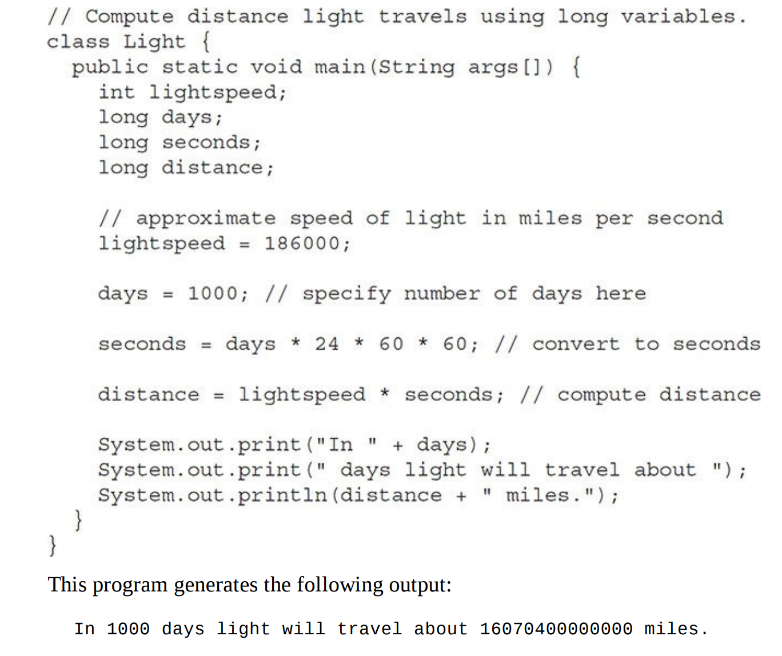
Example : Long
For example, here is a program that computes the number of miles that light will travel in a specified number of days:

Slide 12
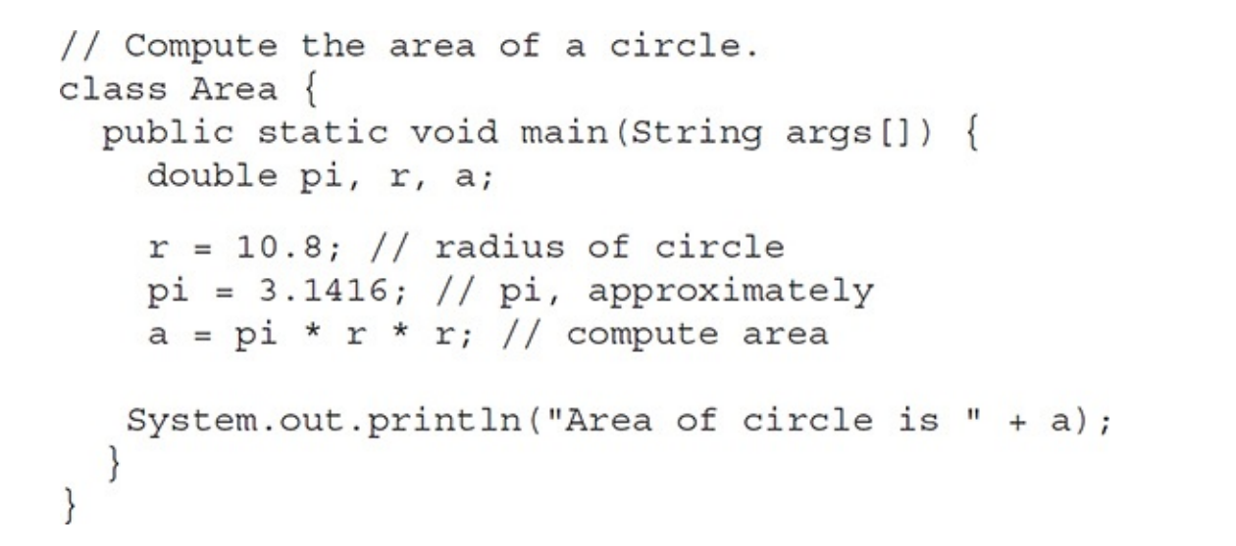
Example: Double
Here is a short program that uses double variables to compute the area of a circle

Slide 13
CharDemo.java
/ Demonstrate char data type.
class CharDemo {
public static void main(String args[]) {
char ch1, ch2;
ch1 = 88; // code for X
ch2 = 'Y';
System.out.print("ch1 and ch2: ");
System.out.println(ch1 + " " + ch2);
}
}
----jGRASP exec: java CharDemo
ch1 and ch2: X Y
----jGRASP: operation complete.

Slide 14
CharDemo2.java
// char variables behave like integers.
class CharDemo2 {
public static void main(String args[]) {
char ch1;
ch1 = 'X';
System.out.println("ch1 contains " + ch1);
ch1++; // increment ch1
System.out.println("ch1 is now " + ch1);
}
}
----jGRASP exec: java CharDemo2
ch1 contains X
ch1 is now Y
----jGRASP: operation complete.

Slide 15
BoolTest.java
// Demonstrate boolean values.
class BoolTest {
public static void main(String args[]) {
boolean b;
b = false;
System.out.println("b is " + b);
b = true;
System.out.println("b is " + b);
// a boolean value can control the if statement
if(b)
System.out.println("This is executed.");
b = false;
if(b)
System.out.println("This is not executed.");
// outcome of a relational operator is a boolean value
System.out.println("10 > 9 is " + (10 > 9));
}
}
----jGRASP exec: java BoolTest
b is false
b is true
This is executed.
10 > 9 is true
----jGRASP: operation complete.

Slide 16
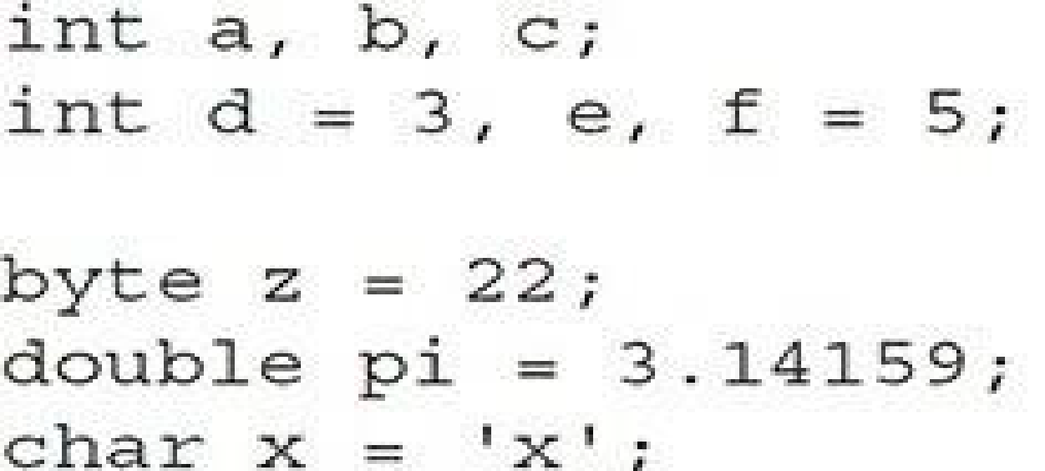
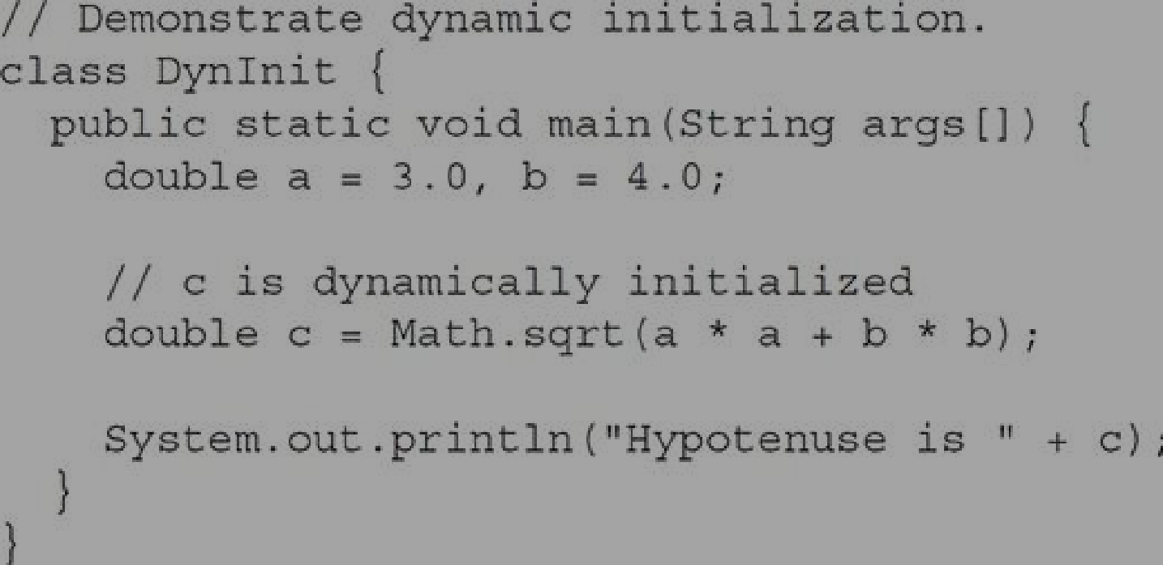
Variables

Slide 17
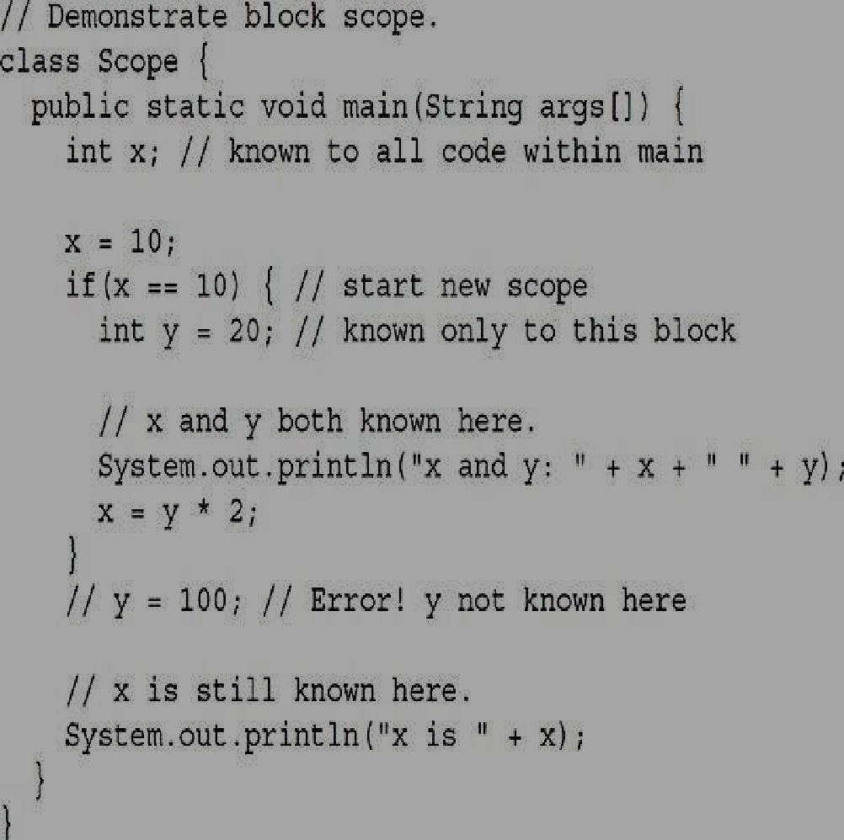
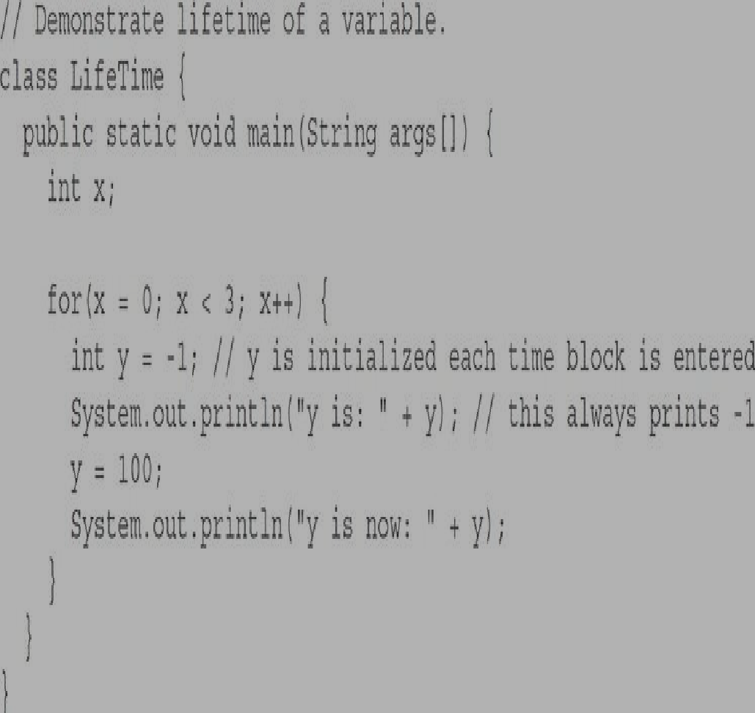
The Scope and Lifetime of Variables

Slide 18
Type Conversion and Casting
Automatic Conversions / Widening conversion / Implicit conversion
When one type of data is assigned to another type of variable, an automatic type conversion will take place if the following two conditions are met:
i. The two types are compatible.
ii. The destination type is larger than the source type.
2) For widening conversions, the numeric types, including integer and floating-point types, are compatible with each other.
3) There are no automatic conversions from the numeric types to char or boolean.
4) Java also performs an automatic type conversion when storing a literal integer constant into variables of type byte, short, long, or char.
public class Test
{
public static void main(String[] args)
{
int i = 100;
long L = i; //no explicit type casting required float f = L; //no explicit type casting required char ch = 100; //no explicit type casting required
System.out.println("Int value "+i); System.out.println("Long value "+L); System.out.println("Float value "+f); System.out.println("Char value "+ch);
}
}

Slide 19
Type Conversion and Casting
2. Explicit conversion or Casting or Narrowing conversion
1) To create a conversion between two incompatible types, we must use a cast.
2) A cast is simply an explicit type conversion.
3) The general form of Casting is – (target-type) value
// Demonstrate casting
class Casting {
public static void main(String args[]) { byte b;
int I = 257;
double d = 323.142;
System.out.println("\n Conversion of int to byte."); b = (byte) I;
System.out.println("I and b: " + I + " " + b);
System.out.println("\n Conversion of double to int."); I = (int) d;
System.out.println("d and I :" + d + " " + I);
System.out.println("\n Conversion of double to byte."); b = (byte) d;
System.out.println("d and b: " + d + " " + b); } }

Slide 20
Data type Example
public class DataTypeDemo {
public static void main(String[] args) {
int age = 20;
double height = 5.8;
char grade = 'A';
boolean pass = true;
System.out.println(age);
System.out.println(height);
System.out.println(grade);
System.out.println(pass);
}
}

Slide 21
Variables

Slide 22
Example on 1D-arrays
// Demonstrate a one-dimensional array.
class Array {
public static void main(String args[]) {
int month_days[];
month_days = new int[12];
month_days[0] = 31;
month_days[1] = 28;
month_days[2] = 31;
month_days[3] = 30;
month_days[4] = 31;
month_days[5] = 30;

Slide 23
month_days[6] = 31;
month_days[7] = 31;
month_days[8] = 30;
month_days[9] = 31;
month_days[10] = 30;
month_days[11] = 31;
System.out.println("April has " + month_days[3] + " days.");
}
}
----jGRASP exec: java Array
April has 30 days.
----jGRASP: operation complete.

Slide 24
Average example using arrays
// Average an array of values.
class Average {
public static void main(String args[]) {
double nums[] = {10.1, 11.2, 12.3, 13.4, 14.5};
double result = 0;
int i;
for(i=0; i<5; i++)
result = result + nums[i];
System.out.println("Average is " + result / 5);
}
}
----jGRASP exec: java Average
Average is 12.299999999999999
----jGRASP: operation complete.

Slide 25
Example on TwoDArray
// Demonstrate a two-dimensional array.
class TwoDArray {
public static void main(String args[]) {
int twoD[][]= new int[4][5];
int i, j, k = 0;
for(i=0; i<4; i++)
for(j=0; j<5; j++) {
twoD[i][j] = k;
k++;
}
for(i=0; i<4; i++) {
for(j=0; j<5; j++)
System.out.print(twoD[i][j] + " ");
System.out.println();
}
}
}
----jGRASP exec: java TwoDArray
0 1 2 3 4
5 6 7 8 9
10 11 12 13 14
15 16 17 18 19
----jGRASP: operation complete.

Slide 26
Example ternary operator (?)
public class EvenOdd {
public static void main(String[] args) {
int num = 7;
String result = (num % 2 == 0) ? "Even" : "Odd";
System.out.println(result);
}
}
//Output: Odd

Slide 27
Example 2: Ternary operator
//Using if-else: //Using ternary operator:
max = (a > b) ? a : b;
if (a > b)
max = a;
else
max = b;
public class TernaryExample {
public static void main(String[] args) {
int a = 10, b = 20;
int max = (a > b) ? a : b;
System.out.println("Largest number = " + max);
}
}
// Output: Largest number = 20

Slide 28
Example for create object
class Student {
String name;
int age;
void display() {
System.out.println("Name: " + name);
System.out.println("Age: " + age);
}
public static void main(String[] args) {
Student s1 = new Student(); //Creates a new Student object and stores its reference in s1
s1.name = “Ravi"; //Assigns “Ravi" to the name variable of object s1
s1.age = 20; //Assigns 20 to the age variable of object s1
s1.display(); //Calls the display() method to print the student's details
}
}
/*
display() → Method (behavior).
new Student() → Creates an object.
s1 → Object reference variable.
*/

Slide 29
Example:1 Default Constructor (No-Argument )
class Student {
String name;
int age;
// Constructor
Student() {
name = “Ravi";
age = 21;
}
// Display student details
void display() {
System.out.println("Name: " + name);
System.out.println("Age: " + age);
}
public static void main(String[] args) {
// Creating an object
Student s1 = new Student();
// Calling the display method
s1.display();
}
}

Slide 30
Example 2: Parameterized Constructor
class Student {
String name;
int age;
// Parameterized constructor
Student(String n, int a) {
name = n;
age = a;
}
void display() {
System.out.println("Name: " + name);
System.out.println("Age: " + age);
}
public static void main(String[] args) {
Student s1 = new Student("Ravi", 20);
Student s2 = new Student("Kiran", 21);
s1.display();
s2.display();
}
}

Slide 31
Constructor vs. Method
Feature | Constructor | Method
Name | Same as class name | Can have any valid name
Return type | No return type | Has a return type or void
Purpose | Initializes an object | Performs an operation
Invocation | Called during object creation | Called explicitly or through other code
Example | Student() | display()

Slide 32
Example: this keyword
class Student {
String name;
int age;
Student(String name, int age) {
this.name = name; // this.name → instance variable of the current object
this.age = age; // name ,age → constructor parameter
}
void display() {
System.out.println("Name: " + name);
System.out.println("Age: " + age);
}
public static void main(String[] args) {
Student s1 = new Student("Ravi", 20);
s1.display();
}
}

Slide 33
Using ‘this’ to Call a Method
class Student {
void display() {
System.out.println("Student details");
}
void show() {
this.display();
}
public static void main(String[] args) {
Student s1 = new Student();
s1.show();
}
}

Slide 34
Difference
Static | Non-Static
Belongs to class | Belongs to object
One class-level member | Associated with individual objects
Can access using class name | Usually accessed using object
Created/managed at class level | Associated with object creation
Example: Student.college | Example: s1.name

Slide 35
Example for static
class Student {
int rollNo;
String name;
static String college = "SNPSU";
Student(int r, String n) {
rollNo = r;
name = n;
}
void display() {
System.out.println(rollNo + " " + name + " " + college);
}
public static void main(String[] args) {
Student s1 = new Student(101, "Rahul");
Student s2 = new Student(102, "Priya");
s1.display();
s2.display();
}
}

Slide 36
.
CLASS
↓
Blueprint
OBJECT
↓
Instance of class
CONSTRUCTOR
↓
Initializes object
INHERITANCE
↓
Parent → Child
POLYMORPHISM
↓
One name → Many forms
ABSTRACTION
↓
Hide implementation details
STATIC
↓
Belongs to class
NON-STATIC
↓
Associated with object
this
↓
Refers to current object

Slide 37
Summary
Class: A blueprint for creating objects.
Object: An instance of a class.
Constructor: A special member used to initialize an object.
Inheritance: Mechanism by which a class acquires members from another class.
Polymorphism: Ability of one interface/method name to represent different behaviors.
Abstraction: Hiding implementation details and exposing essential functionality.
Static member: A member associated with the class rather than an individual object.
Non-static member: A member associated with an instance/object.
this: A reference to the current object.

