Slide 1


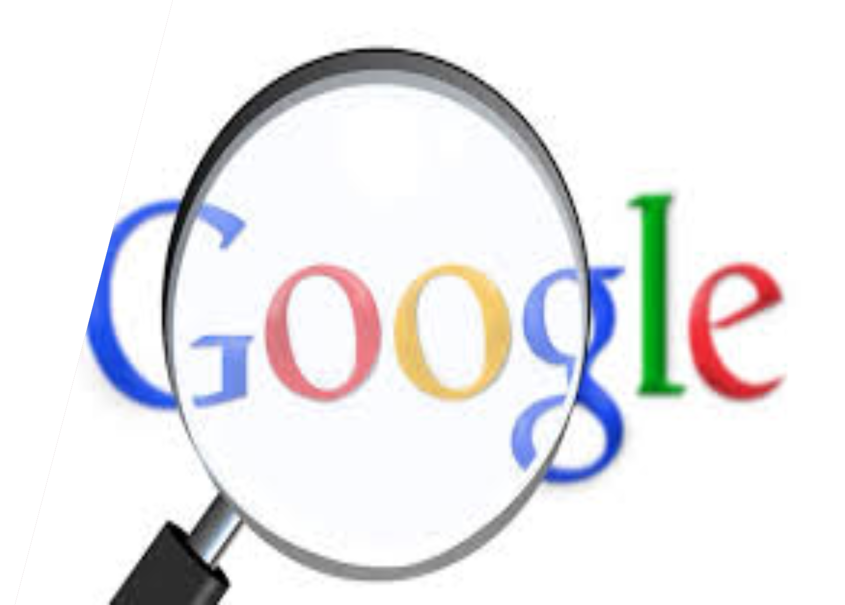
Different Ways to Search In Google
Shyam Kumar
Hemanth
Ranganath
Dileep
Pavan Kumar
Bhanu Prakash
Lohitha

Slide 2
Agenda
Basic Search
Quotation Marks
Minus Operator
Site Specific Search
File Type Search
Advance Search
Synonym Search
Time Based Search
Image And Reverse Search
Voice Search
Map Search
Shopping Search
Scholar Search
AI Based Search

Slide 3
Introduction
Searching in Google is a versatile and powerful tool, and there are several ways to enhance your search queries to get more accurate and desired results.Here are some effective methods you can use:

Slide 4

Basic search

Slide 5
Basic search
Start with a simple search by entering your keywords or phrases directly into the search bar.
Google will return results that match those specific terms.

Slide 6

Quotation Marks

Slide 7
Quotation Marks
Enclose your search query within quotation marks (" ") to search for an exact phrase.
This is helpful when you want to find results that contain a specific set of words in the exact order you specify.

Slide 8

Minus Operator

Slide 9
Minus Operator
Use the minus sign (-) before a keyword to exclude specific terms from your search results.
For example, if you search for "apple -fruit," Google will show results related to Apple Inc. rather than the fruit.

Slide 10
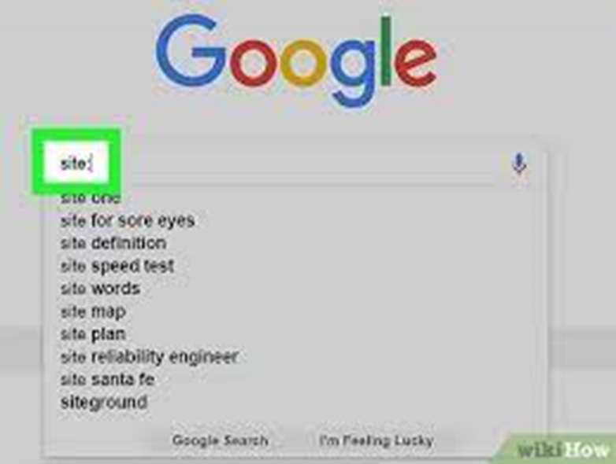
Site-specific Search

Slide 11
Site-specific Search
To limit your search to a specific website or domain, use the "site:" operator.
For instance, searching for "site:wikipedia.org artificial intelligence" will only display results from Wikipedia related to artificial intelligence.

Slide 12

File Type Search

Slide 13
File Type Search
If you're looking for a particular file type, such as PDFs or Word documents, use the "filetype:" operator.
For example, "filetype:pdf climate change" will show results with PDF files related to climate change.

Slide 14

Advanced Search Operators

Slide 15
Advanced Search Operators
Google offers various advanced operators that allow for more specific searches.
Some examples include "intitle:" (searches for words in the title of a page), "inurl:" (searches for words in the URL), and "related:" (displays sites related to a given URL).

Slide 16
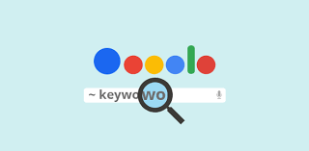
Synonym Search

Slide 17
Synonym Search
Use the tilde (~) before a word to include its synonyms in the search results.
For example, searching for "~healthy recipes" will also include results for "nutritious recipes" and "good-for-you recipes."

Slide 18

Time-based Search

Slide 19
Time-based Search
To find results from a specific time frame, use the "before:" and "after:" operators. For instance, "best movies after:2018" will display movies released after 2018.

Slide 20

Image and Reverse Image Search

Slide 21
Image and Reverse Image Search
Google allows you to search for images using keywords or even by uploading an image for a reverse image search. This can be useful for finding similar images or identifying objects in pictures.

Slide 22

Voice Search

Slide 23
Voice Search
Instead of typing, you can use Google's voice search feature on mobile devices or through voice-enabled assistants to conduct searches using natural language.
Remember to experiment with different combinations of these techniques to refine your search and get the most relevant results.

Slide 24
Maps Search
To search for locations, directions, or maps, click on the "Maps" tab at the top of the Google homepage or select the "Maps" option from the search results page. You can enter addresses, landmarks, or businesses to find relevant maps and directions

Slide 25
Shopping Search
If you're looking to buy products, you can use Google's Shopping search feature. Click on the "Shopping" tab at the top of the Google homepage or select the "Shopping" option from the search results page. You can enter product names, browse categories, compare prices, and find online retailers.

Slide 26
Scholar Search
Google Scholar focuses on searching scholarly literature, including articles, theses, books, and conference papers. You can access Google Scholar by clicking on the "Scholar" option from the Google homepage or by visiting scholar.google.com.

Slide 27
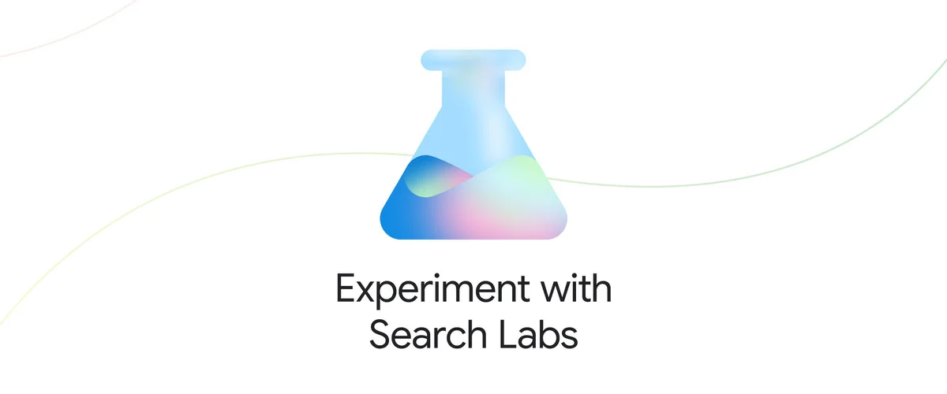
Search Labs by Google

Slide 28
Search Labs by Google
Search Labs is a program for people to experiment with early-stage Google Search experiences and share feedback. Labs experiments, including AI-powered experiences, are in early development and available in the Google app on Android phones and iPhones and in Chrome on desktop.

Slide 29



