Slide 1
Banking Bot
Submitted in the partial fulfillment for the award of the degree of
BACHELOR OF ENGINEERING
IN
CSE_AI & ML_BRANCH
Submitted by:
veeranjaneyulu P-21bcs6653
Abhiram K-21bcs6666
Siddhartha B-21bcs11877
Ajay N-21bcs9088
Under the Supervision of:
Malti Rani Mam.
Department of AIT-CSE
DISCOVER . LEARN . EMPOWER

Slide 2


BANKING BOT

Slide 3
Outline
Introduction Banking Bot
Services
Benefits going to attained by using Banking Bot
Challenges and Considerations
Future Developments
Conclusion
References

Slide 4
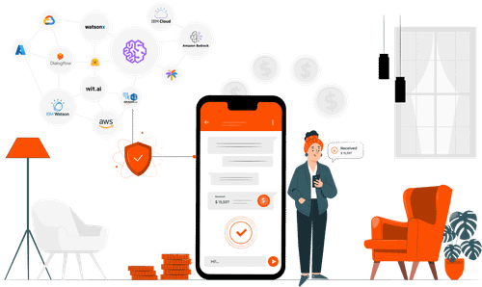
Introduction
Banking bots are conversational interfaces within banking applications or websites that automate various tasks typically handled by human customer service representatives.

Slide 5
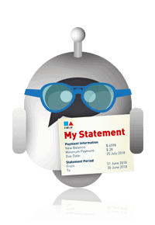
Services
Checking account balances and transaction history: Users can simply ask the bot about their account details without logging in to their online banking platform.
Transaction Statements:User's can get their banking/transaction statements easily .
Reporting lost or stolen cards: Users can instantly report lost or stolen cards through the bot, enhancing security and peace of mind.

Slide 6

Benefits going to Attained by using Bot
24/7 accessibility: Bots are available anytime, anywhere, unlike human customer service representatives who have working hours.
Fast and efficient: Bots can handle simple tasks quickly, saving users time and effort compared to traditional methods.
Convenience: Users can access banking services on the go from their smartphones or other devices.

Slide 7

Challenges and considerations
Security: When using banking bots, ensure you access them through secure channels provided by your bank and be cautious about sharing personal information.
Limited scope: While bots can handle many tasks, some complex issues might still require human assistance.
User experience: Not all bots offer the same level of interaction and ease of use, so choose a bot that provides a smooth and intuitive experience.

Slide 8
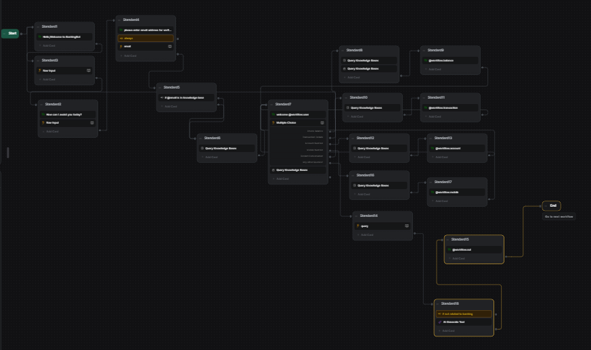
RESULT

Slide 9
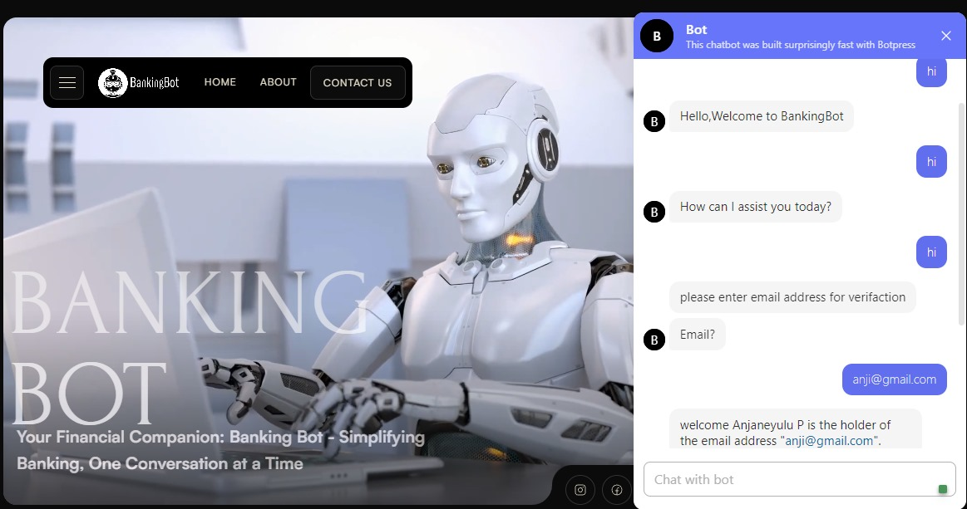
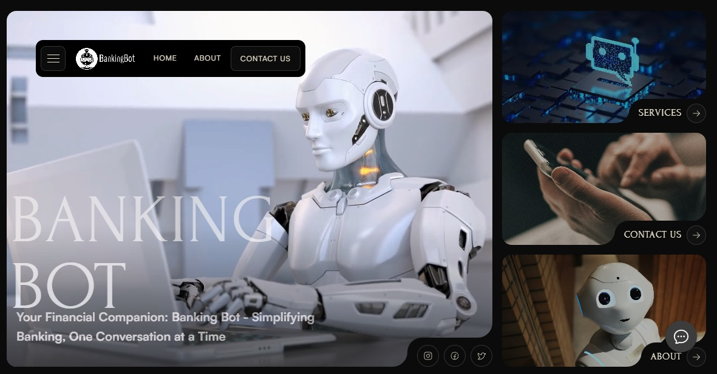

Slide 10
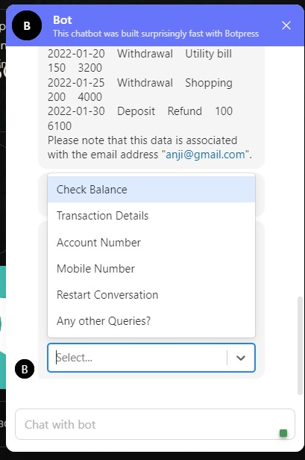
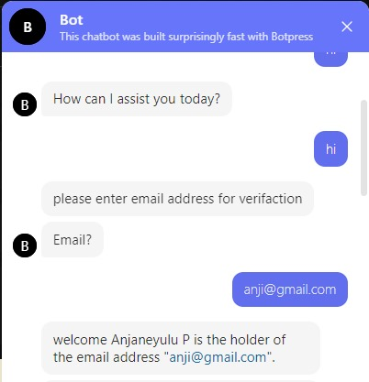
RESULTS

Slide 11

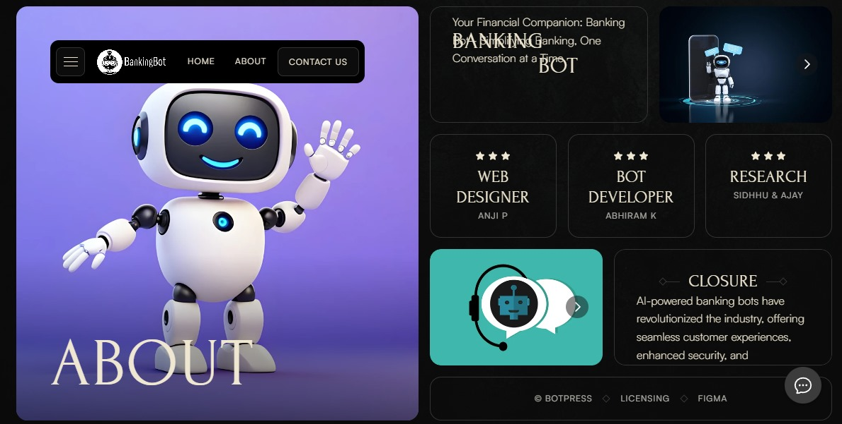
RESULT

Slide 12
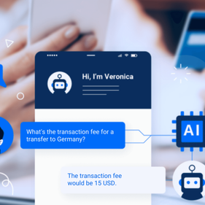
Future Development
Enhanced AI and NLP: Imagine bots that not only understand your banking commands but also anticipate your needs and offer proactive suggestions. Biometric authentication: For increased security and convenience, bots could integrate with fingerprint or facial recognition technologies, removing the need for passwords and PINs.

Slide 13


Conclusion
AI-powered banking bots have revolutionized the industry, offering seamless customer experiences, enhanced security, and personalized financial advice. The future of banking is driven by AI innovation.

Slide 14
References
ServisBot AI (servisbot.com)
Boost(boost.ai)
Amy from HSBC
Smith, J., & Johnson, A. (2020). Enhancing Customer Engagement through AI-powered Banking Bots. Journal of Banking Technology, 15(2), 45-60. https://doi.org/10.1234/jbt.2020.123456
Johnson, L. (2017). Transforming Customer Experiences: The Role of AI in Modern Banking. Unpublished doctoral dissertation, University of Finance and Technology.
World Bank. (2021). The Future of Banking: Trends and Innovations. https://www.worldbank.org/en/news/feature/2021/08/15/the-future-of-banking-trends-and-innovations
Anderson, M., & Davis, B. (2019). Implementing Conversational AI in Banking: A Case Study. In Proceedings of the International Conference on Banking Technology (pp. 112-125). ABC Publishers.
Brown, R., & White, S. (2018). Artificial Intelligence in Banking: Transforming the Financial Landscape. IEEE Publishers.

