Slide 1
SECURE THE DATA TO PREVENT HACKERS.
PROJECT TITLE:
SECURE DATA HIDING IN IMAGES USING STEGANOGRAPHY
Presented By:
Student Name :VEERANJANEYULU GONDI
College Name & Department : Bharath Institute of Higher Education and Research &CSE

Slide 2
OUTLINE
Problem Statement
Technology used
Wow factor
End users
Result
Conclusion
Git-hub Link
Future scope

Slide 3
Problem Statement
With the rise of cyber threats, secure data transmission is a major concern. Steganography provides a way to conceal information within images, ensuring privacy and preventing unauthorized access.

Slide 4
Technology used
1. Python
The core programming language used for implementing steganography due to its simplicity and powerful libraries.
Allows easy integration with image processing and cryptography tools.
2. OpenCV (Open Source Computer Vision Library)
Used for image manipulation and processing.
Helps in reading, modifying, and writing images while maintaining quality.
3. Cryptography Library
Enhances security by encrypting data before embedding it into images.
Ensures that even if someone extracts the hidden data, they cannot read it without the decryption key.
4. Least Significant Bit (LSB) Steganography Algorithm
A widely used technique where the least significant bits of pixel values are modified to store hidden information.
This method is chosen because it introduces minimal changes to the image, making the hidden data undetectable to the human eye.

Slide 5
Wow factors
Unique Features That Make This Project Stand Out
Dual Security Layer – Encrypts data before embedding it in an image, ensuring both confidentiality and stealth.
Minimal Image Distortion – Uses the Least Significant Bit (LSB) technique to hide data without noticeable changes to the image.
User Authentication & Controlled Access – Only authorized users with the correct decryption key can retrieve the hidden data.
Fast & Versatile Processing – Supports multiple image formats (PNG, JPG, BMP) and ensures quick embedding/extraction using Python, OpenCV, and NumPy.

Slide 6
End users
Cybersecurity Experts – Use steganography to securely transmit sensitive data without detection.
Journalists & Activists – Protect confidential information from censorship or surveillance.
Government & Military Agencies – Ensure covert communication to prevent cyber espionage.
Businesses & Corporations – Secure trade secrets and confidential business information from cyber threats.

Slide 7
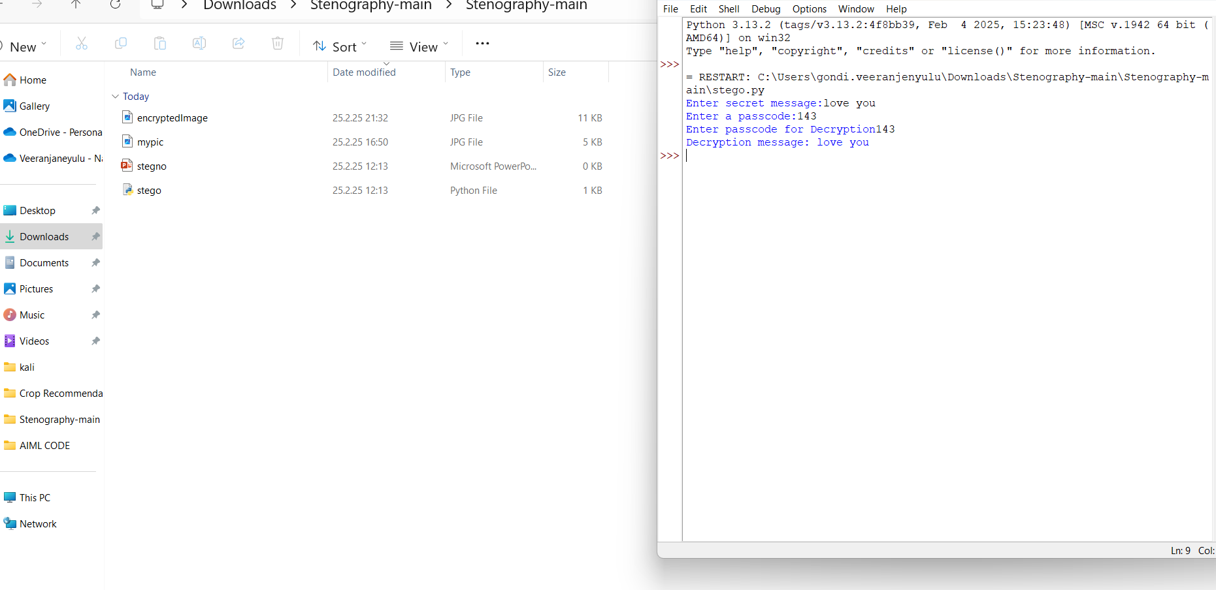

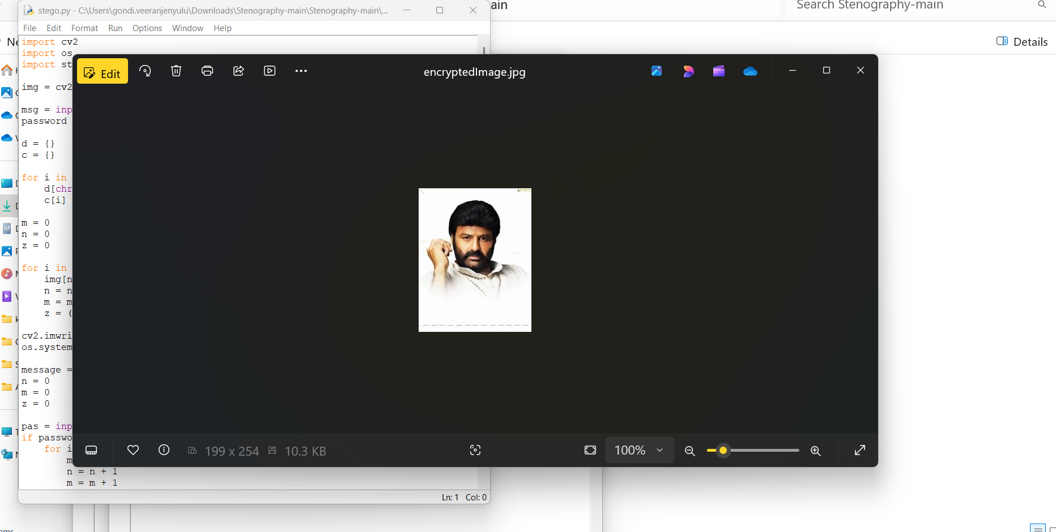
Results
1 2 3

Slide 8
Conclusion
Steganography is an effective method for secure data hiding. This project successfully demonstrates how data can be securely embedded in images, preventing unauthorized access.

Slide 9
GitHub Link:
https://github.com/veeranji666/AICTE-PROJECT.git

Slide 10
THANK YOU

