Slide 1
MACHINE LEARNING MINI - PROJECT FACE HEAD POSITION DETECTION USING ML ALGORITHMS VAGGAIHGARI VEERANJINEYULU ROLL N0: 1901211 Dept. of Computer Science & Engineering Indian Institute of Information Technology, Guwahati. Course: CS360 - Machine Learning Lab

Slide 2
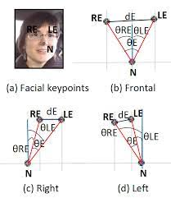
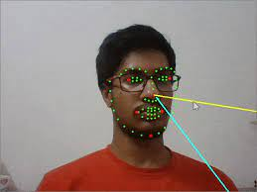
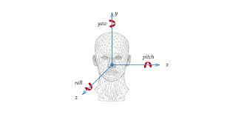
OUTLINE :
ABSTRACTION
INTRODUCTION
PROBLEM DEFINITION
LITERATURE SURVEY
RESULTS ANALYSIS
MATERIALS
Dataset Used.

Slide 3
ABSTRACTION :
Evaluation of driving performance is of utmost importance in order to reduce road accident rate.
Since driving ability includes visual-spatial and operational attention, among others, head pose estimation of the driver is a crucial indicator of driving performance.
This Mini-project proposes a new automatic method for finding head’s yaw angle estimation of the driver. We rely on a set of geometric features computed from just three representative facial keypoints, namely the center of the eyes and the nose tip.
The low computational cost of the method and its robustness makes feasible to integrate it in massive consume devices as a real time application.

Slide 4
INTRODUCTION
Driver fatigue/drowsiness and distraction are known to be behind a large amount of traffic accidents
Distractions are specially challenging because many times are difficult to predict in advance since they may be due to sudden events in the environment or in the cabin
Indeed, a more general challenge including distractions is driving performance. Evaluation of driving performance is of utmost importance in order to reduce road accident rate.
Accordingly, in this project we focus on the computation of yaw angle from driving images.
It is very useful for early detection of abnormal driving performance in common situations. For example, if the driver does not pay attention to the correct direction in a roundabout, or if he/she attends in a crosswalk but does not see a pedestrian crossing on, an Advanced Driver Assistance System (ADAS) combining driving monitoring and exterior hazard assessment, can decide to elevate the warning level or even braking the car.

Slide 5
Find out the driver face direction(looking right ,
frontal, looking left) by estimating the yaw angle using machine learning algorithms.
Yaw angle is the angle between the velocity vector of the vehicle and the driver eye line direction.
3) PROBLEM
STATEMENT:

Slide 6
LITERATURE SURVEY
Single image based head pos estimation with spherical parametriazation and 3D morphing (year-2020)
* This paper was written by Hui Yuan , Mengyu Li , and Junhui Hou.
* They proposed a geometry based algorithm for accurately estimating the head pose from a single 2D face image at a very low computational cost.
* Specifically, the rectangular coordinates of only four non-coplanar feature points from a predefined 3D facial model as well as the corresponding ones automatically/manually extracted from a 2D face image are first normalized to exclude the effect of external factors (i.e., scale factor and translation parameters). Then, the four normalized 3D feature points are represented in spherical coordinates with reference to the uniquely determined sphere by themselves, which are further iteratively refined via 3D morphing.
* Due to the spherical parameterization, the coordinates of feature points could be morphed along all the three directions effectively. Finally, the rotation matrix indicating the head pose is obtained by minimizing the Euclidean distance between the normalized 2D feature points and the 2D re-projections of morphed 3D feature points.
* They have experimented the model over two datasets pointing04 and BIWI Kinect and they got the accuracy as 94%
Link : https://www.sciencedirect.com/science/article/abs/pii/S0031320320301205

Slide 7
Infrared head pose estimation with multi-scales feature fusion on the IRHP database for human attention recognition (Year -2020)
This paper was written by Hai Liu , Xiang Wang , Wei Zhang , Zhaoli Zhang , and You-Fu Li.
They used the Infrared images because they bear unique advantages of being still effective under visible scenarios, which are resistance to illumination changing and strong penetration.
In this paper, they established a first-of-its-kind infrared head pose (IRHP) database and propose a novel convolutional neural network architecture IRHP-Net on the IRHP database. The IRHP database contains 145 kinds of IR head pose images of subjects, and benchmark evaluations are conducted on our database by the facial features-based standard HPE classification methods to prove the usability and effectiveness of IRHP database.
To extract the adaptive features for the IR images, a novel multi-scale feature fusion descriptor is developed in the proposed IRHP-Net model. Quantitative assessments of the proposed method on the IRHP images demonstrate the significant improvements over the traditional methods. The new proposed IRHP-Net model can be utilized in human attention recognition and intelligent driving assistant system.
Link : https://www.sciencedirect.com/science/article/abs/pii/S0925231220310547

Slide 8
Robust Driver Head Pose Estimation in Naturalistic Conditions from Point-Cloud Data (Year - 2020)
This paper was written by Tiancheng Hu, Sumit Jha and Carlos Busso.
This paper presented a novel point-cloud based algorithm to estimate the head pose of a driver from a single depth camera.
The proposed algorithms achieved promising performances, outperforming the state-of-the-art baselines OpenFace2.0 and FAN, which rely on regular RGB images.
The improvement in performance is especially clear onframes with large rotations. For automotive applications such as detecting driver distraction. This method is far more suitable for this purpose than the baselines. Furthermore, the proposed algorithm can also work in cases with very low illumination or even during the night. In these scenarios, RGB based approaches cannot be used.
Link : https://ieeexplore.ieee.org/abstract/document/9304592

Slide 9
Result Analysis
By using the logistic regression I have got the accuracy for test data as 87.76%
By using the multi-layer-perceptron model I have got the accuracy better than logistic regression for the same test data as 92.07%
By using the confusion matrix I have calculated the class wise accuracy , precision and accuracy of all three classes.
By analysing the class wise accuracy I have noticed that this data has a class imbalance problem.
By doing the underfitting the model has given a very less accuracy as 56.03%
To check the affect of initial parameter values in performance I have run the multi-layer perceptron 10 times and in each time I have got the accuracy above 90%. So there is no effect of initial parameter values.

Slide 10
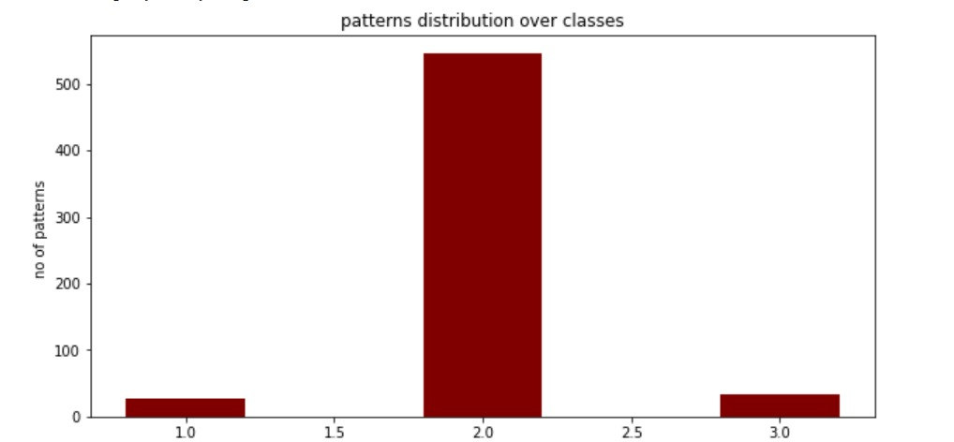
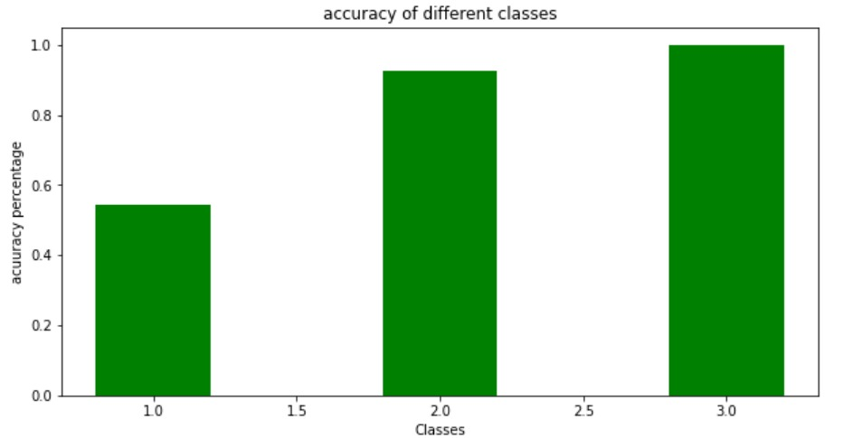
patterns distribution over accuracy of different classes classes

Slide 11
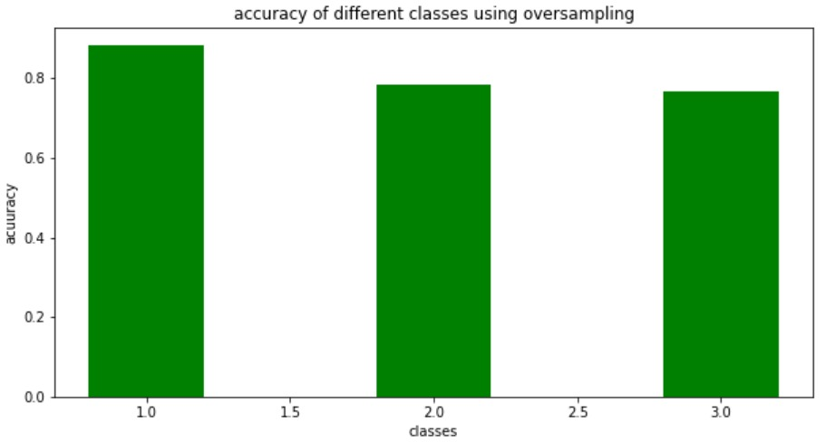
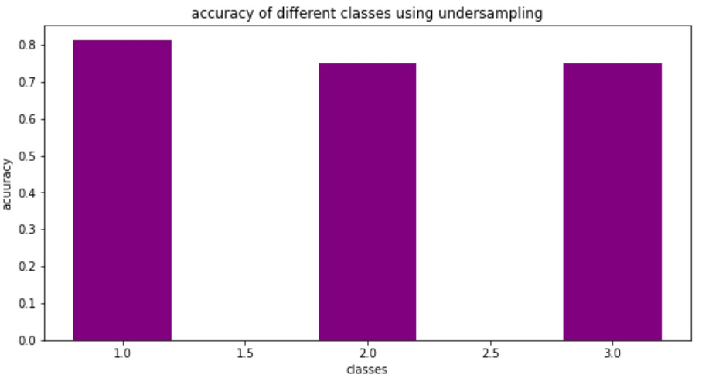
By observing the patterns distribution over the classes graph we can detect that the data set has class imbalance problem, because of that we got the class-wise accuracies are different.
To solve the class imbalance problem I have used the oversampling technique and undersampling technique
After applying these techniques oversampling has given the better results as compared to undersampling because of insufficient data.

Slide 12
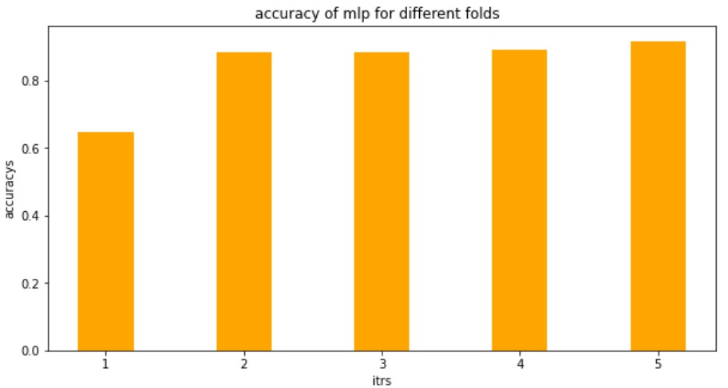
For Logistic Regression and Multi –Layer-Perceptron I have applied K-fold cross validation technique to check whether the random initialization of weights and random assignment of samples to train and test will effect the final results or not.
After applying 5-Fold cross validation I have got all the five accuracies above 80% and average accuracy is 87.9%

Slide 13
By using Single Layer Perceptron I have got the accuracy as 90%, which is low as compared to multi layer perceptron. But due to class imbalance problem I got class wise accuracies(one , three) as very low(below 50%).
By using the multi-layer perceptron model I have got the accuracy as 94% and class-wise accuracies are 97% (class-1) , 93%(class-2),99%(class-3)
Class wise precision by using multi layer perceptron are 0.4(class-1) ,1.0(class-2) , 0.35(class-3)
Class wise recall by using multi layer perceptron are 1.0(class-1),0.93(class-2),1.0(class-3)
Among all the alogorithms(multi-layer perceptron , single layer perceptron ,logistic regression) multi layer perceptron model given the better accuracy(94%).

Slide 14
MATERIAL:
1) Data Used:
The dataset is composed of 606 samples of 14 features each, acquired over different days from 4 drivers (2 women and 2 men) with several facial features like glasses and beard.
Dataset is multivariate ( consisting of two or more than two variables )
Label = This describes the class of the driver.
There are 3 classes in this dataset
Class 1 - looking-right
Class 2 – frontal
Class 3 - looking-left

