Slide 1
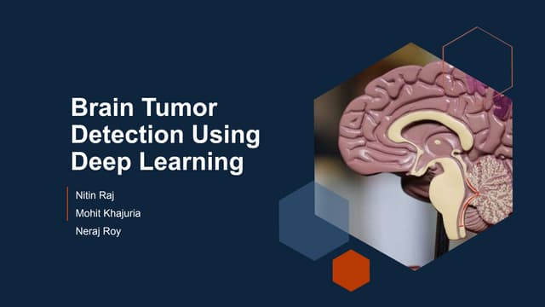
Subtitle: A deep Learning
Approach
By
V.Vijay kumar

Slide 2
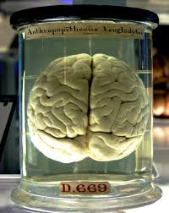
Brain Tumors: Abnormal cell growth in the brain, which can be benign or malignant. Early detection is crucial for effective treatment.
Importance of Early Detection: Timely diagnosis improves survival rates and treatment outcomes. Delayed detection can lead to severe complications.
Role of AI & Deep Learning:
AI-powered models enhance medical imaging analysis.
CNNs and deep learning techniques help in accurate tumor classification and segmentation.
Automating diagnosis reduces human error and speeds up medical assessments.

Slide 3
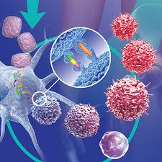
Challenges in Brain Tumor Detection:
Brain tumors vary in shape, size, and location, making detection difficult.
Expert-Dependent Interpretation:
Diagnosis relies on radiologists, leading to potential variability in assessments.
High False-Positive/Negative Rates:
Misclassification can lead to unnecessary treatments or missed diagnoses.
Time-Consuming Manual Analysis:
MRI and CT scan evaluations require significant time and expertise.
Need for Automated Deep Learning-Based Solutions:
AI can enhance accuracy, reduce workload, and provide faster diagnoses.

Slide 4
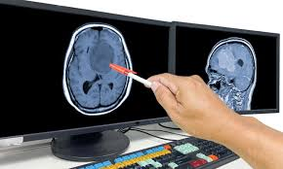
Objectives:
Develop a CNN-Based Model for Accurate Tumor Detection
Design and train a deep learning model to identify brain tumors in medical images.
Classify Tumor Types (Benign vs. Malignant)
Differentiate between benign and malignant tumors to aid clinical decision-making.
Estimate Tumor Volume for Clinical Insights
Provide quantitative measurements to assist in treatment planning and progression monitoring.
Improve Diagnosis Speed and Accuracy
Reduce manual analysis time and enhance diagnostic precision through automation.

Slide 5
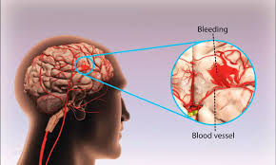
Background of Brain Tumors:
Definition and Types of Brain Tumors:
Brain tumors are abnormal growths of cells in the brain.
They can be classified into primary tumors (originating in the brain) and secondary tumors (metastasized from other body parts).
Difference Between Benign and Malignant Tumors:
Benign Tumors: Non-cancerous, slow-growing, and less likely to spread. Examples: Meningiomas, Pilocytic Astrocytomas.
Malignant Tumors: Cancerous, aggressive, and can invade surrounding tissues. Examples: Glioblastomas, Medulloblastomas.

Slide 6
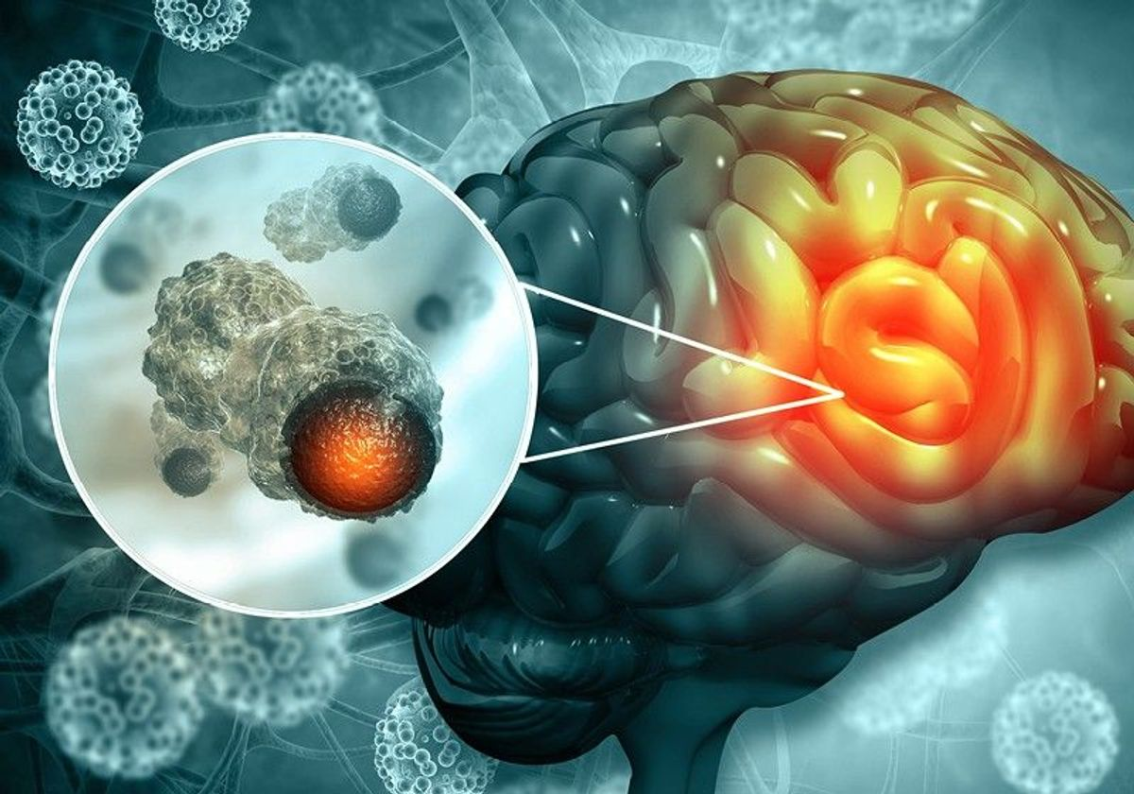
WHO Grading System (Grades I–IV):
Grade I – Least aggressive, slow-growing (e.g., Pilocytic Astrocytoma).
Grade II – Slow-growing but can progress to higher grades (e.g., Diffuse Astrocytoma).
Grade III – Malignant, actively growing (e.g., Anaplastic Astrocytoma).
Grade IV – Most aggressive, highly malignant (e.g., Glioblastoma Multiforme).

Slide 7
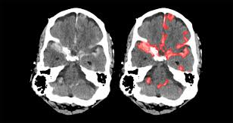
Traditional Detection Methods:
MRI and CT Scans as Standard Methods
Magnetic Resonance Imaging (MRI): Provides high-resolution images of soft tissues, commonly used for brain tumor detection.
Computed Tomography (CT): Uses X-rays to create detailed cross-sectional images, often used in emergency cases.
Challenges with Manual Diagnosis
Requires Expert Radiologists:
Skilled professionals are needed to interpret scans accurately.
Time-Intensive:
Manual review of multiple scan slices is slow and labor-intensive.
Subjective Variations in Interpretation:
Different radiologists may have varying assessments, leading to inconsistencies.
Small or early-stage tumors might be overlooked.

Slide 8
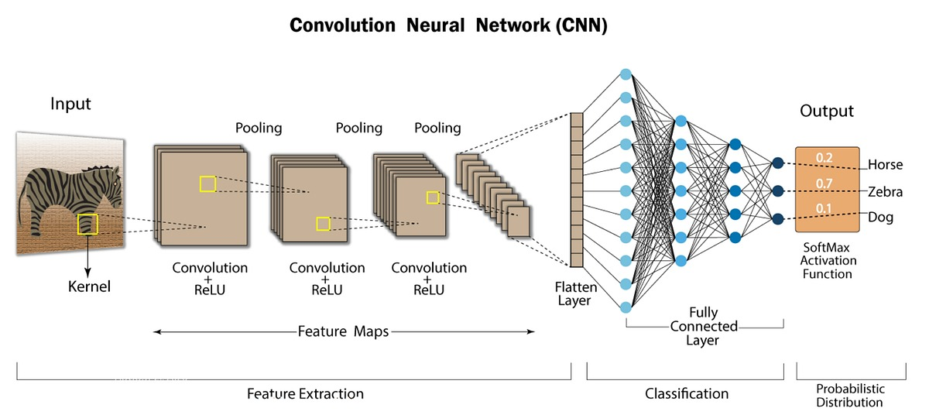
Role of AI & CNN in Medical Imaging:
Overview of Deep Learning in Healthcare
AI-driven models assist in medical imaging, improving diagnostic accuracy and efficiency.
Deep learning helps in disease detection, classification, and prognosis prediction.
Why CNNs for Brain Tumor Detection?
Feature Extraction: Automatically learns patterns from medical images, detecting tumors with minimal preprocessing.
High Accuracy: Outperforms traditional methods by identifying subtle tumor characteristics.

Slide 9
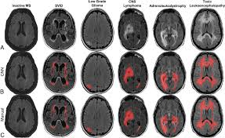
Dataset Used:
Kaggle Brain Tumor MRI Dataset
A publicly available dataset containing MRI scans labeled for tumor detection.
Types of Images Included:
Glioma
Meningioma
Pitutary
No tumour
Tumor vs. Non-Tumor Images:
Dataset includes both tumor-positive and tumor-negative MRI scans for balanced learning.

Slide 10
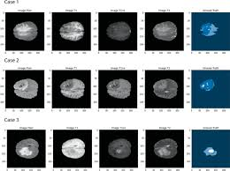
Preprocessing Techniques
Image Resizing (150×150 )
Standardizing image dimensions ensures compatibility with CNN model
Data Augmentation (Rotation, Flipping, Zooming)
Enhances model generalization by creating variations of training images.
Common techniques:
Rotation: Randomly rotating images within a specific range.
Flipping: Horizontal or vertical mirroring to increase dataset diversity.
Zooming: Slight enlargements to simulate different perspectives.
Noise Reduction & Contrast Enhancement
Denoising: Applying filters (Gaussian, median) to remove image noise.
Contrast Adjustment: Enhancing visibility of tumor regions for better feature extraction.

Slide 11
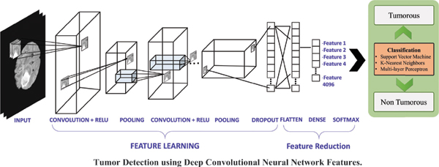
CNN Model Architecture
Convolutional Layers for Feature Extraction
Detects important patterns such as edges, textures, and shapes in MRI scans.
Uses filters/kernels to learn spatial hierarchies in the images.
Pooling Layers for Dimensionality Reduction
Reduces computational complexity while retaining essential features.
Max Pooling is commonly used to extract the most prominent features.

Slide 12
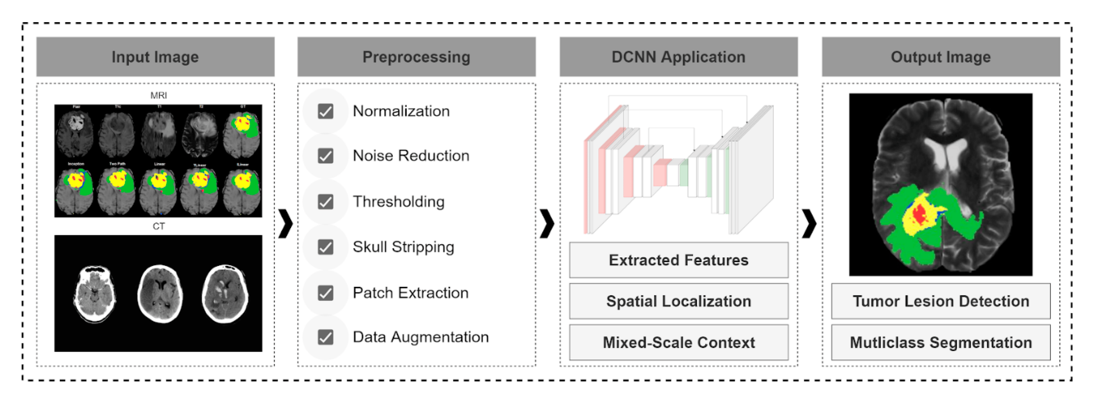
Fully Connected Layers for Classification
Transforms extracted features into a decision-making process.
Connects all neurons for final prediction.
Softmax Activation for Tumor Type Prediction
Converts the output into probability scores for different tumor categories (e.g., benign vs. malignant).

Slide 13
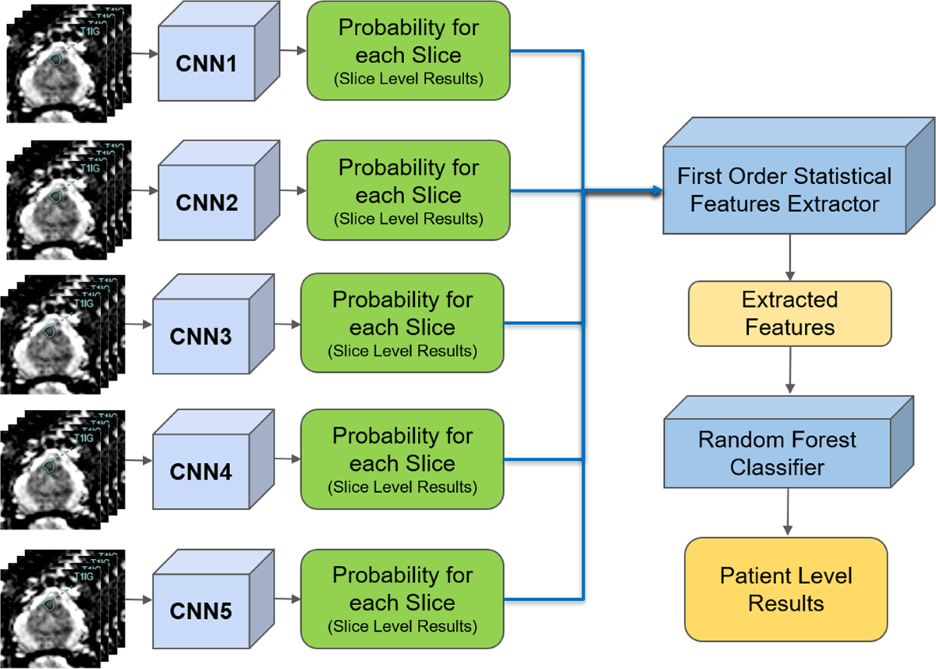
Training & Validation Process
Dataset Split:
Training Set (80%) – Used to train the CNN model on tumor detection.
Validation Set (20%) – Used to evaluate model performance and fine-tune hyperparameters.
Use of Dropout Layers to Prevent Overfitting
Randomly deactivates neurons during training to improve generalization.
Helps prevent the model from memorizing training data instead of learning meaningful features.
Loss Function & Optimizer Used:
Loss Function: Cross-Entropy Loss – Measures the difference between predicted and actual tumor classes.
Optimizer: Adam Optimizer – Efficiently updates weights to minimize loss and improve learning speed.

Slide 14
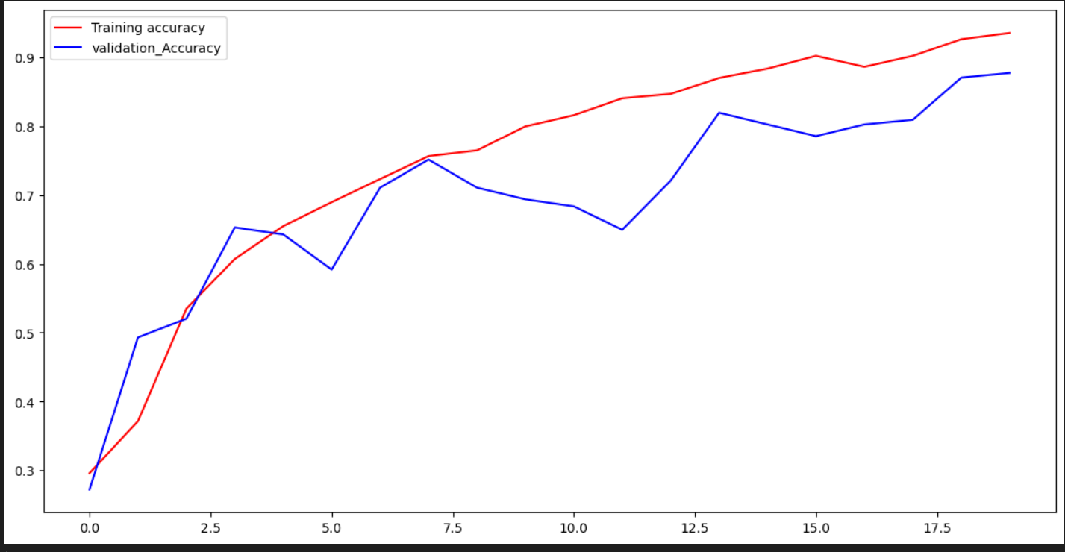
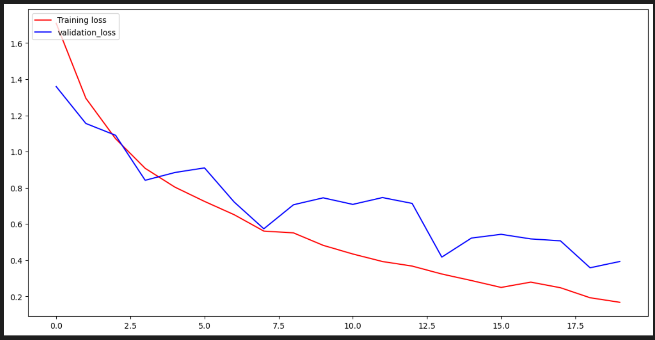
Model Performance Analysis
Accuracy and Loss Trends Over Epochs
The training accuracy steadily increases over the epochs, reaching above 93% by the final epoch.
The validation accuracy follows a similar trend but exhibits slight fluctuations, stabilizing around 87%.
Loss consistently decreases, showing that the model is learning effectively.
Training vs. Validation Accuracy Comparison
The gap between training and validation accuracy is minimal, suggesting good generalization.
Early epochs show a close correlation between training and validation performance.
As training progresses, validation accuracy stabilizes while training accuracy continues increasing.

Slide 15
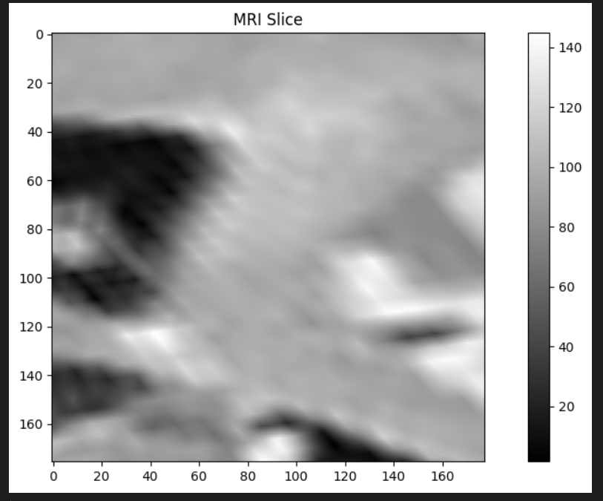
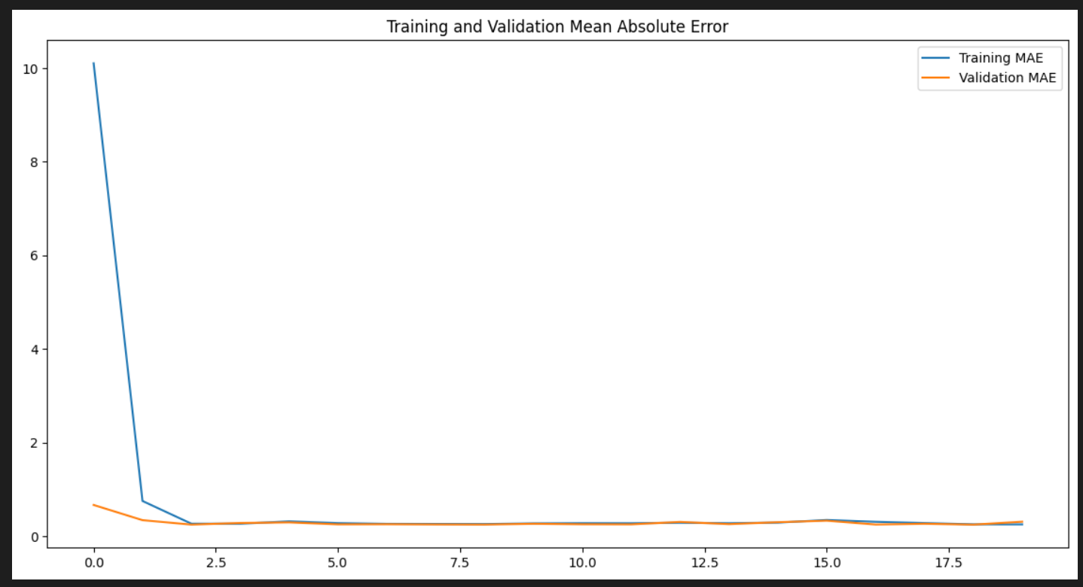
Tumor Segmentation Results
Sample MRI Images with Detected Tumor Regions
The provided grayscale MRI scan represents a sample brain slice.
Bright and dark regions indicate different tissue densities, with potential tumor regions visible.
Before and After Segmentation Results
The CNN model processes MRI images and segments the tumor regions by identifying high-risk areas.
Preprocessed MRI scans (before segmentation) are analyzed using convolutional layers.

Slide 16
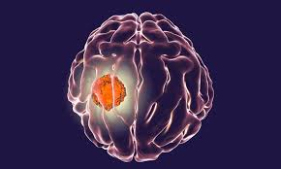
Volume Analysis
Method for Calculating Tumor Volume in CNN
Segmenting the tumor region from MRI slices.
Counting the number of pixels corresponding to the tumor in each slice.
Multiplying by voxel size (determined by MRI scan resolution) to get real-world volume.
Importance of Volume Estimation in Treatment Planning
Helps doctors assess tumor progression over time.
Aids in determining radiation dosage and surgical planning.
Comparison with Manual Annotations
Traditional method: Radiologists manually annotate tumor regions, which is time-consuming and subjective.
CNN-based approach: Automates the process, reducing human error and inter-observer variability.

Slide 17

Conclusion
Summary of Key Findings
CNN-based tumor detection and segmentation offer significant improvements over manual and traditional methods.
Volume estimation enhances clinical decision-making.
The proposed model achieves high accuracy and efficiency.
Effectiveness of the Proposed Method
Automates the process, reducing the workload for radiologists.
Improves consistency in tumor detection and measurement.
Demonstrates strong generalization across MRI scans.
Future Research Directions
Enhancing model robustness with more diverse training data.
Integrating multi-modal imaging (e.g., CT, PET scans).
Exploring real-time implementation for clinical use.

Slide 18


