Slide 1
---
title: "Assignment_Clusters"
author: "Veeranna Hanamashetti"
date: "Thursday, April 02, 2015"
output: html_document
---

Slide 2
Approach:
Hierarchical clustering is performed first. 5 cluster groups seems to be a meaningful division.
Cluster centers based on hierarchical approach (for centers=5) are taken and fed into kmeans algorithm for refinement.
Cluster profile properties have been calculated using suitable code (but not presented in tabular presentation format in this assignment)
Insights are not explicitly explained here (as the case is same as that used in videos and insights are similar)
Knit html is not working due to stack overflow. So screen shots of code chunks and some plots have been showcased in this ppt. Also Rmd (r markdown file) is attached in the mail.

Slide 3
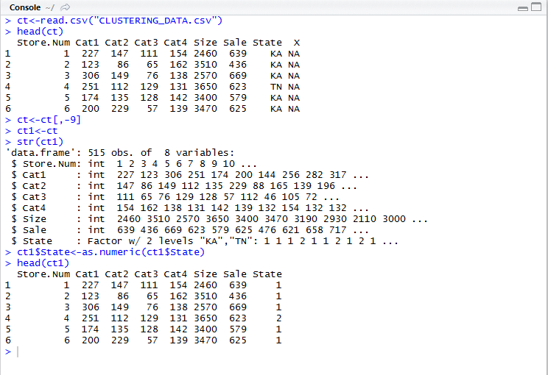

Slide 4
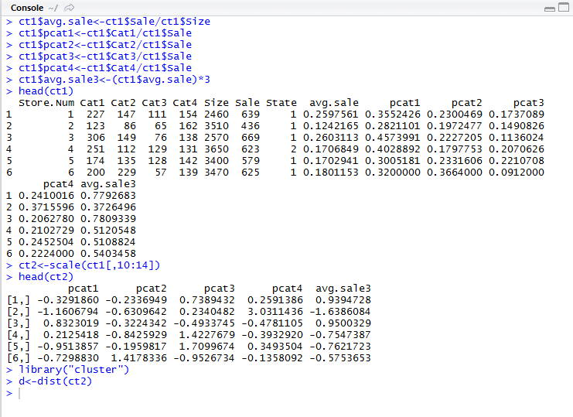

Slide 5
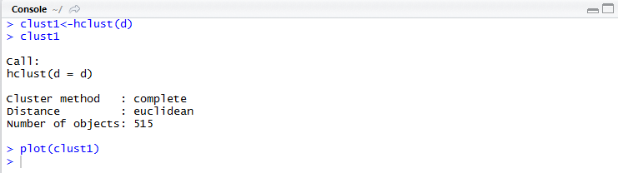

Slide 6
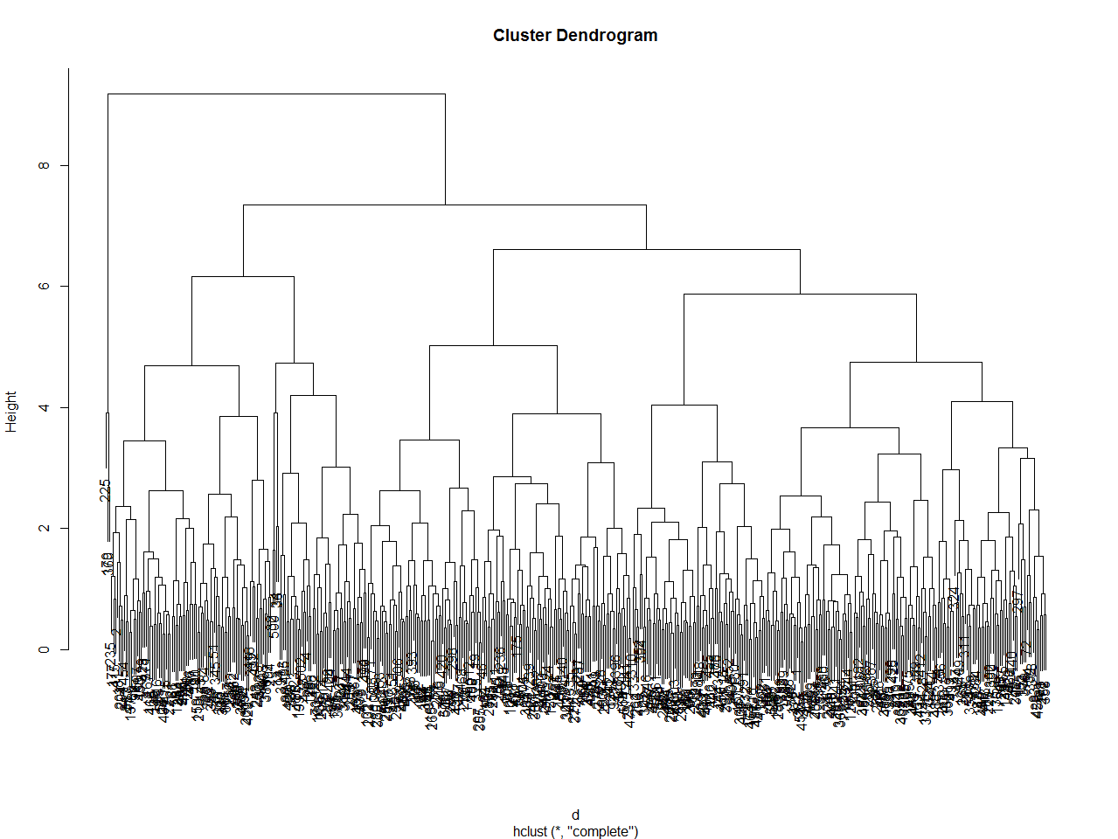

Slide 7
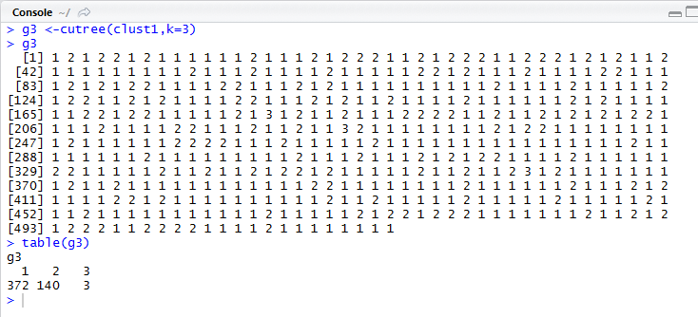

Slide 8
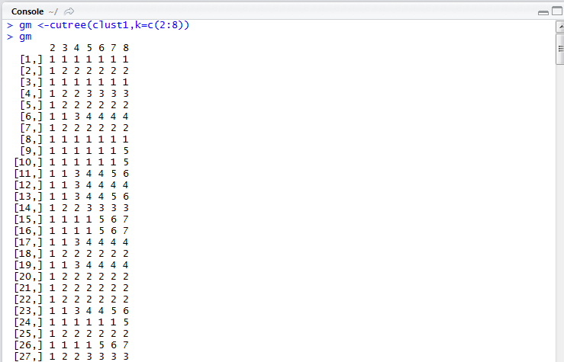
Movement (reallocation) of data points between the clusters as the number of clusters are increased can be seen here.

Slide 9
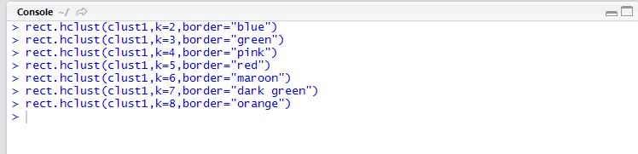

Slide 10
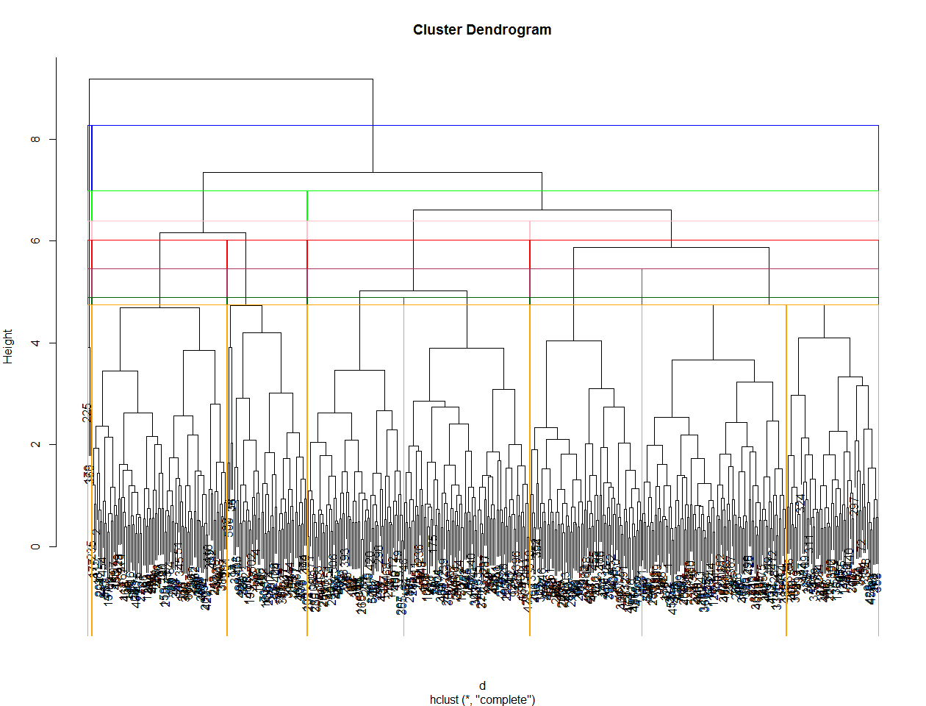

Slide 11
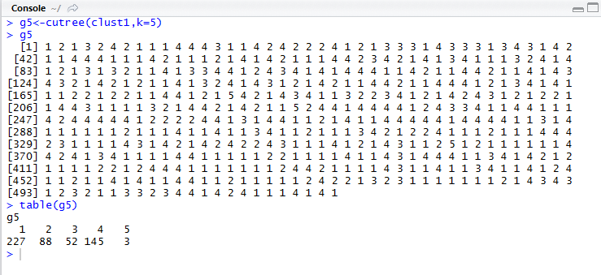
Except for the cluster number 5, other clusters have considerable size

Slide 12
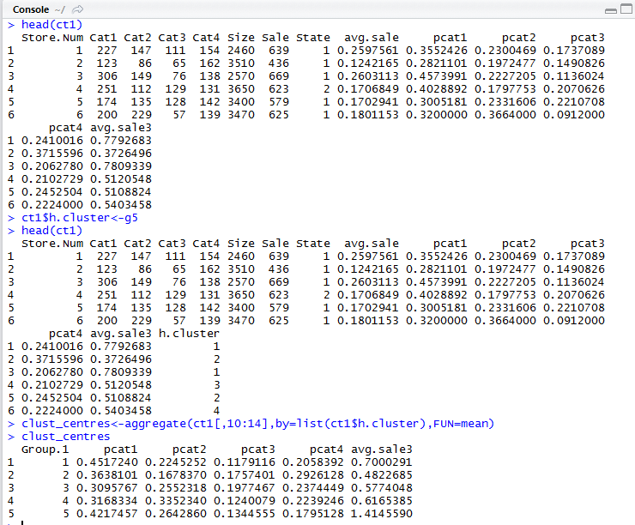

Slide 13
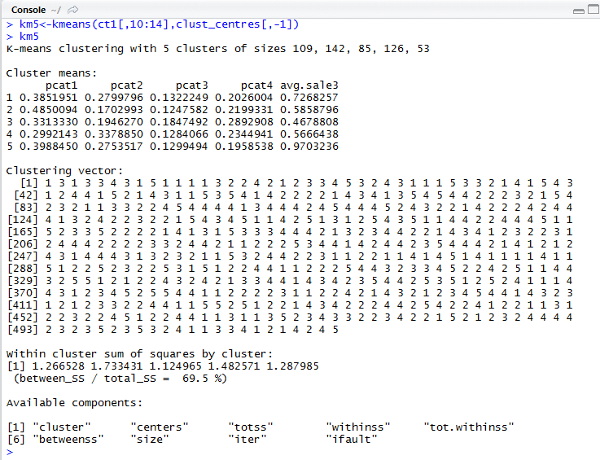
The ratio 69.5% is indicating that still number of clusters can be increased for further better (closer) grouping

Slide 14
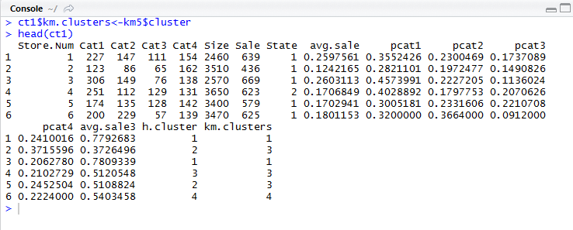
Cluster indexes from hierarchical and kmeans clustering are showing that, in many cases data points have shifted the clusters. This may be an indicator of refinement in kmeans algorithm over hcluster

Slide 15
