Slide 1
ENSEMBLE LEARNING FOR BREAST CANCER DIAGNOSIS: RULE CONVERSION AND FEATURE SELECTION APPROACHES WITH MULTIPLE CLASSIFIERS

Slide 2
AGENDA
Introduction
Problem Definition
Objective
Domain Specification
Literature Survey
Limitations in the Existing System
Architecture Diagram of the Proposed System
Modules
Result Evaluation
Conclusion and Future Scope
Base Papers (minimum 3)
References
Publication Details

Slide 3

Introduction
Breast cancer is a prevalent and serious health concern, and accurate diagnosis plays a crucial role in its treatment and management.
In this project, we have developed an innovative approach that combines ensemble learning, rule conversion, and feature selection techniques to improve the accuracy and interpretability of breast cancer diagnosis.
By leveraging the collective intelligence of multiple classifiers and extracting meaningful rules, our method aims to enhance the diagnostic capabilities and aid medical professionals in making informed decisions.
Accurate and timely diagnosis of breast cancer is crucial for effective treatment and improved patient outcomes.
Throughout this presentation, we will explore the motivation, methodology, experimental results, and future implications of our research.
Notes:
To stress how prevalent this disease is, you could ask that attendees raise their hand if they know someone who has had breast cancer. Many students will likely have been touched in some way by the breast cancer experience.
http://www.breastcancer.org/symptoms/understand_bc/
“In the U.S., an average lifetime is about 80 years. So, it’s more accurate to say that 1 in 8 women in the U.S. who reach the age of 80 can expect to develop breast cancer. In each decade of life, the risk of getting breast cancer is actually lower than 13% for most women.”
http://www.cancer.gov/aboutnci/servingpeople/breast-snapshot.pdf

Slide 4
Problem Definition
The traditional approach to breast cancer classification relies on manual examination of medical images by trained radiologists, which can be time-consuming, subjective, and prone to error.
·Although machine learning methods have been applied to aid in classification, they often require handcrafted features and can be limited by the complexity of the data.
Rule generation is a technique that can be used to extract interpretable rules from complex models like CNNs, providing insight into the specific features that are most relevant for accurate classification.
·By combining deep learning with rules, it is possible to develop a breast cancer classification system that is both accurate and interpretable, providing clinicians with valuable insights into the underlying factors that contribute to breast cancer diagnosis.

Slide 5
Objective:
Develop an ensemble learning framework for breast cancer diagnosis.
Implement rule conversion techniques to extract interpretable rules from the ensemble model.
Apply feature selection methods to identify the most relevant features for accurate diagnosis.
Evaluate the performance of the proposed approach using a comprehensive dataset.
Compare the results with existing methods to assess the effectiveness of the proposed approach.
Provide insights and guidelines for medical professionals to improve breast cancer diagnosis accuracy.
Contribute to the advancement of breast cancer diagnosis methodologies and support clinical decision-making processes.
Notes:
See the Susan G. Komen Foundation website for more info.: http://ww5.komen.org/

Slide 6
Domain Specification
Domain: Data Mining
Data mining is needed to extract knowledge from raw data. Some of the commonly used DM techniques are Associate rule mining, Classification, Clustering, Regression and Prediction.
Data mining techniques helps very well in prediction in the medical field.
Helps to reduce time overhead, improve accuracy and avoid human errors.
Phases in data mining: Data Pre-processing, Data Modelling, Data post-processing.
Data pre-processing: step towards obtaining general overview of data preparation (Data cleaning, Data integration, Data transformation, Data reduction by feature selection) and obtain a general overview of data.
Data modeling: step towards predictive and descriptive categories

Slide 7
Literature Survey
S.NO | Title | Name of the Journal | Technique | Metrics
1 | Breast cancer detection using neural network mammogram | IEEE 2020. | GMM segmentation, PNN Classification | Accuracy, sensitivity, specificity
2 | Diagnosis of Breast Cancer using Decision Tree Data Mining | IEEE 2021 | Grouping, Clustering and Decision tree | Accuracy, Specificity .
3 | Breast Cancer Classification with reduced feature set using associate rules | Springer 2020 | Data Mining, Support Vector Machine | Sensitivity, Accuracy
4 | Detection of Breast cancer based on fuzzy frequent itemset Mining | Elsevier 2020 | Data Mining, Fuzzy logic | Accuracy
5 | CNN based Breast Cancer detection in Mammography | Elsevier 2021 | Computer aided detection, CNN | Accuracy, Efficiency

Slide 8
Limitation in the Existing System
Limited use of ensemble learning techniques: Although some existing works have used ensemble learning for breast cancer diagnosis, the use of multiple classifiers with rule conversion and feature selection approaches is not very common.
Lack of focus on feature selection: Some existing works have used rule-based classifiers for breast cancer diagnosis, but they do not focus on the feature selection process, which is critical for achieving high accuracy.
Limited evaluation: Some existing works do not provide a comprehensive evaluation of their proposed methods using various performance metrics, making it difficult to assess the effectiveness of their approaches.
Limited dataset: Many existing works use a limited dataset, which may not fully represent the diverse population of patients, leading to biased results.
Lack of comparison with state-of-the-art methods: Some existing works do not compare their proposed methods with state-of-the-art approaches, making it difficult to determine the relative performance of their methods.

Slide 9
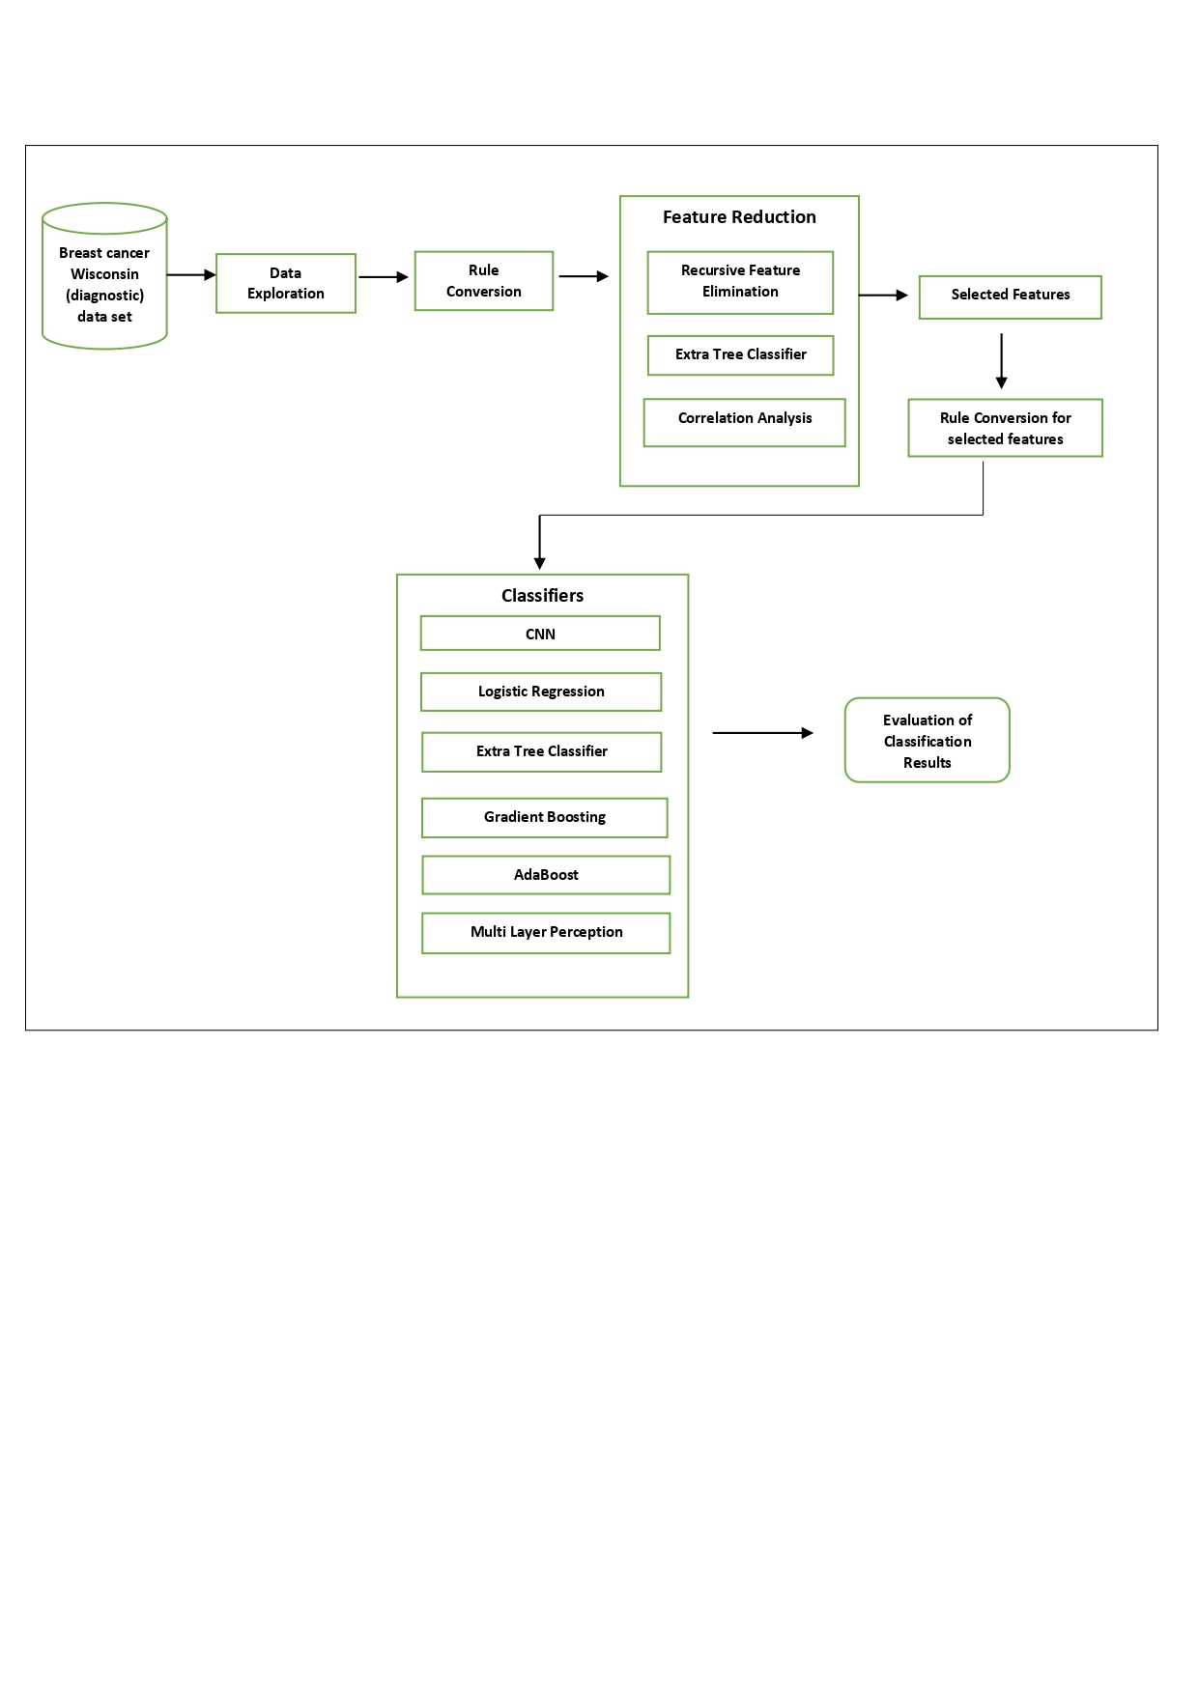
Architecture Diagram of Proposed work

Slide 10
Modules
Dataset Collection
Data Exploration
Rule Conversion
Feature reduction
Rule Conversion for reduced features
Prediction and Evaluation

Slide 11
Module Description
1. Dataset Collection
The dataset used in this project is the Breast Cancer Wisconsin dataset, a widely used and publicly available dataset for breast cancer diagnosis.
The dataset consists of various features that provide information about the characteristics of breast masses, including:
  Radius Mean: Mean of distances from the center to points on the perimeter of the tumor.
  Texture Mean: Standard deviation of gray-scale values.
  Perimeter Mean: Total length of the boundary of the tumor.
  Area Mean: Area occupied by the tumor.
  Smoothness Mean: Local variation in radius lengths.
  Compactness Mean: Perimeter^2/Area-1.0.
  Concavity Mean: Severity of concave portions of the contour.
  Concave Points Mean: Number of concave portions of the contour.
  Symmetry Mean: Reflectional symmetry.
  Fractal Dimension Mean: "Coastline approximation" - 1.
.

Slide 12
Module Description(Cont…)
Diagnosis Labels:
Benign: Indicates that the breast mass is non-cancerous.
Malignant: Indicates that the breast mass is cancerous.
Dataset Source:
The Breast Cancer Wisconsin dataset can be obtained from reliable sources, such as the UCI Machine Learning Repository or Kaggle.
It is a well-studied dataset that has been widely used in research and benchmarking of breast cancer diagnosis algorithms.

Slide 13
Module Description(Cont…)
2. Data Exploration
Before diving into the analysis, it is crucial to gain insights into the dataset and understand its characteristics.
In this module, we perform comprehensive data exploration to gain a deeper understanding of the breast cancer Wisconsin dataset.
The data exploration process involves several key steps, including data visualization, statistical analysis, and data preprocessing.
By exploring the dataset, we aim to identify patterns, outliers, missing values, and potential challenges that may impact the subsequent stages of our analysis.
The insights gained from data exploration will guide us in making informed decisions and ensure the reliability and accuracy of our breast cancer diagnosis model.

Slide 14
Module Description(Cont…)
3. Rule Conversion using Random Forest
  To extract interpretable rules from the breast cancer dataset, we employ the Random Forest algorithm.
  Random Forest is a powerful ensemble learning technique that combines multiple decision trees to generate robust and accurate predictions.
  In this module, we apply the Random Forest algorithm to convert the learned decision tree models into human-readable rules.
  The conversion process involves analyzing the tree structure, identifying decision paths, and translating them into if-then rule format.
  By converting the complex tree models into rules, we can enhance the interpretability of the breast cancer diagnosis system and provide valuable insights to medical professionals.

Slide 15
Module Description(Cont…)
4. Feature Reduction
Feature selection is a critical step in improving the performance and efficiency of our breast cancer diagnosis system. We employ three feature reduction techniques: Recursive Feature Elimination (RFE), Extra Tree, and Correlation analysis
RFE: It recursively eliminates less important features based on their contribution to the overall model performance. With RFE, we were able to reduce the initial feature set from 30 to 11, retaining the most informative features for our classification task.
Extra Tree: It constructs a forest of randomized decision trees to evaluate the importance of each feature. By leveraging Extra Tree, we further refined our feature set, ensuring that only the most relevant features were retained.

Slide 16
Module Description(Cont…)
Correlation analysis: It measures the statistical relationship between features and selects highly correlated features. Through correlation analysis, we identified and preserved features that exhibited strong correlations with the target variable.
After applying these three techniques, we successfully reduced the feature set from 30 to 11. However, we aimed for an even more compact feature set. To achieve this, we employed SelectFromModel, a meta-transformer that selects features based on their importance weights. Using SelectFromModel, we further reduced the feature set to the final six features that provided the most discriminative information for breast cancer diagnosis.
This multi-step approach ensured that we retained only the most relevant and informative features, optimizing the efficiency and accuracy of our breast cancer diagnosis system.

Slide 17
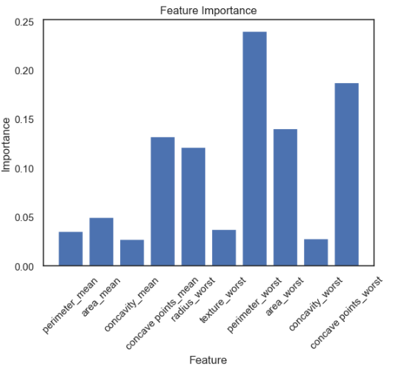
Module Description(Cont…)
Feature reduction using RFE

Slide 18
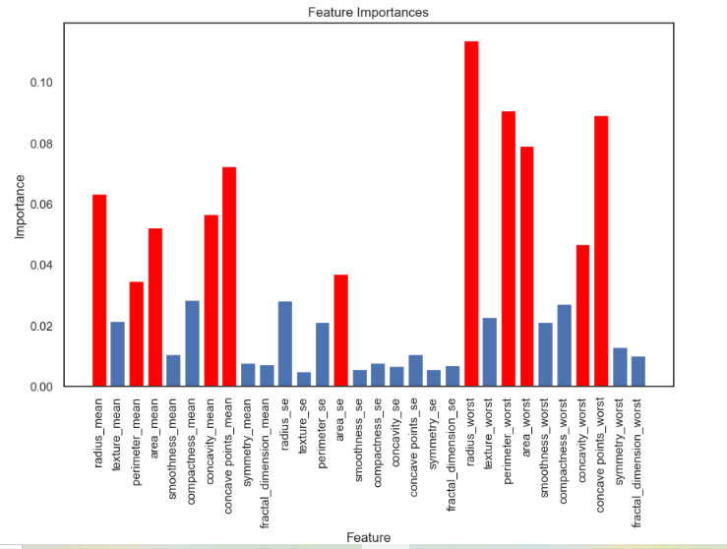
Module Description(Cont…)
Feature reduction using Extra Tree Classifier

Slide 19
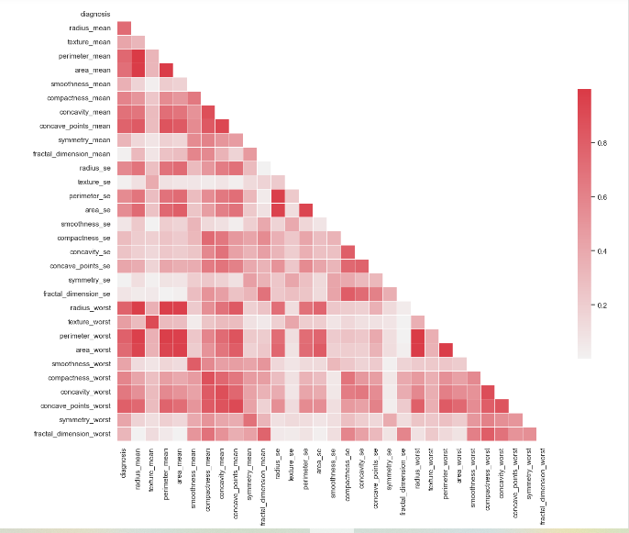
Module Description(Cont…)
Feature reduction using Correlation Matrix

Slide 20
Module Description(Cont…)
5. Rule Conversion for Selected features
After selecting the most informative features using RFE, Extra Tree, and correlation analysis, we proceeded with rule conversion using the Random Forest algorithm.
The goal of rule conversion is to extract interpretable rules from the trained Random Forest model, providing insights into the decision-making process.
Random Forest allows us to generate a set of rules that capture the relationships between the selected features and the diagnosis of breast cancer.
These rules take the form of logical statements, making them easily understandable and interpretable by medical professionals.
The extracted rules can be easily communicated and validated by domain experts, facilitating collaborative decision-making in the medical field.

Slide 21
Module Description(Cont…)
6. Prediction and Evaluation
In order to evaluate the effectiveness of our extracted rules, we conducted predictions on the original dataset using various classification algorithms.
We employed a range of classifiers, including Multilayer Perceptron (MLP), Convolutional Neural Network (CNN), Extra Tree, Gradient Boosting, AdaBoost, and Logistic Regression.
These classifiers were trained on the selected features and evaluated on the testing dataset to assess their performance in breast cancer diagnosis.
By applying our extracted rules to the testing dataset, we obtained predicted labels for each sample.

Slide 22
Module Description(Cont…)
We compared these predictions with the ground truth labels to calculate accuracy, precision, and F1 score, which provide insights into the classifier's performance.
The evaluation metrics help us understand how well the extracted rules generalize to new, unseen data and how they compare to other state-of-the-art classifiers.
Through this comprehensive evaluation, we can identify the most accurate and reliable classifier for breast cancer diagnosis.
The results of the evaluation provide valuable insights into the effectiveness of our ensemble learning approach, rule conversion, and feature selection techniques.

Slide 23
Result Evaluation
The evaluation of our breast cancer diagnosis system revealed interesting insights into the performance of different classifiers.
Among the classifiers tested, Multilayer Perceptron (MLP) demonstrated the highest accuracy in predicting breast cancer with our extracted rules.
MLP achieved an accuracy of 95.61%, outperforming other classifiers such as Convolutional Neural Network (CNN), Extra Tree, Gradient Boosting, AdaBoost, and Logistic Regression.
This indicates that the MLP classifier, when combined with our ensemble learning approach, rule conversion, and feature selection techniques, can effectively classify breast cancer cases.
It is worth noting that while MLP had the highest accuracy, other classifiers also showed promising performance, with accuracy ranging from 93% to 94%.
These results demonstrate the potential of our proposed system in improving breast cancer diagnosis accuracy and assisting medical professionals in making informed decisions.

Slide 24
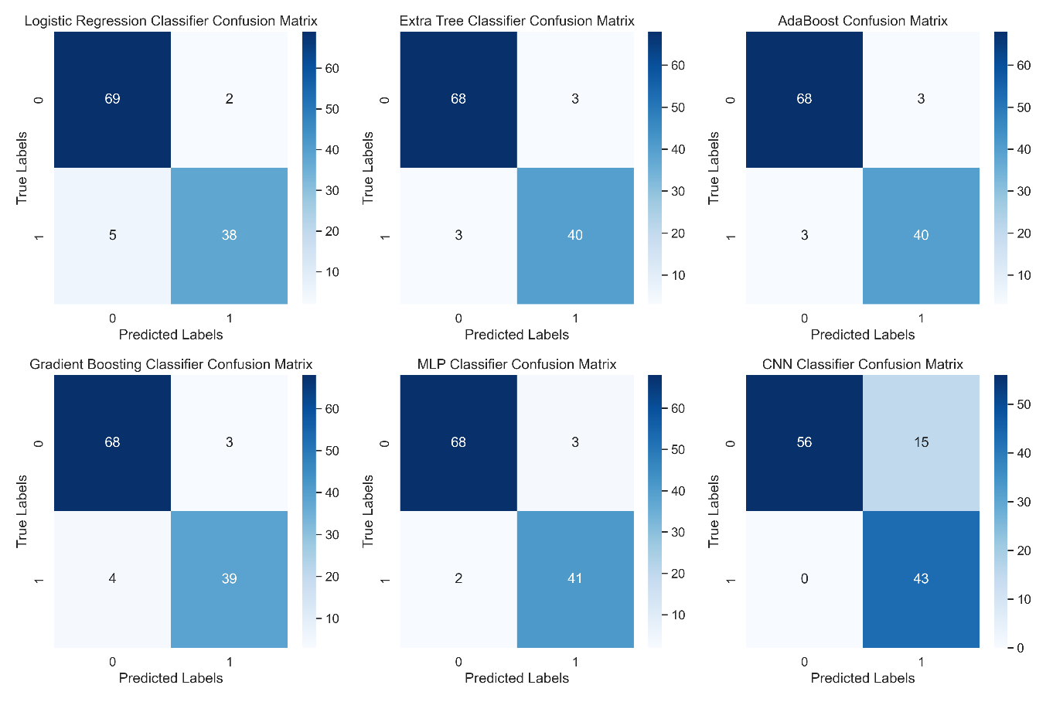
Result Evaluation(Cont…)
Confusion matrix for classifiers

Slide 25
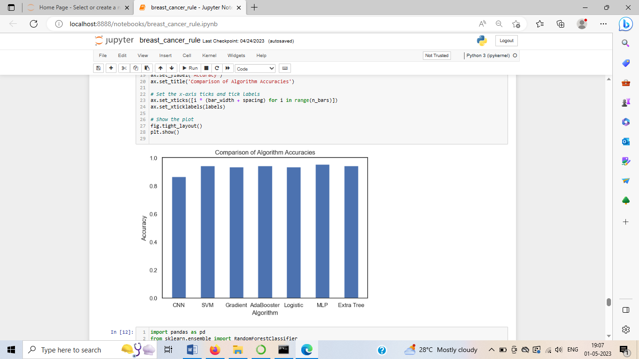
Result Evaluation(Cont..)
Accuracy plot for six Classifiers

Slide 26
Future Work
While our project has made significant contributions to improving breast cancer diagnosis using ensemble learning, rule conversion, and feature selection, there are several avenues for future work to explore:
  Incorporating more advanced ensemble techniques
  Integration of deep learning models.
  Utilizing more comprehensive
  Evaluating the system on real-world clinical data
  Exploring interpretability techniques

Slide 27
Conclusion
In conclusion , Through the integration of multiple classifiers, we have harnessed the collective intelligence of the models to achieve higher accuracy and robustness in breast cancer classification.
The feature selection techniques have reduced the dimensionality of the dataset, enhancing computational efficiency and reducing the risk of overfitting, while maintaining high diagnostic accuracy.
Our experimental results have shown promising performance across various evaluation metrics, with the MLP classifier exhibiting the highest accuracy.
The project opens up new possibilities for enhancing breast cancer diagnosis, and the future work outlined in our presentation will further advance the field and contribute to improved patient outcomes.
We are confident that our research will have a positive impact on the field of breast cancer diagnosis and pave the way for more accurate, efficient, and interpretable diagnostic systems in clinical practice.

Slide 28
Base Papers
Keyvanpour, Mohammad Reza, Barani Shirzad, Mehrnoush, Mahdikhani, Leyli, “WARM: a new breast masses classification method by weighting association rule mining”, Spring Journals, 2022.
Leila Abdelrahman and Manal {Al Ghamdi} and Fernando Collado-Mesa and Mohamed Abdel-Mottaleb, “Convolutional neural networks for breast cancer detection in mammography”, Elsevier, 2021
Haq, Amin Ul and Li, Jian Ping and Saboor, Abdus and Khan, Jalaluddin and Wali, Samad and Ahmad, Sultan and Ali, Amjad and Khan, Ghufran Ahmad and Zhou, Wang, “Detection of Breast Cancer Through Clinical Data Using Supervised and Unsupervised Feature Selection Techniques”, IEEE Access, 2021

Slide 29
REFERENCES
Nagpure, Renuka, Sumita, Pathak, Nileema, “Breast cancer detection using neural network mammogram” IEEE 2020.
Keerthika J, Sruthi D, Swathi D, Swetha D, “Diagnosis of Breast Cancer using Decision Tree Data Mining”, IEEE 2021.
Ed-daoudy A, Maalmi K, “Breast Cancer Classification with reduced feature set using associate rules” Springer 2020.
F. Ramesh Dhanaseelan, M. Jeya sutha, “Detection of Breast cancer based on fuzzy frequent itemset Mining” 2020 Elsevier.
Leila Abdelrahman a, Manal Al Ghamdi b, Fernando Collado-Mesa c,Mohamed Abdel-Mottaleb, “CNN based Breast Cancer detection in Mammography”, Elsevier 2021.

Slide 30
Publication Details
1. Buvaneshraj K, Keerthivasan P, Senthilkumaran S , Veerappan P, “Ensemble Learning for Breast Cancer Diagnosis: Rule Conversion and Feature Selection Approaches with Multiple Classifiers”, International Journal of Advanced Research in Computer and Communication Engineering (IJARCC), ISSN (Online) 2278-1021, IJARCCE ISSN (Print) 2319-5940, Vol. 12, Issue 4, April 2023, pp. 634-638.

Slide 31


Slide 32


Slide 33


Slide 34


Slide 35
Thank you!!

