Slide 1
CAPSTONE PROJECT
Employee Salary prediction using Machine learning algorithms
Presented By
P.Veera Raghavaiah
Vellore institute of technology - AP

Slide 2
OUTLINE
Problem Statement
System Development Approach Algorithm & Deployment
Result Conclusion

Slide 3

Problem Statement
Organizations often struggle to create fair and competitive salary structures due to inconsistent compensation practices.
These inconsistencies can result in salary discrepancies and perceptions of unfairness among employees.
Unclear or non-transparent salary decisions can further contribute to employee dissatisfaction and reduced morale.
Ultimately, unresolved salary structure challenges can negatively impact organizational performance and reputation.
As a result, organizations face difficulties in attracting and retaining top talent, leading to recruitment and retention issues.

Slide 4
System Approach
The "System Approach" section outlines the overall strategy and methodology for developing and implementing. Here's a suggested structure for this section:
System requirements
Library required to build the model

Slide 5
System requirements
Hardware Requirements
Processor: Intel Core i3 or above (recommended: i5/i7 for faster processing) RAM: Minimum 4GB (recommended: 8GB or higher)
Storage: At least 1GB free disk space for datasets, libraries, and project files Operating System: Windows 10/11, macOS, or any major Linux distribution
Software Requirements
Browser: Chrome, Firefox, Edge, or Safari to run Jupyter Notebooks Package Manager: pip or conda (for Python library installation)

Slide 6


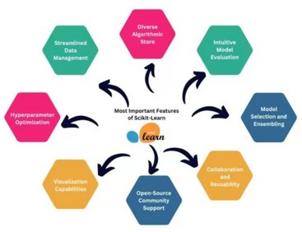
Library required to build the model
PANDAS:
Pandas is a Python library for data evaluation
Matplotlib :
Matplotlib is a widely used for creating visualizations
Scikit-learn:
generate complex diagrams or flowcharts of its internal processes

Slide 7
Algorithm & Deployment
Step-by-Step Procedure to Complete an Employee Salary Prediction using different machine learning alogrithms :
Data Collection and Loading
Import necessary libraries (such as numpy, matplotlib).
Load the dataset ("adult 3.csv") into a pandas DataFrame for analysis
Data Exploration and Preprocessing
Examine the dataset to understand feature types and identify missing or inconsistent values.
Address missing values appropriately (e.g., imputation or removal). Encode categorical variables using suitable techniques (like label encoding or one-hot encoding) to prepare the data for machine learning algorithms.

Slide 8
Feature Selection and Engineering
Identify and select the features most relevant to predicting the target variable (income category).
Engineer or transform features as needed to enhance the predictive power of the dataset.
Data Splitting
Split the dataset into training and testing subsets to allow for proper model evaluation and to avoid overfitting.
Model Selection and Training
Choose an appropriate algorithm for classification (such as logistic regression, decision tree, or random forest).

Slide 9

Train the selected model on the training data.
Model Evaluation
Evaluate the model's performance on the test set using metrics like accuracy, precision, recall, or F1-score.
If needed, perform hyperparameter tuning to improve performance.
Deployment and Reporting
Use the trained model to predict the salary category of new employee data. Document the entire process, the insights gained, and the model’s results in a clear and structured report.

Slide 10
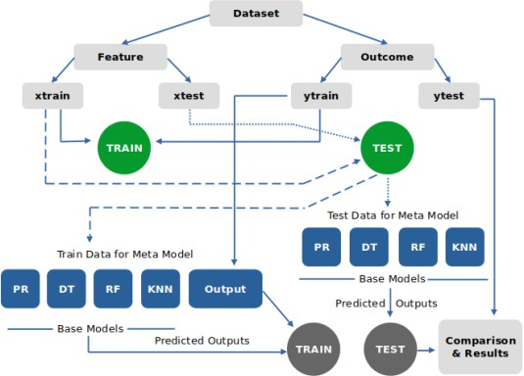

Slide 11
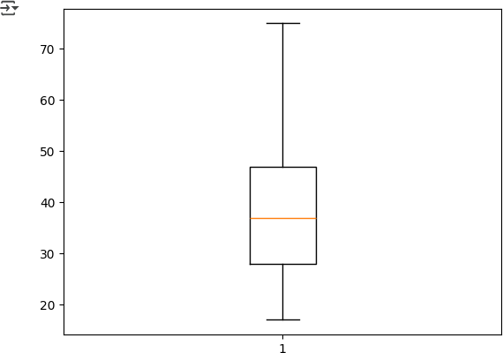
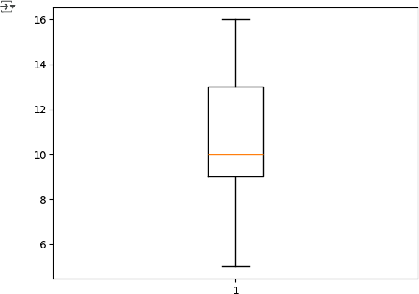
Result
After Outliner detection

Slide 12
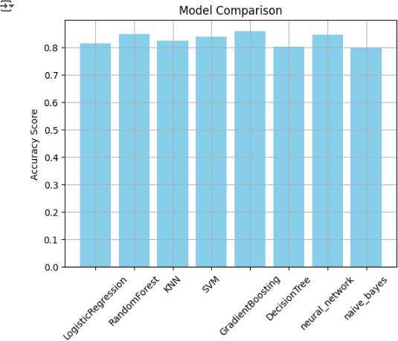

Slide 13
Github Link :
https://github.com/veeraraghava2006/Employee_Salary_prediction

Slide 14

Conclusion
The implementation of the Salary Prediction System , I addressed one of the major concerns in the current workforce.By analyzing employee data and applying machine learning techniques, I developed a system that can predict fair and competitive salaries based on various attributes such as age, education, and role.
This approach enables organizations to offer salaries aligned with market expectations and employee capabilities, helping to reduce turnover and improve satisfaction.
Ultimately, implementing such a predictive system can lead to better retention, more motivated employees, and a stronger competitive position for the company.

Slide 15
THANK YOU
– Veera Raghavaiah

