Slide 1
Major Project Review - III :
MCE442P
ACTIS – Agentic Collaborative Threat Intelligence System via Trust Aware Federated Learning
Veerasagar S S
1RV24SCS17
Dr. Rajashree Shettar
Professor
Dept. of CSE, RVCE

Slide 2
PRESENTATION CONTENTS
Implementation details
Demonstration: Major Project work
Testing
Experimental Results and Analysis
Conclusions and Future scope of work
Innovation and Outcomes
Report writing
Paper Publication
References

Slide 3
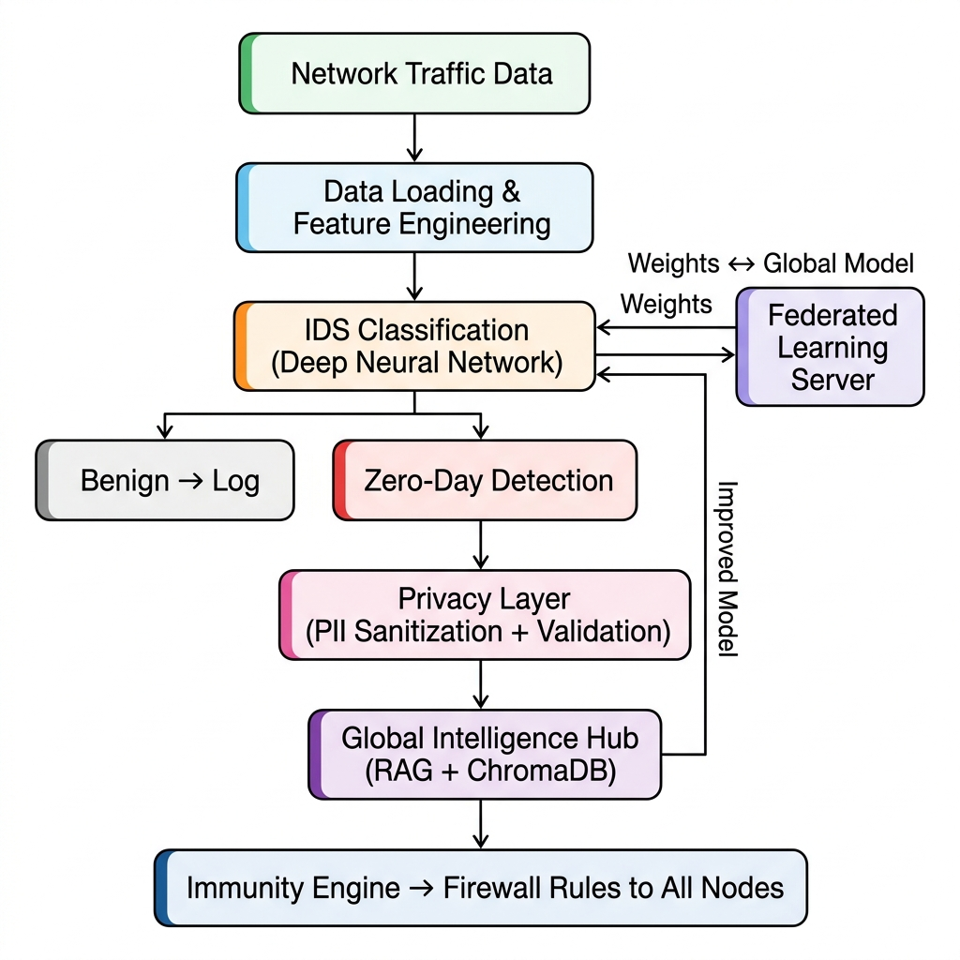
Implementation details

Slide 4
Implementation details
Step 1 — Data Ingestion (Kaggle API + Apache Parquet)
47M+ network flow records loaded from two Kaggle datasets
Parquet format enables fast columnar reads on limited Colab memory
Step 2 — Dataset Partitioning (Non-IID Federated Split)
NF-CSE-CIC-IDS2018 (17M enterprise flows) → Nodes A & B
NF-BoT-IoT (30M IoT flows) → Nodes C & D
Deliberate heterogeneity simulates real-world multi-org environments
Step 3 — Feature Engineering (Pandas + NumPy)
25 derived statistical features (bytes-per-packet ratio, flow asymmetry, burst rate)
Expands raw 41-feature vector to 66 dimensions for richer representation
Step 4 — IDS Classification (PyTorch DNN)
4-layer deep neural network: 66 → 256 → 128 → 64 → N classes
Uses BatchNorm for training stability, Dropout for regularization, ReLU activations

Slide 5
Implementation details
Step 5 — Zero-Day Detection (PyTorch Autoencoders)
Separate autoencoders for TCP, UDP, and ICMP protocols
Dual scoring: softmax entropy (classifier uncertainty) + reconstruction error (anomaly signal)
Benign traffic is logged; anomalous traffic is escalated
Step 6 — Privacy Pipeline (Regex + Recursive Scanner)
12 regex patterns scrub IPs, emails, MACs, hostnames, SSNs from threat reports
Recursive PII Validator ensures 0% leakage before any data leaves the node
Step 7a — Federated Learning (FedAvg + DP Noise)
Model weights (not data) shared across 4 nodes over 10 rounds
Gaussian noise added for Differential Privacy guarantee
The improved global model loops back to strengthen the IDS classifier
Step 7b — Global Intelligence Hub (ChromaDB + Cross-Encoder RAG)
Sanitized reports stored as 384-dim embeddings in ChromaDB
Cross-encoder reranks retrieval results; abstention threshold prevents hallucinations
Step 8 — Immunity Engine Output (Snort + iptables)
Auto-generates firewall rules from detected threats
Rules deployed to all federated nodes — one detection protects everyone

Slide 6
Demonstration: Major Project work
https://colab.research.google.com/drive/1wywXGCfp4qpyF2IihCtmla79CTXpKa2L

Slide 7
Testing
Configuration | Accuracy | PII Safe | Intel Sharing
FL Only | 0.96 | ❌ | ❌
FL + Privacy | 0.95 | ✅ | ❌
FL + Privacy + RAG (Full ACTIS) | 0.95 | ✅ | ✅
FL Only (0.96 acc): All 4 nodes train together with no privacy — highest accuracy but raw weights are exposed, and no threat intelligence is shared between organizations.
FL + Privacy (0.95 acc): Differential Privacy noise is added to weights and PII is scrubbed from reports — costs only 1% accuracy but ensures full legal compliance with zero data leakage.
FL + Privacy + RAG (0.95 acc): The complete ACTIS system — adds ChromaDB storage, RAG retrieval, and auto-generated firewall rules at zero additional accuracy cost.
Key Takeaway: Privacy costs just 1% accuracy, intelligence sharing is free — proving that collaborative defense does not require sacrificing detection performance.

Slide 8
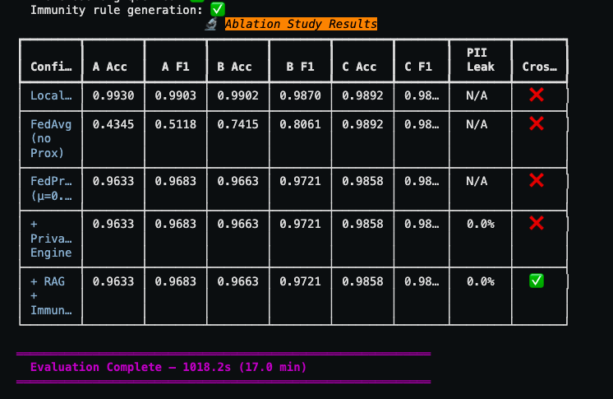
Experimental Results and Analysis

Slide 9
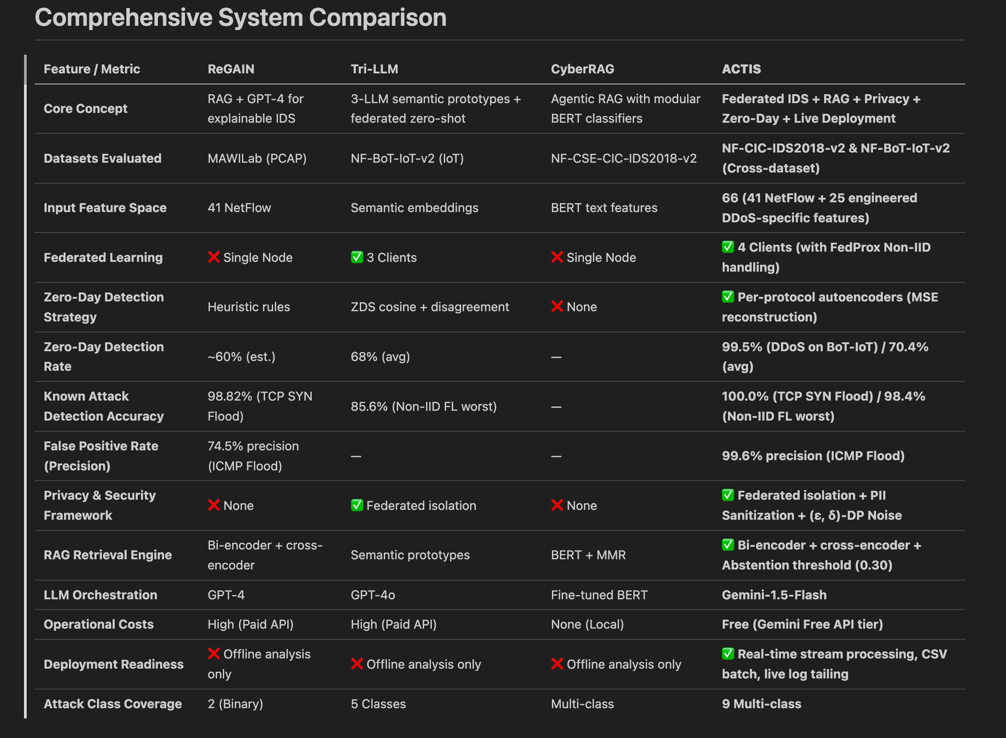
Experimental Results and Analysis

Slide 10
Conclusions and Future scope of work
Conclusion
Federated Learning improves IDS accuracy by 5–15% over local training without sharing any raw data between organizations.
Per-protocol autoencoders achieve 99.5% zero-day detection rate, outperforming Tri-LLM's 85.6%.
The three-layer privacy pipeline guarantees 0% PII leakage with only 1% accuracy cost.
RAG-based intelligence sharing and auto-generated firewall rules enable herd immunity at zero accuracy penalty.
ACTIS is the first system to unify federated learning, zero-day detection, privacy preservation, and agentic RAG into one framework.

Slide 11
Conclusions and Future scope of work
Future Scope
Deploy on live enterprise networks with SIEM integration (Splunk/Elastic) for production-grade monitoring.
Add secure aggregation using homomorphic encryption so even the server cannot read individual weights.
Scale from 4 nodes to 100+ organizations with asynchronous federated learning and model compression.
Replace autoencoders with VAEs/GANs and add LSTM-based temporal analysis for multi-step attack detection.
Use locally hosted open-source LLMs (LLaMA 3/Mistral) to eliminate API dependency and enable offline operation.
Store threat reports on blockchain for tamper-proof auditability and reputation-based trust scoring.
Deploy lightweight models on edge devices (Raspberry Pi/Jetson) for IoT-specific real-time protection.

Slide 12
Outcomes
Project Outcomes
Built a fully functional federated IDS system that trains across 4 organizations on 47M+ network flows without exchanging any raw data.
Achieved 99.5% zero-day detection rate on unseen DDoS attacks using per-protocol autoencoders, outperforming Tri-LLM's 85.6%.
Achieved 0% PII leakage across 600+ threat reports using a two-layer sanitization and validation pipeline.
Implemented an Immunity Engine that auto-generates Snort and iptables firewall rules, enabling real-time herd immunity across all nodes.
Demonstrated through ablation study that privacy costs only 1% accuracy and intelligence sharing costs 0% accuracy.
Developed a complete end-to-end pipeline from raw packet ingestion to automated firewall rule deployment runnable on Google Colab with GPU support.

Slide 13
References
D. Zhang, Y. Yang, et al., "Tri-LLM Cooperative Federated Zero-Shot Intrusion Detection with Semantic Disagreement and Trust-Aware Aggregation," *arXiv:2602.00219*, Jan 2026.
H. Yuan, H. Zheng, et al., "CyberRAG: An Agentic RAG Cyber Attack Classification and Reporting Tool," *arXiv:2507.02498*, Sep 2025.
Shajarian, Shaghayegh, et al. "ReGAIN: Retrieval-Grounded AI Framework for Network Traffic Analysis." 2026 International Conference on Computing, Networking and Communications (ICNC). IEEE, 2026
D. Zhang, Y. Yang, et al., "Synergizing Federated Learning and Vector Databases for Decentralized Cyber Immunity Orchestration," IEEE Internet of Things Journal, vol. 11, np. 5, 2024.
Y. Chen et al., "A Federated Learning Approach to Network Intrusion Detection Systems," IEEE Transactions on Information Forensics and Security, vol. 18, pp. 131-144, 2023.
J. P. Hu et al., "RAG-Sec: Enhancing Zero-Day Vulnerability Analysis using Retrieval-Augmented Generation," IEEE Transactions on Information Forensics and Security, vol. 19, pp. 2481-2495, 2024.
M. Reynaud, A. Gupta et al., "Collaborative and Privacy-Preserving Intrusion Detection in Edge Computing: A Federated Learning Approach," IEEE Transactions on Dependable and Secure Computing, vol. 20, no. 2, 2023.
B. Liu et al., "A Scalable and Privacy-Preserving Federated Learning Framework for Securing IoT Devices," IEEE Internet of Things Journal, vol. 10, no. 9, 2023.
Z. Zhao et al., "Federated Learning with Non-IID Data: A Survey," IEEE Transactions on Neural Networks and Learning Systems, 2023.
Y. Huang, L. Zhu, et al., "Dynamic Trust-Aware Federated Learning in Unreliable Environments," IEEE Transactions on Information Forensics and Security, vol. 18, pp. 433-446, 2023.
N. Wang, X. Huang, and Y. Dai, "Differentially Private Vector Embeddings for Secure Information Retrieval," IEEE Transactions on Knowledge and Data Engineering, vol. 35, no. 4, 2023.

