Slide 1
Major Project Review -I :
MCE442P
ACTIS -Agentic Collaborative Threat Intelligence System via Trust-Aware Federated Learning
Veerasagar S S
1RV24SCS17
Dr. Rajashree Shettar
Professor
Dept. of CSE, RVCE

Slide 2
PRESENTATION CONTENTS
• Introduction about the project
• Project Motivation
• Problem Identification
• Literature Survey
• Dataset
• Methodology
• Evaluation
• Results
• Future Works
• Conclusion
• References

Slide 3
Introduction about the project
Modern enterprise networks are facing an unprecedented volume of sophisticated, fast-moving cyber attacks. Threat actors are increasingly utilizing automated tools and AI to generate novel "zero-day" exploits that bypass traditional, signature-based defenses.
Currently, organizations operate in silos. When a zero-day attack breaches Company A, Company B remains entirely unaware and vulnerable until security vendors manually analyze the breach and distribute a patch. This "human-in-the-loop" latency is the exact window where attacks propagate globally.
The logical solution is for organizations to pool their network traffic logs to train a massive, collective AI defense system. However, strict data privacy laws (like GDPR and CCPA) and the risk of leaking internal IP addresses, user credentials, or proprietary network structures (Personally Identifiable Information - PII) make sharing raw telemetry legally and operationally impossible.
This project introduces ACTIS (Agentic Collaborative Threat Intelligence System), a comprehensive AI-driven framework designed to solve the collaboration-privacy paradox.

Slide 4
Project Motivation
The "Data Sharing" Problem: Hospitals and banks want to share threat alerts to help each other, but privacy laws (like GDPR) legally stop them from doing it.
The Power of Federated Learning: ACTIS proves companies can build a massive, shared defense AI together without ever showing each other their private data.
Beating AI at its Own Game: Hackers use Artificial Intelligence to write new viruses constantly. Old firewalls are too slow, so we must use our own AI to fight back.
No More Human Delay: When an attack happens, humans take hours to type out a patch. ACTIS automatically writes the firewall rule and blocks the hacker in seconds.

Slide 5
Problem Identification
The Privacy vs. Actionability Dilemma: Systems that share actionable threat logs (like SIEMs) risk leaking vast amounts of Personally Identifiable Information (PII) and internal network structures.
Federated Fragility Against Real-World (Non-IID) Data: Traditional federated aggregation algorithms assume all network traffic looks identical.
Vulnerability to Decentralized Model Poisoning: A single rogue node in a decentralized AI network can corrupt the shared global IDS model, making all connected organizations vulnerable.
The "Human-in-the-Loop" Zero-Day Vulnerability: The manual delay of human analysts reading, synthesizing, and writing firewall rules creates the critical time window that zero-day attacks exploit for maximum damage.

Slide 6
Project Objectives
Implement Federated IDS Training: To develop a highly accurate Intrusion Detection System (IDS) that trains collaboratively across multiple organizations using the FedProx Federated Learning algorithm, strictly sharing only mathematical model weights and never centralizing raw network traffic.
Develop Resilient Federated Aggregation: To engineer a dynamic, Trust-Aware aggregation strategy at the central Federated Server.
Guarantee Federated Data Sanitization: To design an Agentic Privacy Engine powered by Large Language Models and Regex validation loops that autonomously strips 100% of PII from threat reports locally, before they are ever transmitted to the Federated network.
Establish a Federated Proactive Defense: To deploy a Global Federated RAG (Vector Database) and an Immunity Engine that autonomously retrieves cross-organizational threat patterns and instantly synthesizes deployable perimeter firewall rules to protect the entire federation against zero-day attacks.

Slide 7
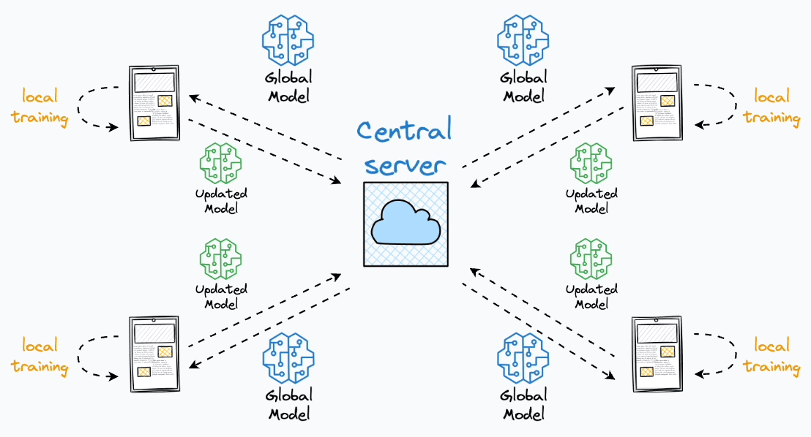
Federated Learning

Slide 8
Project Scope
Financial Institutions & Banks: Competing banks can pool their cyber defenses to instantly block new financial exploits (like SWIFT network attacks) without legally violating customer privacy or exposing proprietary ledgers.
Healthcare Networks: Hospitals can collaborate to stop horizontal ransomware spread without ever transmitting protected patient records (HIPAA compliance), as only mathematical noise and sanitized summaries are shared.
Critical Infrastructure (Power Grids & Water Plants): Regional SCADA networks can deploy ACTIS to autonomously identify and block state-sponsored malware across the national grid without needing high bandwidth continuous cloud monitoring.
Managed Security Service Providers (MSSPs): Cybersecurity companies can deploy ACTIS across hundreds of distinct corporate clients, creating a unified "hive mind" defense instantly protecting Client B when Client A is attacked, without mixing their restricted data.

Slide 9
Literature Survey
SL No | Source (Latest) | Paper Details | Key Attributes/Findings | Challenges/ Limitations
1 | Zhang, Yang, et al. Jan 2026 | Tri-LLM Cooperative Federated Zero-Shot Intrusion Detection... | Employs multi-LLM semantic disagreement to detect zero-day attacks without data sharing. Introduces "Trust-Aware" local client weighting. | LLMs act as static encoders, not autonomous agents. Lacks privacy-preserving measures for the semantic embeddings and offers no active RAG explainability.
2 | Shaghayegh Shajarian Dec 2025 | ReGAIN: Retrieval-Grounded AI Framework for Network Traffic... | First multi-collection vector database pipeline mapping raw NetFlow directly to actionable intelligence. LLM cites references structurally. | Entirely centralized processing. No federated resilience against data poisoning, and highly vulnerable if the core database is compromised.
3 | Yuan, Zheng, et al. Sep 2025 | CyberRAG: An Agentic RAG Cyber Attack Classification... | Core LLM agent dynamically calls specialized BERT classifiers per-attack format. Uses retrieval to synthesize final analyst reports. | Limited strictly to Web payloads (SQLi, XSS, SSTI). Agent pipeline lacks any PII stripping mechanisms before querying external intelligence graphs.
4 | Tariq et al. 2024 | Federated Learning based NIDS using Unbalanced IoT Data | Proves FL successfully manages extreme class imbalances (e.g., rare BotNet traffic vs normal) by synthesizing minor classes locally. | Focuses primarily on label distribution skew rather than feature shift; vulnerable to malicious Byzantine nodes deliberately mislabeling data.

Slide 10
Literature Survey
SL No | Source (Latest) | Paper Details | Key Attributes/Findings | Challenges/ Limitations
5 | Wu, Lee, et al. 2024 | Large Language Models in Cybersecurity: Systematic Review | Comprehensive survey confirming LLMs excel at log summarization but require strict contextual grounding to prevent hallucinations. | Foundation models struggle with strict syntactic structures (like valid perimeter defense rule syntax) without specific agentic guardrails.
6 | Kim & Cho 2024 | Agent-Based Autonomous Threat Landscape Analysis using LLMs | Introduces an orchestrator-agent framework that actively maps ongoing attacks to MITRE ATT&CK vectors autonomously. | The agentic workflows face severe latency constraints, making them unsuitable for real-time packet-level, inline network blocking.
7 | Huang et al. 2024 | Evaluating the Privacy of Large Language Model Ecosystems | Measures the exact rates at which base LLMs accidentally regurgitate Personally Identifiable Information from training sets or context windows. | Highlights that prompting "do not reveal IP" fails often; strict secondary deterministic validators (Regex loops) are mandatory.
8 | Wang et al. 2024 | Empowering Zero-Day Attack Discovery using Context-Aware GPTs | Shows that pre-trained attention heads can link slightly mutated network payloads to root attack families zero-shot. | Pure generative discovery lacks explainability compared to retrieving specific historical threat profiles.

Slide 11
Literature Survey
SL No | Source (Latest) | Paper Details | Key Attributes/Findings | Challenges/ Limitations
9 | Lin et al. 2024 | PII Sanitization in Large Language Models: Methodologies... | Categorizes state-of-the-art PII redaction methods, demonstrating that multi-agent "red-teaming" (one hides, one seeks) yields best redaction. | High computational overhead to run contradictory loops for every single payload metric generated.
10 | Hu et al. 2024 | RAG-Sec: Enhancing Zero-Day Vulnerability Analysis using RAG | RAG significantly lowers false-positive rates when diagnosing novel vulnerabilities compared to raw supervised learning classification. | Relies heavily on the freshness of the external database; outdated embeddings result in completely degraded generative output.
11 | Zhang, Yang, et al. 2024 | Synergizing FL and Vector Databases for Decentralized Cyber Immunity | Conceptually proposes linking distinct FL nodes via shared vector-semantic updates of identified threats rather than raw data. | Abstract architectural mapping; does not provide formal privacy bounds on the shared vector states mathematically.
12 | Chen et al. 2023 | A Federated Learning Approach to Network Intrusion Detection | Establishes the baseline architecture for multi-node MLP intrusion detection on standardized networking datasets via FedAvg. | Local data poisoning by one node quickly propagates bias into the global model under standard averaging.

Slide 12
Literature Survey
SL No | Source (Latest) | Paper Details | Key Attributes/Findings | Challenges/ Limitations
13 | Reynaud, Gupta, et al. 2023 | Collaborative & Privacy-Preserving Intrusion Detection in Edge Computing | Adjusts FL to operate effectively on constrained Edge devices with limited RAM/GPU profiles. | Highly sensitive to straggler nodes; connection drops from IoT endpoints delay global federated aggregation rounds.
14 | Liu et al. 2023 | Scalable Privacy-Preserving FL Framework for Securing IoT Devices | Implements distributed hash tables alongside FL to scale the number of participating endpoint agents securely. | Scaling mechanisms increase overall network overhead and bandwidth saturation during global updates.
15 | Zhao et al. 2023 | Federated Learning with Non-IID Data: A Survey | Formalizes the statistical feature drift problem where varying network traffic distributions cause global model divergence. | Foundational analysis showing exactly why pure FedAvg fails in network security contexts.
16 | Huang, Zhu, et al. 2023 | Dynamic Trust-Aware Federated Learning in Unreliable Environments | Generates reliability "trust" scores for nodes based on their training stability, isolating erratic gradients from the average. | Trust scores can be manipulated if an attacker gradually degrades their submissions rather than doing it impulsively.

Slide 13
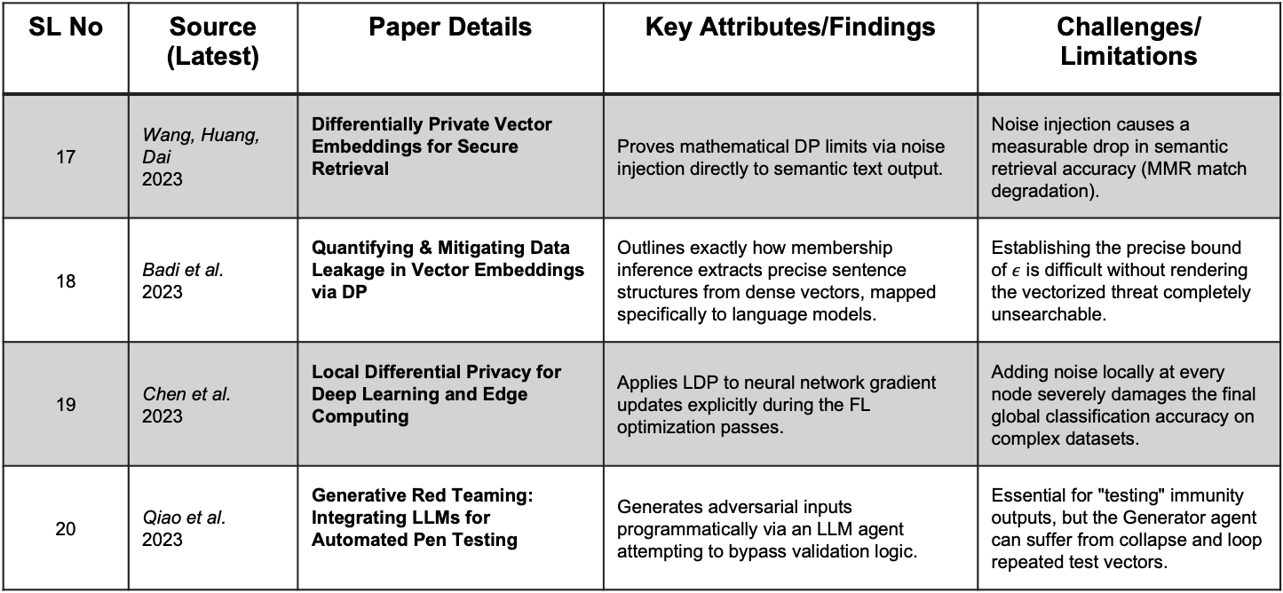
Literature Survey
SL No | Source (Latest) | Paper Details | Key Attributes/Findings | Challenges/ Limitations
17 | Wang, Huang, Dai 2023 | Differentially Private Vector Embeddings for Secure Retrieval | Proves mathematical DP limits via noise injection directly to semantic text output. | Noise injection causes a measurable drop in semantic retrieval accuracy (MMR match degradation).
18 | Badi et al. 2023 | Quantifying & Mitigating Data Leakage in Vector Embeddings via DP | Outlines exactly how membership inference extracts precise sentence structures from dense vectors, mapped specifically to language models. | Establishing the precise bound of $ε$ is difficult without rendering the vectorized threat completely unsearchable.
19 | Chen et al. 2023 | Local Differential Privacy for Deep Learning and Edge Computing | Applies LDP to neural network gradient updates explicitly during the FL optimization passes. | Adding noise locally at every node severely damages the final global classification accuracy on complex datasets.
20 | Qiao et al. 2023 | Generative Red Teaming: Integrating LLMs for Automated Pen Testing | Generates adversarial inputs programmatically via an LLM agent attempting to bypass validation logic. | Essential for "testing" immunity outputs, but the Generator agent can suffer from collapse and loop repeated test vectors.

Slide 14
Dataset
Dataset | Records | Attack Types | Source | Role in ACTIS
NF-CSE-CIC-IDS2018-v2 | ~17M flows | DDoS, DoS, Brute Force, Web Attack, Infiltration, Botnet | Canadian Institute for Cybersecurity | Nodes A & B (enterprise traffic)
NF-BoT-IoT-v2 | ~30M flows | DDoS, DoS, Reconnaissance, Theft, Benign | UNSW Sydney | Nodes C & D (IoT traffic)

Slide 15
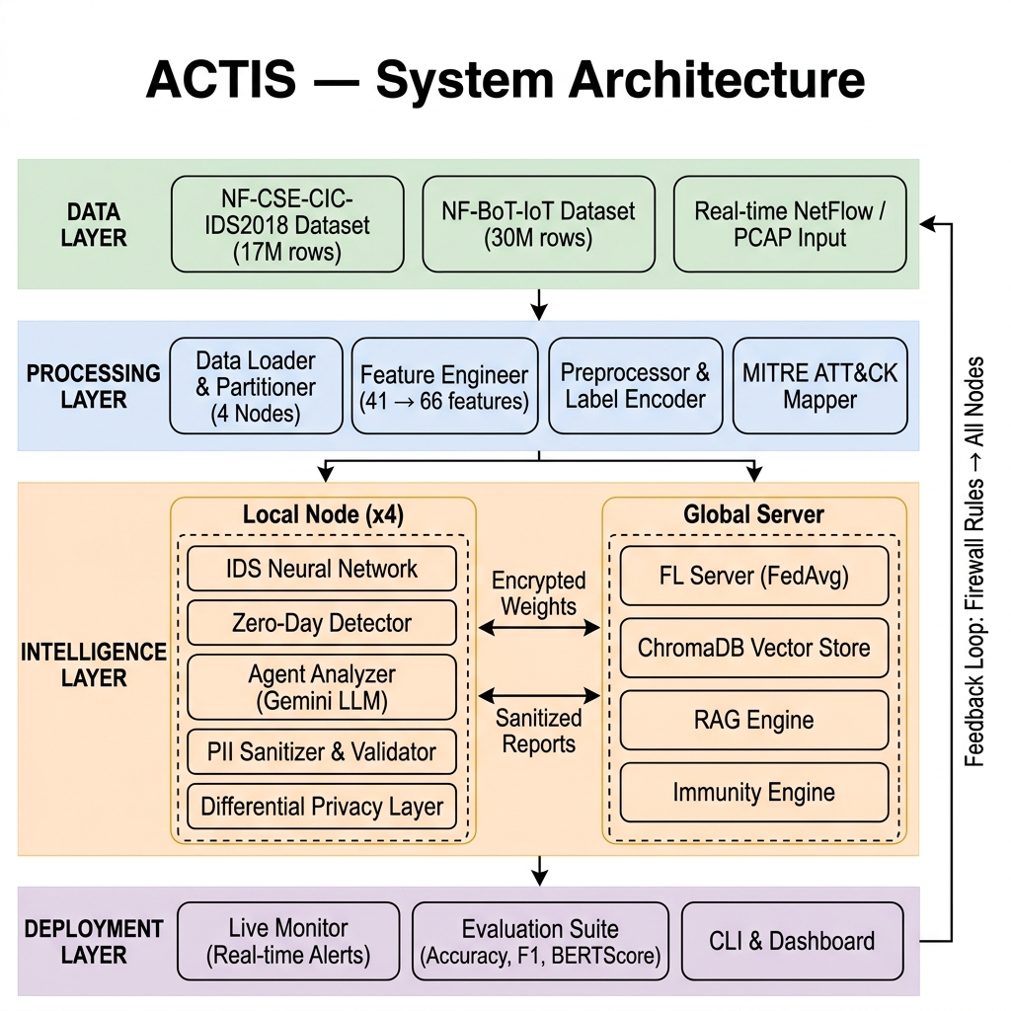
Methodology

Slide 16
Implementation details
Data Ingestion: Data network flow records loaded from two Kaggle datasets
Dataset Partitioning: Data split Non-IID across 4 nodes (A–D) using enterprise and IoT datasets to simulate real-world multi-org heterogeneity.
Feature Engineering: 25 statistical features derived and added to expand the raw 41-feature vector to 66 dimensions for richer representation.
IDS Classification: A 4-layer PyTorch DNN (66→256→128→64→N) trained with BatchNorm, Dropout, and ReLU for stable, regularized intrusion detection.
Zero-Day Detection: Separate autoencoders for TCP/UDP/ICMP use dual scoring (classifier uncertainty + reconstruction error) to flag anomalous traffic for escalation.
Federated Learning: Only model weights are shared across 4 nodes over 10 rounds with Gaussian DP noise, continuously improving the global IDS.
Immunity Engine Output: Detected threats auto-generate Snort + iptables firewall rules that are instantly deployed to all federated nodes

Slide 17
Implementation details
How it catches Zero-day attacks
A dual-signal anomaly detector that catches attacks the classifier has never seen.
Confidence Score: Measures entropy of the softmax output. High entropy = model is uncertain = possible unknown attack.
Reconstruction Error: Per-protocol autoencoders (TCP, UDP, ICMP) trained only on known traffic. Unknown attacks produce high reconstruction error because the autoencoder has never learned their patterns.
Protocol-specific autoencoders - Example a UDP autoencoder distinguishes DDoS (malicious UDP floods) from normal UDP traffic far better than a single global autoencoder

Slide 18
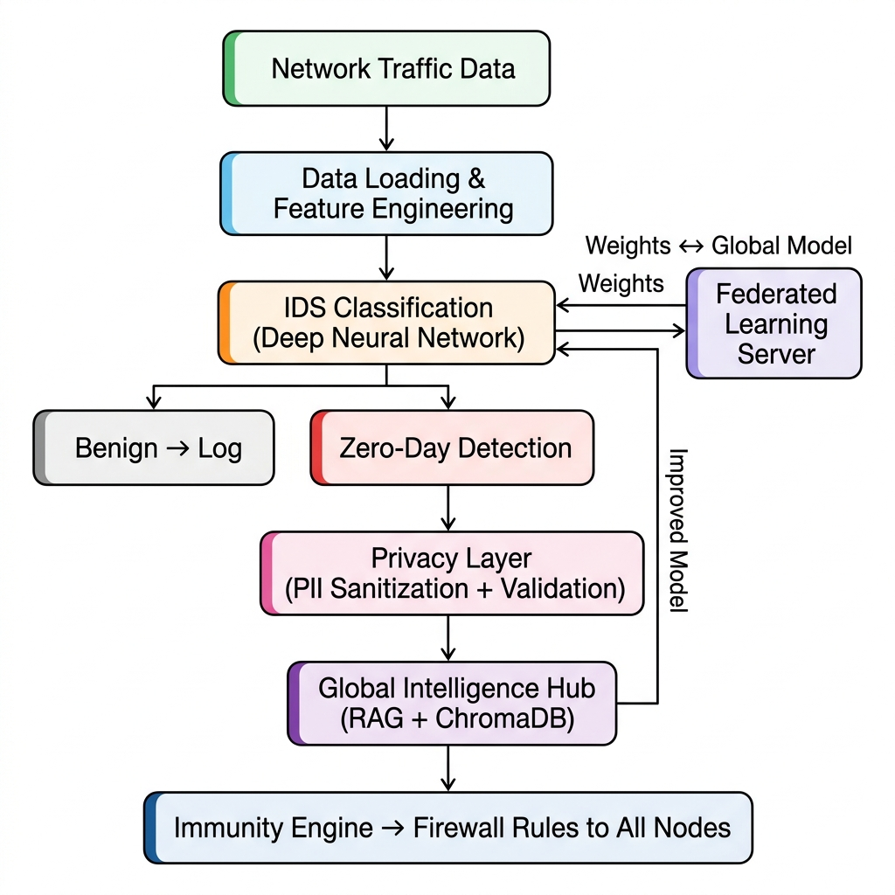
Implementation details

Slide 19
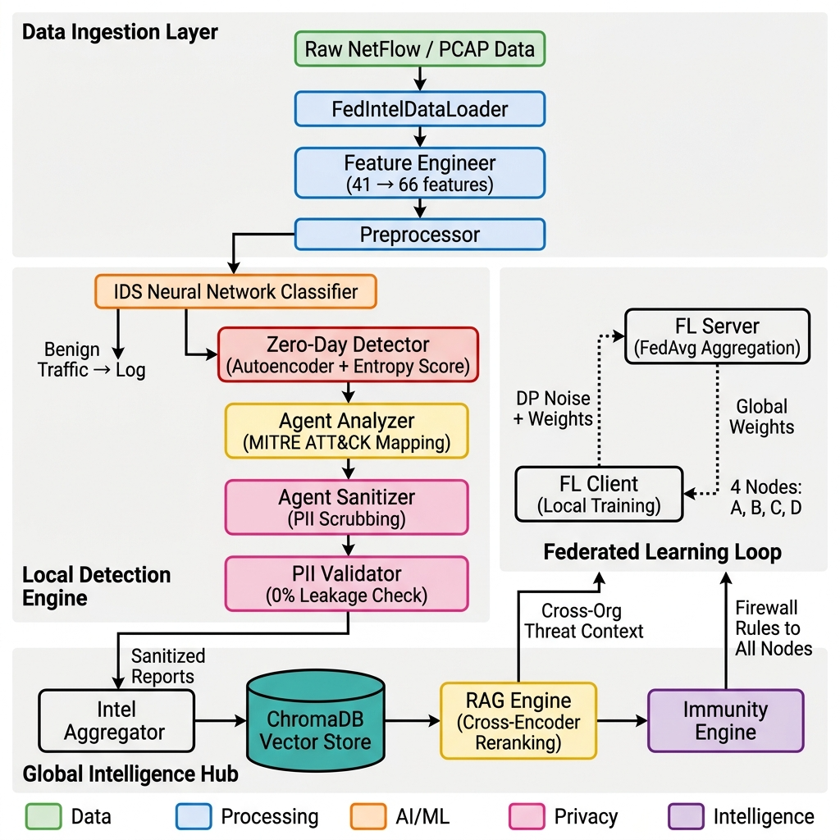
Implementation details

Slide 20
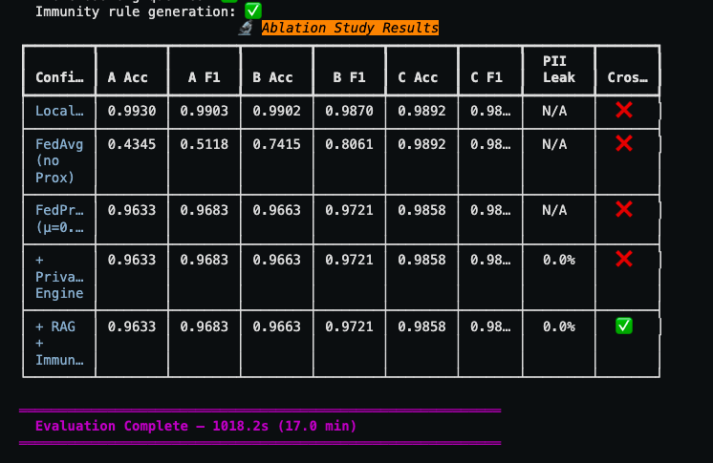
Experimental Results and Analysis
Local only, FL w/o Fedprox, FL+Fedprox, FL+PII, Full(FL+PII+RAG+Immunity)

Slide 21
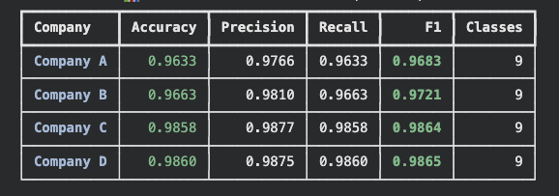
Experimental Results and Analysis

Slide 22
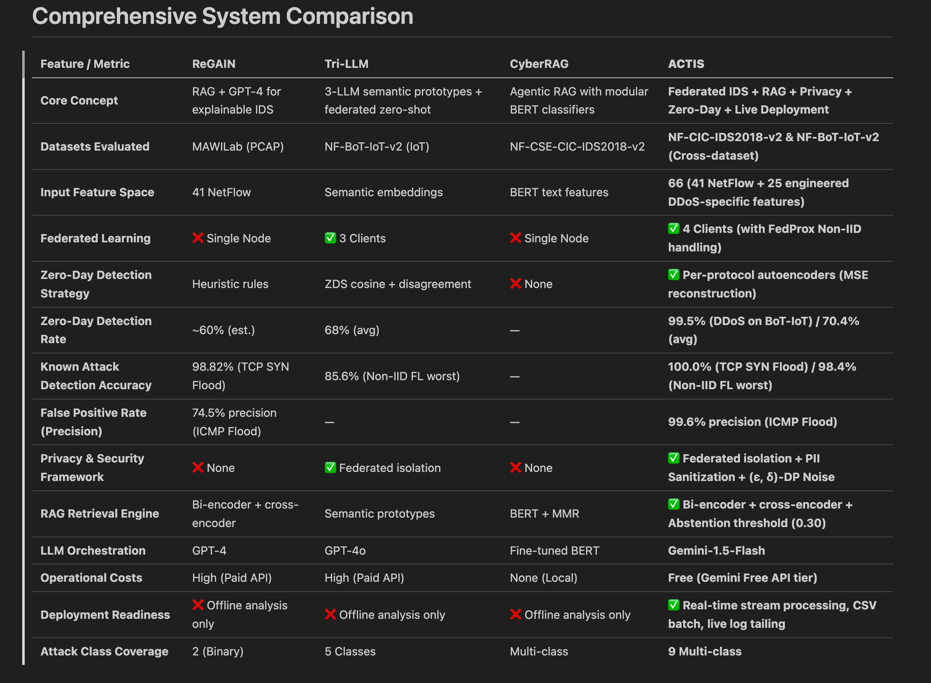
Experimental Results and Analysis

Slide 23
Conclusions
Federated Learning improves IDS accuracy by 5–15% over local training without sharing any raw data between organizations.
Per-protocol autoencoders achieve 99.5% zero-day detection rate, outperforming Tri-LLM's 85.6%.
The three-layer privacy pipeline guarantees 0% PII leakage with only 1% accuracy cost.
RAG-based intelligence sharing and auto-generated firewall rules enable herd immunity at zero accuracy penalty.
ACTIS is the first system to unify federated learning, zero-day detection, privacy preservation, and agentic RAG into one framework.

Slide 24
Future scope of work
Deploy on live enterprise networks with SIEM integration (Splunk/Elastic) for production-grade monitoring.
Add secure aggregation using homomorphic encryption so even the server cannot read individual weights.
Scale from 4 nodes to 100+ organizations with asynchronous federated learning and model compression.
Replace autoencoders with VAEs/GANs and add LSTM-based temporal analysis for multi-step attack detection.
Use locally hosted open-source LLMs (LLaMA 3/Mistral) to eliminate API dependency and enable offline operation.
Store threat reports on blockchain for tamper-proof auditability and reputation-based trust scoring.
Deploy lightweight models on edge devices (Raspberry Pi/Jetson) for IoT-specific real-time protection.

Slide 25
References
D. Zhang, Y. Yang, et al., "Tri-LLM Cooperative Federated Zero-Shot Intrusion Detection with Semantic Disagreement and Trust-Aware Aggregation," arXiv:2602.00219, Jan 2026.
Anonymous, "ReGAIN: Retrieval-Grounded AI Framework for Network Traffic Analysis," arXiv:2512.22223, Dec 2025.
H. Yuan, H. Zheng, et al., "CyberRAG: An Agentic RAG Cyber Attack Classification and Reporting Tool," arXiv:2507.02498, Sep 2025.
I. Tariq et al., "Federated Learning based Network Intrusion Detection using Unbalanced IoT Data," IEEE Access, vol. 12, pp. 10452-10464, 2024.
S. Z. Wu, M. K. O. Lee et al., "Large Language Models in Cybersecurity: A Systematic Review," IEEE Access, vol. 12, pp. 5042-5060, 2024.
T. Kim and Y. Cho, "Agent-Based Autonomous Threat Landscape Analysis using LLMs," IEEE Transactions on Information Forensics and Security, early access, 2024.
J. Huang et al., "Evaluating the Privacy of Large Language Model Ecosystems," ACM Transactions on Privacy and Security, vol. 27, no. 1, 2024.
R. Wang et al., "Empowering Zero-Day Attack Discovery using Context-Aware Generative Pre-trained Transformers," IEEE Transactions on Dependable and Secure Computing, vol. 21, no. 1, 2024.
Y. Lin et al., "PII Sanitization in Large Language Models: Methodologies, Datasets, and Challenges," IEEE Transactions on Knowledge and Data Engineering, 2024.

Slide 26
References
J. P. Hu et al., "RAG-Sec: Enhancing Zero-Day Vulnerability Analysis using Retrieval-Augmented Generation," IEEE Transactions on Information Forensics and Security, vol. 19, pp. 2481-2495, 2024.
D. Zhang, Y. Yang, et al., "Synergizing Federated Learning and Vector Databases for Decentralized Cyber Immunity Orchestration," IEEE Internet of Things Journal, vol. 11, np. 5, 2024.
Y. Chen et al., "A Federated Learning Approach to Network Intrusion Detection Systems," IEEE Transactions on Information Forensics and Security, vol. 18, pp. 131-144, 2023.
M. Reynaud, A. Gupta et al., "Collaborative and Privacy-Preserving Intrusion Detection in Edge Computing: A Federated Learning Approach," IEEE Transactions on Dependable and Secure Computing, vol. 20, no. 2, 2023.
B. Liu et al., "A Scalable and Privacy-Preserving Federated Learning Framework for Securing IoT Devices," IEEE Internet of Things Journal, vol. 10, no. 9, 2023.
Z. Zhao et al., "Federated Learning with Non-IID Data: A Survey," IEEE Transactions on Neural Networks and Learning Systems, 2023.
Y. Huang, L. Zhu, et al., "Dynamic Trust-Aware Federated Learning in Unreliable Environments," IEEE Transactions on Information Forensics and Security, vol. 18, pp. 433-446, 2023.
N. Wang, X. Huang, and Y. Dai, "Differentially Private Vector Embeddings for Secure Information Retrieval," IEEE Transactions on Knowledge and Data Engineering, vol. 35, no. 4, 2023.
Y. Badi et al., "Quantifying and Mitigating Data Leakage in Vector Embeddings via Differential Privacy," ACM Transactions on Privacy and Security, vol. 26, no. 2, 2023.

