Slide 1
Major Project Review -II :
MCE442P
ACTIS – Agentic Collaborative Threat Intelligence System via Trust Aware Federated Learning
Veerasagar S S
1RV24SCS17
Dr. Rajashree Shettar
Professor
Dept. of CSE, RVCE

Slide 2
PRESENTATION CONTENTS
Problem Analysis & Methodology
Design & Technical Approach
Introduction and Significance
System Architecture
DFD’s (Level-0,1,2)
Structure chart
Flow Chart
Use of Tools / Techniques and Implementation
Documentation, Interim Presentation & Identification of Relevant Journal / Conference
References

Slide 3
Introduction & Significance
Modern enterprise networks are facing an unprecedented volume of sophisticated, fast-moving cyber attacks. Threat actors are increasingly utilizing automated tools and AI to generate novel "zero-day" exploits that bypass traditional, signature-based defenses.
Currently, organizations operate in silos. When a zero-day attack breaches Company A, Company B remains entirely unaware and vulnerable until security vendors manually analyze the breach and distribute a patch. This "human-in-the-loop" latency is the exact window where attacks propagate globally.
The logical solution is for organizations to pool their network traffic logs to train a massive, collective AI defense system. However, strict data privacy laws (like GDPR and CCPA) and the risk of leaking internal IP addresses, user credentials, or proprietary network structures (Personally Identifiable Information - PII) make sharing raw telemetry legally and operationally impossible.
This project introduces ACTIS (Agentic Collaborative Threat Intelligence System), a comprehensive AI-driven framework designed to solve the collaboration-privacy paradox.

Slide 4
Problem Analysis & Methodology
Organizations cannot share data to build better IDS models. Each company trains its intrusion detection system only on its own network traffic, so they miss attack patterns that other companies have already seen. Sharing raw data is not possible because it contains private information like IP addresses and user details, which violates privacy laws.
Federated Fragility Against Real-World (Non-IID) Data: Traditional federated aggregation algorithms (like FedAvg) assume all network traffic looks identical. When deployed across real-world corporate networks with vastly misaligned (Non-IID) traffic distributions, these standard algorithms mathematically diverge or collapse entirely.
Existing IDS systems cannot detect new, unknown attacks. Traditional classifiers are trained on known attack types — if a completely new attack (a "zero-day") arrives that was never in the training data, the system either misses it entirely or misclassifies it.
The "Human-in-the-Loop" Zero-Day Vulnerability: Even when an advanced system correctly categorizes and shares a novel threat, human security analysts must manually read the report, synthesize a patch, and write firewall rules. This manual latency creates the exact time window where zero-day horizontal attacks propagate and inflict maximum damage.

Slide 5
Problem Analysis & Methodology
Data Collection & Preprocessing
Collect two benchmark datasets: NF-CSE-CIC-IDS2018 (17M flows) and NF-BoT-IoT (30M flows)
Extract 41 raw NetFlow features → engineer 25 derived features → 66-dimensional feature vector
Partition data across 4 simulated organizations (non-IID distribution)
Federated Model Training
Each organization trains a local deep neural network IDS on its private data
Only model weights (with DP noise) are sent to the central server — raw data never leaves
Server aggregates using FedAvg → distributes improved global model → repeat for 10 rounds
Zero-Day Detection
Train per-protocol autoencoders (TCP, UDP, ICMP) on known traffic only
Combine classifier uncertainty (entropy) + autoencoder reconstruction error into a single anomaly score
Flows exceeding the calibrated threshold are flagged as potential zero-day attacks

Slide 6
Problem Analysis & Methodology
Privacy-Preserving Threat Sharing
Detected threats are mapped to MITRE ATT&CK framework (Agent Analyzer)
PII is scrubbed using 12 regex patterns (Agent Sanitizer) and verified clean (PII Validator)
Sanitized reports are stored as vector embeddings in ChromaDB
Cross-Org Intelligence & Immunity
RAG Engine retrieves similar past threats using semantic search + cross-encoder reranking
Immunity Engine auto-generates firewall rules from threat intelligence
Rules are pushed to all other organizations → one detection protects everyone

Slide 7
Design & Technical Approach
Introduction and Significance
Component | What It Does
Federated Learning | 4 organizations train a shared IDS model by exchanging only model weights (not data), with Differential Privacy noise
Zero-Day Detection | Per-protocol autoencoders (TCP/UDP/ICMP) flag unseen attacks via high reconstruction error
Privacy Pipeline | 3-layer defense: DP noise → PII Sanitizer (12 regex patterns) → PII Validator — 0% leakage
Agentic RAG | ChromaDB + Cross-Encoder reranking shares sanitized threat intel across organizations with hallucination-free abstention
Immunity Engine | Auto-generates firewall rules from one node's detection and pushes to all others herd immunity

Slide 8
Dataset
Dataset | Records | Attack Types | Source | Role in ACTIS
NF-CSE-CIC-IDS2018-v2 | ~17M flows | DDoS, DoS, Brute Force, Web Attack, Infiltration, Botnet | Canadian Institute for Cybersecurity | Nodes A & B (enterprise traffic)
NF-BoT-IoT-v2 | ~30M flows | DDoS, DoS, Reconnaissance, Theft, Benign | UNSW Sydney | Nodes C & D (IoT traffic)

Slide 9
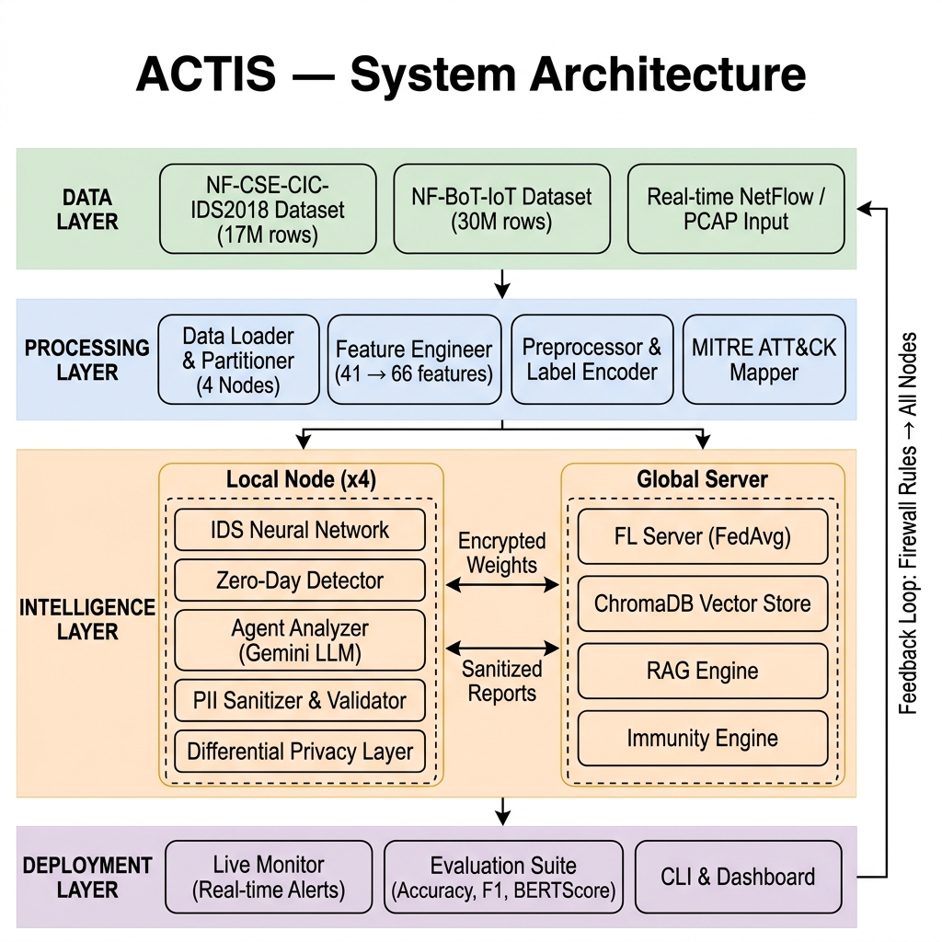
Design
System Architecture

Slide 10
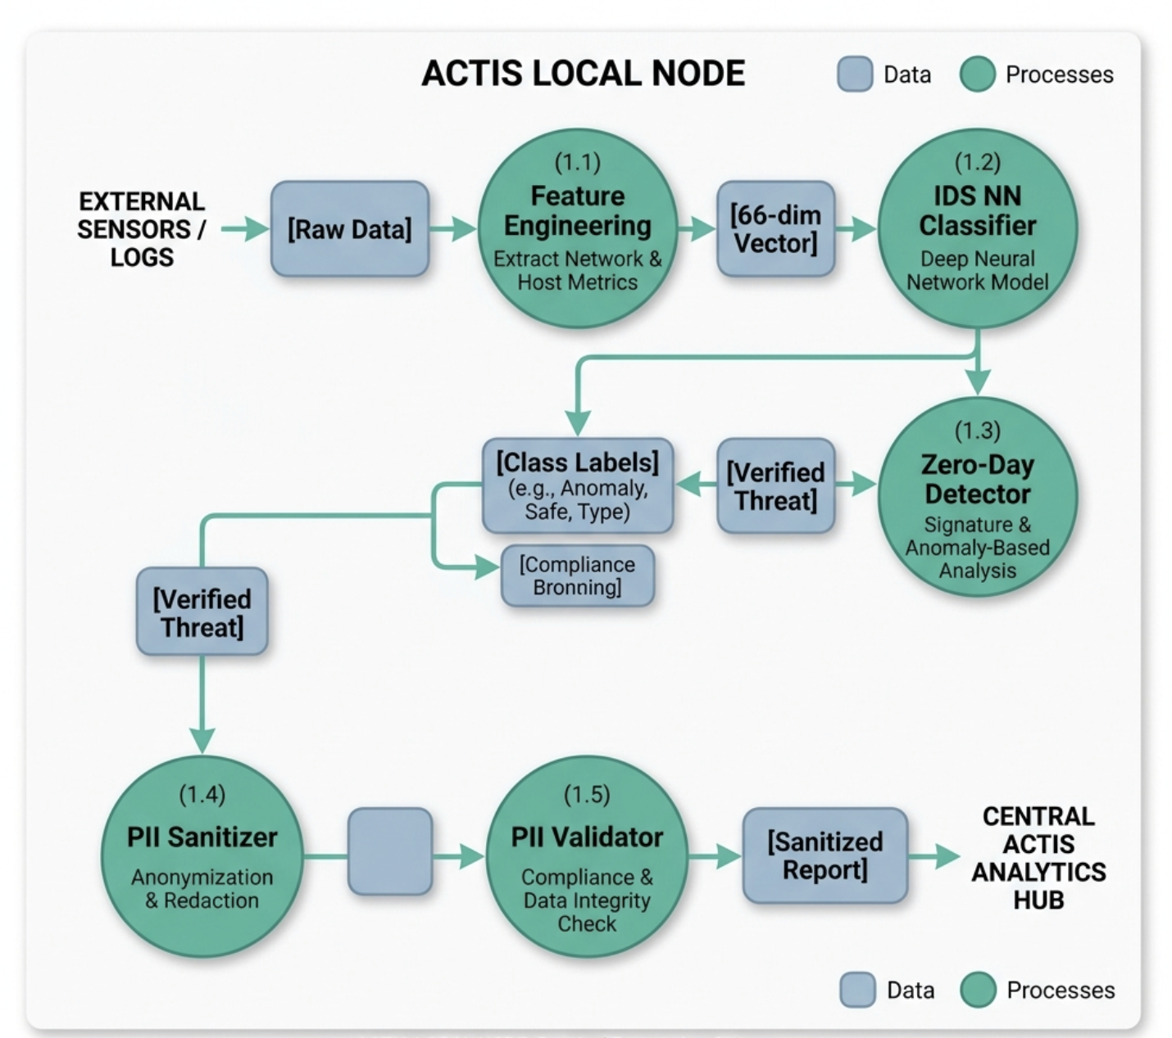
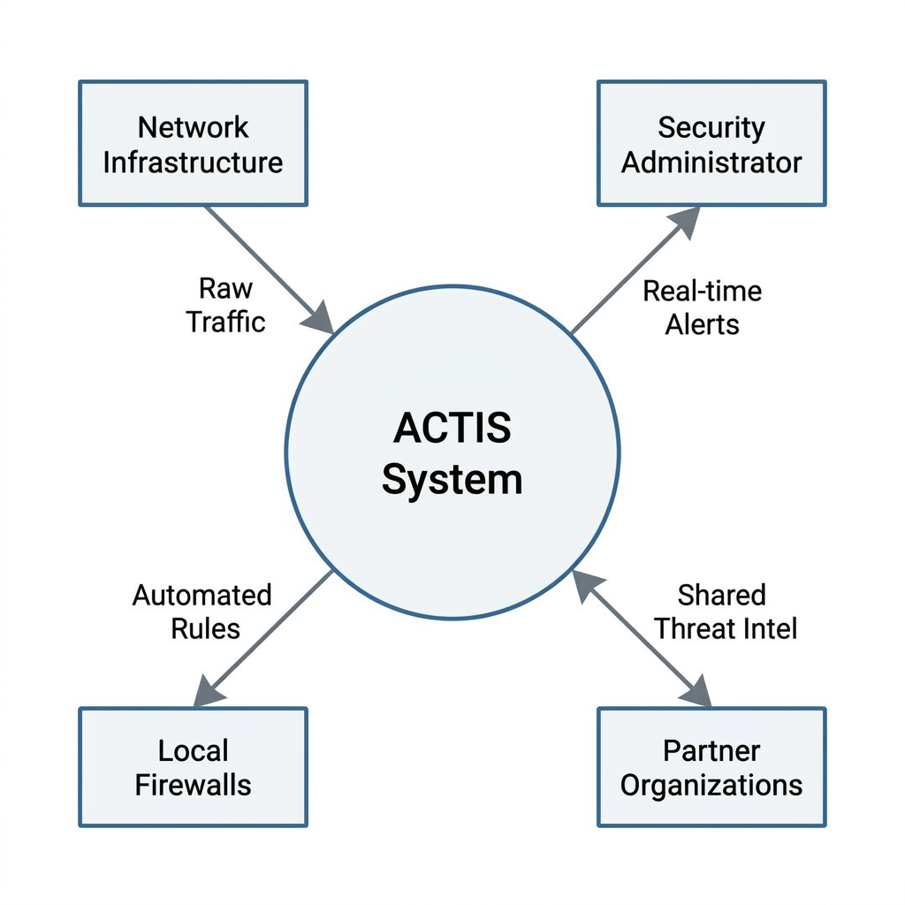
Design
DFD’s (Level-0,1,2)

Slide 11
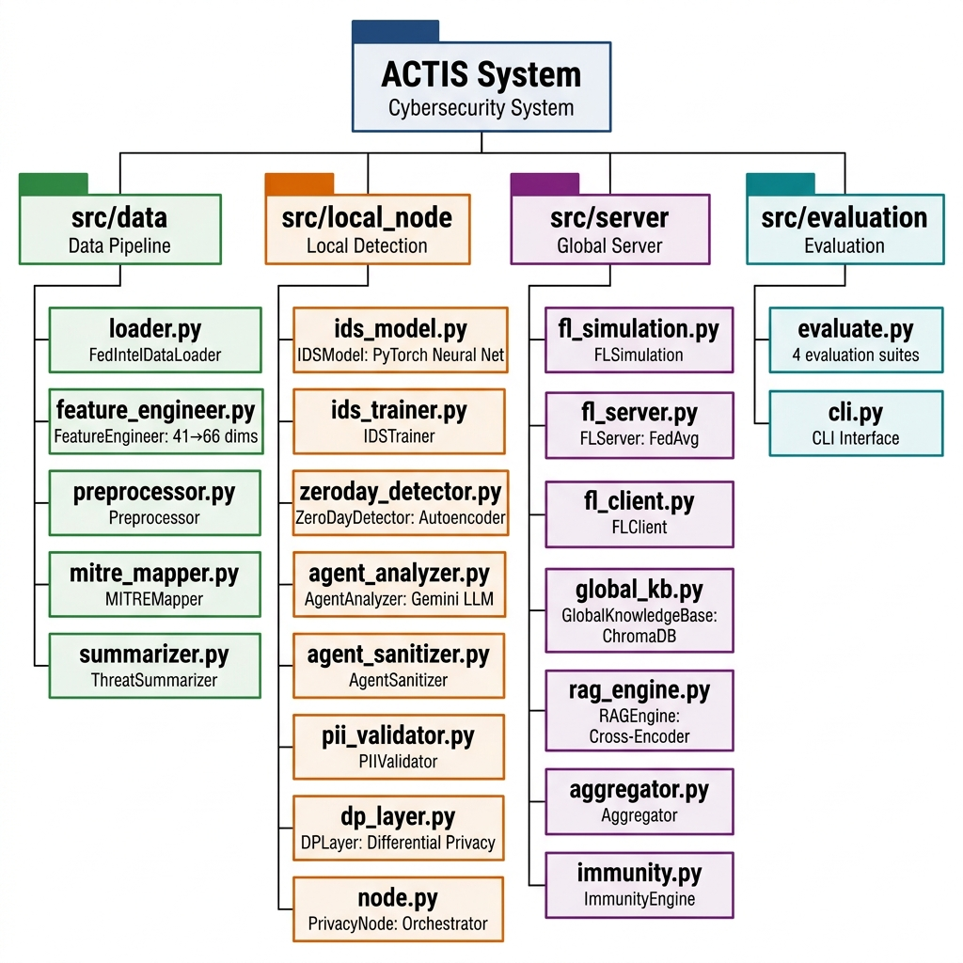
Design
Structure chart

Slide 12
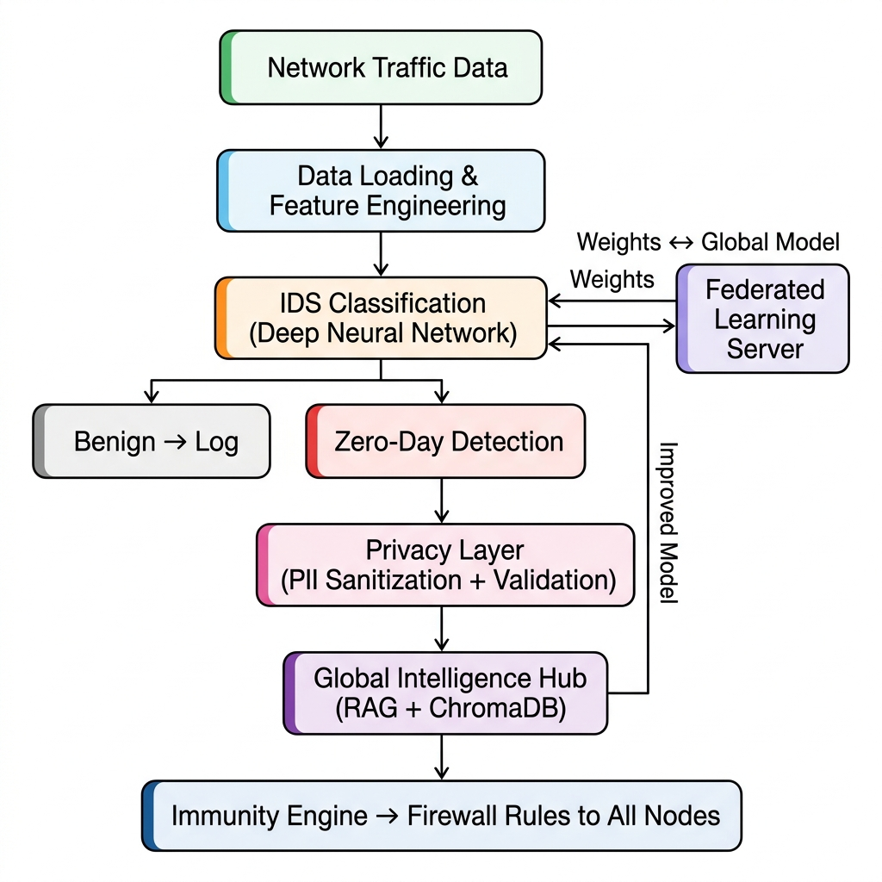
Design
Flowchart

Slide 13
Use of Tools / Techniques
Language: Python 3.10+ (Core implementation and data processing).
Deep Learning Framework: PyTorch (Used for building the IDS Neural Network and Zero-Day Autoencoders).
Vector Database: ChromaDB (Stores sanitized threat reports as high-dimensional embeddings for semantic search).
Retrieval of cross-organizational intelligence from ChromaDB
Large Language Model (LLM): Google Gemini 1.5 Flash (Powers the Agent Analyzer for MITRE mapping and automated threat summarization).
Data Management: Pandas & NumPy (Feature engineering and preprocessing); Apache Parquet (Efficient storage for multi-million row datasets).
AI Components: Sentence-Transformers (all-MiniLM-L6-v2) for generating report embeddings; Cross-Encoders for high-precision RAG reranking.
Evaluation: Scikit-learn (Accuracy, F1, Confusion Matrix); BERTScore (Semantic evaluation of LLM-generated reports).

Slide 14
Identification of Relevant Journal / Conference
# | Journal Name | Publisher | ISSN | Scope Fit | Link
1 | IEEE Transactions on Information Forensics and Security (TIFS) | IEEE | 1556-6013 | High fit for Federated Learning and Differential Privacy research. | Link
2 | Computers & Security | Elsevier | 0167-4048 | Strong fit for Intrusion Detection (IDS) and practical Zero-Day defense. | Link
3 | IEEE Access | IEEE | 2169-3536 | Ideal for multi-disciplinary work involving LLMs (RAG) and Cyber-AI. | Link
4 | IEEE Transactions on Network and Service Management (TNSM) | IEEE | 1932-4537 | Fits the Immunity Engine and automated cross-org threat management. | Link
5 | Journal of Information Security and Applications (JISA) | Elsevier | 2214-2126 | Focuses on Privacy-Preserving applications and data sanitization. | Link
6 | IEEE Transactions on Dependable and Secure Computing (TDSC) | IEEE | 1545-5971 | Perfect for Architecture-level security and trust-based systems. | Link
7 | Cybersecurity (SpringerOpen) | Springer | 2523-3246 | Good for threat intelligence and standardized MITRE-based reporting. | Link

Slide 15
References
D. Zhang, Y. Yang, et al., "Tri-LLM Cooperative Federated Zero-Shot Intrusion Detection with Semantic Disagreement and Trust-Aware Aggregation," *arXiv:2602.00219*, Jan 2026.
H. Yuan, H. Zheng, et al., "CyberRAG: An Agentic RAG Cyber Attack Classification and Reporting Tool," *arXiv:2507.02498*, Sep 2025.
Shajarian, Shaghayegh, et al. "ReGAIN: Retrieval-Grounded AI Framework for Network Traffic Analysis." 2026 International Conference on Computing, Networking and Communications (ICNC). IEEE, 2026
D. Zhang, Y. Yang, et al., "Synergizing Federated Learning and Vector Databases for Decentralized Cyber Immunity Orchestration," IEEE Internet of Things Journal, vol. 11, np. 5, 2024.
Y. Chen et al., "A Federated Learning Approach to Network Intrusion Detection Systems," IEEE Transactions on Information Forensics and Security, vol. 18, pp. 131-144, 2023.
J. P. Hu et al., "RAG-Sec: Enhancing Zero-Day Vulnerability Analysis using Retrieval-Augmented Generation," IEEE Transactions on Information Forensics and Security, vol. 19, pp. 2481-2495, 2024.
M. Reynaud, A. Gupta et al., "Collaborative and Privacy-Preserving Intrusion Detection in Edge Computing: A Federated Learning Approach," IEEE Transactions on Dependable and Secure Computing, vol. 20, no. 2, 2023.
B. Liu et al., "A Scalable and Privacy-Preserving Federated Learning Framework for Securing IoT Devices," IEEE Internet of Things Journal, vol. 10, no. 9, 2023.
Z. Zhao et al., "Federated Learning with Non-IID Data: A Survey," IEEE Transactions on Neural Networks and Learning Systems, 2023.
Y. Huang, L. Zhu, et al., "Dynamic Trust-Aware Federated Learning in Unreliable Environments," IEEE Transactions on Information Forensics and Security, vol. 18, pp. 433-446, 2023.
N. Wang, X. Huang, and Y. Dai, "Differentially Private Vector Embeddings for Secure Information Retrieval," IEEE Transactions on Knowledge and Data Engineering, vol. 35, no. 4, 2023.

