Slide 1


M.Tech in Computer Science Engineering
Internship Review - 2
“Xception-Powered Deep Neural Network for Radiographic Analysis”
Veerasagar S S
1RV24SCS17
Internal Guide Name: Dr. Soumya A External Guide Name: Dr. M S Srividya
Designation: Professor Designation: Professor
Organization: R. V. College Of Engineering Organization: R. V. College Of Engineering

Slide 2
Table of Contents
Interim Outcome Summary
Importance of Resource Management in Internship work
Environment and Sustainability related to Internship work
Final Outcome

Slide 3
Interim Outcomes summary
Learnt core python fundamentals and programming
Exposure to various python tools for data analysis and visualization such as matplotlib, numpy, pandas, seaborn, Librosa
Gained sound knowledge on Machine learning classification and regression algorithms such as KNN, decision tree, naive based etc

Slide 4
Contd..
Implementation of prediction analysis model using Neural Networks such as Artificial Neural networks, Convolutional Neural Networks and Recurrent Neural Networks
Exposure to testing methods involved in ML models like computing precision, accuracy, confusion matrix and many more.

Slide 5
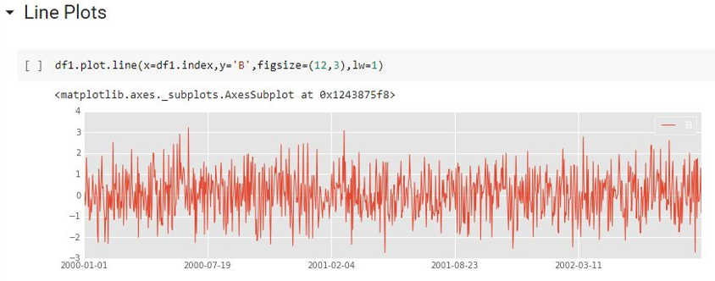
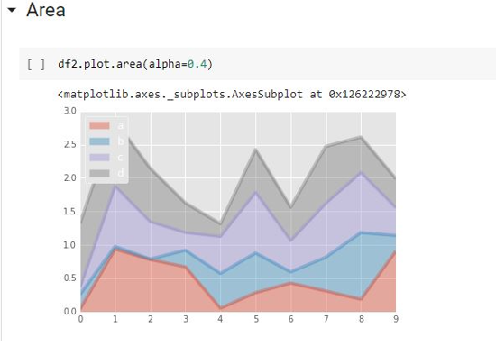
Contd..

Slide 6
Environment and sustainability related to Internship work
This project uses deep learning and transfer learning, specifically the Xception model, to automatically classify chest X-ray images into categories such as COVID-19, Normal, and Pneumonia. By leveraging advanced image-processing techniques and pre-trained neural networks, the system aims to improve diagnostic accuracy, reduce human error, and assist medical professionals in early disease detection.
Problem statement
  “Develop a deep learning model using transfer learning to accurately classify COVID-19 radiography images while handling data imbalance and improving diagnostic reliability.”

Slide 7
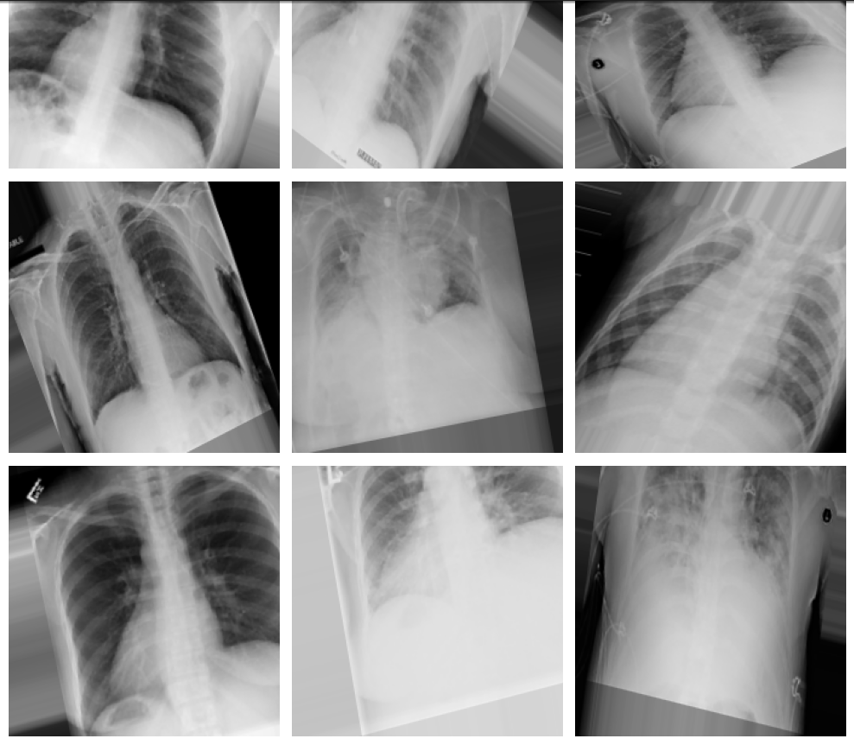
Contd..

Slide 8
Program-Specific Skills and Tool Application
Manual analysis of X-rays is time-consuming and prone to human error.
Radiologists experience fatigue → reduced accuracy
Deep learning provides:
  Rapid screening
  Consistent predictions
  Improved sensitivity for COVID detection
Useful in remote or resource-limited settings.

Slide 9
Why Xception Model?
Uses depth wise separable convolutions → highly efficient and accurate
Performs exceptionally well on medical images
Pre-trained on millions of images (ImageNet)Reduces training time and improves generalization
Excellent at capturing:
  Lung opacities
  Structural patterns
  Texture variations associated with COVID-19.

Slide 10
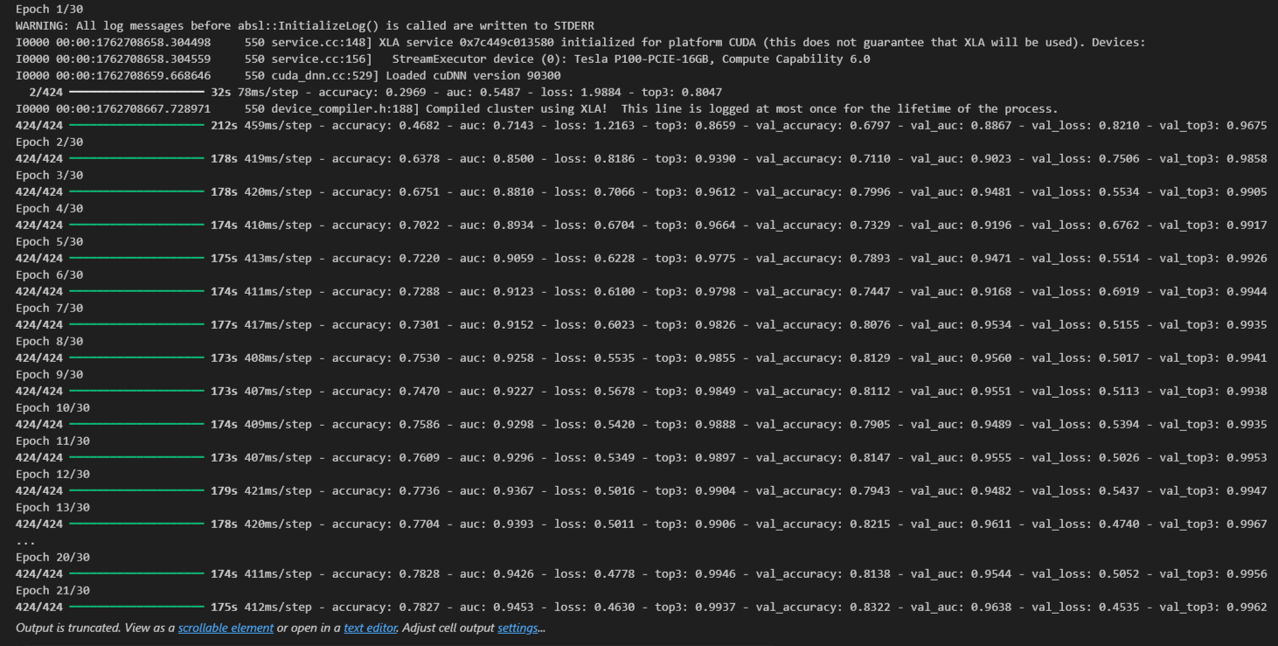
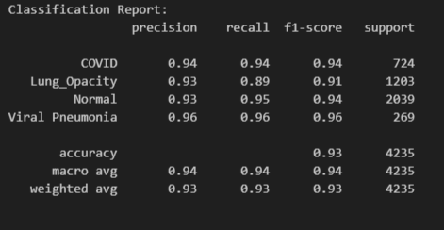
Results

Slide 11
Conclusion
The project demonstrates that deep learning can effectively classify chest X-ray images for COVID-19 diagnosis
The Xception-based transfer learning model achieved high accuracy and strong generalization across multiple radiographic classes.
The system provides a fast, reliable, and scalable tool to support radiologists in early COVID-19 detection
Automated classification reduces manual workload and minimizes human error in radiographic interpretation
The project highlights the potential of AI-driven solutions to improve medical diagnostics, especially during large-scale outbreaks.

Slide 12
References
T. Rahman et al., “COVID-19 Radiography Database,” Kaggle, 2020. [Online]. Available: https://www.kaggle.com/datasets/tawsifurrahman/covid19-radiography-database
F. Chollet, “Xception: Deep Learning with Depthwise Separable Convolutions,” in Proc. IEEE Conf. Comput. Vis. Pattern Recognit. (CVPR), 2017, pp. 1251–1258.
A. Krizhevsky, I. Sutskever, and G. E. Hinton, “ImageNet Classification with Deep Convolutional Neural Networks,” Commun. ACM, vol. 60, no. 6, pp. 84–90, 2017.
S. Minaee et al., “Deep-COVID: Predicting COVID-19 from Chest X-Ray Images Using Deep Transfer Learning,” Med. Image Anal., vol. 65, p. 101794, 2020.
L. Wang, Z. Q. Lin, and A. Wong, “COVID-Net: A Tailored Deep Convolutional Neural Network Design for Detection of COVID-19 Cases from Chest X-ray Images,” Sci. Rep., vol. 10, pp. 1–12, Aug. 2020.
P. K. Sethy and S. K. Behera, “Detection of Coronavirus Disease (COVID-19) Based on Deep Features,” Preprint, Mar. 2020. [Online]. Available: https://doi.org/10.13140/RG.2.2.21946.93125

Slide 13
Contd..
Chi-Yuan Koh, Jaw-Yuan Chang , Chiang-Lin Tai , Da- Yo Huang, “Bird Sound Classification using Convolutional Neural Networks”, Jr. Springer Publications, arXiv:2007.07966 , 2019
Aarti Madhavi, Rajni Pamnani, “Deep Learning Based Audio Classifier for Bird Species” ISSN-2455-2631, IJSDR Vol3, Oct 2018
Stefan Kahl , Thomas Wilhelm-Stein , Holger Klinck , Danny Kowerko, “Recognizing Birds from Sound - The 2018 BirdCLEF Baseline System”, arXIV:1804.07177v1, vol 1, Apr 2018
Somervuo, P., Harma, A., & Fagerlund, S, “Parametric representations of bird sounds for automatic species recognition”, IEEE Transactions on Audio, Speech and Language Processing, 14, 2252– 2263, 2016

Slide 14
THANK YOU

