Slide 1

ANNAMACHARYA INSTITUTE OF TECHNOLOGY AND SCIENCES::TIRUPATI (AUTONOMOUS) CSE(IoT and Cyber Security including Blockchain Technology) A.Y.: 2025-2026 Design and Analysis Review Securing Industrial Control Systems Against Cyber Physical Attacks
Under the Guidance of
Mr. D Nagabhushanam., M.Tech., (Ph.D)
Assistant Professor
Department of CIC
AITS, Tirupati
Head of the Department
Mr. D Nagabhushanam., M.Tech., (Ph.D)
Assistant Professor
Department of CIC
AITS, Tirupati
BATCH NO: 07
22AK1A3649 VEERASEKHAR ACHARI K
22AK1A3622 KRANTHI KUMAR P
22AK1A3601 ABRAR ALI S
22AK1A3625 MANOJ KUMAR REDDY R

Slide 2
ABSTRACT
This research addresses the critical issue of securing Industrial Control Systems (ICS) against cyber-physical attacks, focusing on the implementation of Intrusion Detection Systems tailored specifically for ICS environments. ICS, which are increasingly vulnerable to both cyber and physical threats, require robust security frameworks to safeguard critical infrastructure. The research explores the role of IDS in continuously monitoring industrial networks to detect potential intrusions, anomalies, and unauthorized activities. By employing both anomaly detection and signature-based techniques, IDS improves the system's capacity to recognize and eliminate threats before they have a substantial negative impact by utilizing both anomaly detection and signature-based tools. ICS environments benefit greatly from the extensive real-time threat detection, network visibility, and incident response capabilities offered by the Dragos Platform, a top-tier cybersecurity technology. This research include key experimental results, such as the achieved detection rate (92%), false-positive rate (5%), response time (2 seconds), and system resource utilization (30% CPU).

Slide 3
DOMAIN INTRODUCTION
Industrial Control Systems (ICS) form the technological backbone of modern critical infrastructure, arranging complex operations across multiple vital sectors including energy distribution, water treatment facilities, manufacturing processes, and transportation networks. Traditional IT security measures prove inadequate for ICS environments due to fundamental differences in architecture, operational requirements, and constraints. The convergence of operational technology (OT) with information technology (IT) has further complicated the security landscape. The integration of Intrusion Detection Systems (IDS), anomaly detection techniques, and signature-based detection methods, combined with specialized platforms like Dragos, represents a multilayered defense strategy capable of addressing both known and emerging threats in real-time.

Slide 4
EXISTING WORK
S. No | Title of the Paper | Problem Statement | Method/ Algorithm Used | Advantages | Disadvantages
1. | Anomaly Detection in Industrial Control Systems Using Machine Learning | Traditional security mechanisms fail to detect sophisticated cyber-physical attacks targeting ICS networks.. | Machine learning-based anomaly detection using SVM and Random Forest on network traffic data. | Capable of detecting unknown attacks; improves visibility into abnormal system behavior. | High false positive rate; requires large labeled datasets for training.
2. | Intrusion Detection System for SCADA Networks | SCADA systems are vulnerable due to legacy protocols lacking built-in security mechanisms. | Signature-based and anomaly-based IDS using rule engines and traffic pattern analysis. | Effective in detecting known attack signatures; low computational overhead. | Unable to detect zero-day attacks; requires frequent signature updates.

Slide 5
S.No | Title of the Paper | Problem Statement | Method/ Algorithm Used | Advantages | Disadvantages
3. | Deep Learning-Based Cyber-Physical Attack Detection in ICS | Difficulty in identifying complex attack patterns that manipulate physical processes through cyber means. | Deep Neural Networks (DNN) and LSTM models for time-series sensor data analysis. | High detection accuracy; suitable for sequential process data. | Computationally expensive; limited real-time deployment feasibility.
4. | Securing Industrial Networks Using Network Segmentation and Firewalls | Flat network architectures in ICS increase the attack surface and lateral movement risk. | Network segmentation, industrial firewalls, and access control mechanisms. | Reduces attack propagation; improves overall network resilience. | Cannot detect insider threats; lacks intelligent attack detection.
5. | Cyber-Physical Security Framework for Industrial Control Systems | Lack of integrated security approaches addressing both cyber and physical layers. | Hybrid framework combining IDS, real-time monitoring, and rule-based control validation. | Provides holistic protection; improves system reliability and safety. | Complex deployment; higher implementation and maintenance cost.

Slide 6
PROPOSED SYSTEM
Proposed system is an ICS-specific IDS that continuously monitors network traffic across all industrial network segments.
The system implements sophisticated anomaly detection using machine learning algorithms.
Complementing anomaly detection, the system maintains a comprehensive database of attack signatures.
The system implements intelligent response mechanisms that automatically initiate appropriate countermeasures.

Slide 7
PROBLEM STATEMENT
The primary problem is the inadequacy of traditional IT security solutions when applied to ICS environments. Conventional security tools often fail to account for the unique characteristics of industrial networks, including real-time operational requirements, legacy system constraints, and the criticality of continuous availability. Furthermore, ICS environments face a diverse threat landscape encompassing both known attack patterns and zero-day exploits, requiring detection mechanisms capable of identifying both signature-based and anomalous activities.

Slide 8
MINIMUM SYSTEM REQUIREMENTS
Software Requirements:
Application platform : Python 3.8 & above
Operating System : Windows 10/11
IDE : VSCODE
Framework : Django (Python)
Hardware Requirements:
RAM : 4GB & above
Processor : Intel Core I3

Slide 9
ANALYSIS & DESIGN

Slide 10
ANALYSIS
1. Administrative Module
This module is responsible for managing the overall Industrial Control System (ICS) security platform, including user access control, system configuration, and security policy management.
Functions:
User Management: Add, update, or remove users such as system administrators and security analysts.
System Configuration: Configure security parameters such as IDS sensitivity levels, alert thresholds and logging policies.
Device & Asset Management: Maintain an inventory of ICS assets including PLCs, sensors, actuators.
Policy Management: Define and enforce security policies for network segmentation, access permissions
System Monitoring: Monitor system health, network traffic status, security alerts, and attack logs in real time.
Explanation:
The Administrative Module ensures smooth operation of the ICS security system by managing users, devices, and security configurations.
It provides centralized control and visibility, ensuring the system remains secure, reliable, and up-to-date against evolving cyber-physical threats.

Slide 11
2. System Module
This module forms the core of the ICS Security System, handling data collection, attack detection, and real-time threat analysis.
Functions:
Data Acquisition: Collect data from the dataset.
Data Pre-processing: Filter, normalize, and preprocess network traffic and sensor data to remove noise and inconsistencies.
Intrusion Detection Engine: Apply ML/DL-based IDS models to detect cyber attacks, anomalies, and malicious control commands.
Attack Classification: Classify detected threats such as spoofing, replay attacks and command injection.
Alert Generation: Generate real-time alerts and notifications for detected cyber-physical threats.
Explanation:
The System Module is responsible for intelligent threat detection and analysis within the ICS environment. By integrating machine learning and real-time monitoring, it enables early detection of cyber-physical attacks and helps prevent physical damage to industrial processes.

Slide 12
3. Manufacture Module
This module manages the deployment, integration, and maintenance of the ICS security system in real-world industrial environments.
Functions:
System Deployment: Deploy the security system within industrial plants and integrate it with existing SCADA and control infrastructures.
Hardware Configuration: Configure industrial hardware such as servers, gateways, firewalls, and monitoring devices.
Maintenance and Updates: Provide regular system updates and model retraining to address new attack patterns.
Scalability Testing: Ensure the system can handle large-scale industrial networks with multiple devices and high traffic volumes.
Security and Compliance: Ensure compliance with industrial security standards such as IEC 62443, NIST, and ISA standards.
Explanation:
The Module focuses on real-world deployment and operational reliability of the ICS security solution. It ensures the system remains scalable, and secure while protecting critical infrastructure from cyber-physical attacks.

Slide 13
DESIGN
DATA FLOW DIAGRAM The data flow diagram illustrates the workflow of the Industrial Control System (ICS) security framework. Feature extraction identifies critical patterns related to network traffic, control commands, and process behavior. The machine learning or deep learning-based intrusion detection model analyzes the processed data to detect cyber-physical attacks. Detected threats and anomalies are classified and alerts are generated in real time.
UML (Unified Modeling Language) UML diagrams are used to model the structure and behavior of the ICS security system. Use case diagrams represent interactions between users such as system administrators, security analysts, and plant operators with the system (monitoring traffic, viewing alerts, managing policies). Sequence diagrams illustrate the process flow: data collection → preprocessing → feature extraction → intrusion detection → alert generation → response. Class diagrams define system components such as data collectors, intrusion detection engine, alert manager, and database. Activity diagrams detail operational steps: monitor traffic → analyze data → detect attack → raise alert → log event. UML provides a clear and structured representation of system design and functionality.

Slide 14
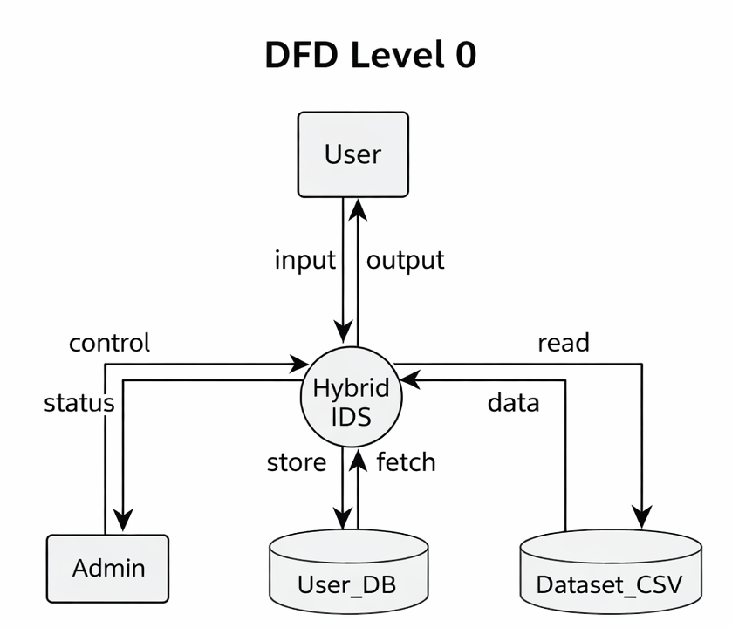
Data Flow Diagram: Level - 0
🔹 Level 0 (Context Diagram): Represents the entire ICS Security System as a single process. Receives real-time data from PLCs, sensors, and SCADA networks. Analyzes data using a hybrid intrusion detection mechanism. Detects cyber-physical attacks and generates alerts.

Slide 15
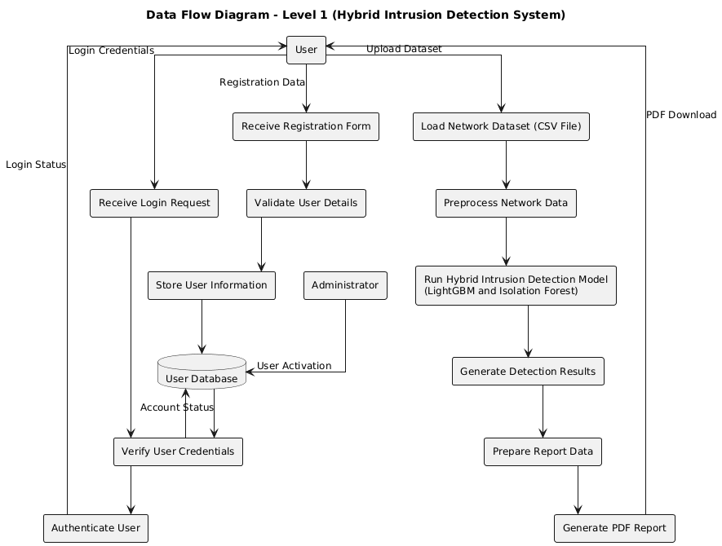
Data Flow Diagram: Level - 1
🔹 Level 1: Level 1 DFD explains the internal working of the system in detail. It shows how data flows between users, processes, and databases.

Slide 16
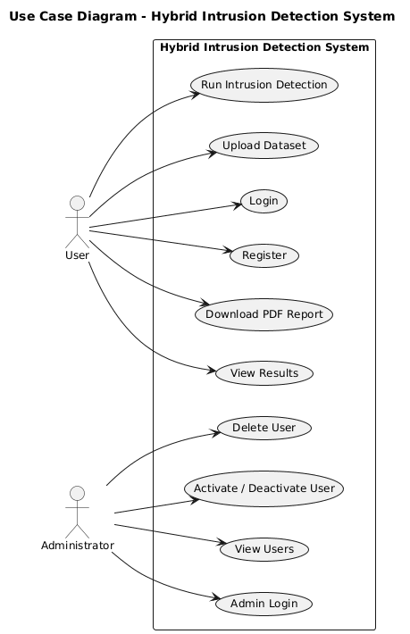
UML Diagrams: Use case Diagram
3. Use Case Diagram
Explanation:
User: Registers and logs into the system, views detection results and downloads PDF report.
Admin: Views registered users, activates or deactivates user accounts and deletes users when required

Slide 17
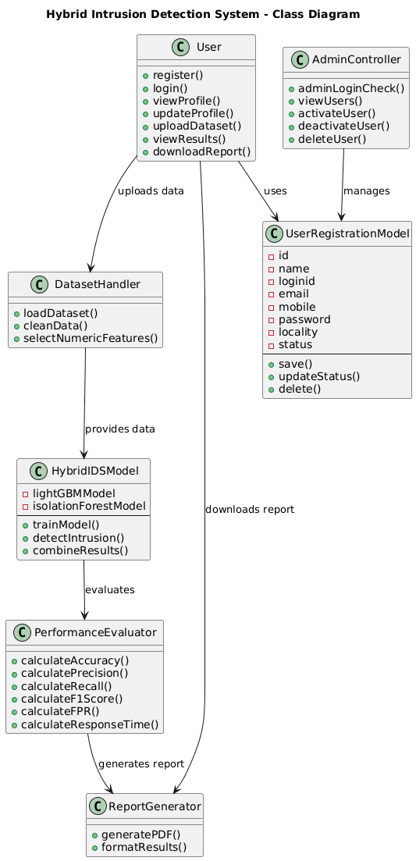
UML Diagrams: Class Diagram
2. UML Class Diagram
Explanation:
Views: Handles all user requests such as registration, login, intrusion detection, prediction, and PDF download.
UserRegistrationForm: Manages user input during registration and saves user details.
UserRegistrationModel: Stores user information including user ID, name, login ID, password, and account status.
DatasetHandler: Loads the network dataset and runs the hybrid intrusion detection model.

Slide 18
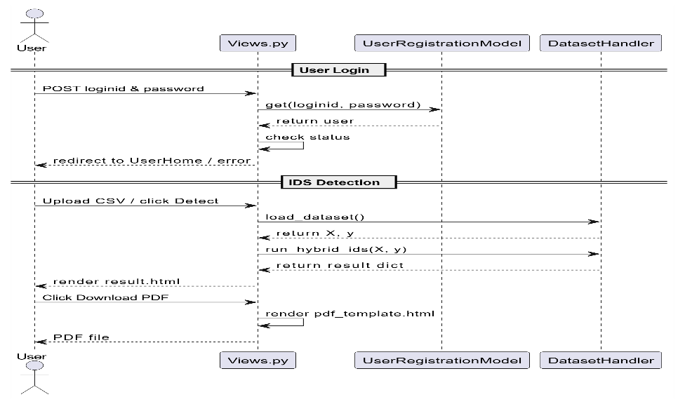
UML Diagrams: Sequence Diagram
4. Sequence Diagram
Explanation:
User: Logs into the system, uploads the network dataset, views results, and downloads the PDF report.
Views.py: Acts as the controller that receives user requests and coordinates communication between components.
UserRegistrationModel: Validates login credentials, retrieves user details, and checks account activation status.
DatasetHandler: Loads the CSV dataset, executes the hybrid intrusion detection model, and returns detection results.

Slide 19
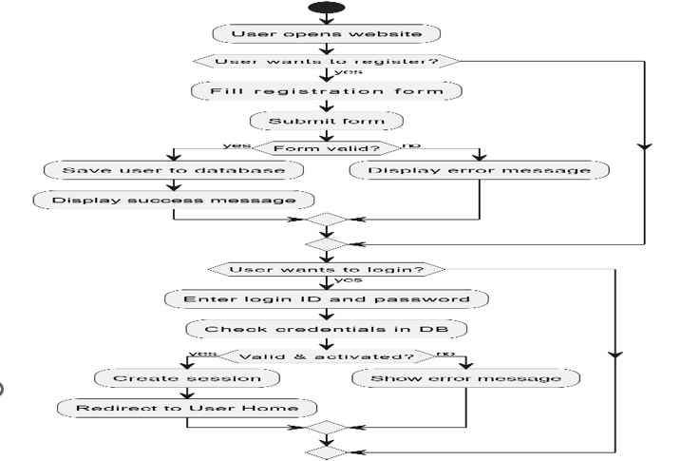
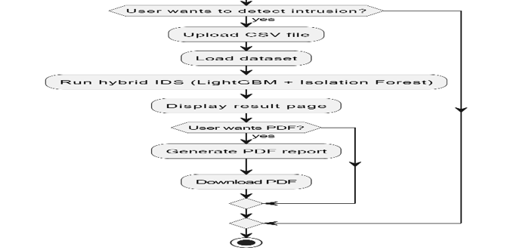
UML Diagrams: Activity Diagram
5. Activity Diagram
Explanation:
The activity diagram represents the overall workflow of the Hybrid Intrusion Detection System.
The user can register and log into the system. The system loads the dataset and runs the hybrid IDS model. Detection results are displayed to the user. If required, the system generates a PDF report for download.

Slide 20
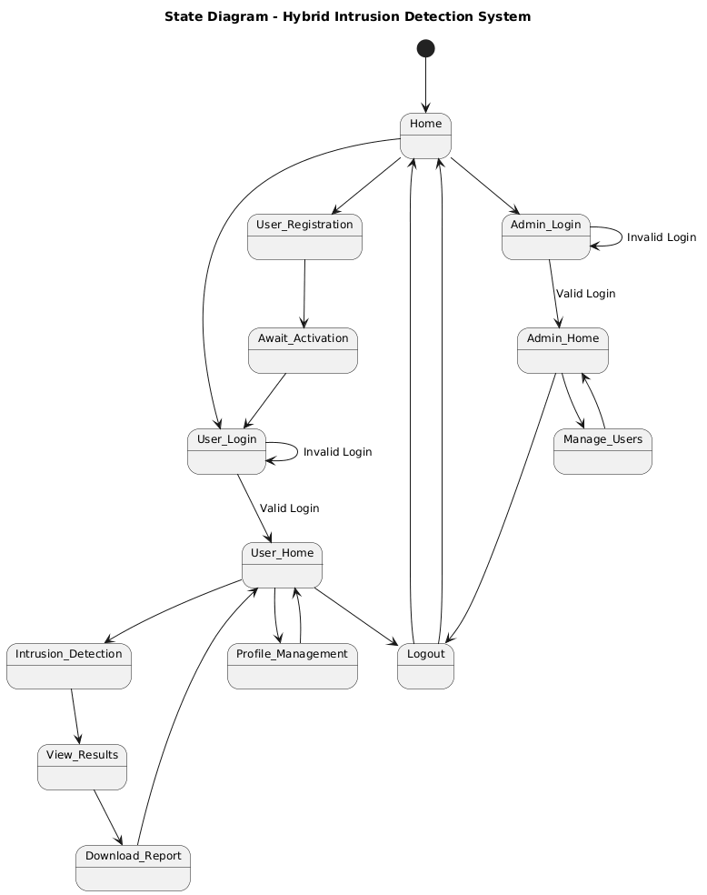
UML Diagrams: State Diagram
Explanation:
The system begins at the Home state. From home, users can choose User Registration or Admin Login. Invalid login attempts keep the user in the login state. Admin users, after successful login, move to Admin Home and can manage users. Both admin and user can move to the Logout state and return to home.

Slide 21
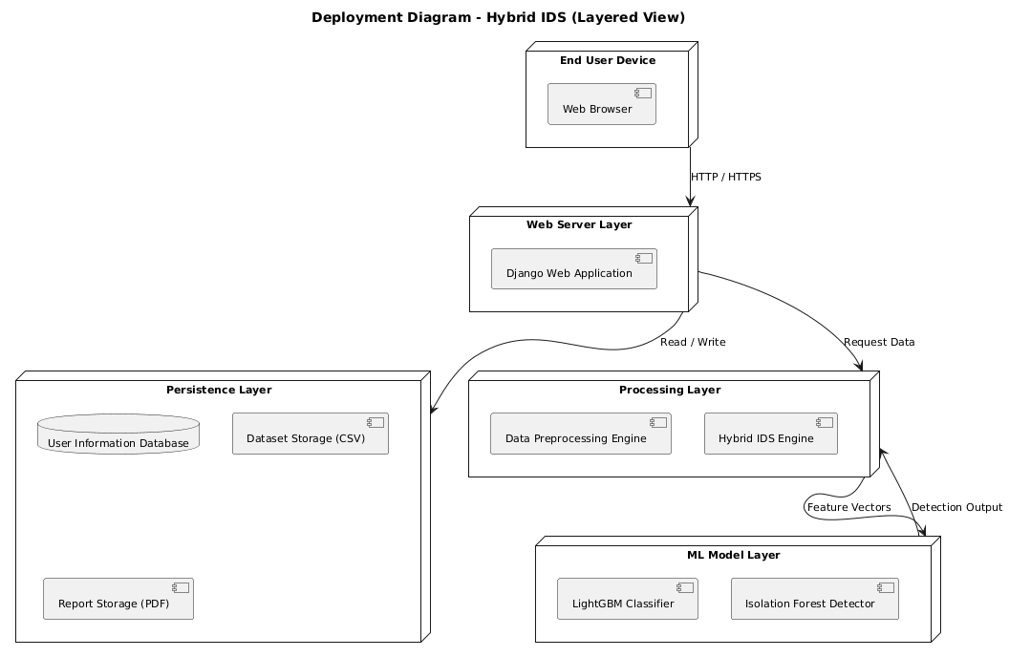
UML Diagrams: Deployment Diagram
Explanation:
End User Device: The user accesses the system through a web browser to upload datasets and view intrusion detection results.
Web Server Layer: The Django web application handles user requests, authentication, and communication between system components using HTTP/HTTPS.
Processing Layer : This layer performs data preprocessing and executes the hybrid IDS engine for intrusion detection.
ML Model Layer: Contains the machine learning models including LightGBM Classifier and Isolation Forest Detector, which analyze feature vectors and generate detection results.
Persistence Layer: Stores user information, uploaded datasets (CSV files), and generated PDF reports.

Slide 22
MODULES
User Module: The User Module is intended for authorized users such as industrial operators, security analysts, or system monitoring personnel who interact with the application for observing system activities and security status. Users are provided with secure authentication mechanisms to access the system, ensuring that only authorized personnel can view sensitive information related to industrial control system security. However, users are restricted from modifying system configurations, detection rules, or security policies.
Admin Module: The Admin Module is designed for system administrators who have complete control over the application and its security management functions. Administrators are responsible for configuring, maintaining, and managing the overall system. This module provides advanced privileges that allow admins to control user access, manage system settings, and oversee security operations.

Slide 23
REFERENCES
N. B. Gaikwad et al., "Hardware Design and Implementation of Multiagent MLP Regression for the Estimation of Gunshot Direction on IoBT Edge Gateway," in IEEE Sensors Journal, vol. 23, no. 13, pp. 14549-14557, 1 July1, 2023, doi: 10.1109/JSEN.2023.3278748.
William DeGroat, Dinesh Mendhe, Atharva Bhusari, Habiba Abdelhalim, Saman Zeeshan, Zeeshan Ahmed, Intelligence: a novel machine learning pipeline for biomarker discovery and predictive analysis using multi-genomic profiles, Bioinformatics, Volume 39, Issue 12, December 2023, btad755, https://doi.org/10.1093/bioinformatics/btad755.
Kumar, S., Choudhary, S., Jain, A. et al. Brain Tumor Classification Using Deep Neural Network and Transfer Learning. Brain Topogr 36, 305–318 (2023). https://doi.org/10.1007/s10548-023-00953-0.
K. Stouffer, J. Falco, and K. Scarfone, "Guide to Industrial Control Systems (ICS) Security," NIST Special Publication 800-82, May 2015.

Slide 24
Thank You
Any Questions

