Slide 1
BRITT WORLD WIDE
WELCOME TO ALL

Slide 2
Ms office
Ms word
Ms excel
Ms PowerPoint
Ms access
Ms outlook

Slide 3
Ms word
Keyboard keys
Refresh method
Font command
Bullets and number
Font size
Alignments
Page borders
Tables
Insert row , columns
Photo insert
Photo move
Short cut keys
Mothers day exercise

Slide 4
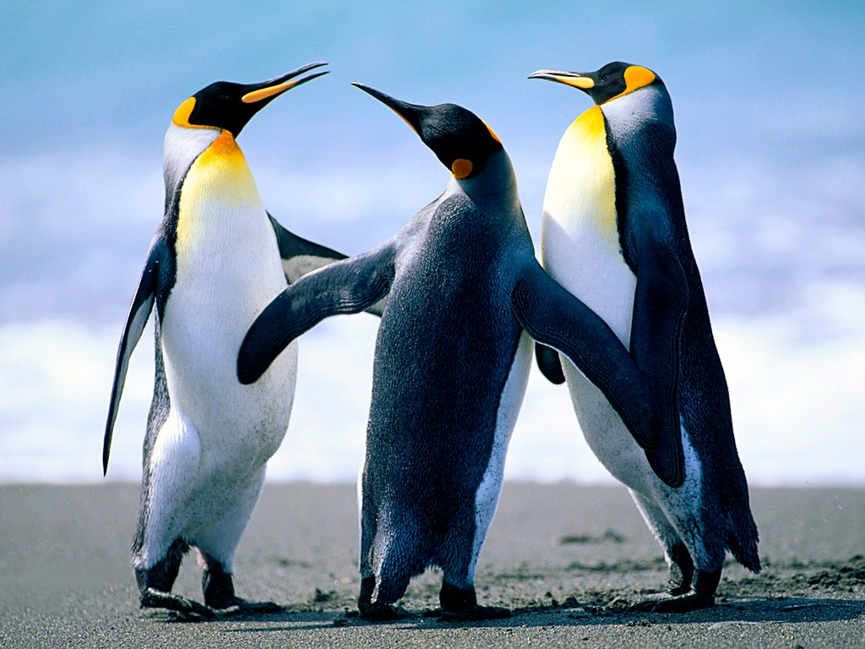
Ms office

Slide 5


Ms office

Slide 6
Created by …[BALA]

