Slide 1
Project Overview
Project Name: Failed Banking Transaction Analysis
Objective: Identify and analyze failed banking transactions to improve customer experience and reduce financial losses.
Tools Used: Google Cloud Storage, Dataproc, PySpark, Cloud SQL, BigQuery, Looker Studio.
Steps Involved: Data Collection, Data Cleaning, Database Setup, Data Loading, and Data Analysis.

Slide 2
Data Collection
15 CSV files for 3 major cities (Hyderabad, Bangalore, Mumbai), each containing 5 branches.
Daily transaction data collected for 7 days.
Files named based on popular branch names (e.g., HYD-Ameerpet, BAN-Whitefield, MUM-Andheri).
Folder uploaded to Google Cloud Storage for centralized data management.

Slide 3
Data Cleaning with PySpark
Script 1: Data Cleaning
Removed null values from each CSV file to ensure data consistency and accuracy.
Used PySpark on Google Cloud Dataproc for efficient processing.
Script 2: Failed Transactions Filtering
Filtered out failed transactions based on the 'Transaction_Status' column.
Generated a 'failed_transactions.csv' file for further analysis.

Slide 4
Database Setup in Cloud SQL
Created a Cloud SQL instance for secure and scalable data storage.
Steps:
Created a Cloud SQL instance (MySQL).
Configured a database within the instance.
Created a user with authentication for secure access.
Created a table with 18 columns to match the 'failed_transactions.csv' file structure.

Slide 5
Data Loading into Cloud SQL
Loaded the cleaned and filtered 'failed_transactions.csv' file into the created table.
Ensured data integrity and consistency for accurate analysis.
Verified the successful upload of records into the database.

Slide 6
Data Analysis in BigQuery
Connected the Cloud SQL database to BigQuery.
Created a new dataset in BigQuery for advanced analysis.
Imported the failed transactions data from the Cloud SQL database.
Used SQL queries to analyze transaction patterns and identify failure trends.

Slide 7
Data Visualization in Looker Studio
Connected BigQuery dataset to Looker Studio for interactive visualizations.
Created bar charts, pie charts, and trend lines to represent failed transaction insights.
Highlighted cities with the highest failed transactions and most common failure modes.

Slide 8
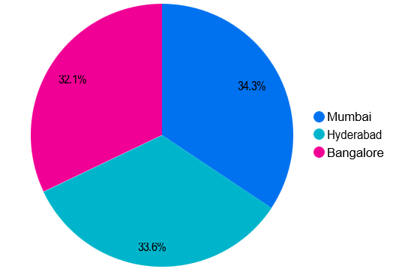
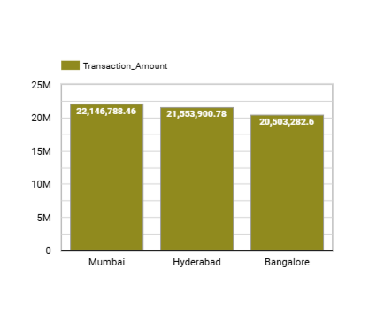

Slide 9
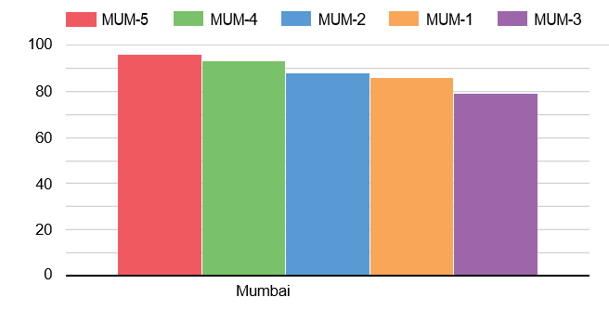
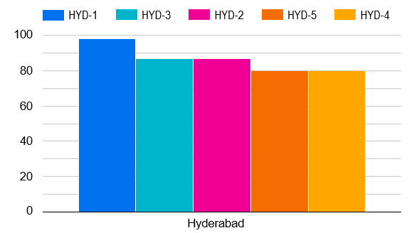

Slide 10
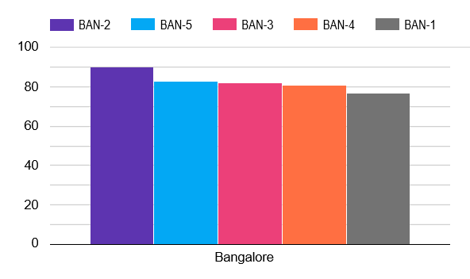
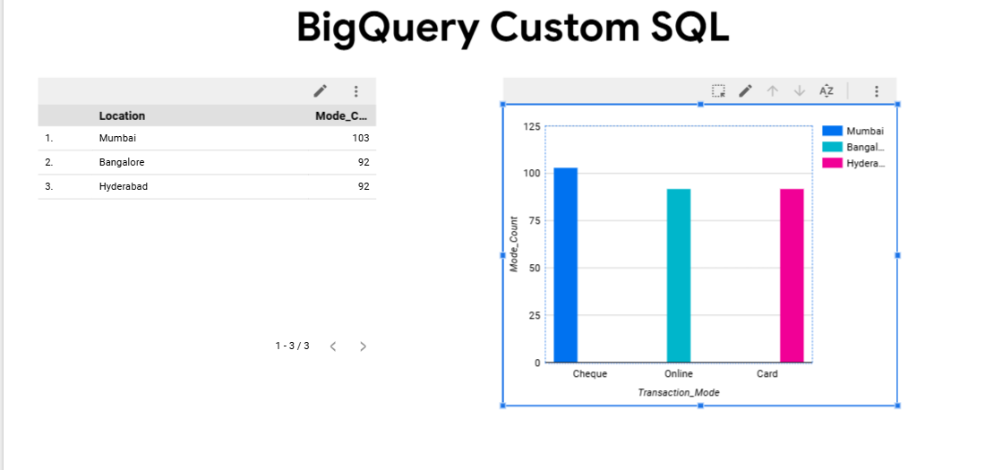

Slide 11
Conclusion and Future Scope
Project successfully identified failed transactions and their underlying patterns.
Future enhancements:
Real-time failure monitoring.
Predictive analysis for proactive issue detection.
Integration with machine learning for fraud detection.

Slide 12
Thank You

