Slide 1

Task 3

Slide 2
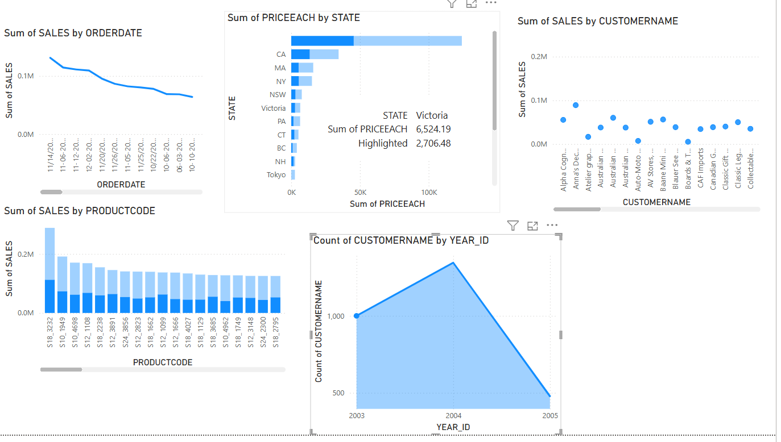
KPI
A Key Performance Indicator (KPI) is a measurable value that helps track and assess progress toward a specific business goal. KPIs provide insights into how well a company, team, or individual is performing in relation to set objectives.
Sales KPI: Tracks revenue, number of transactions, conversion rates, etc.
Growth KPI: Measures percentage increase in revenue, customer acquisition, or market expansion.
Profit KPI: Analyzes net profit, gross margin, and cost efficiency.

Slide 3
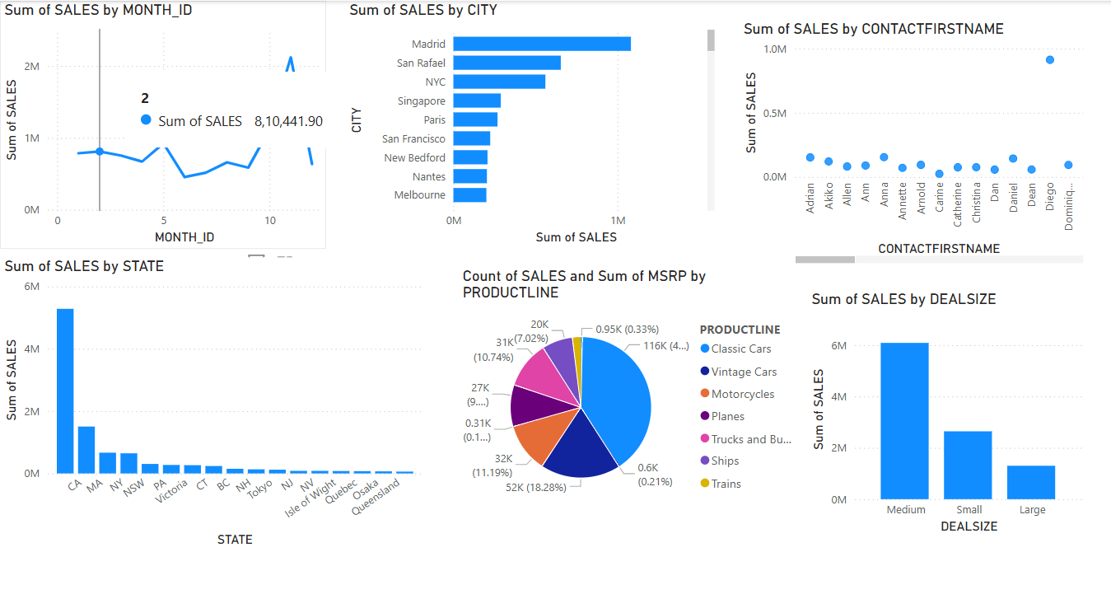
Time Series Analysis
Time Series Analysis is a statistical technique used to analyze data points collected over time to identify patterns, trends, and seasonal variations. This method is essential for forecasting future values based on past behavior.

Slide 4
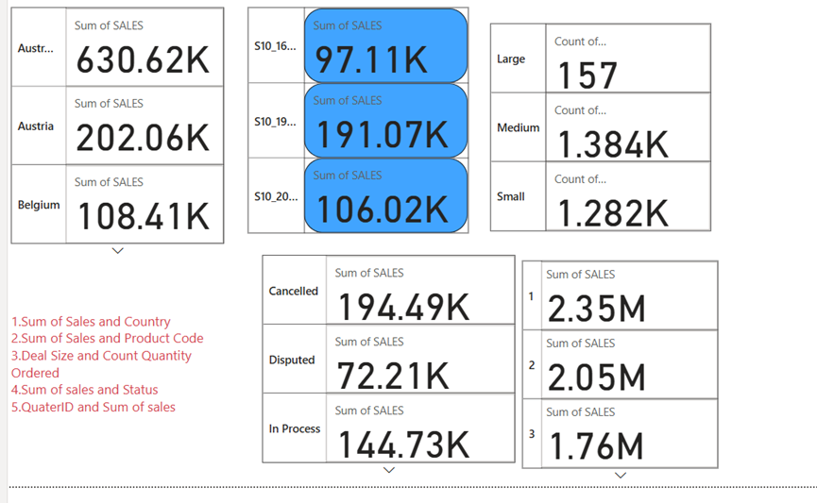
Cards
In Power BI, a Card is a visualization used to display a single key metric or summary value in a clear, easy-to-read format. It’s commonly used to highlight important numbers like Total Sales, Profit, Customer Count, or Growth Rate.

Slide 5

Conclusion
In analyzing the Sales Dataset, we used KPIs, Cards, Time Series Analysis, and a Navigator to extract actionable insights:
KPIs and Cards provided quick visibility into key performance metrics such as Total Sales, Revenue, Profit, and Units Sold, allowing stakeholders to monitor performance at a glance.
Time Series Analysis revealed important trends and seasonal patterns in sales, helping to forecast future sales, identify peak periods, and detect potential declines or anomalies in performance over time.
The Navigator (slicers/filters) enabled dynamic interaction with the data, allowing users to explore sales by region, product category, time period, or sales representative, enhancing the depth of analysis and personalization.
Final Insight:
This combination of tools empowered decision-makers to track performance, uncover patterns, and make data-driven decisions, ultimately supporting better sales strategies and business growth.

