Slide 1

NM1026 – ANDROID APPLICATIONDEVELOPMENT
A SLEEP TRACKING APP FOR A BETTER NIGHTS REST
Team members:
BALAJI K -711222104008
SANTHOSH KUMAR S -711222104039
THIYAGARAJ S -711222104058
VEERAVIVIN PRAKASH - 711222104060

Slide 2
Abstract
Overview of the App: Tracks and analyzes sleep patterns.
Objective: Improve sleep quality using personalized insights.
Highlight: User-friendly, data-driven, and accessible.

Slide 3
Introduction
What is Sleep Tracking?
Importance of Sleep Quality: Impacts mental, physical health, and productivity.
Motivation: Addressing modern sleep challenges with technology.

Slide 4
Problem Definition
Challenges:
- Insufficient sleep awareness.
- Lack of accessible sleep solutions.
Impact: Health issues like stress, fatigue, and insomnia.

Slide 5
Solution Overview
Proposed Solution: Sleep Tracking App.
Key Features:
- Sleep pattern monitoring.
- Sleep quality analysis.
- Personalized suggestions.

Slide 6
Advantages
Improves Sleep Awareness
Encourages Healthy Habits
Customizable and User-Friendly Interface
Cost-Effective Compared to Medical Consultations

Slide 7
Software Requirements
Platform: Android/iOS
Technologies:
- Programming Languages: Kotlin/Java
- Database: Firebase/SQLite
- API: Sleep Analysis Algorithm

Slide 8
Hardware Requirements
Devices Supported:
- Smartphone with Android8.0 or higher
- Minimum 2Gb RAM
- 16GB internal storage

Slide 9
System Architecture
Visual diagram of how the app works:
Input -> Processing -> Output
Inputs: Sleep Data from Sensors.
Processing: Analysis Algorithms.
Outputs: Reports and Insights.

Slide 10
Implementation
Development Stages:
- Ideation and Prototyping
- Backend Development
- Frontend Interface Design
- Integration and Testing

Slide 11
Modules Overview
1. User Registration/Login
2. Sleep Data Collection
3. Analysis and Report Generation
4. Notification and Alerts

Slide 12
Module Details
Example: Sleep Data Collection Module
- Tracks motion, sound, and sleep duration.
- Uses accelerometer and microphone for data gathering.

Slide 13
Results and Insights
Visual Example: Sample Sleep Graphs and Reports (Duration, Deep Sleep, REM Sleep).
Example Insights: 'Average Sleep Quality Improved by 15% Over a Month.'

Slide 14
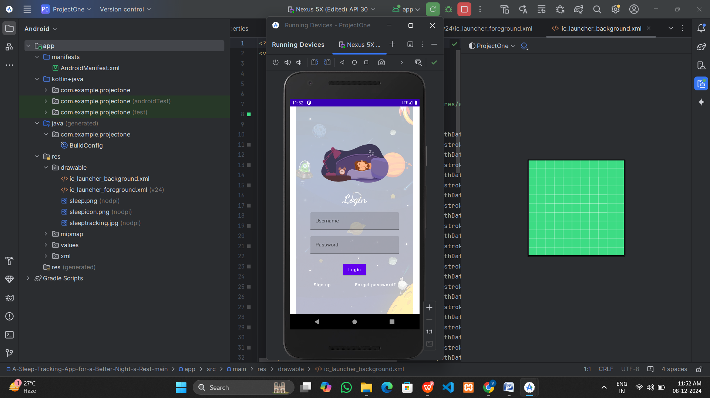
OUTPUT

Slide 15
Conclusion
Summary:
- Addresses key sleep challenges.
- Combines technology and health science for better living.
Future Scope:
- Integration with Smart Home devices.
- Advanced AI for personalized recommendations.

Slide 16


