Slide 1



BYTESMART INTERNSHIP CASE STUDY
Data Center Cooling
Regulation & Sensor Technology
Sensor-based monitoring and real-world data collection using temperature, humidity, and pressure sensors
Ranveer Singh · Partnered with ByteSmart · June 2026
TEMPERATURE
HUMIDITY
PRESSURE
Includes Arduino DHT22 + BMP280 Field Sensor Project

Slide 2


AGENDA
What We'll Cover
This case study has two halves: the research behind data center cooling, and the live analysis pipeline built to put that research into practice.
Part 1
Part 2
The Research Report
The Analysis Pipeline
How data centers generate and manage heat
The three sensor types: temperature, humidity, pressure
ASHRAE standards and industry regulation
Environmental costs and counteractions
Building a real Arduino DHT22 + BMP280 sensor station
Inside the Google Colab notebook, cell by cell
A bug found in the code — and the fix
How the notebook's dataset ties back to the report
What 5 months of real sensor data actually shows
Takeaways connecting the report to the pipeline

Slide 3
GLOSSARY · WORD BANK
Glossary: Cooling + ML
A quick reference for the data-center terms and model vocabulary used throughout this case study.
SENSORS & AIRFLOW
COOLING & EFFICIENCY
RISK & MODEL TERMS
ASHRAE: thermal guidance benchmark
Inlet temp: air entering servers
Outlet temp: warmed air leaving servers
Thermal delta: outlet minus inlet
AHU: moves and conditions air
Chiller: removes water-side heat
Cold source: chilled-water side
Cooling power: cooling draw in kW
PUE: total facility energy / IT energy
Ambient heat stress: outdoor heat raises demand
ESD: static risk at low humidity
Condensation: moisture risk at high humidity
Workload: compute demand
Train/test: fit, then evaluate
Inference: use saved models
Pickle (.pkl): stored model
CER: claim, evidence, reasoning

Slide 4
INTRODUCTION
Every Click Runs Through a Data Center
Streaming a video, sending an email, or asking an AI a question all route to a data center — a building packed with thousands of servers running around the clock. Keeping them cool isn't just about performance; it prevents fires, equipment failure, and large-scale outages.
5,000+
40–140 kW
460 TWh
1.8%
U.S. data centers as of 2024 — about a third of the world's total capacity
power draw of a single AI-focused server rack (vs. ~1.2 kW for an average home)
electricity used by global data centers in 2025, projected to exceed 800 TWh by 2028
share of total world electricity demand that figure represents — rivaling all of France
Because nearly all of that electricity eventually becomes heat, cooling systems must run 24 / 7 / 365 — with no days off.

Slide 5
THE HEAT PROBLEM
Heat Is the #1 Enemy of Hardware
Every chip has an operating range — past it, hardware throttles, crashes, or fails permanently
A single unchecked hotspot can cascade into a full outage
Cooling-related problems cause 19% of all data center outages (Uptime Institute, 2024)
More than half of organizations report their most recent major outage cost over $100,000
ASHRAE Inlet Temperature
18–27°C
recommended range (64.4–80.6°F)
What happens as a server overheats:
32°C
Fans spin faster
→
CPU throttles speed
→
Server shuts down
→
Risk spreads to the room
allowable maximum before risk (89.6°F)

Slide 6
COOLING INFRASTRUCTURE
Keeping Hot and Cold Apart
Racks alternate so cold air intakes face each other and hot exhausts face each other — preventing hot exhaust from mixing back into intake air. ASHRAE-style hot/cold aisle containment cuts cooling energy use by 15–20%.
Method | How It Works | Best For | Efficiency
CRAC | Refrigerant-based air cooling | Small server rooms | Low
CRAH + Chilled Water | Chilled water circulated through coils | Medium–large data centers | Medium
Direct-to-Chip | Cold plates on CPUs / GPUs | High-density AI racks | High
Immersion Cooling | Servers submerged in dielectric fluid | Ultra-dense deployments | Very High
Free Cooling | Outdoor air / ambient temperatures | Cold-climate facilities | Excellent
By 2024, liquid-based cooling had captured 46% of the data center cooling market — and that share keeps growing as AI racks push past 100 kW.

Slide 7
MONITORING
The Nervous System of a Data Center
Temperature
Humidity
Pressure
The most direct indicator of hardware health. Measured at server inlets, outlets, and rack tops/bottoms — ASHRAE requires sensors at the top, middle, and bottom of every third rack.
Too dry (<40% RH) risks electrostatic discharge that can destroy a chip instantly. Too humid (>60% RH) causes condensation, short circuits, and corrosion.
Differential pressure confirms cold air is reaching every rack at the right speed. A pressure drop flags blocked vents, clogged filters, or failed fans.

Slide 8
INDUSTRY STANDARDS
The Rulebook: ASHRAE Classes + PUE
ASHRAE Equipment Classes
Class | Temp Range | Humidity | Typical Use
A1 | 15–32°C | 20–80% | Data centers
A2 | 10–35°C | 20–80% | IT spaces
A3 | 5–40°C | 8–85% | Offices
A4 | 5–45°C | 8–90% | Warehouses
Power Usage Effectiveness (PUE)
Total facility energy ÷ energy used by IT equipment alone. Lower is better.
1.0
Theoretical perfect
1.1–1.2
Excellent (hyperscale)
1.2–1.4
Good — efficient facility
1.4–1.6
Average (industry ~1.55)
Minimum 3 temperature sensors per rack (top / middle / bottom)
Sensors must measure at the server inlet, not room air
Humidity sensors need ±3% RH accuracy or better
Temperature change must not exceed 5°C per hour
>1.6
Poor / outdated

Slide 9


ENVIRONMENTAL COST
The Price Tag Behind the Cooling
176 TWh
105M tons
17.4B gal
U.S. data center electricity in 2023 — 4.4% of all U.S. consumption
CO₂-equivalent emitted — a 300% increase in just six years
freshwater consumed by U.S. data centers in 2023 alone
Solutions already underway
Renewable energy
Liquid cooling
Zero-water designs
Sensor-driven tuning
Hyperscalers committing to 100% renewable power
Direct-to-chip & immersion cut PUE significantly
Microsoft: closed-loop chip cooling saves 125M+ L/yr per site
Real-time data avoids overcooling, saving energy

Slide 10

REAL-WORLD DATASET
From Theory to Real Numbers
The report references a public dataset — the Data Center Cold Source Control Dataset on Kaggle — capturing sensor readings from the chilled-water “cold source” side of a real cooling system. This is the exact file the Colab pipeline in Part 2 analyzes.
What it captures
Supply & return chilled-water temperature
Water flow rate and total cooling load (kW)
Chiller power consumption over time
Server workload, inlet / outlet / ambient temperature
cold_source_control_dataset.csv
How researchers use data like this
3,498
hourly readings
Optimization modeling — the most efficient way to run a chiller plant
Anomaly detection — flagging readings that break the normal pattern
Control system design — validating automated cooling responses
5 months
Jan – May 2025
12
tracked fields

Slide 11

HANDS-ON PROJECT
Building a Personal Data Center Monitor
Two inexpensive sensors — the DHT22 (temperature + humidity) and BMP280 (pressure + temperature) — let you measure the same three parameters that industrial data centers track 24/7, for under $30.
Component | Purpose | Cost
Arduino Uno / Nano | Main microcontroller | $10–25
DHT22 module | Temperature + humidity | $4–8
BMP280 module | Pressure + temperature | $2–5
Breadboard + wires | Connects components | $5–10
10 kΩ resistor | DHT22 data pull-up | $0.10
Wiring at a glance
DHT22
Data → Digital Pin 2 (with 10kΩ pull-up to VCC)
BMP280
SDA → A4, SCL → A5 (I²C, address 0x76)
BMP280 power
Total under $30 if you already have a USB cable and computer.
3.3V only — never connect to 5V

Slide 12
HANDS-ON PROJECT
Reading the Data — With Built-In ASHRAE Checks
Serial Monitor output (9600 baud, one reading every 3 seconds)
# | Temp (°C) | Temp (°F) | Humidity | Pressure | Altitude
1 | 24.5°C | 76.1°F | 52.0% | 1012.45 hPa | 8.2 m
2 | 24.6°C | 76.3°F | 51.8% | 1012.47 hPa | 8.1 m
3 | 24.6°C | 76.3°F | 52.1% | 1012.44 hPa | 8.3 m
if (tempC_dht > 27.0) {
Serial.println("WARNING: Above ASHRAE max");
}
if (humidity < 40.0) {
Serial.println("WARNING: ESD risk");
}
if (humidity > 60.0) {
Serial.println("WARNING: Condensation risk");
}
Each reading is checked against the report's own ASHRAE thresholds in real time:
Temp > 27°C → “Above ASHRAE recommended max inlet temp”
Humidity < 40% → “ESD risk” warning
Humidity > 60% → “Condensation risk” warning

Slide 13
PART 1 RECAP
Report Takeaways
Temperature is the clearest signal
Humidity is dangerous at both ends
The most direct read on hardware health and cooling effectiveness — which is why it gets the most sensors.
Too dry risks static discharge; too humid risks condensation and corrosion. There's no safe direction to drift.
Pressure gives airflow its context
The physics don't change with scale
It doesn't cool anything directly, but it proves cool air is actually reaching the racks that need it.
A $5 sensor and a $15 microcontroller measure the same properties a $10B hyperscale facility tracks — just at a smaller scale.

Slide 14
PART 2
From Report to Live Data
Inside Ranveer's Google Colab analysis pipeline — and how it connects back to the report

Slide 15


IOT_DATA_ANALYSIS.IPYNB
How the Colab Notebook Works
1
2
3
4
Mount Google Drive
Load & clean the CSV
Parse timestamps
Plot 7 metrics
drive.mount('/content/drive') — so the CSV loads with no manual upload
Reads cold_source_control_dataset.csv, drops 4 unused columns
Converts the Timestamp column to real datetime objects for plotting
Workload, temps, cooling power, chiller & AHU usage — one line chart

Slide 16
REGRESSION QUESTION SET
Questions 1-2: Original Set
Eight total questions: the original five from Drive plus the three new predictive questions.
Q1. How frequently does the cooling system violate the ASHRAE recommended maximum inlet temperature threshold of 27°C?
Regression: Logistic, if reframed as violation vs no violation.
Why: The prediction target is binary.
Use: No
Q2. Which cooling strategy achieves the best balance between minimizing financial overhead and maximizing thermal stability?
Regression: Multinomial logistic, if strategy choice becomes the target.
Why: The output would be one category from several strategy options.
Use: No
Original questions from the Drive notebook · not selected for the current scripts
Notes:
define ashrae in slideshow
add a wordbank/glossary of terms at the end of the slideshow

Slide 17
REGRESSION QUESTION SET
Questions 3-4: Original Set
These questions are useful analysis ideas, but they are not the three scripts selected right now.
Q3. Under what combined conditions of ambient temperature does the control loop rely heavily on chiller usage over AHU usage?
Regression: Logistic regression.
Why: The target can be chiller-dominant vs not chiller-dominant.
Use: No
Q4. As workload rises, how much additional heat appears across the rack airflow path, and does cooling respond before inlet temperatures drift toward the ASHRAE limit?
Regression: Linear regression.
Why: Thermal delta and cooling response are continuous values.
Use: No
Original questions from the Drive notebook · not selected for the current scripts

Slide 18
REGRESSION QUESTION SET
Questions 5-6: Original + Selected
Question 6 is one of the three chosen prediction scripts for the next Colab work.
Q5. When outdoor ambient temperature increases, how much harder do the cooling units work, and how much does total energy cost rise across the hottest temperature band?
Regression: Linear regression.
Why: Cooling power and cost are continuous values.
Use: No
Q6. Can current workload and temperature readings predict the server inlet temperature at the next recorded time interval?
Regression: Linear regression.
Why: Future inlet temperature is a continuous numeric value.
Use: YES
Selected script: Q6 uses linear regression

Slide 19
REGRESSION QUESTION SET
Questions 7-8: Selected Scripts
These two questions complete the current set of three prediction scripts.
Q7. Can current operating conditions predict whether the inlet temperature will exceed the 27°C ASHRAE limit during the next interval?
Regression: Logistic regression.
Why: The output is binary: violation or no violation.
Use: YES
Q8. Can workload, ambient temperature, and cooling utilization predict cooling-unit power consumption?
Regression: Linear regression.
Why: Cooling-unit power is a continuous numeric value.
Use: YES
Selected scripts: Q7 uses logistic regression · Q8 uses linear regression

Slide 20
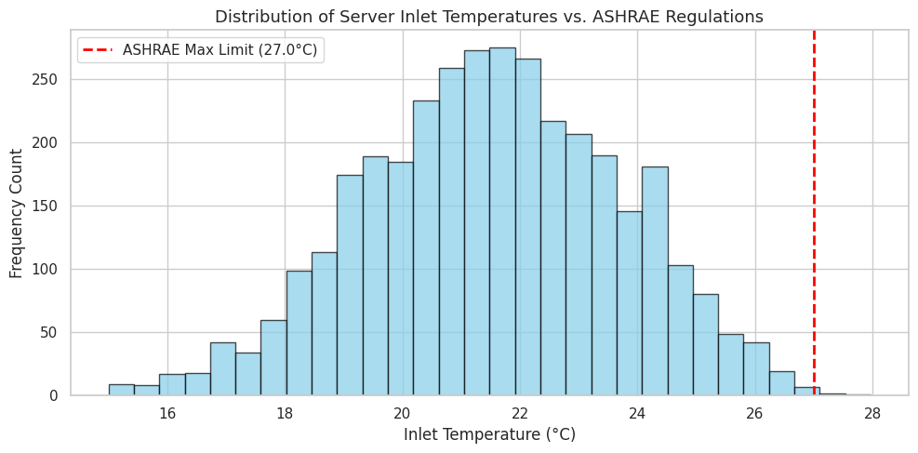
RESEARCH QUESTION OUTPUT #1 · ASHRAE COMPLIANCE
Inlet Temps Stay Below ASHRAE Limit
Claim
The cooling system is almost always inside the ASHRAE recommended inlet-temperature max.
Evidence
3,498 readings
4 violations above 27°C
0.11% violation rate
Reasoning
The red limit line sits at the far right tail, so overheating appears rare rather than routine.

Slide 21
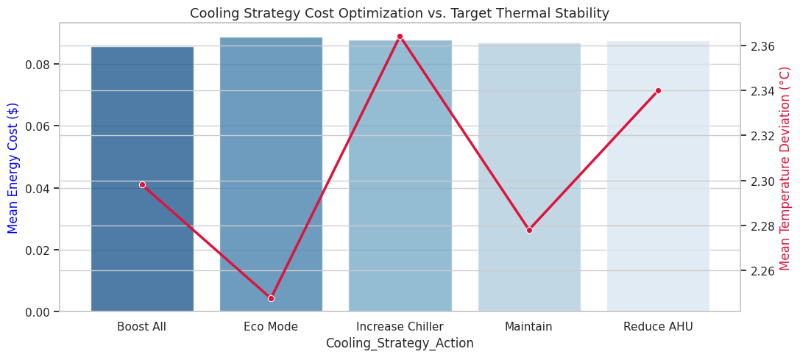
RESEARCH QUESTION OUTPUT #2 · STRATEGY TRADE-OFF
Cost Is Tight; Stability Drives Choice
Claim
The best strategy is a trade-off, not the lowest bar alone.
Evidence
Mean energy cost stays tightly clustered across actions, while temperature deviation changes more visibly.
Reasoning
Because cost differences are small, the strategy decision should prioritize thermal stability unless a cost gap becomes meaningful.

Slide 22
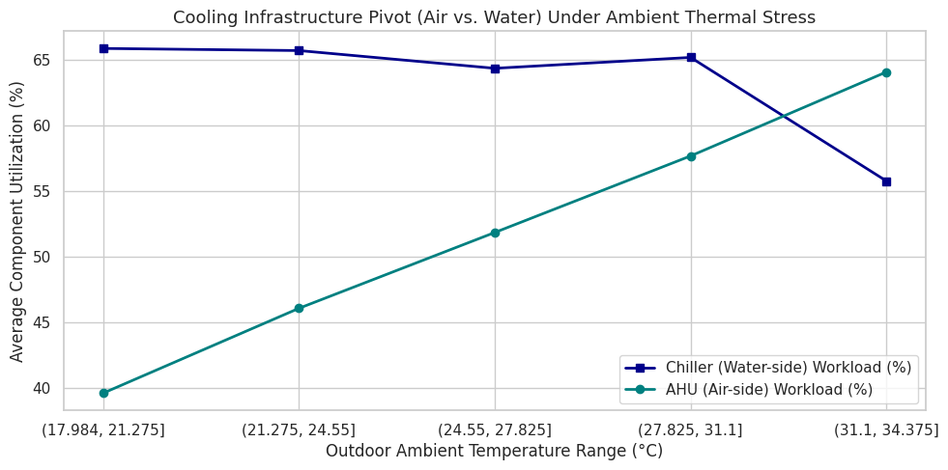
RESEARCH QUESTION OUTPUT #3 · CHILLER VS. AHU
Ambient Heat Shifts Load Toward AHU
Claim
The control loop changes which cooling component carries the work as outdoor conditions heat up.
Evidence
AHU usage climbs across warmer ambient bands, while chiller usage drops in the hottest band.
Reasoning
Air-side handling becomes more active under heat stress, showing that the cooling loop is adaptive rather than fixed.

Slide 23
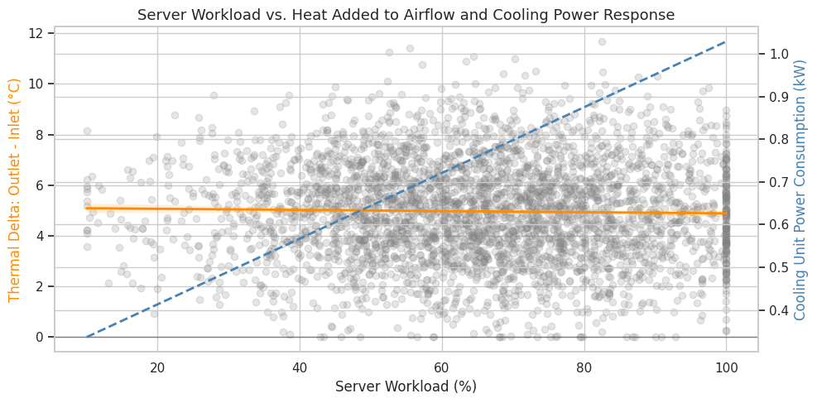
RESEARCH QUESTION OUTPUT #4 · WORKLOAD RESPONSE
Cooling Power Tracks Compute Load
Claim
Cooling power responds strongly when server workload rises.
Evidence
Workload vs. cooling power correlation: r = 0.94
Workload vs. thermal delta correlation: r = -0.02
Reasoning
The cooling system increases power with compute load, keeping thermal delta roughly flat instead of letting heat build up across the rack.

Slide 24
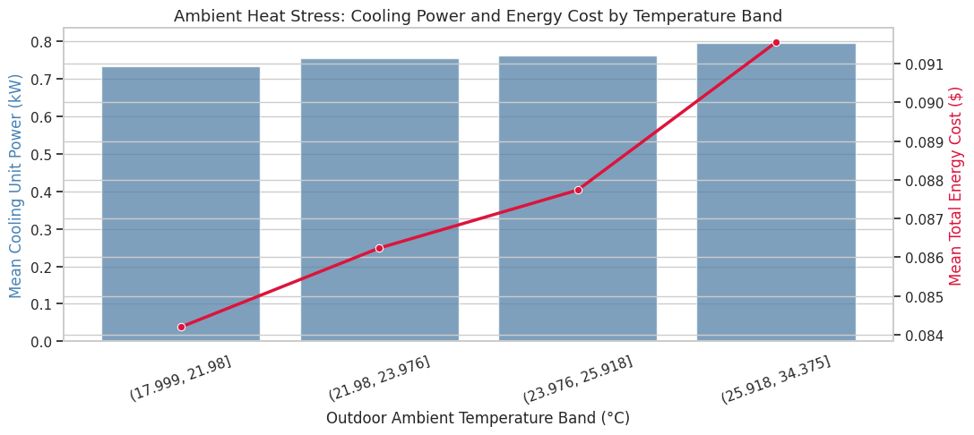
RESEARCH QUESTION OUTPUT #5 · AMBIENT HEAT STRESS
Outdoor Heat Raises Cooling Cost
Claim
Hotter outdoor conditions make the cooling system work harder and cost more.
Evidence
Hottest band vs. coolest band:
+8.38% cooling power
+8.74% energy cost
Reasoning
Ambient heat stress raises the energy needed to maintain safe inlet temperatures, linking weather directly to operating cost.

Slide 25
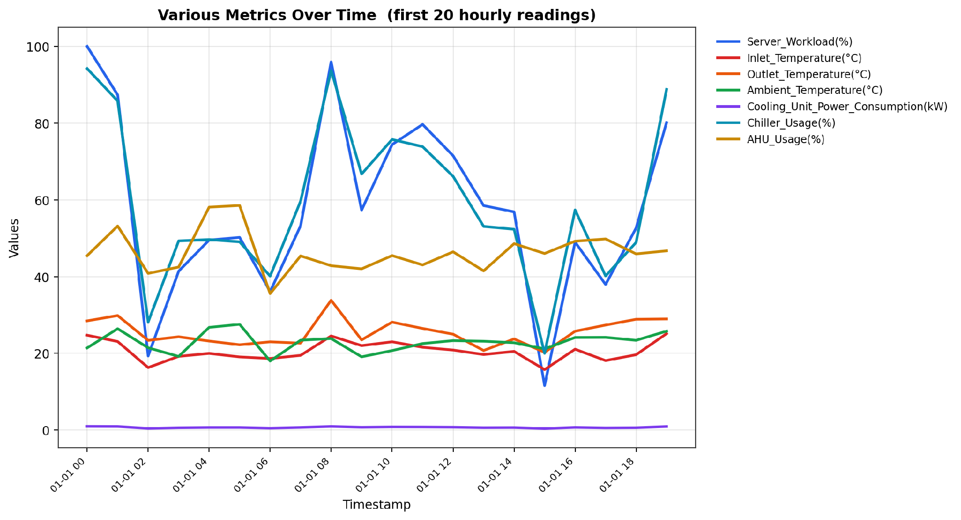
PIPELINE OUTPUT #1
What the Code Actually Produces
Bug-fixed, faithful reproduction
Plots the first 20 hourly readings exactly as the code requests
Server Workload and Chiller Usage (both %) dominate the y-axis
Cooling_Unit_Power_Consumption (kW, range ~0.3–1.1) is squashed flat near zero
Design note: mixing %, °C, and kW on one axis hides the kW line. Splitting into 2–3 small-multiple panels (or a secondary axis) would make every metric readable.

Slide 26
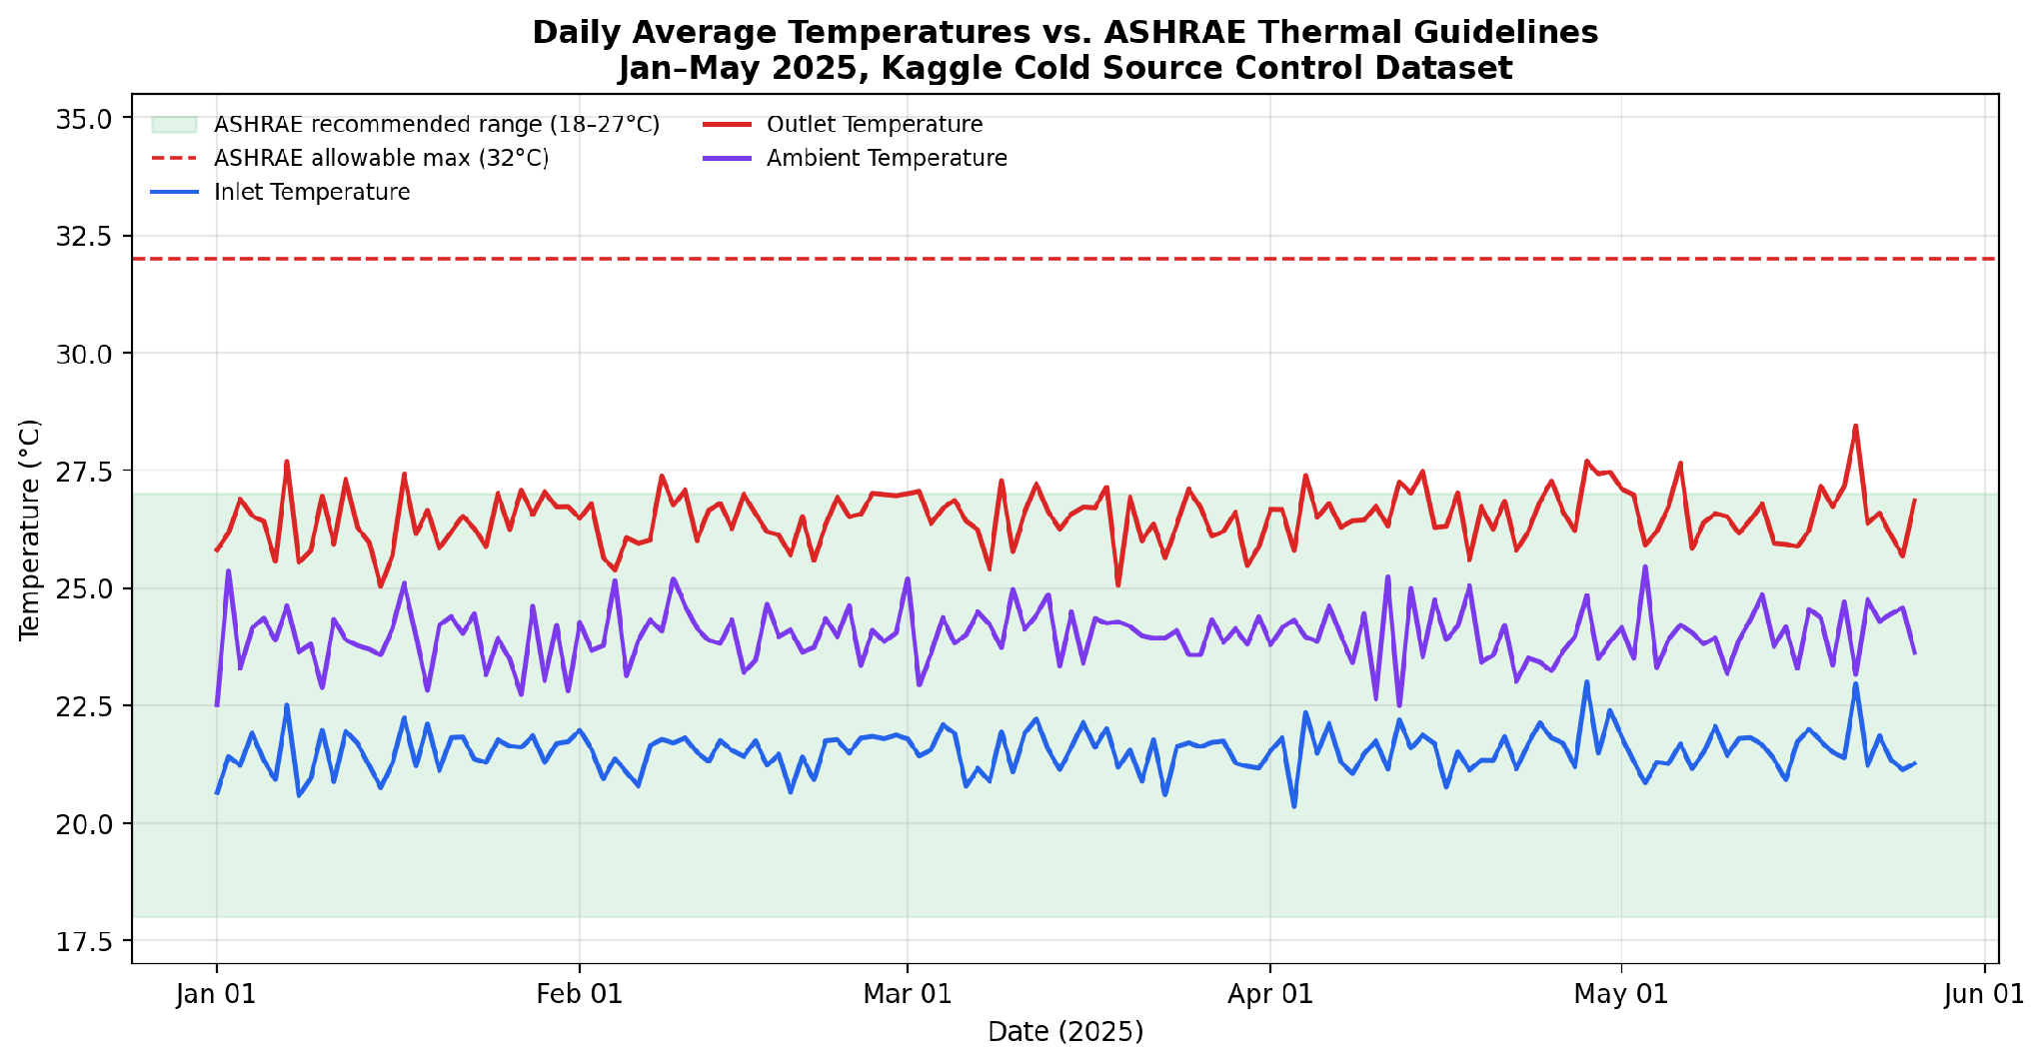
PIPELINE OUTPUT #2 · CONNECTING TO THE REPORT
Does the Real Data Match the Standard?
99.9%
of all 3,498 readings stayed inside the ASHRAE 18–27°C recommended band
0
readings ever crossed the 32°C allowable maximum

Slide 27
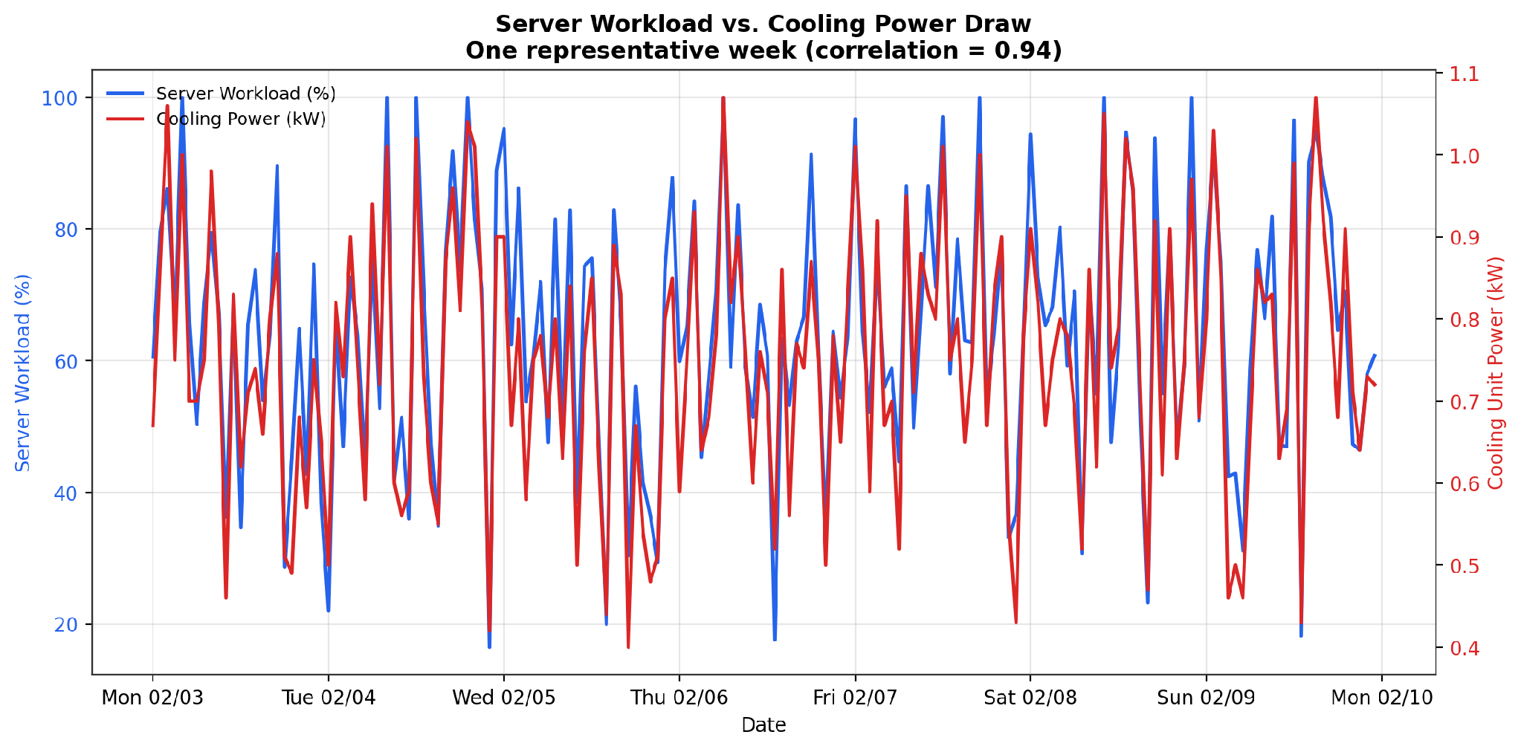
PIPELINE OUTPUT #3 · CONNECTING TO THE REPORT
The Leading Indicator, Confirmed
r = 0.94
correlation between server workload and cooling power draw
This is the same “compute load drives heat” relationship the report describes in Section 2.2 — now shown directly in 5 months of real readings.
The report defines the standard. The dataset proves real systems follow it. The Arduino project lets you measure it yourself.

Slide 28
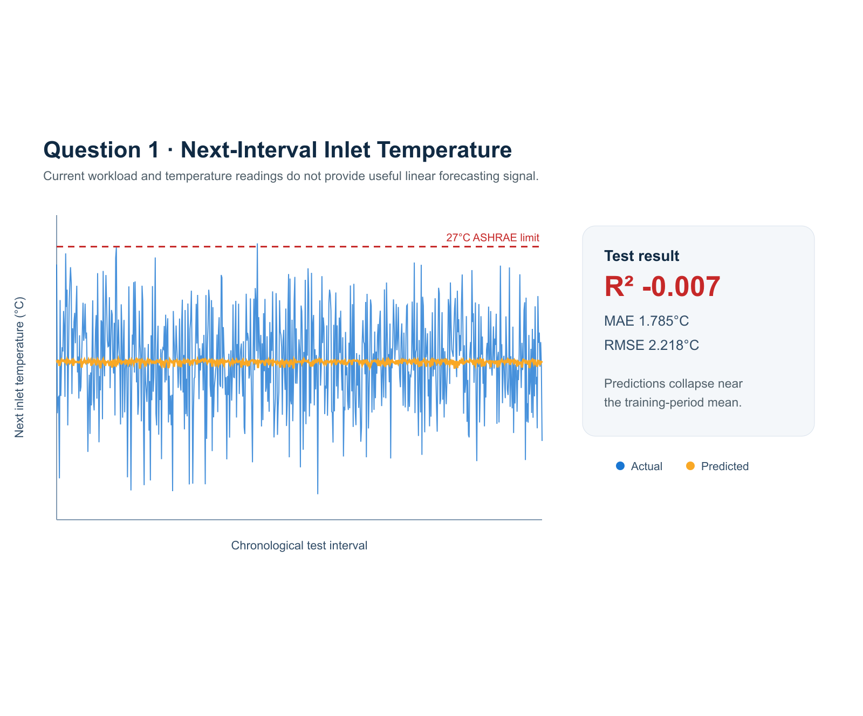
QUESTION 1 | NEXT INLET TEMP
Next-Hour Inlet Temperature Is Not Predictable
A chronological 80/20 linear-regression test found no useful next-interval signal.
Test results
R² = -0.007
MAE = 1.785°C
RMSE = 2.218°C
What it means
Predictions collapse near the training mean.
Use this as a valid negative result, not a forecasting claim.
Actual vs. predicted inlet temperature on chronological test data.

Slide 29
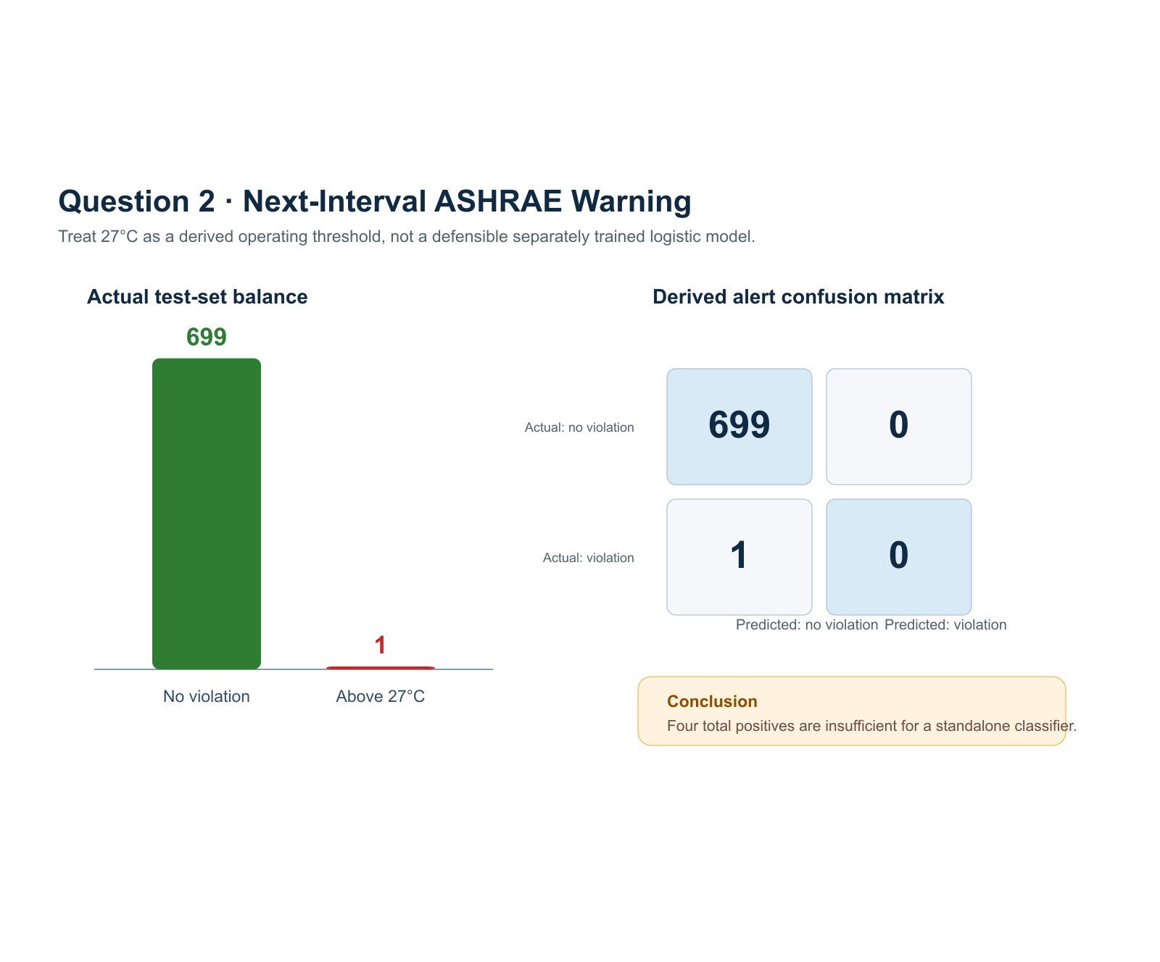
QUESTION 2 | ASHRAE RISK
Four Violations Cannot Train a Reliable Classifier
Only four of 3,497 shifted targets exceeded 27°C, so a standalone logistic model would be misleading.
Chronological test set
699 no-violation intervals
1 violation interval
Derived alert result
TN 699 | FP 0
FN 1 | TP 0
Decision
Use the 27°C rule as a warning threshold,
not as proof of a trained classifier.
Class balance and derived-alert confusion matrix for the test set.

Slide 30
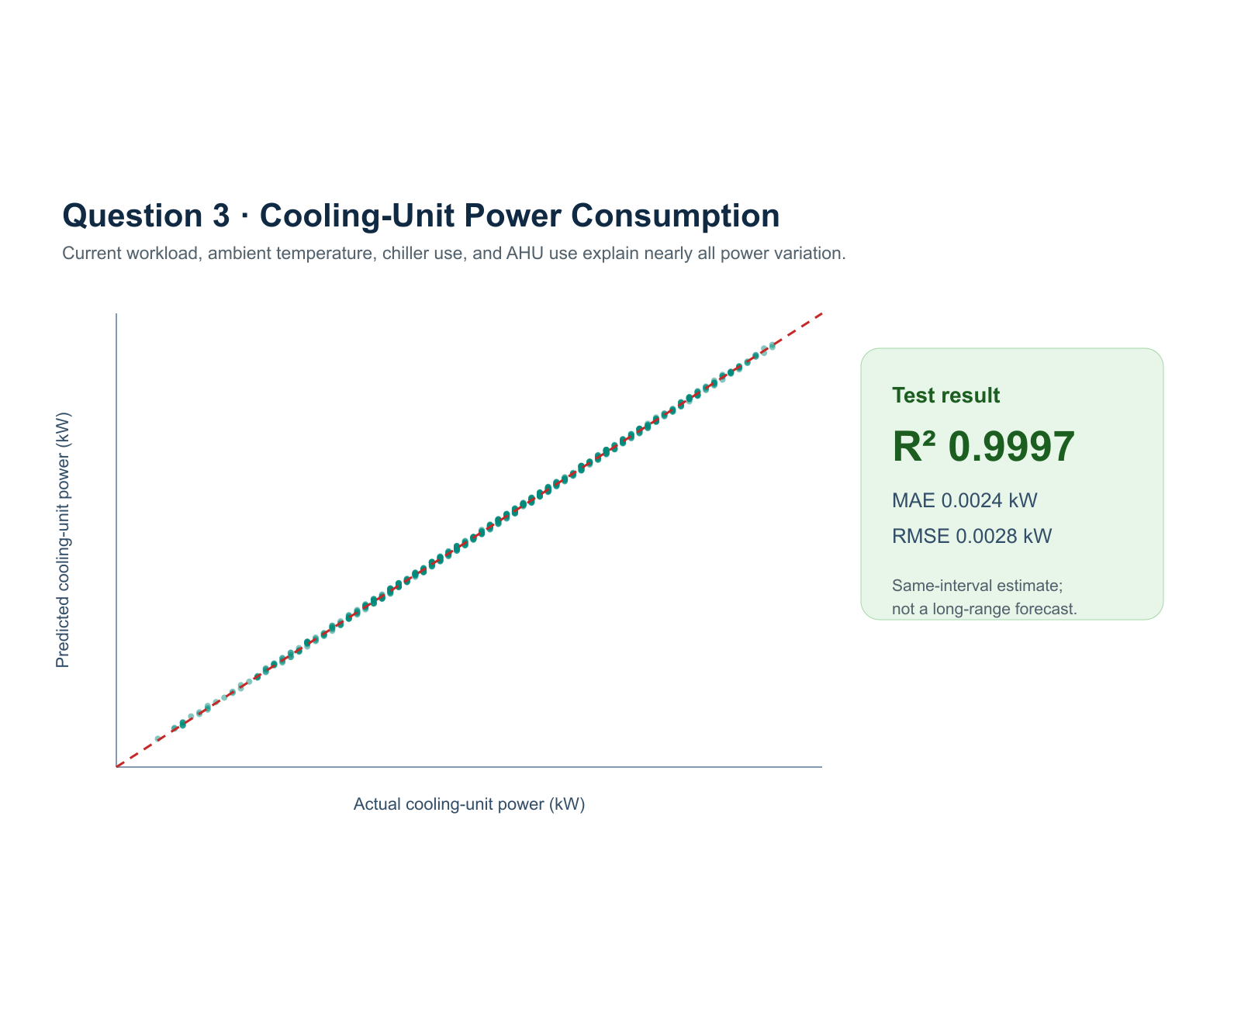
QUESTION 3 | COOLING POWER
Cooling Power Is Estimated Almost Exactly
A chronological linear model links workload, ambient temperature, chiller use, and AHU use to cooling power.
Test results
R² = 0.999689
MAE = 0.00243 kW
RMSE = 0.00283 kW
Important limitation
This is a same-interval estimate.
It is not a future power forecast.
Actual vs. predicted cooling-unit power on chronological test data.

Slide 31
REFERENCES · SOURCES
Evidence Used in the Case Study
ASHRAE. Thermal Guidelines for Data Processing Environments / Datacom Series. Used for inlet-temperature, humidity, and rack-sensor guidance.
Uptime Institute. Annual Outage Analysis 2024. Used for outage/cooling-risk context.
International Energy Agency. Energy and AI. Used for global data-center electricity demand context.
Lawrence Berkeley National Laboratory. 2024 United States Data Center Energy Usage Report. Used for U.S. electricity, emissions, and water-consumption context.
The Green Grid. Power Usage Effectiveness (PUE). Used for the facility-energy efficiency definition.
Kaggle cold_source_control_dataset.csv and Data_Center_Analysis_5_Questions.ipynb. Used for the five notebook visualizations and computed outputs.
Fathom meeting summary, July 7, 2026. Used for CER, glossary, references, and slide-revision action items.

Slide 32
IMPLEMENTATION UPDATE
Cooling Project: Current Implementation
Completed pipeline
Scenario-aware cooling events publish to MQTT, are validated by a subscriber, and can be stored in PostgreSQL.
Traceable exports
Model-compatible CSVs retain operational fields plus scenario, severity, data quality, and outlier metadata.
What the analysis adds
Database summaries cover workload, temperature, cooling power, cost, control strategy, thermal risk, and unusual events.
Validation still required
A live dashboard demonstration and a Colab retraining run need read-back evidence before they can be called complete.

Slide 33

Thank You
Questions about the report, the sensors, or the pipeline?
Ranveer Singh · ByteSmart Internship · June 2026

