Slide 1

Project(CS-893)
SPATIALLY AWARE
RECOMMENDATION ALGORITHM
Under the supervision of :
Prof. (Dr.) Prosenjit Gupta (professor)
&
Prof. (Dr.) Subhashis Majumdar(professor& HOD)

Slide 2





Wants to Buy Something Online ??
The Problem is..
How to get enough INFORMATION to make a Decision ?
Product
BUT ..
recommendations
How to make a RIGHT DECISION out of enormous information ?

Slide 3
Introduction
Recommender System
– Apply statistical and knowledge discovery techniques to the problem of making Product Recommendation.
–It receives information from a customer about which products he/she is interested in, and recommends products that are likely to fit his/her needs.
– Today, recommender systems are deployed on hundreds of different e-commerce websites, serving millions of customers.

Slide 4
Collaborative Filtering
-Basic Principle :
  To find a subset of users, having similar tastes and preferences to that of active user.
  And offering recommendations based on that subset of users.
-Assumptions :
  Users with similar interest have common preferences and vice-versa.
  Sufficiently large number of user preferences is available.

Slide 5
Past Works
Amazon.com
  - Uses Item-to-Item Collaborative Filtering.
  - Focuses on finding similar Items, not similar Customers.
Google- Hotpot
  - A recommendation engine for places.
  - To make local recommendation more personal, by recommending places based on ratings.
Netflix.com
  - Recommendation engine for movies.
  - Uses matrix- factorization and so called “temporal-dynamics” to perform Collaborative Filtering.

Slide 6


IMPORTANT CHALLENGES
1. Scalability Issue
Recommendation Algorithm- Performance
In Searching Neighbors having similar preferences – Active user
Tens of thousands of users
Tens of millions of users

Slide 7
2. To improve Quality Of Recommendation
Consumers need Recommendations
  they can trust upon to help them in finding products - they will like.
Time – to have closer look on
Different contextual information
- To add new methods of recommendation !!
BALANCE REQUIRED !!
To Search more number of related customers (neighbors)
CONFLICT IN TWO CHALLENGES
Lesser Time algorithm spends in searching neighbors
More scalable it is.
But
Lesser the Quality of Recommendation is.

Slide 8
Why Spatially Aware ?
Recommendation system considers
Location of Active User
Preferences of other users, who share same Location
Recommendation for Active user

Slide 9
Project Objective
To Decompose User’s Space based on their location (voronoi Diagram)
To Find Correlation among Users within same location (Pearson’s correlation coefficient)
To Recommend relevant Items of interest to
active user (Collaborative Filtering)

Slide 10
Voronoi Diagram
p_{i} : site points
q : free point
e : Voronoi edge
v : Voronoi vertex
v
q
p_{i}
e

Slide 11
Everyday Example of Voronoi diagram
The post office problem:-
Suppose in a city with several post offices we would like to mark the service region of each post office proximity. What are those regions??
Let us solve this problem for a section of kolkata.

Slide 12
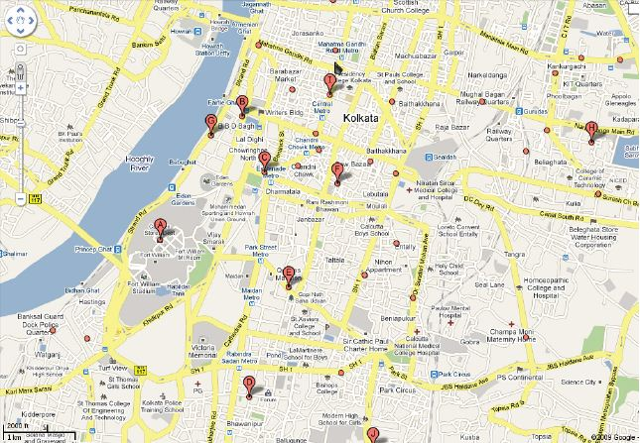
Post offices in a section of kolkata

Slide 13
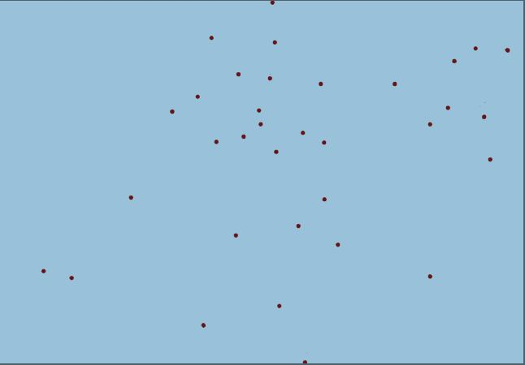
Post-offices as Points in Plane

Slide 14
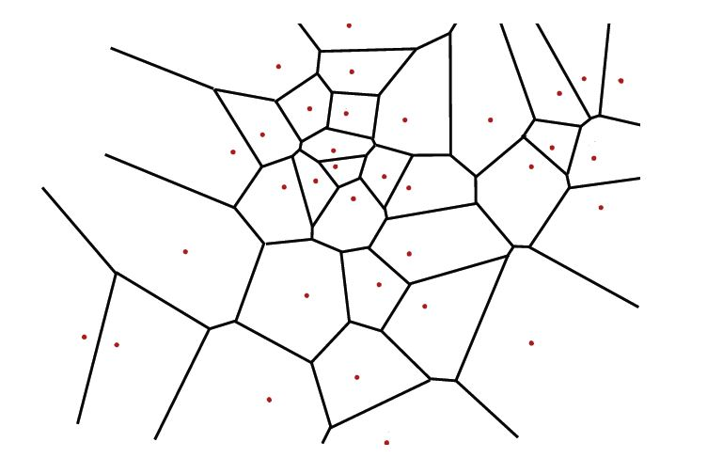
Proximity Regions of Post offices

Slide 15
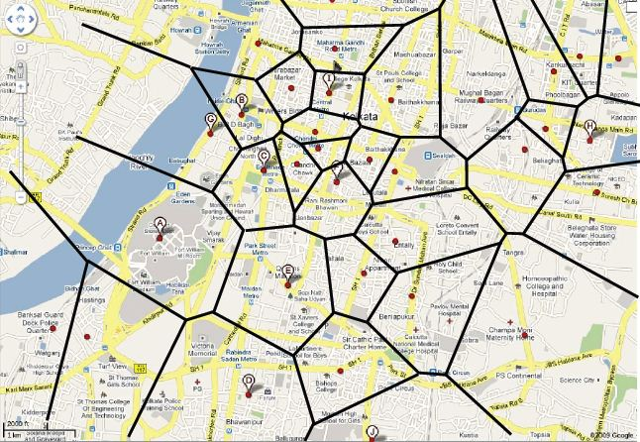
Post-office services in Kolkata

Slide 16
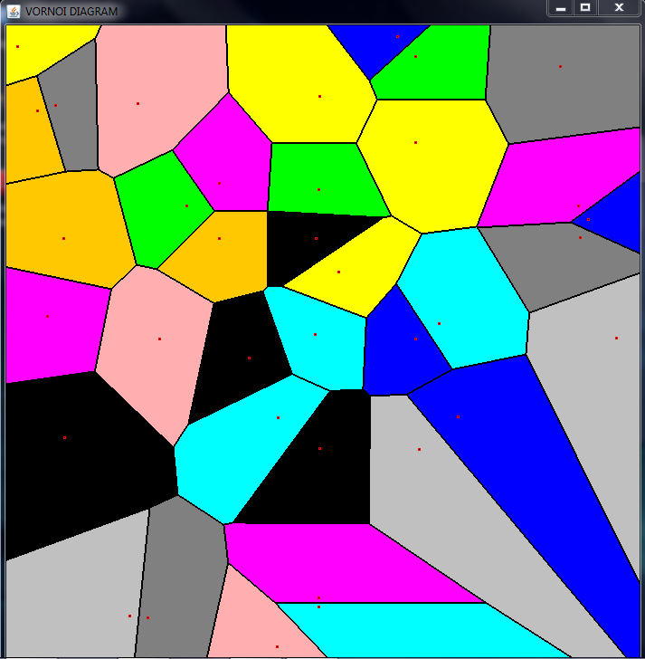
GUI Application developed in Java

Slide 17
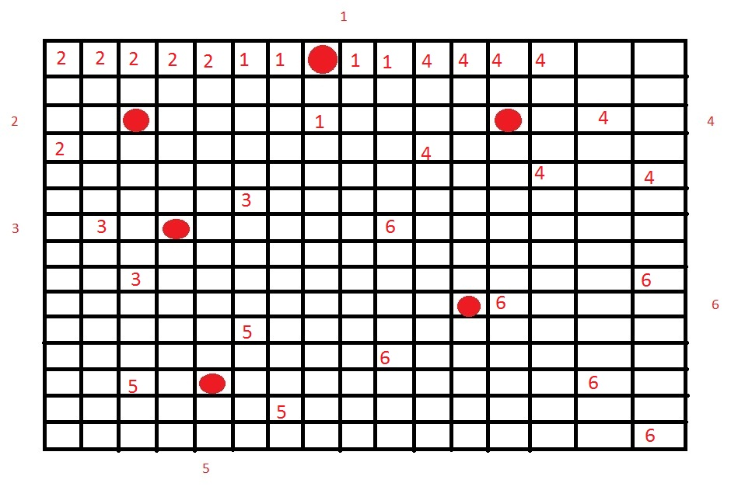
Raster-scan Concept

Slide 18
Project
Implementation
Part

Slide 19


DATA SET PROVIDED
Users.dat file
UserID | Gender | Age | Occupation | Zip-code
* Contains around 6000 0f user’s information
Zips_sm.txt file
Zip-code | City-name | longitude | latitude
*Contains around 30000 cities information

Slide 20


DATA SET PROVIDED
Movies.dat file
MovieID::Title::Genres
*Contains around 4000 movies informations
Ratings.dat file
UserID::MovieID::Rating::Timestamp
*UserIDs range between 1 and 6040
*MovieIDs range between 0 and 3592
**Ratings are made on a 5-star scale
**Each user has at least 20 ratings

Slide 21

Decomposing User’s space based on their location-
‘Voronoi Diagram’
Concept

Slide 22



Users.dat file
UserID | Gender | Age | Occupation | Zip-code
Find_sites.java Threshold value =15 users(say)
Zip_cen.dat file
Zip-code | user’s count
*Contains all voronoi sites(i.e. zip-codes having no. of users >= Threshold value of users )
all_Zips.dat file
Zip-code
*Contains all zip-codes

Slide 23



Zip_cen.dat file
Zips_sm.txt file
All_zips.dat file
Find_zipcen_coords.java
zip_cen_coordinates.dat
Zip-code | longitude | latitude
*Contains all voronoi sites along with their longitude and latitude
zip_coordinates.dat
Zip-code | longitude | latitude
*Contains all zip-codes along with their longitude and latitude

Slide 24

zip_cen_coordinates.dat
*Contains all voronoi sites
zip_coordinates.dat
*Contains all zip-codes
Find_zip_voronoi.java
voronoi_zip_coordinates.dat
Zip-code | Corresponding_zip_centre
*Contains all zip-codes with corresponding voronoi centers

Slide 25

Find Correlation among Users within same location
‘Pearson’s correlation coefficient’

Slide 26


Given voronoi site
Users.dat file
UserID | Gender | Age | Occupation | Zip-code
voronoi_zip_coordinates.dat
Zip-code | Corresponding_zip_centre
Find_Zipsite_users.java
ZipsiteN.dat file
Zip-code| Userid
*Contains all the users lying inside Nth voronoi cell , along with their corresponding zip-codes

Slide 27

Ratings.dat file
UserID::MovieID::Rating::Timestamp
*UserIDs range between 1 and 6040
*MovieIDs range between 0 and 3592
**Ratings are made on a 5-star scale
**Each user has at least 20 ratings
ZipsiteN.dat file
Zip-code| Userid
*Contains all the users lying inside Nth voronoi cell , along with their corresponding zip-codes
Find_zipcen_ratings.java
Zipsite_ratingsN.dat
Userid | movieid | ratings
*Contains the ratings of all the users within one voronoi cell, on different movies

Slide 28


Pearson’s correlation coefficient
C_{a,b} =
C_{a,b} =Pearson correlation between user a & user b
r_{a,i} =rating of user ‘a’ on item ‘i’
r_{b,i}
=rating of user ‘b’ on item ‘i’
=average rating of user ‘a’ on all the ‘m’ items
=average rating of user ‘b’ on all the ‘m’ items
Value of C_{a,b} lies between -1 to 1.
1/-1= positive/negative preferences between users.
0= users have no common set of preferences.

Slide 29

Zipsite_ratingsN.dat
Userid | movieid | ratings
*Contains the ratings of all the users within each of the voronoi cells on different movies .
Find_correlation.java
CorrelationsN.dat
Userid_a | userid_b | c(a,b)
*Contains the correlation coefficient between all the pairs of different users lying within each voronoi cells.

Slide 30

To Recommend Relevant Items of
Interest to Active User
‘Collaborative Filtering’

Slide 31
















Searches in which zip cell, the user belongs
Filters out an array of highly correlated users ( > threshold value)
Active user, u(i)
ZipsiteN.dat file
CorrelationsN.dat
RECOMMENDATION ALGORITHM (Find_recommendation.java)
Set of User’s highly rated movies (having ratings 4 or 5 out of 5)
Top two categories of user’s choice
Set of movies highly rated by correlated users
RECOMMENDED MOVIES

Slide 32

Testing
‘Experiments & Results’

Slide 33



Active user [u(i)]
Set of all the movies seen & rated so far by active user.
Set of movies generated after collaborative filtering and being recommended to active user.
Calculate average of all the ratings on these movies. (Avg2)
Set of common movies in both the above two sets.
Calculate average of all the ratings on these common movies. (Avg1)
Calculate Difference , diff(i) = Avg1(i) – Avg2(i)
Repeat this process for N no. of users.
Store the Results in a Table.

Slide 34




From this Table of differences,
Calculate ..
Number of users with positive difference values. (Pos_count_{u} )
Number of users with negative difference values. (Neg_count_{u})
Average of absolute of all these difference values. (Avg_{u})
&
Standard Deviation (SD_{u})

Slide 35

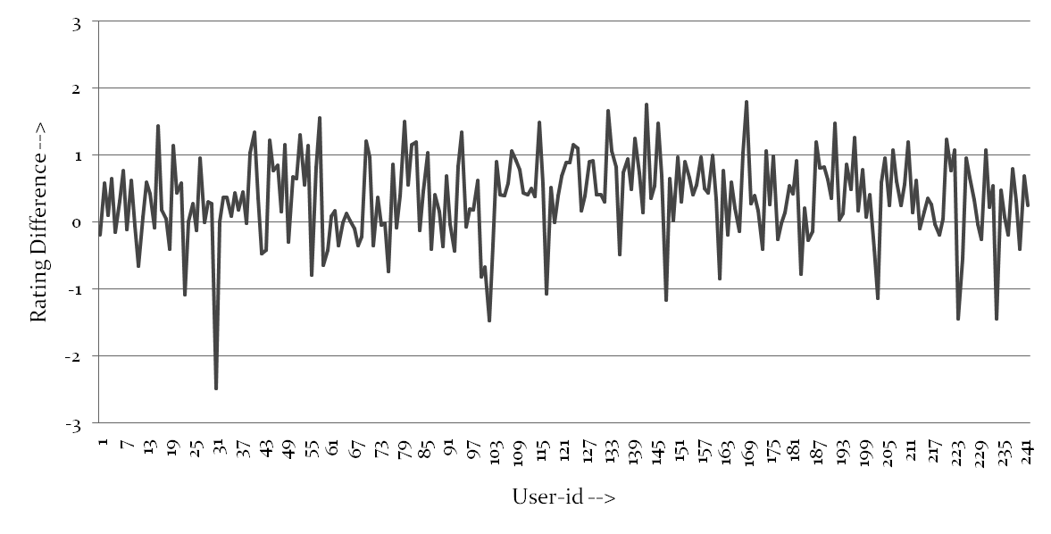
TEST CASE 1.
N= 242 (around 250) Users
RESULTS: [A] Pos_count_{u} = 181, Neg_count_{u} = 61
[B] Avg_{u} = 0.35702798. [C] SD_{u} = 0.63110024.

Slide 36
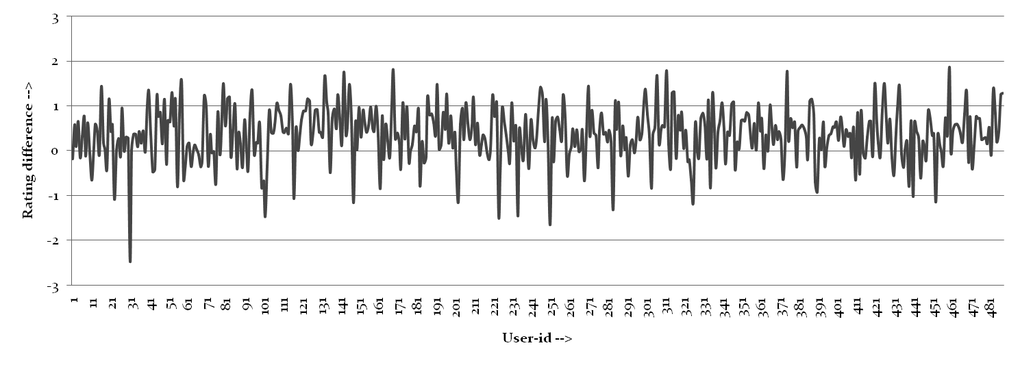
TEST CASE 2.
N= 488(around 500) Users
RESULTS: [A] Pos_count_{u} = 373, Neg_count_{u} = 115
[B] Avg_{u} = 0.3604241. [C] SD_{u} = 0.60164124.

Slide 37

(Pos_count_{u} ) /(Neg_count_{u}) ≈3 : 1, so out of every four users, three users are being recommended relatively better movies by our algorithm, than they have already seen and rated.
Since Avg_{u} ≈ 0.3 and SD_{u} ≈ 0.6, so although the one user out of four, which are not being recommended better movies, Still the average rating of those recommended set of movies(which are not better) differ from the average rating on all the movies he has seen so far, just by [0.3 ± 0.6].

Slide 38
Thank you..
Veer Chandra (085118)
Ashis Senapati (085123)
Suvodeep Majumder (085128)
All B-tech in Computer Sc. & Engg.
Heritage Institute of Technology (Kolkata)

