Slide 1
DBMS Project
Topic: Music Management System
By: Veerendra, Madhavan, Issac

Slide 2
CERTIFICATE
This is to certify that the DBMS Project titled “Music Management System" has been done by V S S Veerendra Kumar(422179), Karthikeya Madhavan(422134), D Issac(422135) pursuing Bachelor of Technology, Computer Science & Engineering during semester IV from National Institute of Technology Andhra Pradesh towards DBMS Lab.
Mr. D. Prasad
Faculty
CSE Department
NIT Andhra Pradesh

Slide 3
Table of Contents
S.no | Name
1 | Abstract
2 | Introduction
3 | Existing System and Disadvantages
4 | Proposed System and Disadvantages
5 | Entities and their attributes
6 | Relationships and Cardinalities
7 | Entity-Relationship Diagram
8 | Normalization
9 | Schema Creation in MySQL
10 | Integrity Constraints
11 | Sample MySQl Queries
12 | Conclusion

Slide 4
ABSTRACT
The Music Management System (MMS) is designed to streamline the organization and accessibility of music-related data within an online platform. It encompasses functionalities to manage albums, songs, artists, and customer interactions. Each album is uniquely identified by an Album ID and features attributes such as Title, Price, and Release Date. Songs, identified by Song ID, can belong to multiple albums and genres, each with attributes like Title and Play Time. Artists are represented by Artist IDs and include details like Name and Debut Date. Customers register with the system, providing essential information like Customer ID, Name, Address, Phone Number, and Birthday. Orders, identified by Order ID, include details such as Order Date, Total Price, Payment Method, and Delivery Option, facilitating seamless transactions. The MMS aims to optimize data management practices, enhance operational efficiency, and improve user experience within the music platform.

Slide 5
INTRODUCTION
In the ever-evolving landscape of digital music consumption, effective management of music-related data is paramount for online platforms to thrive. This project introduces the Music Management System (MMS), a comprehensive solution designed to streamline the organization and accessibility of music-related information. With a focus on albums, songs, artists, and customer interactions, the MMS aims to revolutionize the way online music platforms operate. By centralizing and efficiently managing data pertaining to albums, songs, artists, and customers, the MMS promises to enhance operational efficiency, improve user experience, and ultimately elevate the success of music platforms in the digital age. This introduction provides an overview of the MMS project, highlighting its significance in the context of the evolving digital music industry and outlining the key objectives and functionalities it aims to achieve.

Slide 6
EXISTING SYSTEM AND ADVANTAGES
EXISTING SYSTEM
ADVANTAGES
Handling of transactions such as album purchases and customer orders through manual processes.
Utilization of separate databases or spreadsheets for storing various types of data
Stability: Established processes provide stability.
Minimal Disruption: Avoids potential downtime.
Historical Data: Valuable for analysis.

Slide 7
PROPOSED SYSTEM AND DISADVANTAGES
PROPOSED SYSTEM
DISADVANTAGES
Centralized Database: Single storage for all music data.
Enhanced Efficiency: Streamlined operations.
Improved Data Integrity: Ensuring accuracy.
Scalability: Designed for future growth.
Initial Cost: Setting up and automation require investment.
Data Migration Challenges: Transitioning data poses risks.

Slide 8
Entities & their Attributes
Entity Name | Attributes | Description
Album | Album_id, Album_title, Album_price, release_date | Collection of music tracks released together, identified by Album ID.
Song | Song_id, Song_title, play_time | Individual music piece with unique Song ID, including title, playtime, and genre.
Artist | Artist_id, Artist_name, Debut_date | Creator of music, identified by Artist ID, with attributes like name and debut date.
Genre | genre_id, genre_name | Category or style of music that songs can belong to, defining their musical characteristics.
Customer | Customer_id, Birthday, Phone_Number, Address, Customer_name, Registration_date | Platform member providing personal details like name, address, and contact information.
Order | Order_id, Order_date, total_price, payment_method | Transaction initiated by a customer to purchase albums, identified by Order ID, including order details and payment information.

Slide 9
Relationship & Cardinalities
Entities | Relationship | Cardinality | Explanation
Album & Song | contains | One to Many | An album can contain multiple songs
Song & Artist | written | Many to One | A song can be written by multiple artists, and an artist can write multiple songs
Song & Genre | belongs | Many to Many | A song can belong to multiple genres, and a genre can have multiple songs
Album & Customer | purchases | Many to Many | Multiple album can be purchased by multiple customers
Customer & Order | places | One to Many | A customer can place multiple orders

Slide 10
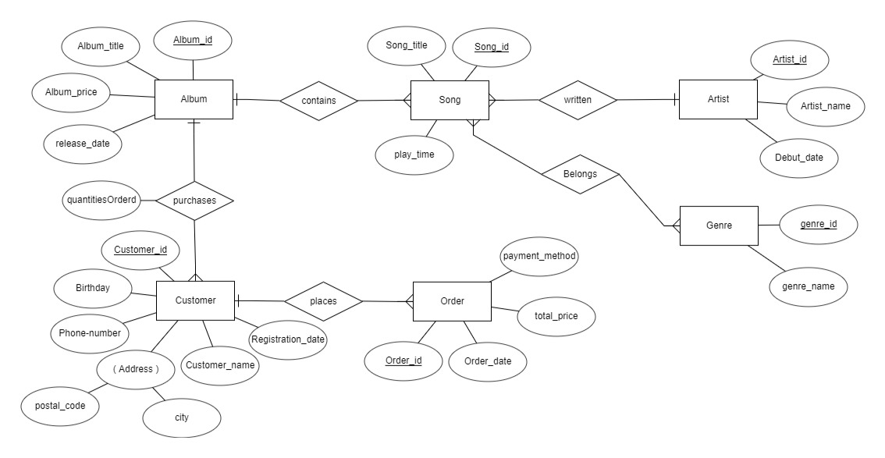
ER Diagram

Slide 11
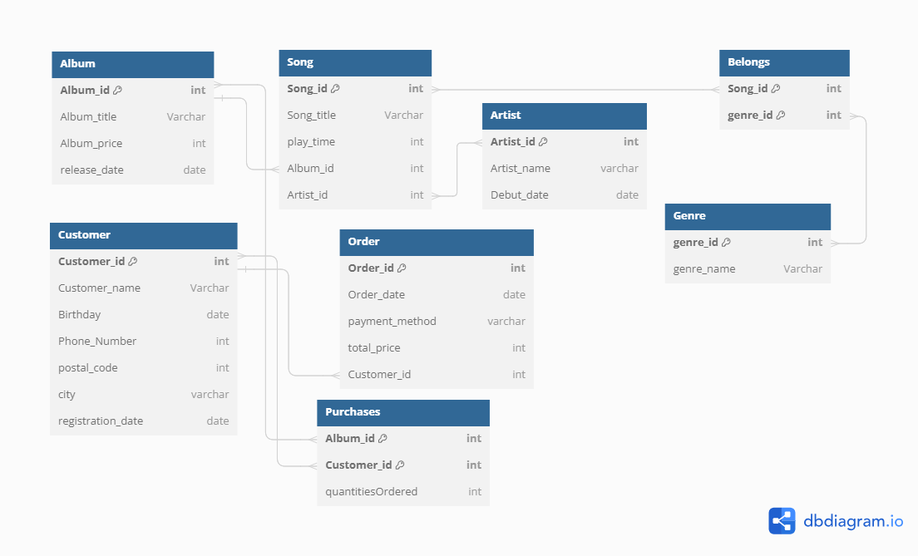
Relational Schema Before Normalization

Slide 12
Schema Refinement(Normalization)
Album: Album_id, Album_title, Album_price, release_date
F. D = {Album_id -> Album_title, Album_price, release_date}
Prime attributes = {Album_id } Non-Prime attributes = {Album_title, Album_price, release_date}
- 1NF
The table is already in 1NF as there are no multiple values in any attribute.
- 2NF
Non prime attributes are fully dependent on prime attributes
- 3NF
Non prime attributes are not determining other non prime attributes
Chosen Primary Key: Album_id

Slide 13
Schema Refinement(Normalization)
Song: Song_id, Song_title, play_time
F. D = {Song_id -> Song_title, play_time}
Prime attributes = {Song_id } Non-Prime attributes = {Song_title, play_time}
- 1NF
The table is already in 1NF as there are no multiple values in any attribute.
- 2NF
Non prime attributes are fully dependent on prime attributes
- 3NF
Non prime attributes are not determining other non prime attributes
Chosen Primary Key: Song_id

Slide 14
Schema Refinement(Normalization)
Artist: Artist_id, Artist_name, Debut_date
F. D = {Artist_id -> Artist_name, Debut_date}
Prime attributes = {Artist_id} Non-Prime attributes = {Artist_name, Debut_date}
- 1NF
The table is already in 1NF as there are no multiple values in any attribute, i.e. attributes are atomic
- 2NF
Non prime attributes are fully dependent on prime attributes, i.e. No Partial Dependency
- 3NF
Non prime attributes are not determining other non prime attributes i.e. No Transitive Dependency
Chosen Primary Key: Artist_id

Slide 15
Schema Refinement(Normalization)
Belongs: Song_id, genre_id
-Prime attributes = {(Song_id, genre_id)}
- 1NF
The table is already in 1NF as there are no multiple values in any attribute, i.e. attributes are atomic
- 2NF
Non prime attributes are fully dependent on prime attributes, i.e. No Partial Dependency
- 3NF
It is in 3NF because no non-prime attribute determines a non-prime attribute, i.e., no Transitive Dependency
Chosen Primary Key: (Song_id, genre_id)

Slide 16
Schema Refinement(Normalization)
Genre: genre_id, genre_name
F.D = {genre_id -> genre_name}
Prime attributes = {genre_id } Non-Prime attributes = {genre_name}
- 1NF
The table is already in 1NF as there are no multiple values in any attribute, i.e. attributes are atomic
- 2NF
Since there are no non prime attributes there is no Partial Dependency
- 3NF
Since there are no non prime attributes there is no Tranisitive Dependency
Chosen Primary Key: genre_id

Slide 17
Schema Refinement(Normalization)
Customer: Customer_id, Customer_name, Birthday, Phone_Number, postal_code, city, registration_date
F.D = {Customer_id -> Customer_name, Birthday, Phone_Number, postal_code, city, registration_date
postal_code-> city}
Prime attributes = {Customer_id } Non-Prime attributes = {Customer_name, Birthday, Phone_Number, postal_code, city, registration_date}
- 1NF
The table is already in 1NF as there are no multiple values in any attribute, i.e. attributes are atomic
- 2NF
Non prime attributes are fully dependent on prime attributes, i.e. No Partial Dependency
- 3NF
Non prime attributes are determining other non prime attributes i.e. Transitive Dependency {postal_code-> city}
Chosen Primary Key: Customer_id
To make Customer table in 3NF decompose Customer into Customer and Address Tables

Slide 18
Schema Refinement(Normalization)
Address: postal_code, city
F.D = {postal_code -> city}
Prime attributes ={ postal_code} Non-Prime attributes = {city}
- 1NF
The table is already in 1NF as there are no multiple values in any attribute, i.e. attributes are atomic
- 2NF
Since there are no non prime attributes there is no Partial Dependency
- 3NF
Since there are no non prime attributes there is no Tranisitive Dependency
Chosen Primary Key: postal_code

Slide 19
Schema Refinement(Normalization)
Customer: Customer_id, Customer_name, Birthday, Phone_Number, postal_code, registration_date
F.D = {Customer_id -> Customer_name, Birthday, Phone_Number, postal_code, registration_date }
Prime attributes = {Customer_id } Non-Prime attributes = {Customer_name, Birthday, Phone_Number, postal_code, registration_date}
- 1NF
The table is already in 1NF as there are no multiple values in any attribute, i.e. attributes are atomic
- 2NF
Non prime attributes are fully dependent on prime attributes, i.e. No Partial Dependency
- 3NF
Non prime attributes are not determining other non prime attributes i.e. NO Transitive Dependency
Chosen Primary Key: Customer_id

Slide 20
Schema Refinement(Normalization)
Purchases: Album_id, Customer_id, quantitiesOrdered
F.D = { (Album_id, Customer_id) -> quantitiesOrdered}
Prime attributes = { (Album_id, Customer_id)} Non-Prime attributes = {quantitiesOrdered}
- 1NF
The table is already in 1NF as there are no multiple values in any attribute, i.e. attributes are atomic
- 2NF
Non prime attributes are fully dependent on prime attributes, i.e. No Partial Dependency
- 3NF
Non prime attributes are not determining other non prime attributes i.e. No Transitive Dependency
Chosen Primary Key: Album_id, Customer_id

Slide 21
Schema Refinement(Normalization)
Orders: Order_id, Order_date, payment_method, total_price
F.D = {Order_id -> Order_date, payment_method, total_price}
Prime attributes = {Order_id } Non-Prime attributes =
{Order_date, payment_method, total_price}
- 1NF
The table is already in 1NF as there are no multiple values in any attribute, i.e. attributes are atomic
- 2NF
Non prime attributes are fully dependent on prime attributes, i.e. No Partial Dependency
- 3NF
Non prime attributes are not determining other non prime attributes i.e. No Transitive Dependency
Chosen Primary Key: Order_id

Slide 22
Relational Schema after Normalization

Slide 23
INTEGRITY CONSTRAINTS
Album_id int primary key not null,
Album_title Varchar(20) not null,
Song_title Varchar(20) not null,
play_time int not null,
Customer_name Varchar(20) not null,
Phone_Number Varchar(20) check(length(Phone_Number)=10),

Slide 24
Schema Creation in MySQL
Create databasecreate database musicDB;
use musicDB;
Create Album table
create table Album (
Album_id int primary key not null, Album_title Varchar(20) not null, Album_price int,
release_date date);
-- Create Artist table
create table Artist (
Artist_id int primary key not null,
Artist_name Varchar(20) not null,
Debut_date date);
-- Create Song table
create table Song (
Song_id int primary key not null,
Song_title Varchar(20) not null,
play_time int not null,
Album_id int,
Artist_id int,
foreign key (Album_id) REFERENCES Album(Album_id),
foreign key (Artist_id) REFERENCES Artist(Artist_id));

Slide 25
Continuation
-- Create Genre table
create table Genre (
genre_id int primary key not null,
genre_name Varchar(20) not null);
Create Belongs table
create table Belongs (
genre_id int,
Song_id int,
foreign key (genre_id) REFERENCES Genre(genre_id),
foreign key (Song_id) REFERENCES Song(Song_id));
-- Create Customer table
create table Customer (
Customer_id int primary key not null,
Customer_name Varchar(20) not null,
Birthday date,
Phone_NumberVarchar(20)check(length(Phone_Number)=10),
postal_code int);
ALTER TABLE Customer ADD INDEX idx_postal_code (postal_code);

Slide 26
Continuation
-- Create Address table
create table Address (
postal_code int primary key,
city Varchar(20) not null,
FOREIGN KEY (postal_code) REFERENCES Customer(postal_code));
-- Create Purchases table
create table Purchases (
Album_id int,
Customer_id int,
quantitiesOrdered int,
foreign key (Album_id) REFERENCES Album(Album_id),
foreign key (Customer_id) REFERENCES Customer(Customer_id));
-- Create Orders table
create table Orders (
Order_id int primary key not null,
Order_date date,
payment_method Varchar(20),
total_price int,
Customer_id int,
foreign key (Customer_id) REFERENCES Customer(Customer_id));

Slide 27
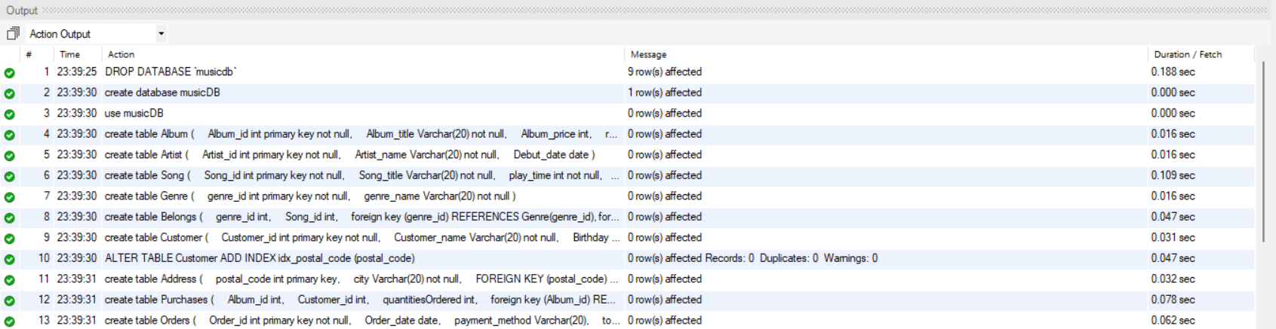
Output Screenshots

Slide 28
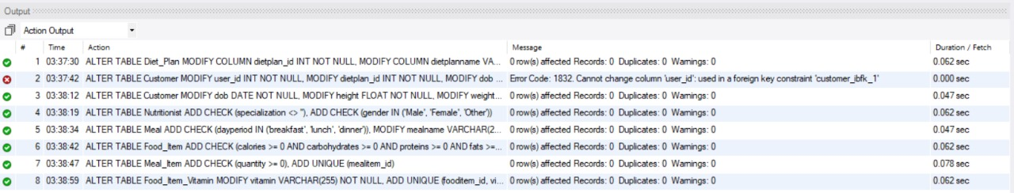
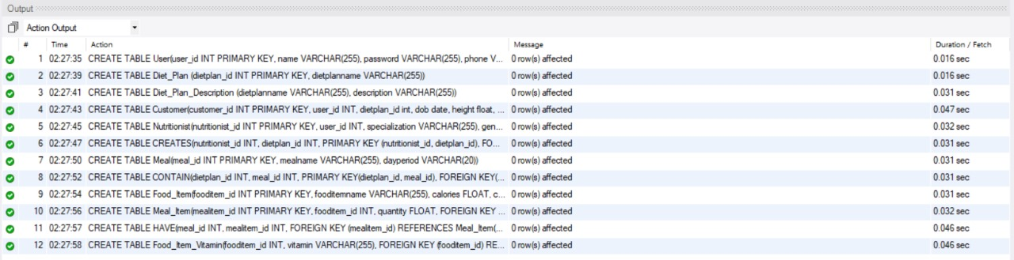
Output Screenshots

Slide 29
Insert sample values into Album table
insert into Album (Album_id,Album_title,Album_price,release_date) values(7701,"MELODY_HITS",500,"2002-05-20"), (7823,"AR_RAHMAN_HITS",1500,"2013-06-10"), (7093,"PAWAN_KALYAN_HITS", 25000, "2019-11-13"), (7983, "THAMAN_HITS",400, "2005-08-11"), (7121, "DSP_HITS" ,1500 ,"2008-07-07"), (7345, "MAD_HIT_SONGS", 2000,"2020-12-08");

Slide 30
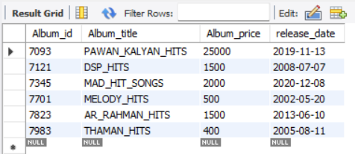
select * from Album;

Slide 31
Insert sample values into Artist table
insert into Artist (Artist_id,Artist_name,Debut_date) values
(8769,"BALASUBRAMANYAM","1981-05-20"), (8469,"AR_RAHMAN","1982-06-10"), (8596,"ANIRUDH","1981-11-13"), (8367, "THAMAN","1982-08-11"), (8473, "DSP","1982-07-07"), (8639, "BHEEM","1981-12-08");

Slide 32
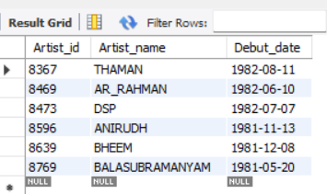
select * from Artist;

Slide 33
Insert sample values into Song table
insert into Song (Song_id,Song_title,play_time,Album_id,Artist_id)values
(9769,"BALAPAMPATTI",189,7701,8769), (9469,"AGAR_TUM_SATH_HO",256,7823, 8469), (9596,"WHY_THIS_KOLEVERI", 90, 7093, 8596), (9367, "AKANDA",110,7983, 8367), (9473, "OH_MADHU" ,153,7121, 8473), (9639, "SWATHI_REDDY",152,7345, 8639);

Slide 34
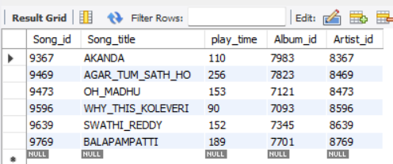
select * from Song;

Slide 35
Insert sample values into Genre table
insert into Genre (genre_id,genre_name) values
(1769,"MELODY"), (1469,"ROMANTIC"), (1596,"RAP"), (1367, "MIX"), (1473, "MASS"), (1639, "JUST_FEEL");

Slide 36
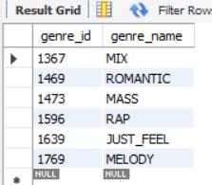
select * from Genre;

Slide 37
Insert sample values into Belongs table
insert into Belongs (genre_id,Song_id) values
(1769,9769), (1469,9469), (1596,9596), (1367,9367), (1473,9473), (1639,9639);

Slide 38
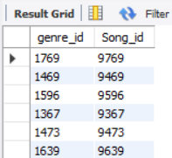
select * from Belongs;

Slide 39
Insert sample values into Customer table
insert into Customer (Customer_id,Customer_name,Birthday,Phone_Number,postal_code)values(3769,"MADHAVAN","2004-03-21","4567890123",534101), (3469,"VEERENDRA","2005-04-07","5678901234",533342), (3596,"ISSAC", "2004-08-01","7890123456",502355), (3367, "TEJA","2003-09-07","8901234567",532201), (3473, "SRINIVAS","1986-09-25" ,"9012345678",531001), (3639, "CHANDU","1999-10-17","3456789012",535001);

Slide 40
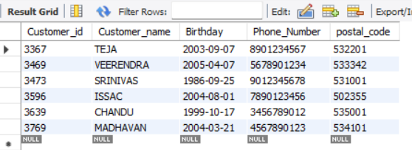
select * from Customer;

Slide 41
Insert sample values into Address table
insert into Address (postal_code,city)values(534101,"TADEPALLIGUDEM"), (533342,"ANAPARTHI"), (502355,"VIJAYAWADA"), (532201, "TEKKALI"), (531001, "ANAKAPALLI"), (535001, "VIZIANAGARAM");

Slide 42
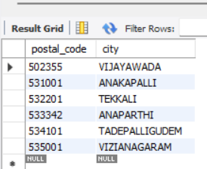
select * from Address;

Slide 43
Insert sample values into Purchases table
insert into Purchases (Album_id,Customer_id,quantitiesOrdered)values(7701,3769,5), (7823,3469,2), (7093,3596,0), (7983,3367,6), (7121,3473,10), (7345,3639,6);

Slide 44
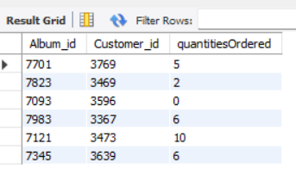
select * from Purchases;

Slide 45
Insert sample values into Orders table
insert into Orders (Order_id,Order_date,payment_method,total_price,Customer_id)values
(4769,"2023-09-08","COD",2500,3769), (4469,"2024-01-02","UPI",500, 3469), (4596,"2020-07-15", "COD", 1032, 3596), (4367, "2021-09-09","RUPAY",561, 3367), (4473, "2022-10-09" ,"RUPAY",861, 3473), (4639, "2023-01-10","UPI",259, 3639);

Slide 46
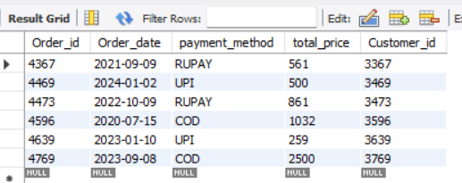
select * from Orders;

Slide 47
CONCLUSION
In conclusion, the implementation of a music management system offers significant advantages for S Record and its operations. By centralizing data and automating processes, the system enhances efficiency, improves data integrity, and provides valuable insights through analytics. Additionally, personalized user experiences and robust security measures contribute to customer satisfaction and trust in the platform. With scalability to accommodate growth and adaptability to evolving industry needs, the music management system positions S Record for long-term success in the competitive online music market. Through continuous refinement and innovation, S Record can leverage its enhanced data management practices to drive business growth, foster artist collaborations, and deliver exceptional music experiences to its customers.

Slide 48
Thank You

