Slide 1
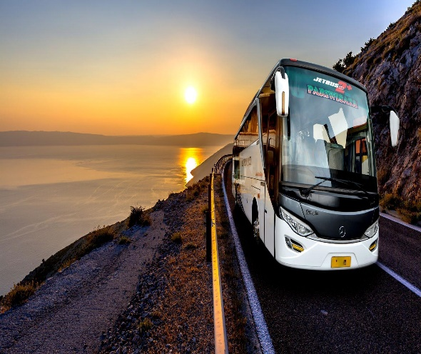
BUS RESERVATION SYSTEM
A
Capstone Project
On
Batch-2
Developed By:-
Siva Lahari
Nishitha
Veerendra
Anil
Aditya
Prakash

Slide 2
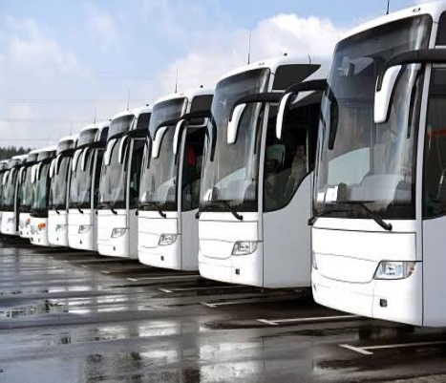
Contents
Introduction.
Objective of the project
Aim and Goals To Be Achieved
System Requirements
Technologies Used
Admin Modules & Customer Modules
Problem Statement
Solution
Screenshots of the project
Future Scope

Slide 3
Introduction
Traveling is a large growing business across all countries.
The focus of the project is to computerize traveling company to manage data, so that all the transactions become fast and there should not be any error in transaction like calculation mistake, bill generation and other things.
It replaces all the paper work. It keeps records of all bills also, giving to ensure 100% successful implementation of the computerized Bus reservation system.
This reservation system has three modules.
First module helps the customer to enquire the availability of seats in a particular.
Second module helps him to reserve a ticket.
Using third module we can cancel a reserved ticket.
we can reserve tickets from any part of the world, through telephone lines, via internet.

Slide 4
Objective of the Project
The main objective of the proposed system” Bus Reservation System” is to eliminate the manual reservation system. Making the reservation system, fast, user friendly avoid the unnecessary delay in reservation.
Aim and Goals To Be Achieved
Conserve data safely
Reduce time in transactions.
Creating a login for administrator, which should be easy to manage.
Facilitating the administrator to view the approved request list.
Add or delete the customer/bus list.
Enter the route and, bus timings.
Cancellation of the bus seats.

Slide 5
System Requirements
Hardware
Software
Intel processor
Ram : 4 GB or Above
Eclipse
Java 1.8
Front-End Using Angular, Bootstrap5 ,Html 5, CSS

Slide 6
Technologies Used
Spring boot.
Angular 13.
CSS3.
HTML5.
JSP.
JPA( Java Persistence API).

Slide 7
Admin Modules & Customer Modules
Admin
Customer
Update Reservation
Update Route
Update Bus
Registration
Login
Bus Availability Enquiry
Make Reservation
Cancel Reservation
Wallet payment

Slide 8
Problem Statement
In today’s world of bus transportation many private bus transportation company have traditional approach of managing work on paper which seems to be money and time consuming. Also not guaranteed that all transaction to be error free and may lead to many calculation mistakes in bill generation and costing.
Solution
The method to solve this problem is to create an online booking bus ticket system. Customer can buy the book ticket over the Internet, 24 hours a day, 7 days a week and the bus ticket can't be lost, stolen or left behind.
In addition, the online system lets the customers check the availability of the bus ticket before they buy bus ticket.
Furthermore, customers no need to pay cash to buy bus ticket because they can pay the bus ticket on the traveling time.

Slide 9
Screenshots of Customer Modules

Slide 10
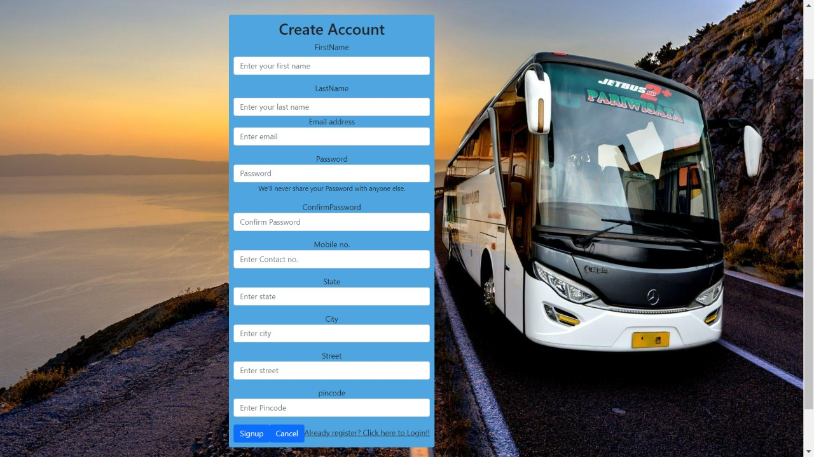
Registration

Slide 11
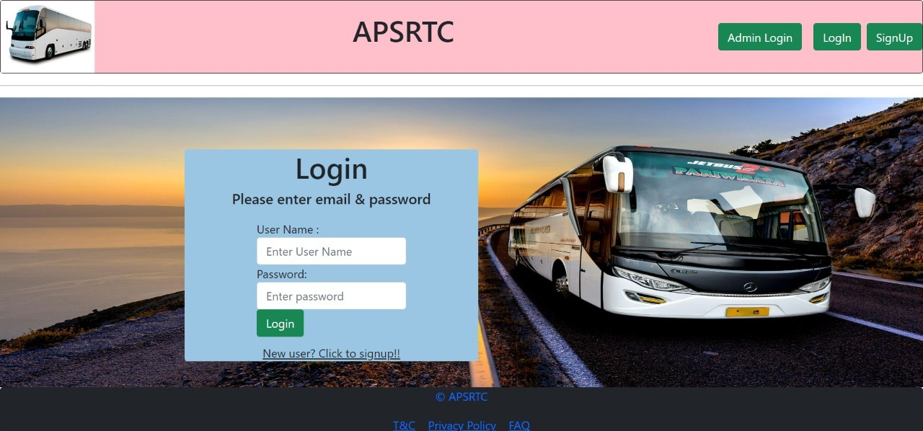
Login Page

Slide 12
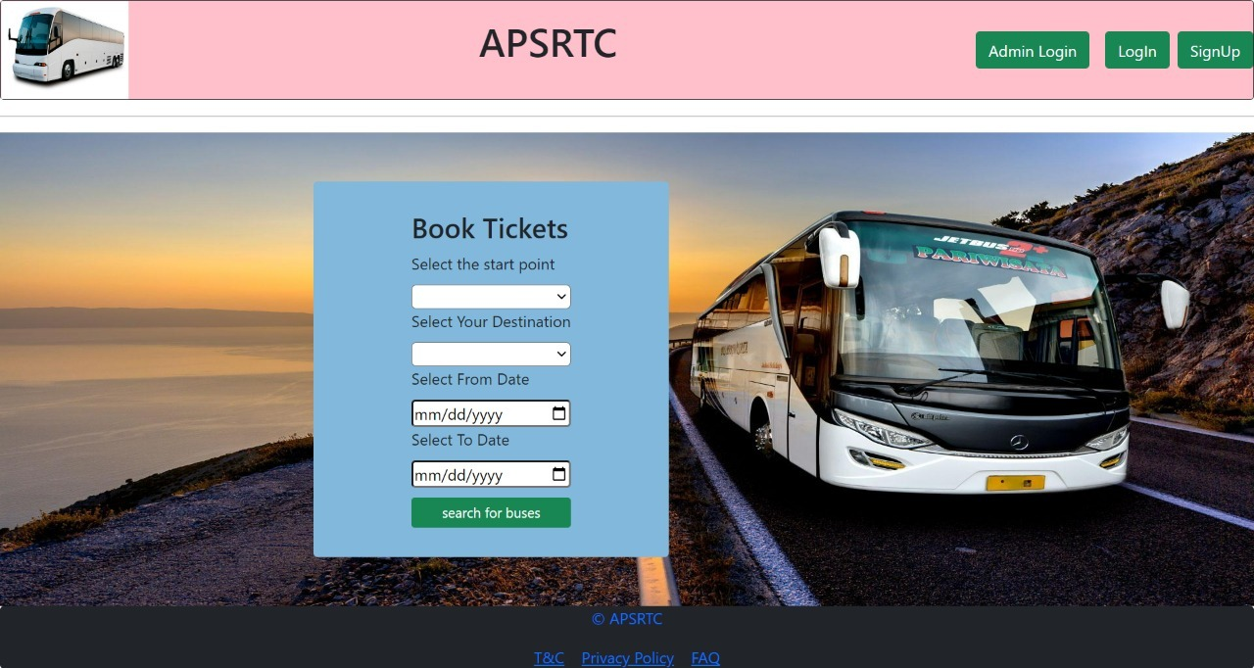
Book a Ticket

Slide 13
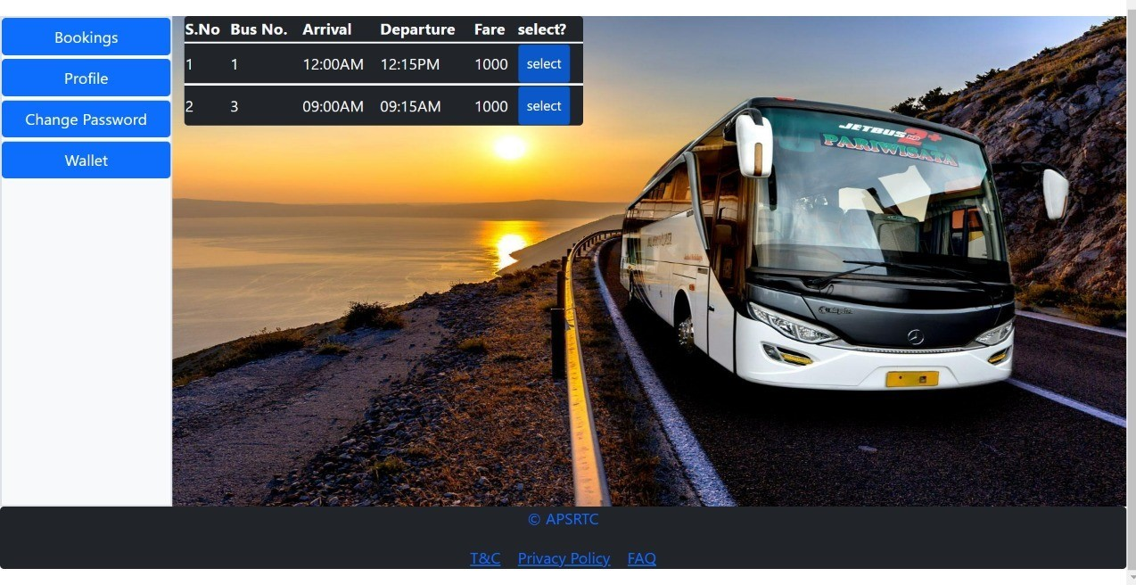
Bus Availability

Slide 14
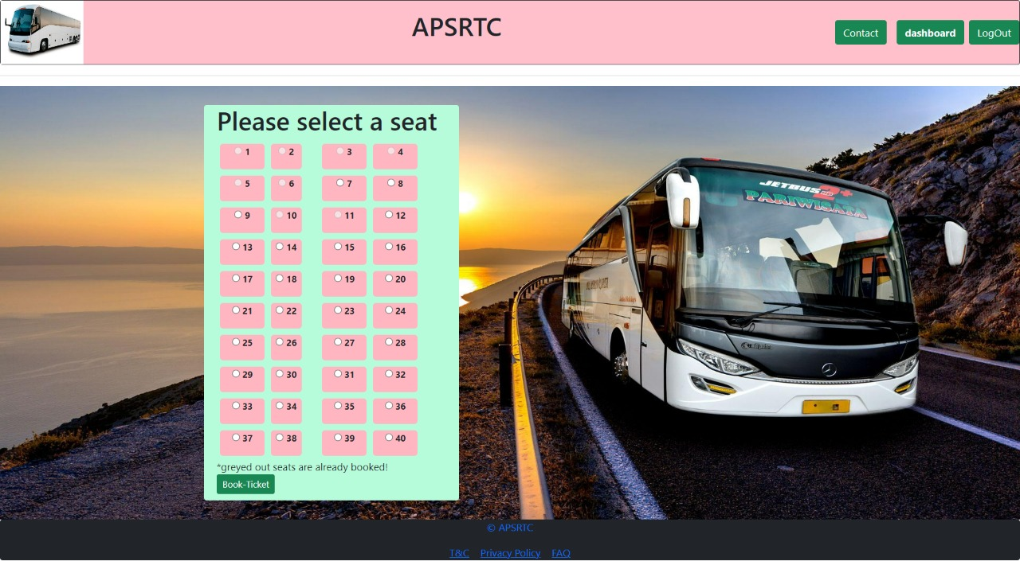
Seat Availability

Slide 15
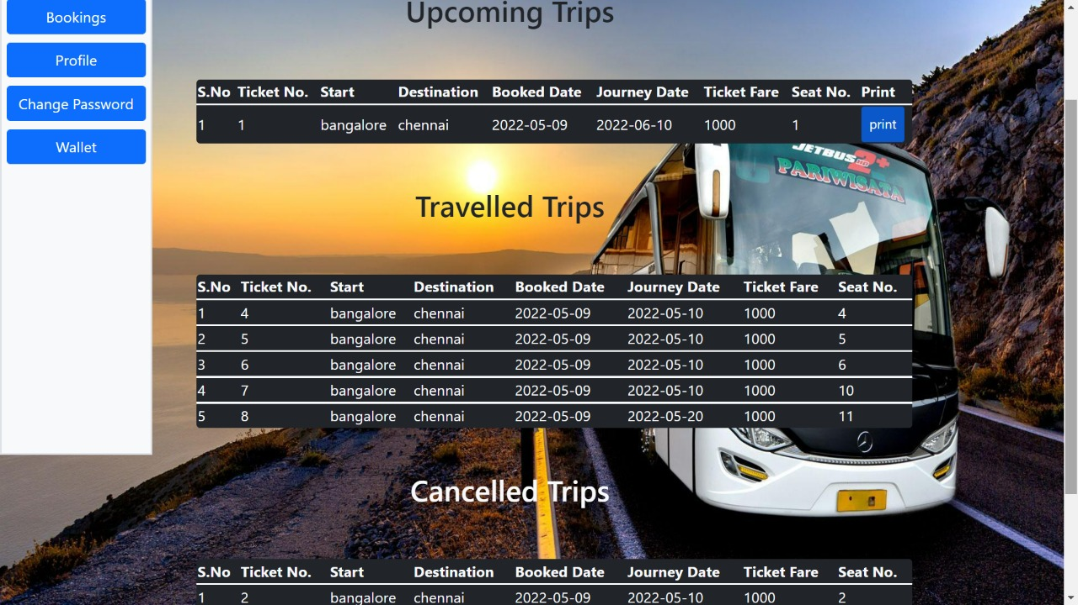
Bookings

Slide 16
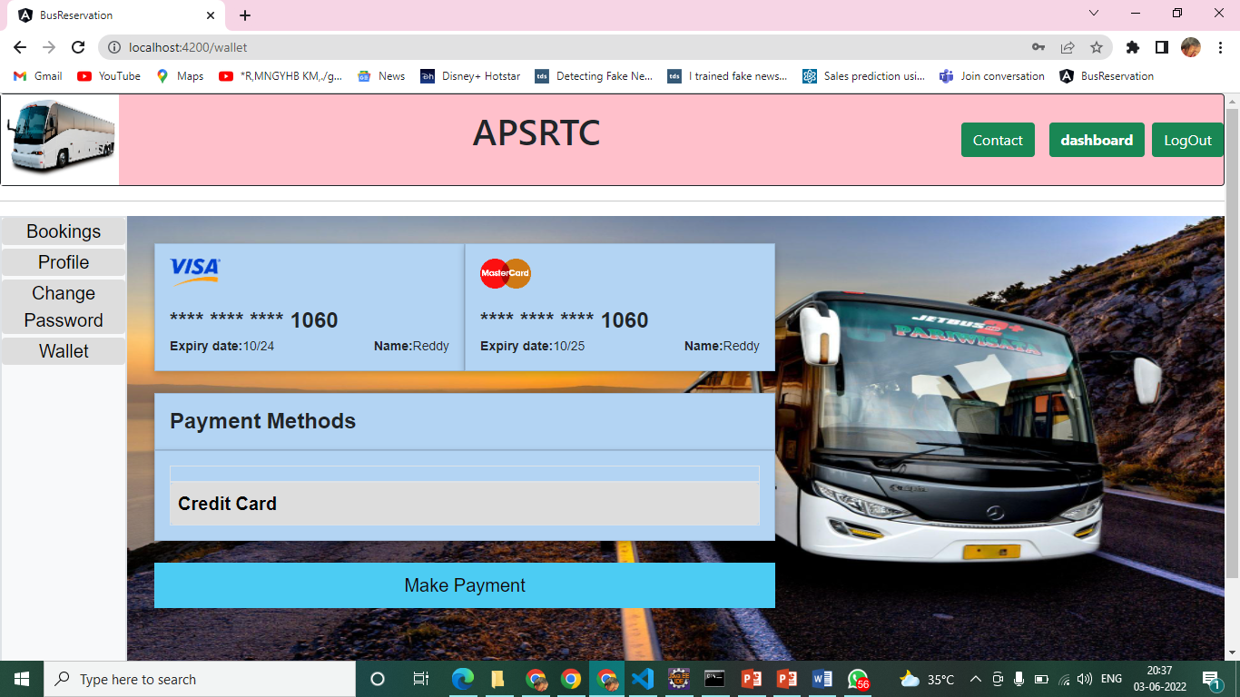
Wallet Payments

Slide 17
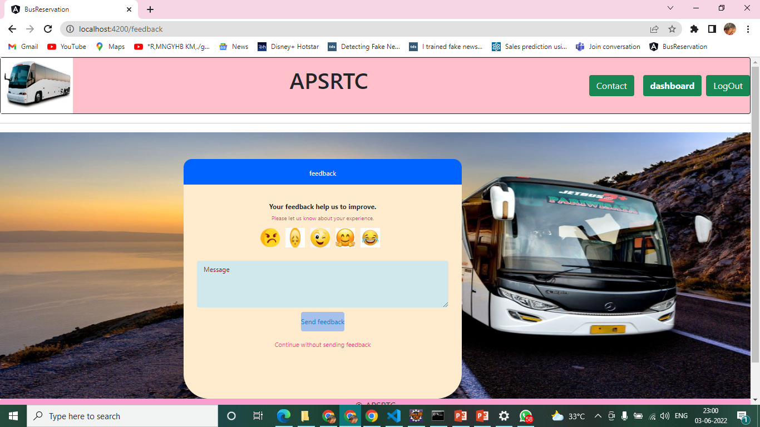
Feedback Form

Slide 18
Screenshots of Admin Modules

Slide 19
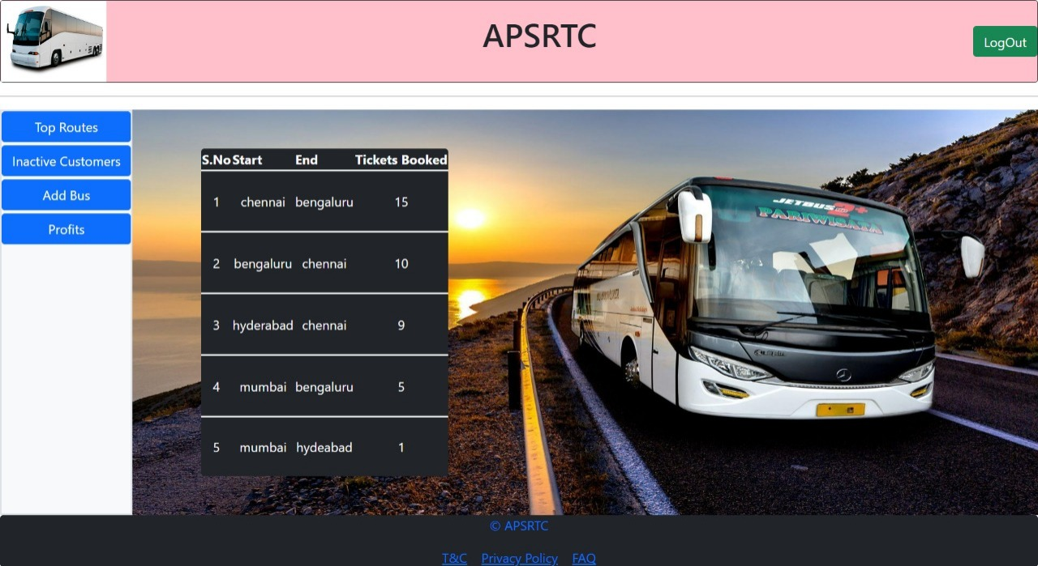
Frequently Travelled Routes

Slide 20
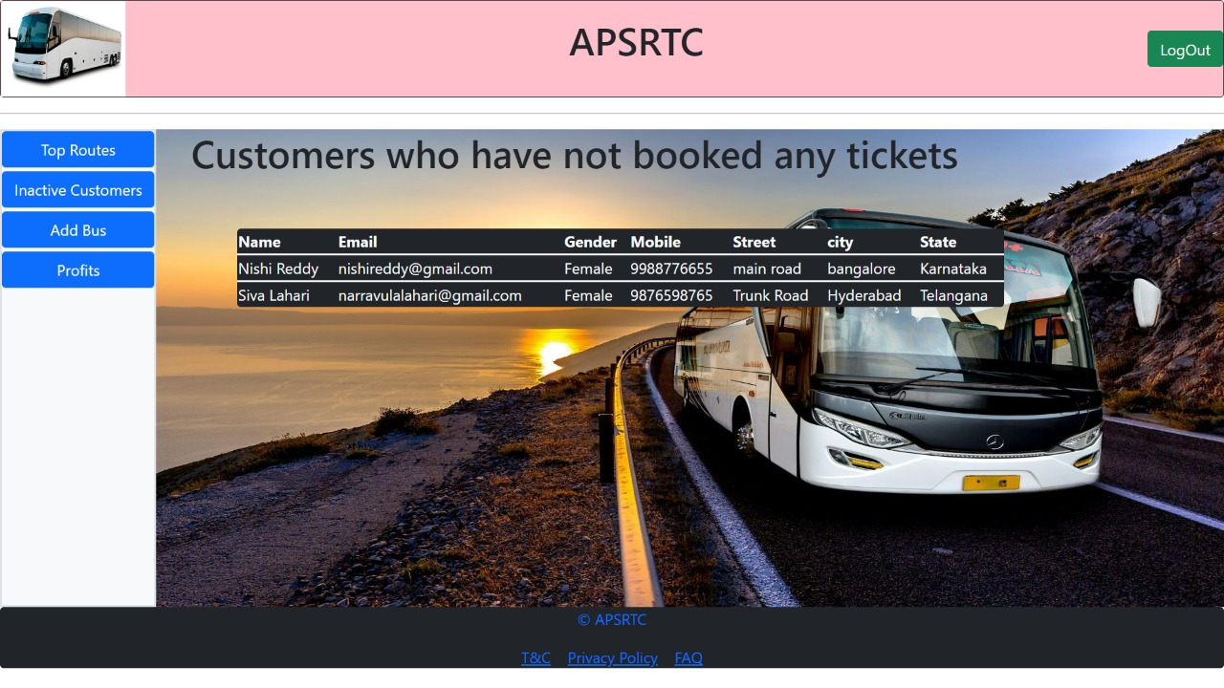
customer who has registered but not made any reservation

Slide 21
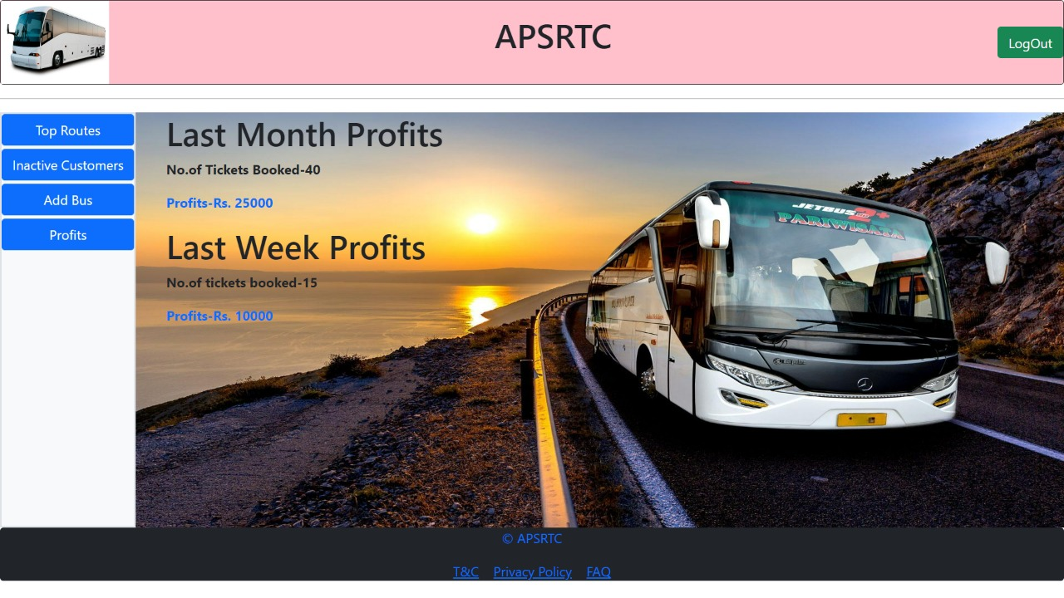
Last month record and profits.

Slide 22
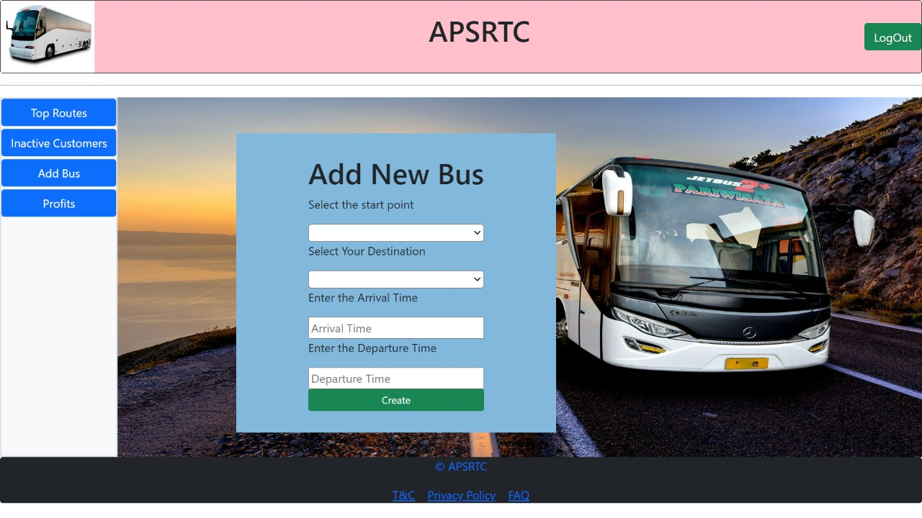
Adding New Bus

Slide 23
Future Scope
To allow the admin message the clients within the system.
Integrating the system with Digital card for customers to make payments using the system.
Implementing tracking system for the clients to track the Bus.
Notification System, Chat Functionality

Slide 24
Thank You

