Slide 1

Valina Veerendra
Final Project

Slide 2

KEYLOGGER AND SECURITY
Understanding Keylogging Threats and Protection Strategies

Slide 3

AGENDA
Introduction
Problem Statement
Problem Overview
End Users
Solution and Value Proposition
The “wow” Factor in Our Solution
Modelling
Results
This Photo by Unknown Author is licensed under CC BY-NC

Slide 4

PROBLEM STATEMENT
Problem:
Keylogger pose significant risks to both individuals and
organizations, including data theft, privacy invasion, and
financial loss.
Impact:
Affect individuals and organizations by compromising security,
leading to identity theft, financial loss, and data breaches

Slide 5
PROJECT OVERVIEW
This project explores the nature of keyloggers, their impact on security, and effective countermeasures.
Includes analysis of current keylogger detection and prevention techniques
Aimed at educating users about keylogging threats and enhancing cybersecurity practices.

Slide 6

WHO ARE END USERS
1. Individual Internet Users:
General public who use the internet for personal activities such as browsing, online shopping, social networking, and banking.
2. IT Professionals and Cybersecurity Experts:
Specialists responsible for maintaining and securing IT infrastructure.
3. Businesses and Organizations:
Small to large enterprises that rely on computers and networks for their daily operations.
4. Government and Educational Institutions:
Public sector organizations and educational entities handling a vast amount of sensitive and personal data.

Slide 7
YOUR SOLUTION AND ITS VALUE PROPOSITION
SOLUTION:
Utilize advanced algorithms to monitor and detect keylogging activities as they happen.
Combines multiple security measures (e.g., heuristic analysis, signature-based detection) to provide robust protection.
Ensures the software is always up-to-date with the latest security patches and keylogger definitions
VALUE PREPOSITION:
Reduces the risk of sensitive data being captured by keyloggers, thus safeguarding personal
Provides educational resources and alerts that help users recognize and avoid potential threats.

Slide 8

THE “WOW” IN YOUR SOLUTION
Innovative real-time keylogger detection algorithms.
User-friendly interface for non-technical users.
Comprehensive and regularly updated threat database.
Integration with existing cybersecurity tools for seamless protection.

Slide 9

MODELLING
The keylogger is modelled using the keylogger python program. This keylogger uses the ‘ pynput ’ library to capture press, hold, and release events. Keys are categorized as pressed, held, or released. It listens for key events using ‘ pynput.keyboard.listener ’ and logs are saved in “key_log.txt” and “ key_ log.json ”. The GUI includes a buttons such as ‘start’ button which initializes a listener and ‘stop’ button which disable it. The text logging appends events to “ key_log.txt ” with key state and JSON logging appends events to “ key_log.json ” with structured data. This keylogger monitors user activity, analyses keystroke dynamic for security.

Slide 10
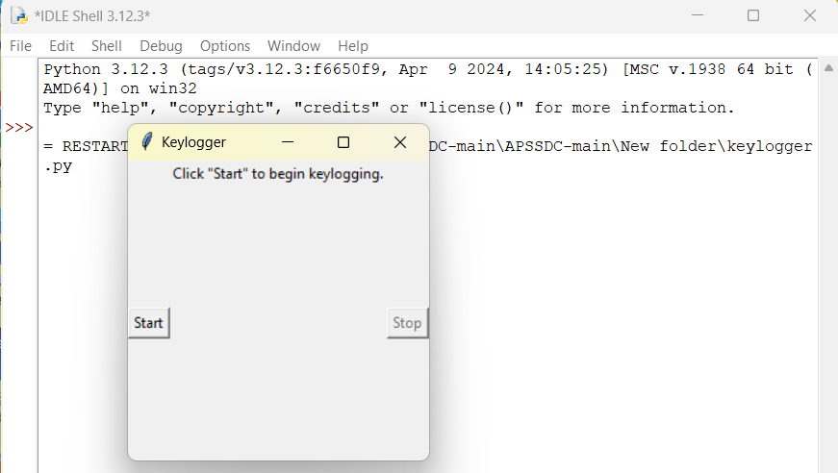
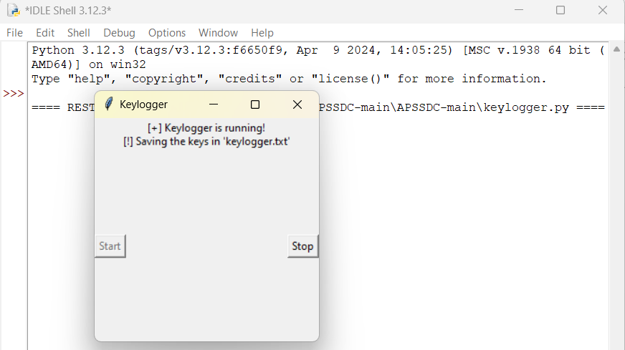
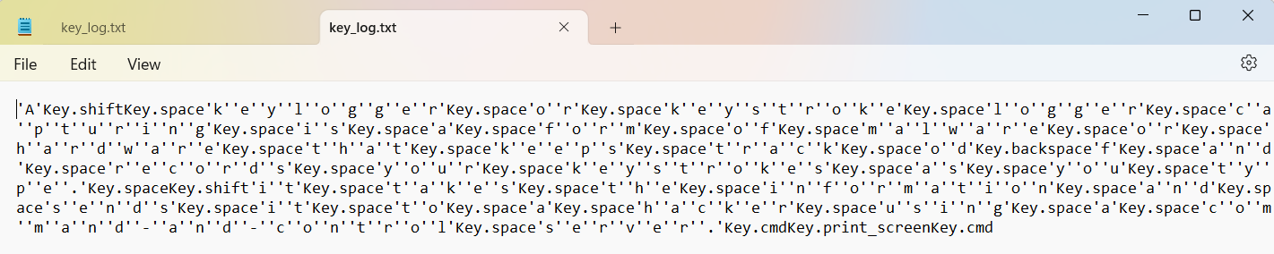
RESULTS
Screenshots of Keylogger GUI
Key _ log.txt

Slide 11
CONCLUSION:
The keylogger project is successfully completed. In this project, successfully developed a robust keylogging system that captures and logs keystrokes into text and JSON files and Implemented real-time keylogging, allowing users to monitor activities as they happen. The user-friendly GUI made controlling the keylogger intuitive and accessible for all users. Added start and stop controls within a straightforward GUI, enhancing usability and making keylogging operations easy to manage. This project demonstrated the system's capability to capture and log keystrokes in real-time effectively and emphasized the importance of ethical use and the need for robust security measures to prevent misuse and protect user privacy.

Slide 12
PROJECT LINK
https://github.com/veerendra718/Keylogger-project.git

