Slide 1


Slide 2
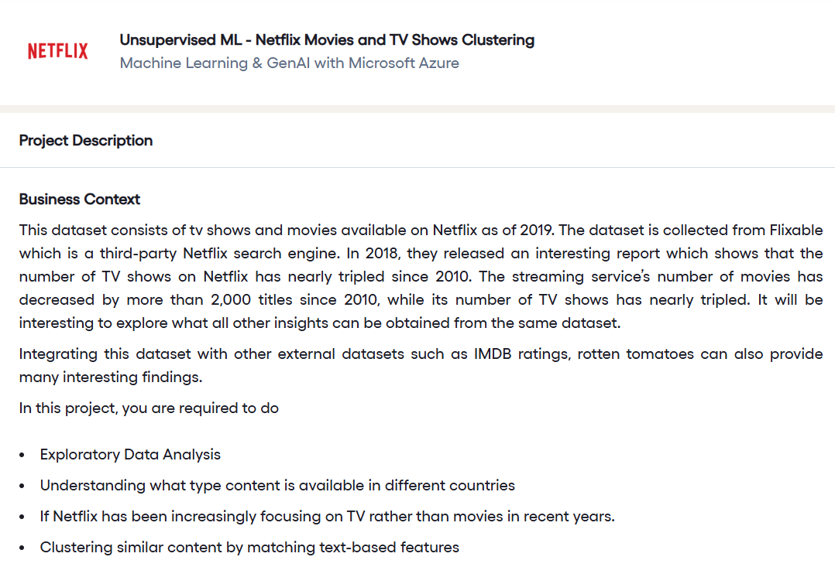

Slide 3
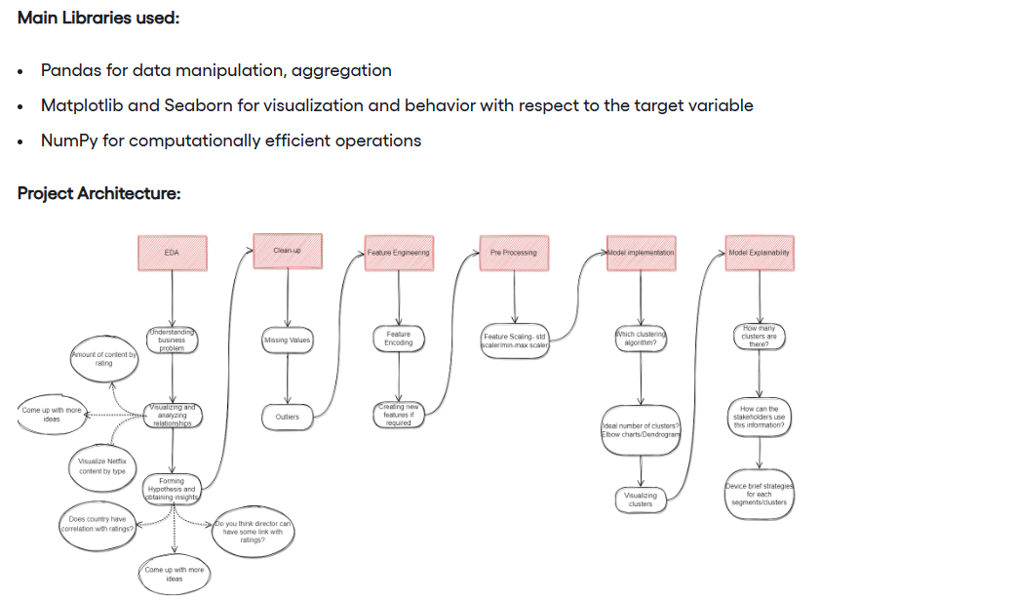

Slide 4
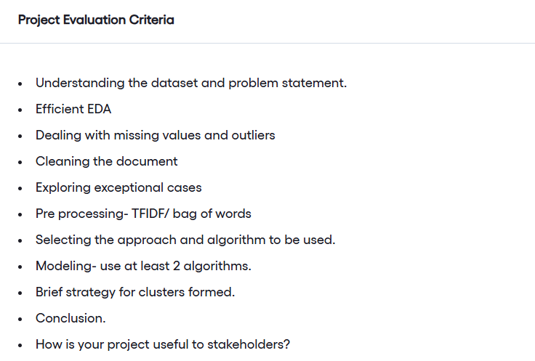

Slide 5
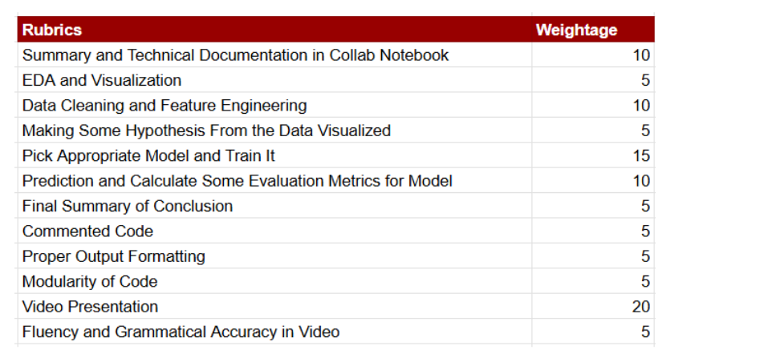

Slide 6
https://drive.google.com/file/d/1xJGllnE12mAggLuRo8b0oNSshUlG8GvF/view

