Slide 1
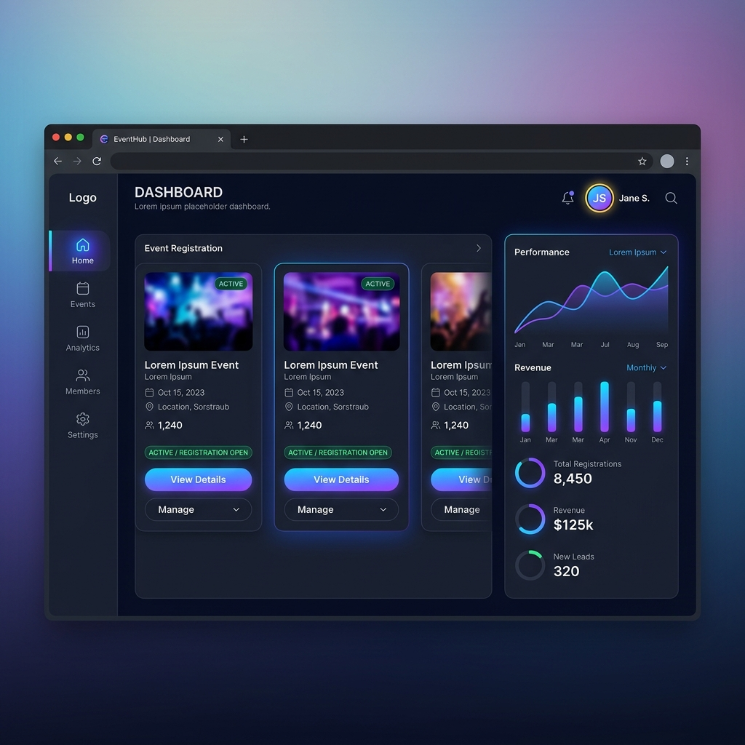
EventHub — The Future of Event Management
A Production-Ready Platform for Discovering and Managing Events
Presented by: [Your Name]

Slide 2
Problem Statement
The Challenge in Event Management:
• Fragmentation: Multiple tools for registration, ticketing, and analytics.
• Complexity: Setting up custom registration forms is often technical.
• Engagement: Lack of built-in social tools like reviews and discussions.
• Verification: Manual check-ins are slow and error-prone.

Slide 3
The Solution — EventHub
An Integrated Ecosystem:
• Single Point of Truth for organizers and attendees.
• Automated Workflow: From discovery to QR-code entry.
• Data-Driven: Real-time insights for organizers.
• AI-Enhanced: Smart discovery via natural language.

Slide 4
Key Features
🎫 QR-Powered Ticketing: Secure entry verification.
📈 Organizer Dashboard: Live revenue and registration charts.
📝 Custom Forms: Adaptive questions per event.
📧 Notifications: Automated registration and reminder emails.
💳 Payments: Razorpay and 'Pay at Venue' support.

Slide 5
System Architecture
• Backend Core: Django 5.1 & Python 3.12
• Database Layer: PostgreSQL for robust data
• Media Storage: Cloudinary integration
• Frontend: Clean design with Bootstrap 5
• AI Integration: Google Gemini API Assistant

Slide 6
User Onboarding Flow
[Insert Flow Diagram A from presentation_content.md here]

Slide 7
Event Booking & Ticketing Flow
[Insert Flow Diagram B from presentation_content.md here]

Slide 8
Organizer Experience
• Revenue Overview: Visual breakdown of ticket sales.
• Attendee Insights: Exportable CSV lists.
• Performance Tracking: Analytics at a glance.
• Effortless Management: Complete CRUD for events.

Slide 9
AI Discovery Engine
Concept: Hybrid Assistant (DB Queries + AI Reasoning)
• Natural Language Discovery ('What's on this weekend?')
• Process Guidance: Helping users with registration.
• Context Awareness: Location-based responses (Kalaburagi).

Slide 10
Conclusion & Roadmap
Current State: Stable, Production-Ready.
Future Goals:
• Google Calendar Integration
• Native QR Scanner Mobile Apps
• Multi-lingual support

