Slide 1
Paper Title: Meeting Summarizer: AI Tool that Converts Meeting Transcripts into Action Plans Paper Id: 104
Track: Artificial Intelligence, Machine Learning, Blockchain, and Cybersecurity for Secure Social Systems
Presented by
Dr. D. Dhinakaran, K. Veeresh, E. Nandu Royal
Dept. of CSE, Vel Tech University, Chennai, India

Slide 2
Content
Introduction
Literature Survey
Problem Statement
Proposed Model
Methodology
Results & Discussion
Conclusion & Future Work
References

Slide 3
Introduction
Virtual and hybrid work environments have sharply increased meeting frequency and volume
Meetings generate large amounts of unstructured conversational data
Participants struggle to recall decisions, track responsibilities, and follow up on tasks
Existing tools provide only verbatim transcripts or generic summaries
Critical tasks and decisions often get lost in lengthy transcripts
A need exists for automated, structured, action-oriented meeting intelligence

Slide 4
Problem Statement
Current meeting tools lack structured outputs such as action plans, ownership, and deadlines
Transcription-only systems create high cognitive load — users must manually review transcripts
Summarization tools produce descriptive, not action-oriented, outputs
ML-based action extraction systems are siloed — not integrated with speech and NLP pipelines
Limited multilingual support and privacy concerns in cloud-based deployments
Objective
Design an end-to-end AI system that converts unstructured meeting transcripts into structured, actionable plans with owner and deadline attribution

Slide 5
Related Work
A. Transcript-Based Documentation Systems
Early ASR tools improve accessibility but require manual review to identify key points
No structured outputs, accountability, or task attribution [1]
B. Meeting Summarization Approaches
Extractive: select salient utterances by statistical/linguistic features
Abstractive: transformer models generate concise summaries (e.g., BERT, T5) [2][3][4]
Summaries are descriptive, not action-oriented — still require human interpretation
C. ML-Based Action & Decision Extraction
Dialogue act classification and intent detection studied in prior work [7][10]
Limited by small datasets, lack of multilingual support, and no integration with STT

Slide 6
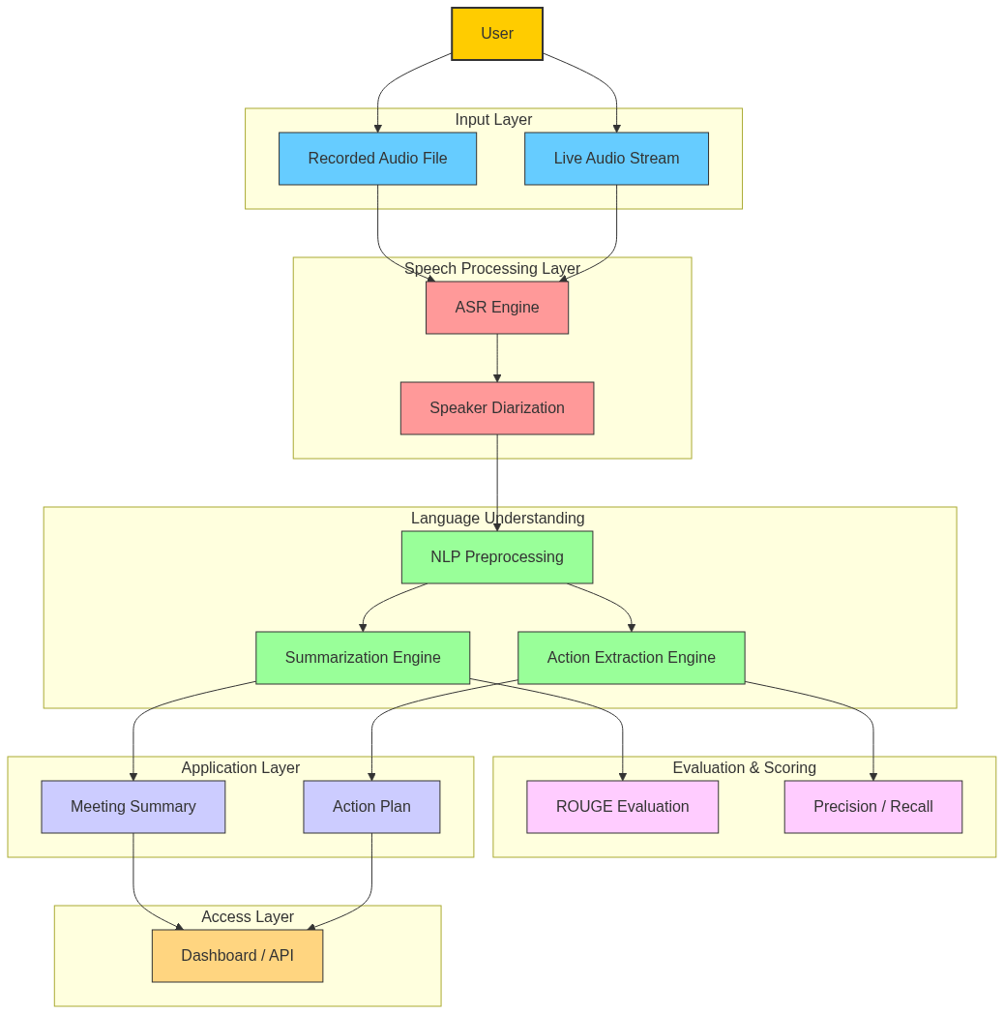
Proposed Model
End-to-end AI system: Speech-to-Text → NLP Pipeline → Summarization → Action Extraction
Key Modules
Audio Processing & Transcription: ASR engine with multilingual support and timestamps
Speaker Identification: Labels utterances to enable per-speaker attribution
NLP Pipeline: Normalisation, sentence segmentation, NER, discourse categorisation
Summarization Engine: Transformer-based, contextual, multi-level meeting summary
Action Plan Generator: Extracts tasks, assigns owners, detects deadlines
Modular, privacy-conscious architecture — supports cloud and local deployment

Slide 7
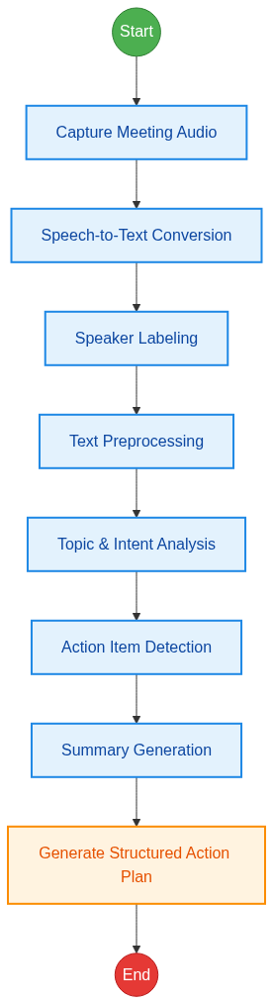
System Workflow
End-to-End Pipeline
1. Audio Acquisition — live stream or recorded file
2. Transcription & Speaker Labeling — STT with speaker-aware output
3. Content Analysis — NLP categorises utterances: discussion / decision / action
4. Action Extraction — linguistic patterns detect tasks, owners, and deadlines
5. Output Generation — structured summary & action plan via UI or API
Key Advantages
Structured action plans with accountability mapping and deadline detection
Multilingual, speaker-aware, scalable modular design

Slide 8
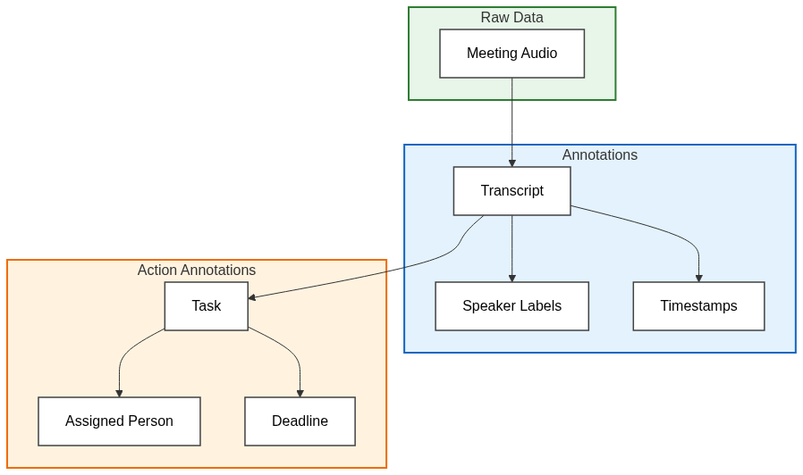
Dataset Description
Meeting Audio & Transcript Dataset
Features: audio_file, speaker_id, timestamp, language, transcript
Enables training of ASR, speaker ID, and summarisation modules
Action Annotation Dataset
Features: utterance, action_type, assigned_to, deadline, confidence_score
Enables training of action extraction and decision identification modules
Preprocessing
Text normalisation, tokenisation, speaker & context encoding, label assignment
80:20 train-test split; Python-based ML frameworks

Slide 9
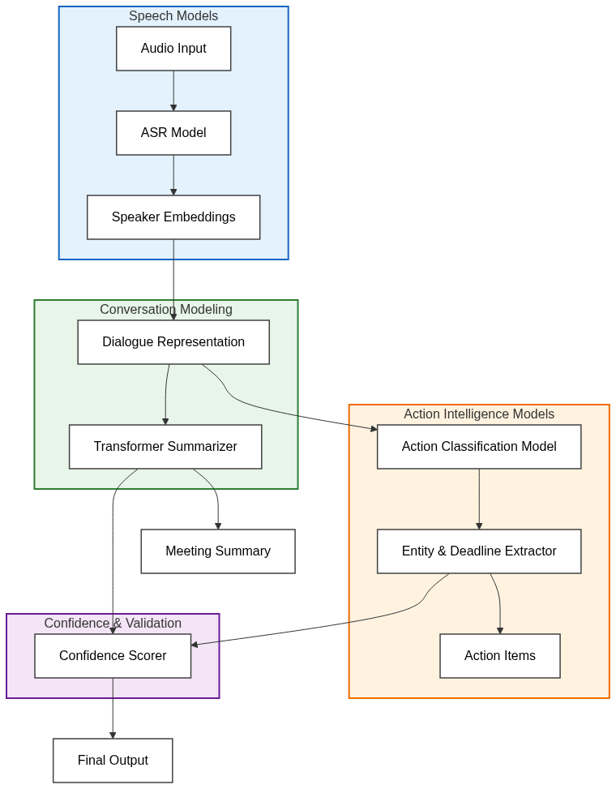
Model Architecture & Implementation
Core Architecture
ASR models → textual transcripts; speaker models → conversational context
Transformer-based NLP for summarisation and semantic understanding
Supervised action extraction model — detects tasks, owners, and deadlines
Implementation
Web application built with Python Flask; input formats: .txt, .doc
Confidence scores associated with each extracted action item
Feedback mechanisms enable iterative refinement of extraction accuracy
Hybrid backend: modular services; supports cloud and local deployment

Slide 10
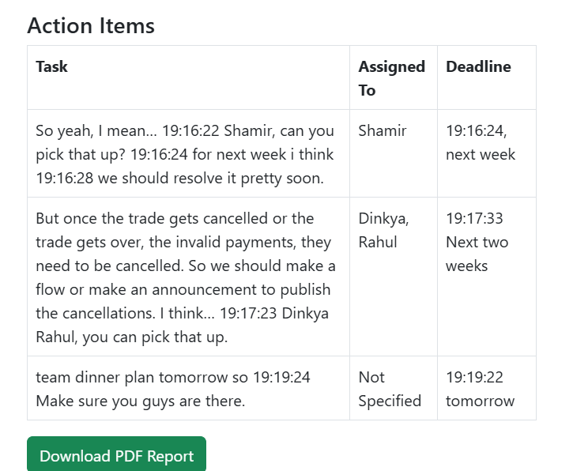
Results & Discussion
Transcription Accuracy (WER)
Average WER: 6.85% | Transcription Accuracy: ~93%
Corporate: 94.53% | Academic: 91.05% | Technical: 93.87%
Summarisation Quality (ROUGE)
ROUGE-1: 0.82 | ROUGE-2: 0.74 | ROUGE-L: 0.80
Action Extraction Performance
Precision: 0.88 | Recall: 0.86 | F1-Score: 0.87
Deadline Detection: 84% | Owner Attribution: 91%
Usability Study
Task identification time reduced by 65% vs. manual transcript review
87% of users reported improved clarity; 91% reported reduced cognitive load

Slide 11
Conclusion & Future Work
Conclusion
Meeting Summarizer converts unstructured transcripts into structured action plans
Integrates STT, transformer summarisation, and supervised action extraction in one pipeline
Achieves 90-95% transcription accuracy, ROUGE 0.75-0.85, 85-90% action extraction F1
User study confirmed 65% reduction in task identification time
Future Work
Expand multilingual datasets and conduct large-scale real-world validation
Develop personalized adaptive summarization models
Integrate with productivity platforms: Microsoft Teams, Slack

Slide 12
Thank You

