Slide 1
<Ngrx>

Slide 2
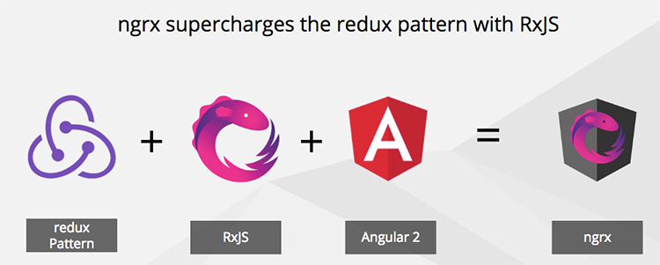
Introduction

Slide 3
Introduction
What is Application State?
Server response date
User information
User input
UI State
Router / location state
What is State Management?
Model our app state
Update state
Read state values
Monitor / observer changes to state

Slide 4
Redux
Three Principles
Single Source of truth
State is read-only
Pure functions update state
Redux Core Concepts
Single State Tree
Actions
Reducers
Effects
Store
One-way dataflow

Slide 5
Actions
Action has two properties
type: string, describes event Actions are objects that extend the NgRx Action class with a ‘type’ property.
payload: optional data They have an optional ‘payload’ property (naming is up to you but the standard is to name it ‘payload’) for sending in data to the effect/reducer and are dispatched by the store to either run an effect or change state in a reducer

Slide 6
Reducer
Reducers are functions which accepts current state as an action and returns new state
To change the store you dispatch an action which is finally handled by reducer
Forbidden in Reducers => Reducers should be pure functions
Mutate state
Perform side effects like API calls, Routing transitions
should not call non-pure functions like date or math.random

Slide 7
Effects
An effect listens for actions that are dispatched, and performs some side effect, usuaully an asynchronous request. The benefit to using effects is that it enables us to isolate our async requests outside of our components, making our components less complex. Now, our components just dispatch actions and listen for values to be emitted from the store when our state changes.

Slide 8
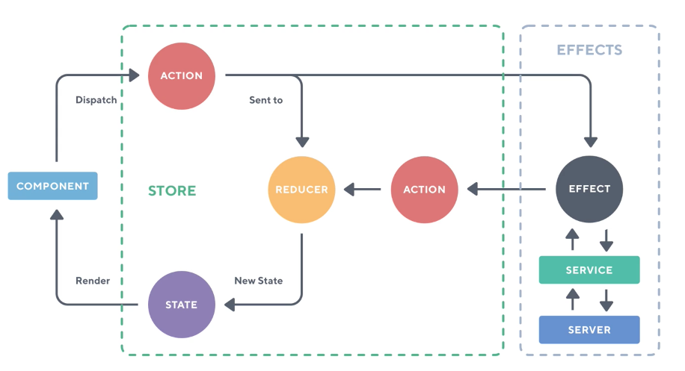
One-way dataflow

