Slide 1
Multi-Classifier System for Face Recognition
Veeresha M Thotigar
Student ID : 1620975
Email ID : vmt9mm@mail.umkc.edu

Slide 2
Face Recognition
Face recognition systems generally divided into two categories:
Identification - set-up the similarity between a given face image and all the face images in a large database is computed, the top match is returned as the recognized identity of the subject.
Verification - set-up the match between a given face image and the face image is computed, the returned result as the authentication of the subject.

Slide 3
ATT - Dataset
The AT&T database is freely downloadable and contains a set of 400 face images (http://www.cl.cam.ac.uk/research/dtg/attarchive/facedatabase.html)
There are ten different images of each of 40 distinct subjects
For some subjects, the images were taken at different times, varying the lighting, facial expressions (open / closed eyes, smiling / not smiling) and facial details (glasses / no glasses)

Slide 4
MCS: Two Experiments​
Multi-classifier System combining PCA and LDA at score level​
Scores of PCA and LDA should be combined using minimum, maximum and average rules. ​
B. Multi-classifier System combining PCA and LDA at decision level​
Scores should be assigned labels (0/1) based a set threshold determined intelligently.​

Slide 5
Method
Face recognition system involves following steps The Acquisition Module, The Pre-Processing Module, The Feature Extraction Module , The Classification Module, Creating Face Database. In this project the first three steps are done by well known PCA and LDA method, further the state of the-art is while selecting the model to classifying the each sample.
Steps:
Here we have used Multi Classifier System (MCS) to combine the power of PCA and LDA, we have computed PCA and LDA, saved the scores for each sample separately.

Slide 6
Method
Mode A: The PCA and LDA scores saved are loaded, calculated the target matrix for 40 samples based on if-else rule, inserted zero-matrix or one-matric. Calculated the maximum, minimum and average scores matrix out of PCA and LDA.
Mode B: The PCA and LDA scores saved are loaded the decision matrix (0/1) is calculated based on the threshold value, calculated the target matrix for 40 samples based on if-else rule, inserted zero-matrix or one-matric.

Slide 7
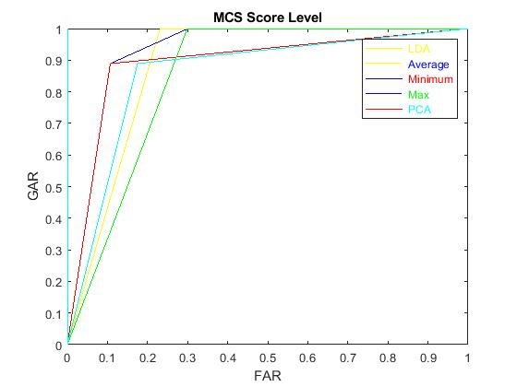
Results - Mode A
Mean values,
FAR - 0.01
FRR - 0.23
GAR - 0.76
GRR - 0.98
Fig : ROC curve

Slide 8
Results - Mode B
 | LDA | PCA | MCS decision level
FAR | 0.17 | 0.17 | 0.05
GAR | 0.88 | 0.88 | 0.94
Accuracy | 0.88 | 0.85 | 0.94
Threshold | 0.002 | 0.002

Slide 9
Conclusion
Mode A
In the field of face recognition system, no doubt stand alone PCA and LDA had set there own benchmarks. The recent findings to combine multi-classes have improved the accuracy of the classifier, by observing the figure ROC curve for MCS at the score level, the Maximum score level performs well, the LDA and PCA are noteworthy, later comes the minimum score and average score level MCS.
Mode B
It is clear that accuracy of MCS (decision rule) is better than PCA and LDA .

