Slide 1
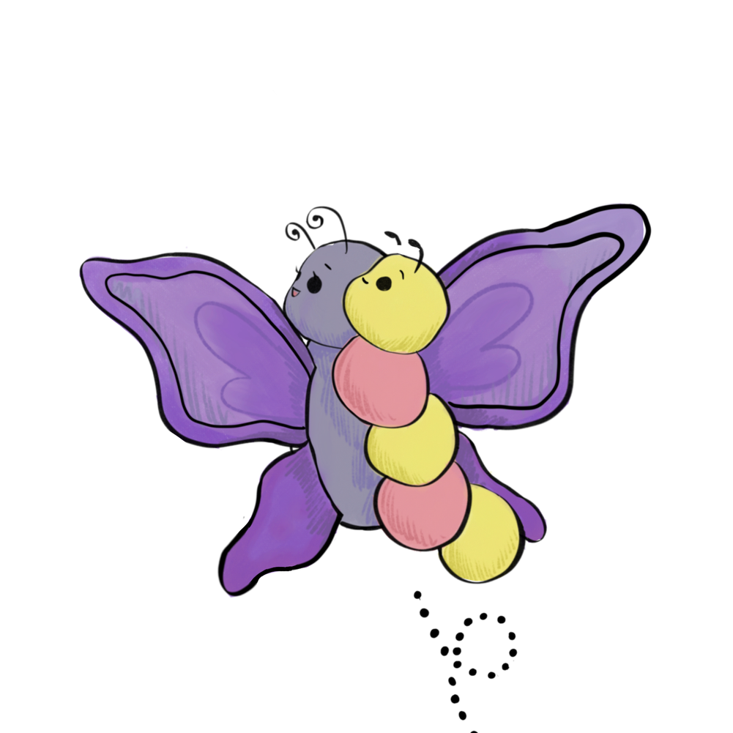


What is Neurodiversity?
Everyone thinks differently. The person sitting next to you might see the world in a completely different way! Neurodiversity is the idea that these differences are normal and are not a problem.
Common Examples of Neurodiversity
What is Autism?
What are autism’s strengths?
STANFORD NEURODIVERSITY PROJECT

Slide 2
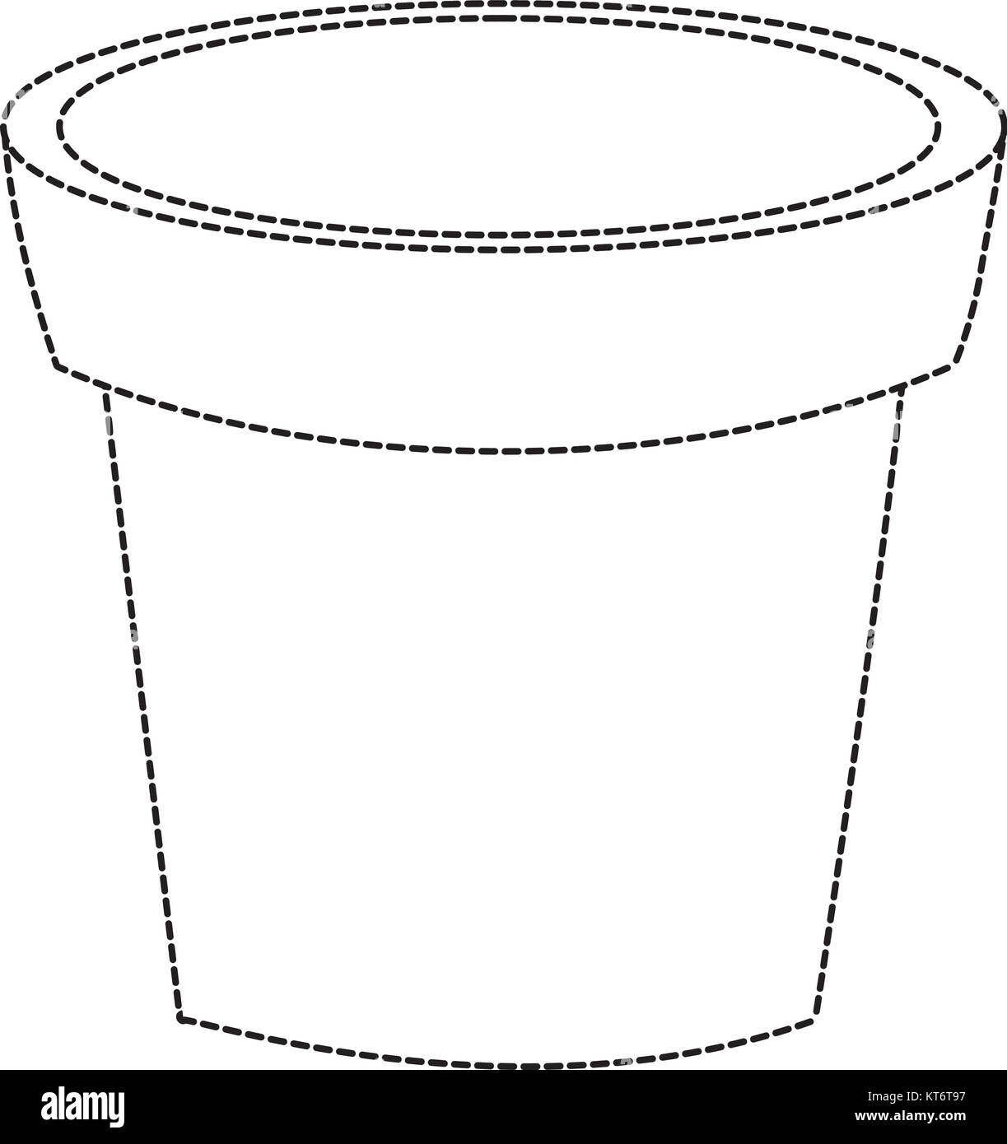
Accommodating Difference
Exercise 1: Brain Garden
Quiet Space Fidget Toy Extra Time
Draw 3 different plants. Then, under each plant, write one thing they need. Pick from the box above.
_____________ ______________ _____________
Different brains need different things to learn and grow.
Concept 2: Fair or Equal
Fair
Equal
Fair means everyone gets what they need to succeed
Equal means everyone gets the exact same thing
STANFORD NEURODIVERSITY PROJECT

Slide 3

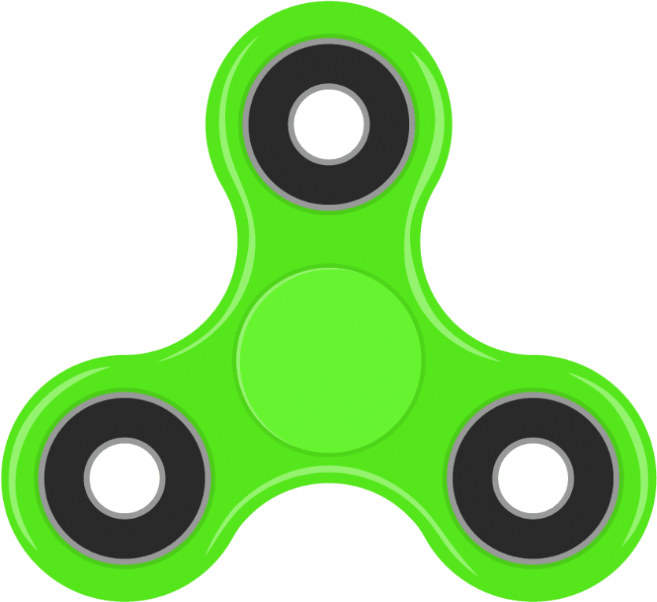
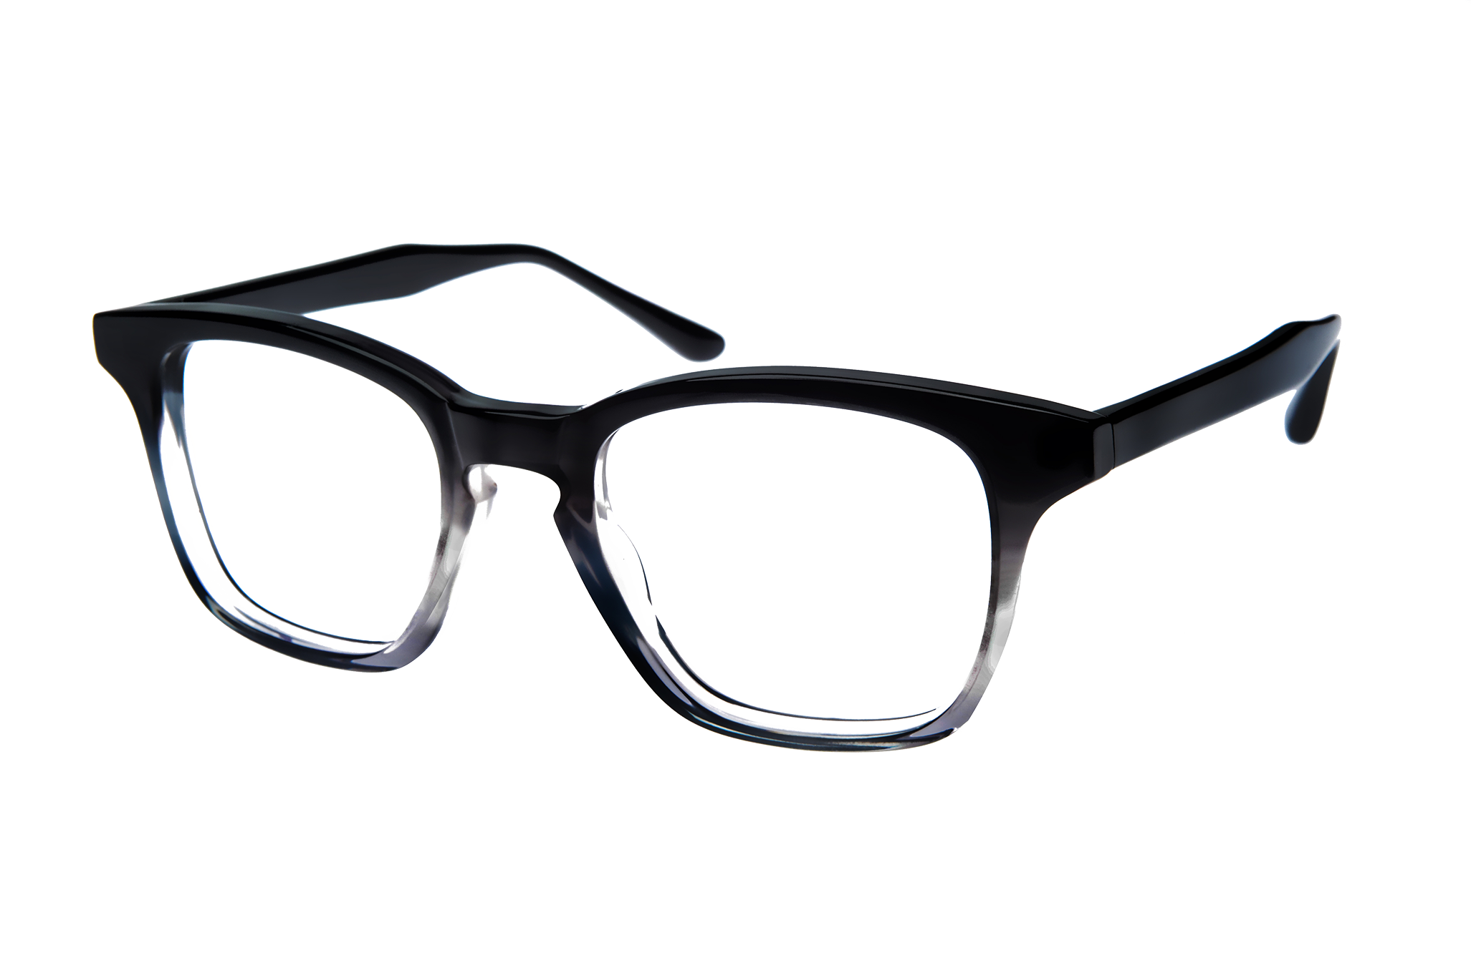
Concept 2: Fair or Equal
Fair
Equal
Giving the student with small feet small shoes, and the student with big feet big shoes. They didn't get the "same" thing, but they both got what they needed to go for a run.
Giving every single student a pair of size 7 shoes, even if some have bigger or smaller feet. It’s the same for everyone, but it might not work for everyone.
Exercise 2: Matching
Match the student with their specific need!
Fair means everyone gets what they need to succeed, not everyone gets the same thing.
STANFORD NEURODIVERSITY PROJECT

