Slide 1

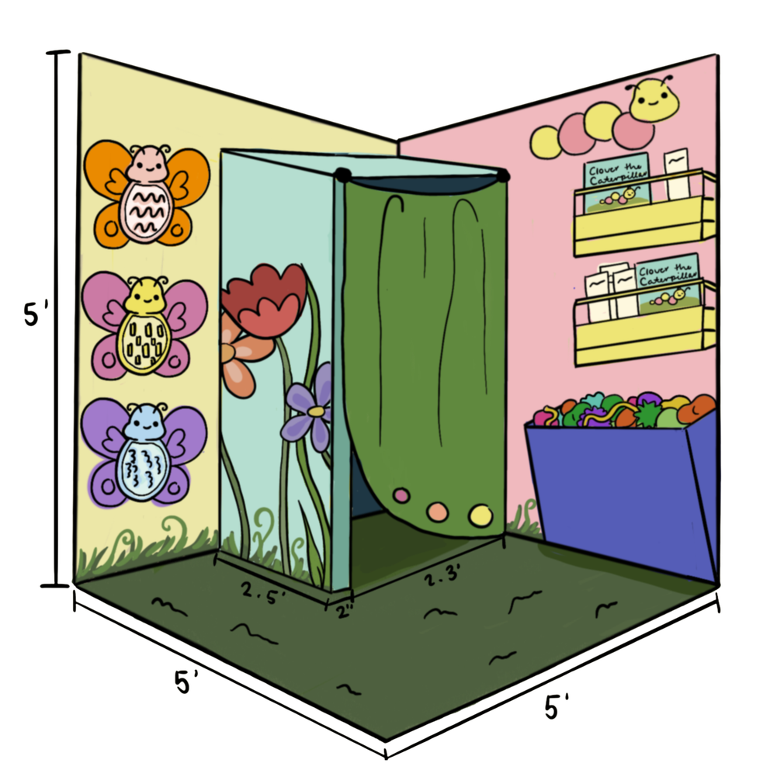


Making a Sensory Space
Pick a place in the classroom to devote to a sensory space
Provide soft seating and proprioceptive input.
Examples:
Bean Bags
Weighted lap pads
Egg chairs
Yoga ball
Pick items to include in your sensory space.
Examples:
Fidget toys
Slime
Shakers
Pop its
Rubiks Cubes
Manage the sound
Examples
Add rugs, wall panels, and bean bags.
Noise-canceling headphones or white noise machine
Establish Sensory Space Protocols
Use it as 15-min reset rather than an escape from class.
More
resources!

Slide 2
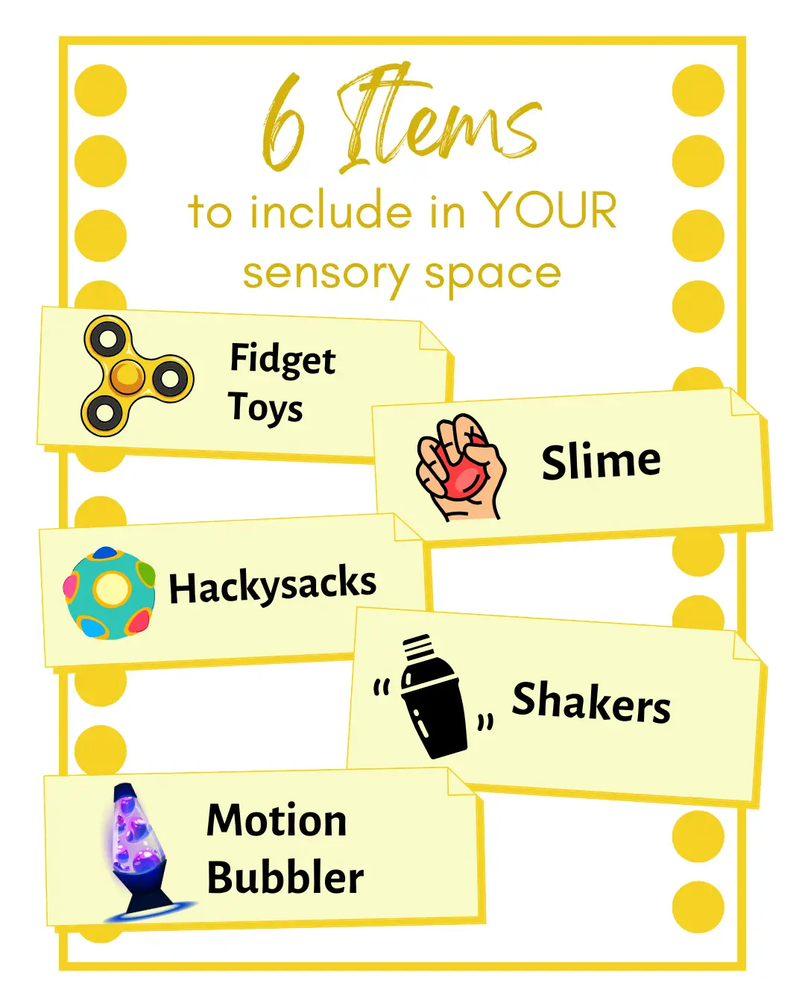

Slide 3
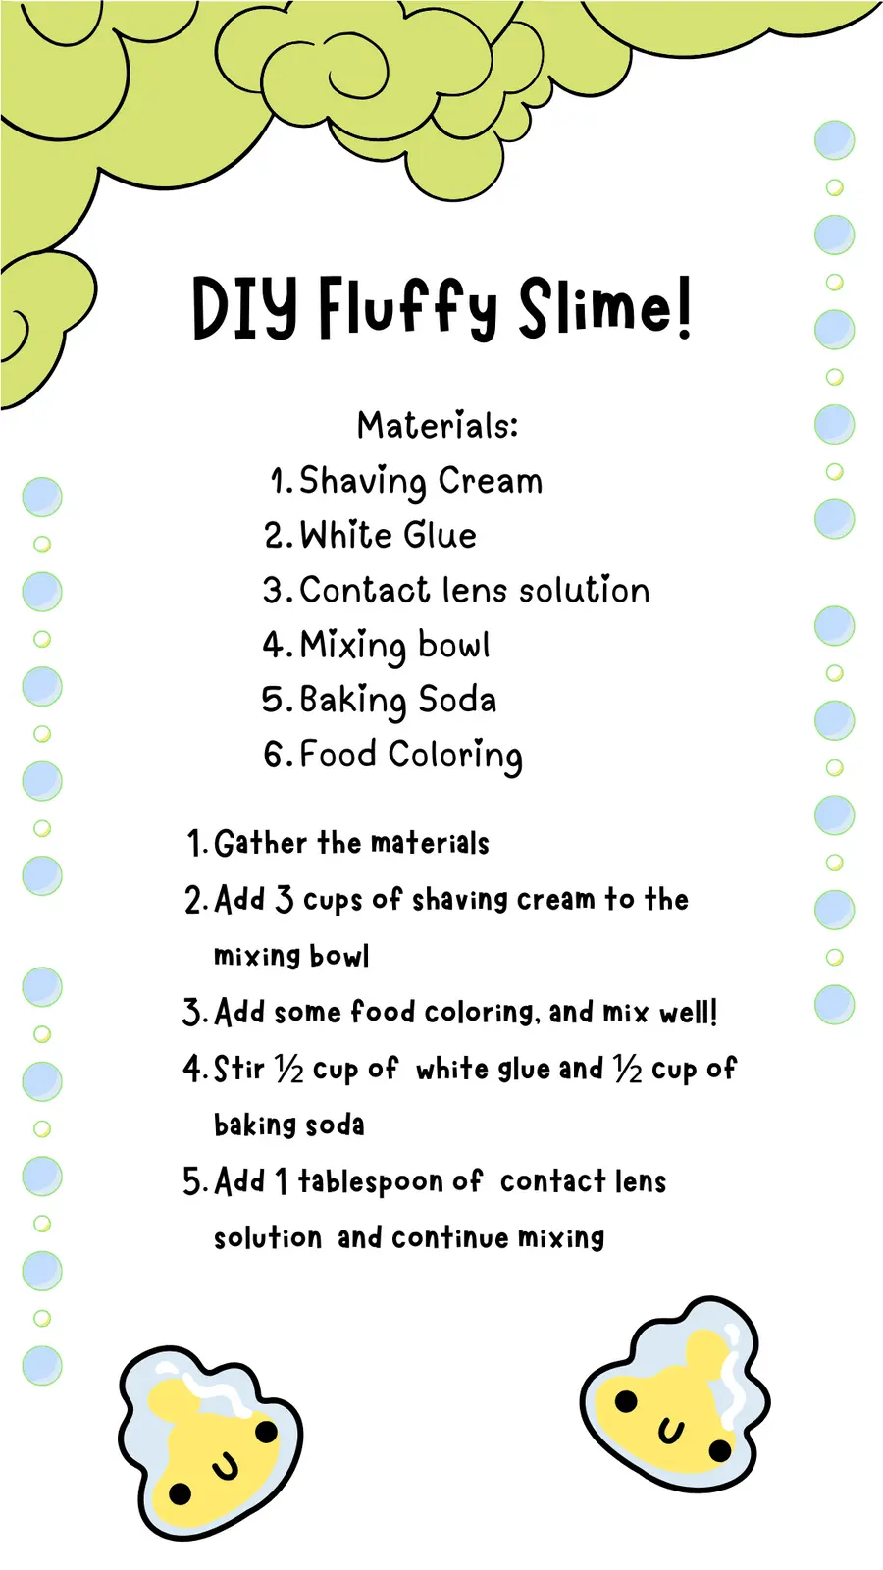

Slide 4
