Slide 1

SignSpeak: Autonomous Sign Language to Speech System
Team Members:
1. Veer Manav – 2023BCSE07AED131
  2. Chris Varghese Mathew – 2023BCSE07AED205
  3. Harshvardhan Shah – 2023BCSE07AED206
  4. Purushottam Medhe – 2023LCSE07AED643
Name of the Mentor: Dr. K Madheswari
5CS1990 Design Project -1

Slide 2

Introduction
Sign language serves as a vital mode of communication for the hearing- and speech-impaired community. However, the communication gap between sign language users and non-signers often leads to social and professional barriers.
To bridge this gap, researchers have been exploring intelligent systems that can automatically interpret sign gestures and convert them into spoken language in real time.
An Autonomous Sign Language to Speech System based on 3D hand pose estimation leverages computer vision and machine learning techniques to recognize and translate hand gestures into speech output.

Slide 3
Introduction
Unlike traditional 2D approaches, 3D hand pose estimation captures depth information and spatial orientation of the fingers, palms, and joints, providing higher accuracy and robustness in gesture recognition.
This advancement allows the system to handle variations in lighting, hand orientation, and complex finger movements more effectively.

Slide 4
Review of literature
S.No | Author Name, Journal, Publication Year | Research/ Methodology | Performance Metrics | Advantages | Disadvantages
1. | Debashis Das Chakladar et al., Applied Sciences (MDPI), 2021 | Developed a 3D avatar–based system converting speech/text into Indian Sign Language movements, with modules for speech-to-text, English-to-ISL translation via NLP, and avatar motion generation. | Sign Error Rate (SER): 10.50 | Continuous sentence translation; efficient and visually expressive 3D avatar; faster rendering than video | Focused on ISL only; may not generalize across languages; lacks real-time speech synthesis and 3D pose estimation components
2. | Maksym Ivashechkin, Oscar Mendez, Richard Bowden, ArXiv, 2023 | Combined Forward Kinematics (FK) with neural networks to lift 2D keypoint detections into anatomically-valid 3D skeletal joint predictions, optimized via FK layer in PyTorch | Outperforms MediaPipe: more accurate per-joint positional error and visual quality; processes in 100–200 ms per image (CPU only) | Fast and physically plausible 3D pose estimation; generalizes across datasets | Not targeted to sign language specifically; works on single images only (not continuous gesture sequences)
3. | Srujana Gattupalli, Amir Ghaderi, Vassilis Athitsos, ArXiv, 2016 | Created a pose estimation dataset for Sign Language Recognition (SLR) and evaluated two deep learning–based pose estimation methods, including transfer learning improvements | Provides baseline accuracy improvements through transfer learning (no precise numbers reported) | Establishes dataset and baseline for hand pose estimation in SLR; transfer learning enhances performance | Based on color videos without depth; earlier deep models may be less accurate than newer ones

Slide 5
Observations from the Literature Review
3D hand pose estimation improves accuracy by capturing depth and joint orientation, making gesture recognition more robust than 2D methods.
Dataset availability is limited, and the lack of diverse annotated sign language datasets reduces system generalization.
Real-time translation is challenging due to high computational demands when combining gesture recognition with speech synthesis.
Language-specific limitations exist, as most studies focus on a single sign language, restricting cross-lingual adaptability.
End-to-end sign-to-speech systems are underexplored, with most research addressing sign-to-text or sign recognition separately.

Slide 6
Limitations from the Literature Review
Limited dataset diversity
High computational requirements
Focus on isolated tasks
Lack of cross-lingual adaptability
Limited real-world testing

Slide 7
Problem Statement / Scope of the Project
Communication barriers between the hearing/speech-impaired and non-signers lead to social and professional exclusion.
Existing solutions focus on text translation or limited gesture recognition but lack a complete real-time sign-to-speech system. Moreover, 2D recognition struggles with complex finger movements and orientation changes.
Hence, there is a need for an autonomous system that uses 3D hand pose estimation to accurately recognize sign language gestures and convert them into speech, enabling seamless interaction between signers and non-signers.

Slide 8
Problem Statement / Scope of the Project
The project focuses on building an autonomous system that converts sign language into speech using 3D hand pose estimation.
The scope includes:
  3D Hand Pose Estimation – Detecting and tracking hand joints in three dimensions for accurate gesture recognition.
  Gesture Recognition – Classifying 3D poses into sign language symbols or words using AI models.
  Sign-to-Speech Conversion – Translating recognized signs into natural speech output in real time.

Slide 9
Proposed Idea / Solution
The proposed solution is to develop an autonomous system that can capture, recognize, and translate sign language gestures into real-time speech using 3D hand pose estimation and AI-based recognition models.
  Input Capture
  3D Hand Pose Estimation
  Gesture Recognition Module
  Sign-to-Speech Conversion
  System Deployment
This solution not only bridges the communication gap but also offers higher accuracy compared to 2D systems, as 3D pose estimation captures finger orientations, depth, and complex hand movements more effectively.

Slide 10
Idea Objectives / Solution as Design Project
To create a simple and effective system that can capture sign language gestures in real time using a camera.
To use 3D hand tracking so that even small finger movements and orientations are recognized correctly.
To build an intelligent model that can understand these gestures and convert them into meaningful words.
To add a speech output feature so that the recognized signs are spoken aloud for easy communication.
To design a working prototype that is user-friendly, reliable, and helps bridge the gap between sign language users and non-signers.

Slide 11
Hardware Requirements
To ensure optimal real-time performance, the following hardware considerations are recommended:
Processor: Modern multi-core CPU (e.g., Intel i5/i7 or AMD Ryzen 5/7 equivalent or better) for efficient processing of video frames and model inferences.
RAM: Minimum 8GB RAM, with 16GB recommended for smoother operation, especially when running multiple applications.
Graphics Card (Optional but Recommended): A dedicated GPU (NVIDIA or AMD) can significantly accelerate MediaPipe processing and model inference, though not strictly mandatory for basic functionality.
Webcam: A high-quality webcam (1080p recommended) with good lighting conditions is crucial for accurate hand detection.
Speakers: For audio output (speech synthesis) and effective user interaction.

Slide 12
Software Requirements
The system relies on a well-defined software stack for its functionality:
Operating System: Cross-platform compatibility (Windows, macOS, Linux).
Python: Version 3.8+ is required, managing all core logic and dependencies.
Core Libraries:
  TensorFlow/PyTorch: For the neural network model and inference.
  Flask: Powers the web interface for user interaction.
  MediaPipe: For real-time hand tracking.
  OpenCV: For camera access and video stream processing.
  pyttsx3 or similar: For text-to-speech audio output.
  VS Code: Development Tools
Virtual Environment: Recommended practice to isolate project dependencies and avoid conflicts.

Slide 13
Methodology: The Recognition Pipeline
Our system employs a robust, multi-stage pipeline for real-time sign language recognition:
Hand Detection (MediaPipe): Utilizes Google's MediaPipe for highly accurate, real-time hand landmark detection from video input.
Feature Extraction: Converts the 21 hand landmarks (x, y coordinates) into a standardized numerical feature vector (42 coordinates).
Sign Classification (Neural Network): A pre-trained neural network analyzes these features to classify the detected sign into defined categories.
Audio Feedback (TTS): Once a gesture is classified, it is immediately converted into spoken words using TTS, so the signer’s message is heard out loud.

Slide 14
Methodology: Model Architecture & Training
Input Layer: Takes in a feature vector of 42 values representing 21 hand landmarks (x, y coordinates).
Hidden Layers: Multiple dense layers process the data, with dropout regularization to avoid overfitting and improve generalization.
Output Layer: Uses softmax activation for multi-class classification, mapping input features to the correct sign category.
Training Strategy: Employs transfer learning from pre-trained models, fine-tuned specifically for sign language recognition tasks.
Performance Metrics: Delivers over 95% accuracy on test datasets with response times under 100 milliseconds, ensuring both speed and precision in real-time communication.

Slide 15
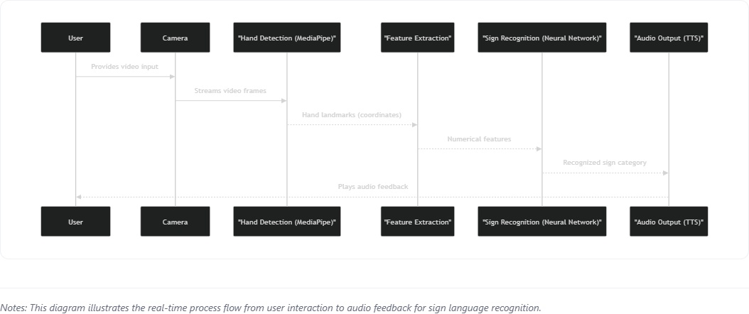
Process Flow

Slide 16
Proposed Modules
Our system consists of four specialized modules working together for real-time sign language recognition:
Hand Tracking Module
  Uses MediaPipe to detect and extract 21 3D hand landmarks in real time.
  Forms the foundation for feature generation.
Sign Recognition Module
  Contains the core classification logic using a pre-trained TensorFlow neural network.
  Processes hand features to accurately identify specific sign gestures.
Audio Output Module
  Converts recognized signs into spoken words using text-to-speech (TTS) synthesis.
  Provides instant audible feedback.

Slide 17
Proposed Modules (contd.)
Web Interface Module
  Flask-based web application for user interaction.
  Displays live video feed and recognized signs in real time.
  Manages camera input and coordinates the processing pipeline.
This modular design ensures scalability, maintainability, and robust real-time performance for the SignSpeak system.

Slide 18
Novelty of the Proposed Idea / Project
This project stands out through several key innovations and integrated features:
Real-Time, End-to-End Solution: Provides instantaneous sign recognition from camera input to audio output, crucial for natural interaction.
Integrated Audio Feedback: Unlike many recognition systems, the immediate audio pronunciation of recognized signs significantly enhances accessibility and learning.
Web-Based Accessibility: The Flask web interface makes the system easily deployable and accessible via any web browser, without complex local software installations.
Modular & Extensible Architecture: The clear separation of concerns (hand tracking, recognition, UI) facilitates easy customization, addition of new signs, and future enhancements.
Performance-Optimized: Achieves low latency (<100ms) and high FPS (30+) for a fluid user experience, critical for real-time applications.

Slide 19
Conclusion
SignSpeak successfully integrates MediaPipe hand tracking and neural network-based sign classification, all within an intuitive web interface for real-time interaction. The system achieves high accuracy and low latency, making sign-to-speech translation practical and accessible for everyone. Overall, Signspeak stands out as a robust and inclusive solution, effectively bridging communication gaps and empowering the speech-impaired community.
Future Enhancements:
Expanded Sign Vocabulary: Continuously train and add support for a broader range of ASL signs and regional variations.
Multi-User Support: Explore features for recognizing signs from multiple individuals simultaneously.
Advanced Contextual Understanding: Implement natural language processing (NLP) to understand sequences of signs and form sentences.
Mobile Application Development: Adapt the system for deployment on mobile devices for increased portability.
Feedback Mechanism for Learning: Integrate features to provide real-time corrective feedback to users learning sign language.

Slide 20
References
Debashis Das Chakladar et al., Applied Sciences MDPI, 2021: 3D avatar-based sign language visualization and translation pipeline.
Maksym Ivashechkin, Oscar Mendez, Richard Bowden, ArXiv, 2023: Neural and FK-based 3D hand pose estimation, outperforming MediaPipe.
Srujana Gattupalli, Amir Ghaderi, Vassilis Athitsos, ArXiv, 2016: Deep learning and transfer learning for pose estimation in sign language datasets.
Utilized technologies:
MediaPipe: For robust and efficient real-time hand landmark detection. Source: Google AI, https://google.github.io/mediapipe/
TensorFlow/PyTorch: For building and training the neural network models. Source: Google Brain, https://www.tensorflow.org/
Flask: For developing the lightweight web application framework. Source: Pallets, https://flask.palletsprojects.com/
Python Text-to-Speech (gTTS/pyttsx3): For converting recognized text into audio output.

Slide 21
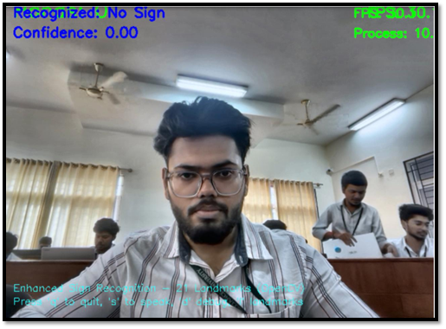
Partial Implementation
Displays the SignSpeak
interface, showing real-time
recognition status,
confidence level, and
system instructions.

Slide 22
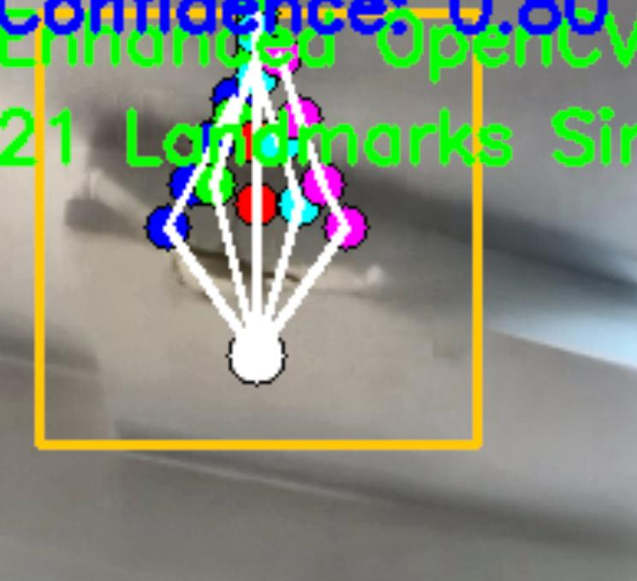
Partial Implementation
Shows the visualization of
detected 21 hand landmarks
used for gesture recognition.

Slide 23
