Slide 1

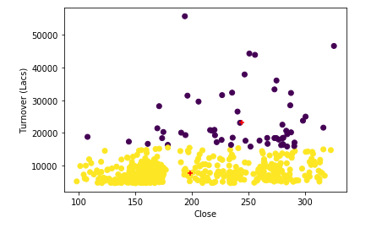
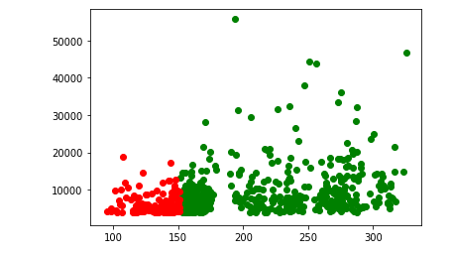

Stock Market Analysis for TATAGLOBAL
Jeevan Sai Subhash Veeramachaneni
School of Computer Science and Information Systems, Northwest Missouri State University
Introduction
Results
Conclusions
TataGlobal is going through an enormous increase in the stock market in the recent past, the data which I am going to work on is going to analyze the stock market for a particular company and predict the turnover for the company.
Evaluation of close values which are near to the centroid had to be chosen for a high turn over.
Strongest aspects: Accuracy/Precision, F1 Score
The Close values which are near to the centroid can be chosen because in turn the turnover of those values will also be high.
Materials/Methods
Features:
Close value
Turnover
Overall Turnover
Performed Linear regression to train the model.
Used Decision Tree Classifier to implicitly perform feature selection.
Evaluate
Even though the closing stock value of a company is greater than 150, the turnover of the company is not performing so good.
This is acceptable because a company may see a loss through a year.
Additional Resources
Acknowledgements
Poster Repository
https://www.quandl.com/data/NSE/TATAGLOBAL-Tata-Global-Beverages-Limited
https://scikit-learn.org/stable/
Mentor: Dr. Charles Hoot
https://github.com/veersubhash25/ML-project-presentation

